Slide 1


UE23AM441A – Capstone Project Phase – 3
Project Progress Review # 1
Project Title : Explainable Multi-Agent ESG Risk Analysis System for Indian Companies
Project ID : PW25_MK_01
Project Guide : Dr. Manjula K
Project Team : PES1UG24AM815--Varalakshmi K M
PES1UG24AM807--Malashree H K
PES1UG23AM232--Ranjan C
PES1UG23AM069--Aryan S

Slide 2
Explainable Multi-Agent ESG Risk Analysis System for Indian Companies
Outline
Abstract and Scope of the Project
Capstone Project Phase – 2
  Summary of work
  Inferences drawn from Literature Survey
List of Tasks/Modules with Individual Contribution
Design of overall Architecture
Demonstration and Testing of the completed modules.

Slide 3
Explainable Multi-Agent ESG Risk Analysis System for Indian Companies
Abstract and Scope
Problem — ESG assessment is increasingly important for investors and regulators, but existing systems often depend on self-reported company disclosures and provide limited transparency or independent verification, creating a risk of greenwashing.
Objective — Develop an explainable ESG risk analysis system that combines company disclosures with independent environmental, news and financial data to validate ESG claims and identify inconsistencies.
Approach — A sequential seven-agent pipeline extracts ESG information from BRSR reports, validates it using external data, performs cross-source analysis, detects potential greenwashing, and generates an explainable ESG assessment.
Dataset — FY 2024–25 BRSR reports of 50 IT companies, along with CPCB AQI data, ESG-related news and NIFTY 50 historical stock data.

Slide 4
Explainable Multi-Agent ESG Risk Analysis System for Indian Companies
Abstract and Scope
Scope of This Review:
In Scope
▪ BRSR extraction and ESG metric processing
▪ AQI-based environmental validation
▪ ESG news sentiment analysis
▪ Financial correlation analysis
▪ Greenwashing detection
▪ ESG scoring and explainability
▪ Five Indian IT companies
Not Yet in Scope
▪ Large-scale coverage of Indian companies
▪ Real-time ESG dashboard
▪ Social-media-based validation
▪ Predictive/time-series ESG forecasting
▪ Additional governance verification sources

Slide 5
Explainable Multi-Agent ESG Risk Analysis System for Indian Companies
Summary of Work
Pipeline Built — Designed and implemented a seven-agent pipeline (extraction, validation, greenwashing detection, scoring, and explainability) covering BRSR extraction, AQI/news/stock cross-validation, and human-readable ESG scoring.
Scope Delivered — End-to-end system validated on 50 major Indian IT companies (TCS, Infosys, Wipro, HCL Technologies, Tech Mahindra) using FY 2024–25 BRSR data, producing 7 structured, auditable output datasets with full data lineage tracking.
Greenwashing Detection — A statistically adaptive three-way cross-check (BRSR claim vs. AQI signal vs. news sentiment) flagged a high-severity contradiction at TCS — a 94% claimed renewable energy figure against a 2.0/10 measured environmental score.
Results Achieved — Classification accuracy improved from 82% to 90% after cross-validation and bias correction. Infosys ranked highest (7.83/10, Low-Medium risk); Tech Mahindra ranked lowest (6.57/10). External benchmark rank correlation of 0.70.
Panel Feedback Incorporated — All seven agents integrated into a single scoring flow, score computation made fully auditable, and the sector-first (IT-only) scope was retained as advised; real-time news ingestion remains in progress.

Slide 6
Explainable Multi-Agent ESG Risk Analysis System for Indian Companies
Inferences from Literature Survey
Survey Scope — 20 peer-reviewed papers and technical reports reviewed across four themes — India-specific ESG/BRSR frameworks, ESG scoring methodologies, multi-agent systems in finance, and explainable AI in finance.
Self-Reported ESG Data is Unreliable — ESG rating-agency correlation averages only 0.54 (vs. 0.99 for credit ratings), motivating an independent, cross-validated scoring approach rather than relying on a single disclosure source.
BRSR Compliance is Often Minimal — Only 17.7% of companies made explicit Net Zero commitments and most comply minimally with disclosure norms, reinforcing the need for a dedicated greenwashing-detection agent.
Composite Scores Hide the Real Picture — Underlying sub-metrics carry more signal than a single aggregate score, and peer-normalization can distort rankings — supporting separate E/S/G pillars scored against absolute BRSR thresholds instead of one opaque number.
Multi-Agent Decomposition Outperforms Single-Agent Analysis — Configurable, specialized agent groups improve accuracy, efficiency, and adaptability for complex financial analysis — validating the project's seven-agent, loosely-coupled pipeline design.
Explainability Should Be Local, Not Global — Finance-domain XAI research favors company-specific, evidence-backed justifications over model-wide explanations, shaping Agent 7 to generate individual reasoning per company.

Slide 7
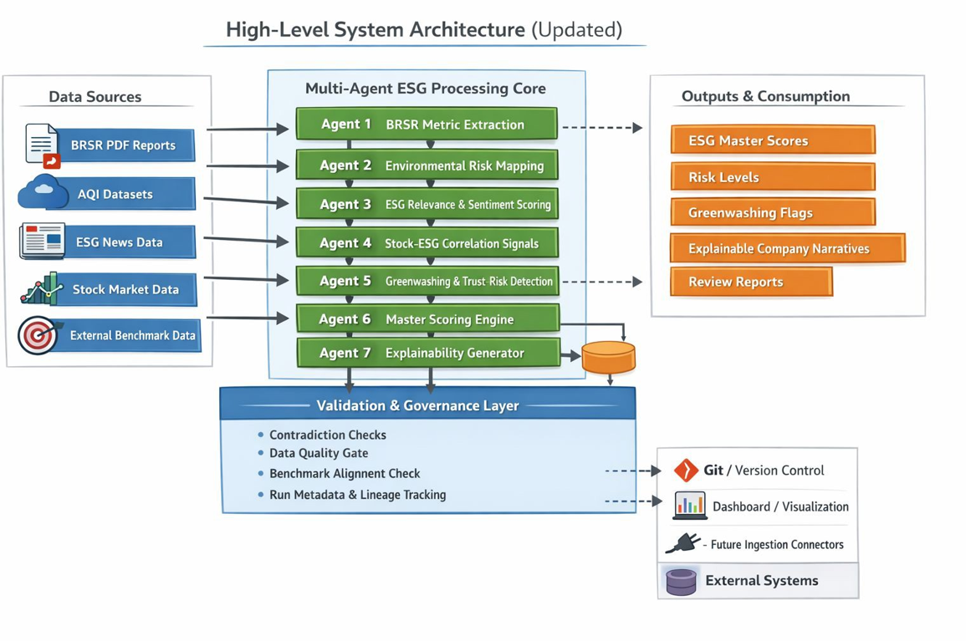
Explainable Multi-Agent ESG Risk Analysis System for Indian Companies
Architecture
1.Design of overall Architecture

Slide 8
Explainable Multi-Agent ESG Risk Analysis System for Indian Companies
Modules
1.Modules
Agent / Module | Technique Used | Main Function
Frontend | HTML5 + CSS3 + JavaScript | Provides web dashboard and user interface
Backend | Python + FastAPI | Provides backend services and REST APIs
Pipeline Orchestration | demo.py + Subprocess + Multithreading | Executes and coordinates Agent 1–7 pipeline
Agent 1 – BRSR Metric Extraction | PDF extraction + keyword/rule-based matching | Extracts ESG metrics from company BRSR reports
Agent 2 – Environmental Risk Mapping | Location matching + AQI threshold rules | Assesses environmental risk based on company locations and AQI
Agent 3 – ESG News Sentiment Analysis | ESG keyword rules + VADER sentiment analysis | Filters ESG-related news and determines sentiment

Slide 9
Explainable Multi-Agent ESG Risk Analysis System for Indian Companies
Modules
2.Modules
Agent / Module | Technique Used | Main Function
Agent 4 – Stock–ESG Correlation | Statistical analysis + scoring rules | Analyzes stock performance and its relationship with ESG indicators
Agent 5 – Greenwashing & Trust Risk Detection | Rule-based claim/evidence comparison | Identifies potential inconsistencies and greenwashing risks
Agent 6 – Master ESG Scoring | Weighted/rule-based score aggregation | Combines outputs from different agents to generate the overall ESG score
Agent 7 – Explainability Generator | Rule/template-based explanation | Converts ESG scores and risk factors into understandable company-level explanations
Utility Layer | PDF extraction + data validation + data lineage | Supports document processing and data quality
Data Storage | CSV + JSON | Stores agent outputs and final reports

Slide 10
Explainable Multi-Agent ESG Risk Analysis System for Indian Companies
List of Tasks/Modules
List of tasks/Modules to be elaborated in discussion with the guide.
1. Data collection and preparation
2. BRSR PDF download, validation, and extraction
3. Environmental and location-based risk analysis
4. ESG news filtering and sentiment analysis
5. Stock market performance and ESG correlation analysis
6. Greenwashing and contradiction detection
7. Master ESG score calculation and quality assessment
8. Explainable AI report generation
9. Cross-validation and data-quality reporting
10. Testing, validation, and performance evaluation
Technologies Used: Python, Pandas, FastAPI, HTML, CSS, JavaScript, CSV/JSON, BRSR reports, AQI datasets, ESG news data, and stock-market datasets.

Slide 11
Explainable Multi-Agent ESG Risk Analysis System for Indian Companies
List of Tasks/Modules
BRSR Data Collection and Preparation
1. Data Collection & Data Preparation
BRSR reports for the configured 50-company cohort were collected from official company, NSE, and BSE sources. Reports were checked for company identity, reporting year, PDF validity, and duplicate files.
2. Data Input
Validated FY 2024-25 BRSR PDFs were used as the primary input. Each report contains environmental, social, and governance disclosures.
3. Data Pre-processing
Text was extracted from PDFs and mapped to standardized ESG metrics. Missing, undisclosed, invalid, and low-confidence values were flagged for review.
4. Data Visualization
Extracted metrics are presented through CSV reports and the web dashboard using company-level ESG summaries and completeness indicators.
5. Data Interpretation
The extracted information is used to evaluate energy consumption, emissions, water usage, employee welfare, governance, and other ESG indicators.
6. Storage
Source PDFs are stored in `brsr-pdfs`. Extracted metrics and data-quality reports are stored in `processed-data` and `demo-output`.

Slide 12
Explainable Multi-Agent ESG Risk Analysis System for Indian Companies
List of Tasks/Modules
Multi-Agent ESG Analysis and Scoring
1. Data Collection & Data Preparation
BRSR metrics, AQI and location data, ESG news articles, and historical stock-market data were collected and aligned using company codes and reporting dates.
2. Data Input
The seven agents receive validated CSV datasets and extracted BRSR metrics as input for environmental, social, governance, sentiment, market, and quality analysis.
3. Data Pre-processing
News articles are filtered for ESG relevance, numerical values are normalized, missing records are identified, and company-level datasets are prepared for analysis.
4. Data Visualization
The frontend dashboard displays company profiles, ESG scores, risk levels, news sentiment, environmental risk, stock correlation, and data-quality results.
5. Data Interpretation
Agent 6 calculates the master ESG score, while Agent 7 generates explanations. Cross-validation and greenwashing checks identify contradictions and review requirements.
6. Storage
Final outputs are stored as CSV and JSON files, including `esg_master_scores.csv`, `greenwashing_detection.csv`, `multi_agent_explanations.csv`, and `run_metadata.json`.

Slide 13
Explainable Multi-Agent ESG Risk Analysis System for Indian Companies
Demonstration and Testing of the Modules Completed
Demonstrated Modules
1. BRSR Extraction: Extracted ESG metrics from company reports.
2. Environmental Risk Analysis: Calculated location-based AQI and environmental risk.
3. News Sentiment Analysis:Classified ESG-related news as positive or negative.
4. Stock Correlation: Compared ESG scores with stock-market performance.
5. Greenwashing Detection: Identified suspicious or contradictory ESG claims.
6. Master ESG Scoring: Generated company-level Environmental, Social, Governance, and overall ESG scores.
7. Explainable AI: Generated explanations for scores, risks, and review flags.
8. Dashboard: Displayed companies, scores, risk levels, sentiment, and data-quality results.
Results Obtained
- 50 company score records
- 900 extracted BRSR metric records
- 677 ESG news sentiment records
- 91 stock-analysis records
- 83 environmental/location-risk records
- Average master ESG score: 6.17/10
- Average BRSR completeness: 40.22%
- 4 companies passed the quality gate
- 46 companies received low-quality warnings
- Cross-validation identified 2 high-severity and 6 medium-severity contradiction

Slide 14
Explainable Multi-Agent ESG Risk Analysis System for Indian Companies
Demonstration and Testing of the Modules Completed
Testing of Completed Modules
### Testing Performed
1. Verified that the configuration contains **50 companies**.
2. Checked BRSR PDFs for valid file format, company identity, reporting period, and duplicates.
3. Verified that the seven agents execute in the correct sequence.
4. Tested missing, undisclosed, and incomplete BRSR values.
5. Checked that ESG scores and risk levels are generated correctly.
6. Tested news filtering and sentiment classification.
7. Tested contradiction and greenwashing detection.
8. Verified CSV and JSON output generation.
9. Tested backend API endpoints and dashboard data loading.
10. Performed cross-validation and data-quality checks.
Testing Outcome
The pipeline generated the expected output files for the 50-company configuration. Companies with incomplete or unavailable source data were retained as review records instead of being silently removed. The quality-gate process correctly classified records as either **Pass** or **Low-Quality Warning**.

Slide 15
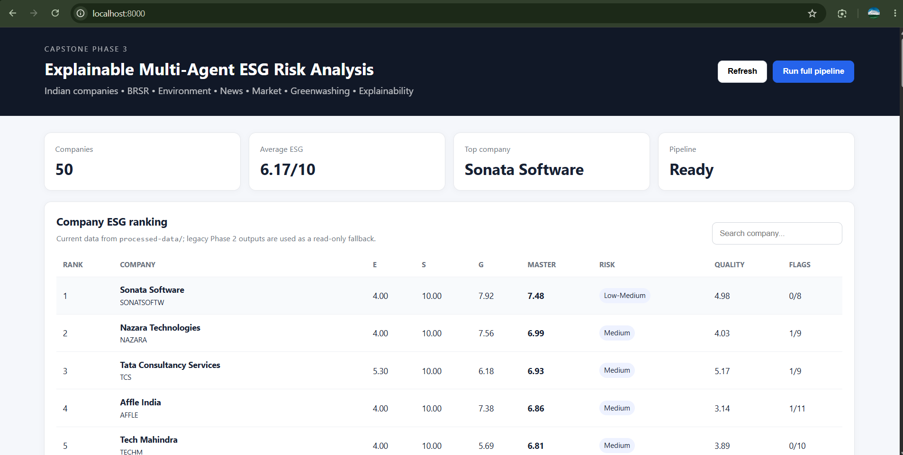
Explainable Multi-Agent ESG Risk Analysis System for Indian Companies
Demonstration and Testing of the Modules Completed

Slide 16
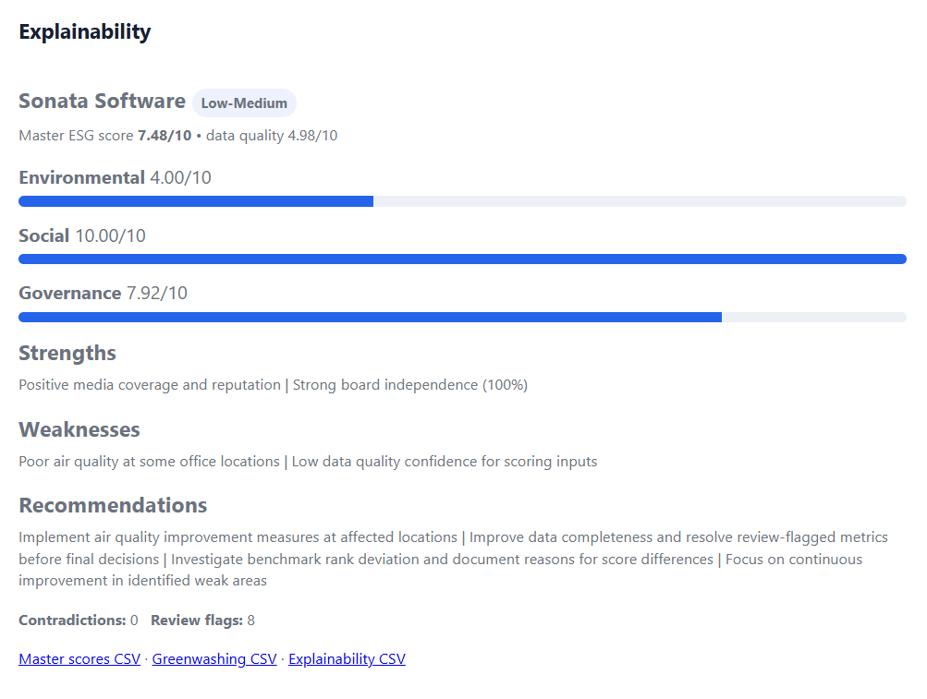
Explainable Multi-Agent ESG Risk Analysis System for Indian Companies
Demonstration and Testing of the Modules Completed

Slide 17
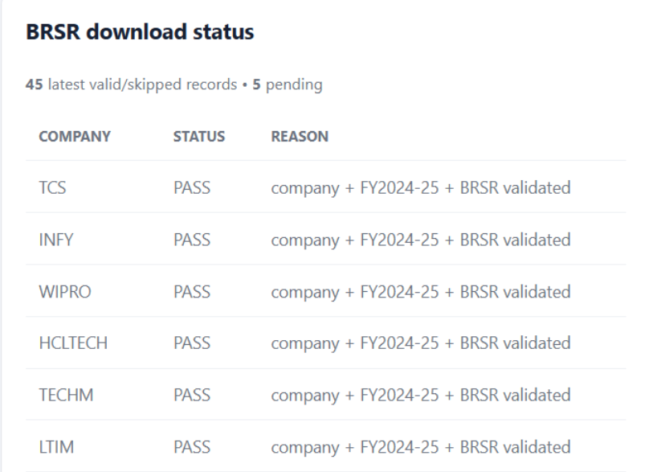
Explainable Multi-Agent ESG Risk Analysis System for Indian Companies
Demonstration and Testing of the Modules Completed

Slide 18
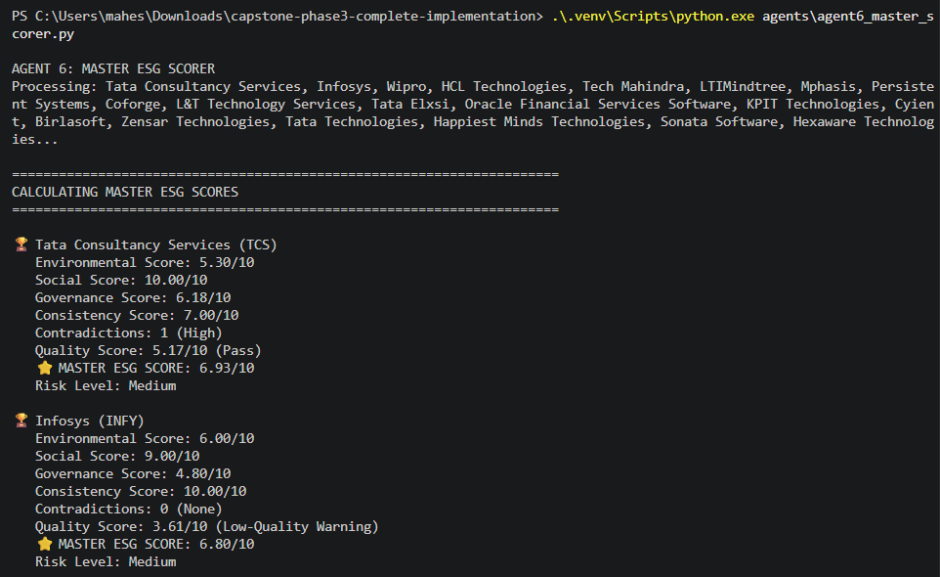
Explainable Multi-Agent ESG Risk Analysis System for Indian Companies
Demonstration and Testing of the Modules Completed

Slide 19
Explainable Multi-Agent ESG Risk Analysis System for Indian Companies
References
[1] A. Berg, K. Fabisik, and Z. Sautner, “Chasing ESG performance: How methodologies shape ESG scores,” Journal of Financial Economics, 2025.
[2] S. Riedl and M. Smeets, “Evaluation of environmental, social, and governance risks: A critical literature review,” Sustainability, vol. 17, no. 18, 2024.
[3] J. Escrig-Olmedo et al., “The use of ESG scores in academic literature: A systematic literature review,” Business Strategy and the Environment, 2023.
[4] L. Dorfleitner, R. Halbritter, and M. Nguyen, “Deconstructing ESG scores: Investing at the category score level,” Journal of Asset Management, 2024.
[5] H. Liu et al., “Creating a systematic ESG scoring system using social network analysis and machine learning,” arXiv preprint arXiv:2309.05607, 2023.

Slide 20
Thank You

