Slide 1

Cloud Computing

Slide 2
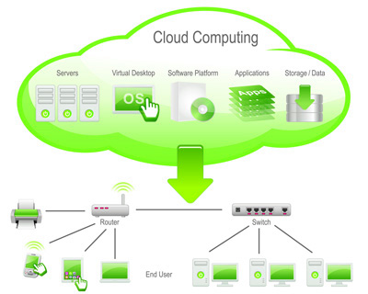
What is Cloud Computing?
Cloud Computing often referred to as “the cloud”, in simple terms means storing or accessing your data and programs over the internet rather than your own hard drive.

Slide 3
Where exactly is this cloud?
It is somewhere at the other end of your internet connection where you store your files and can be accessed from anywhere in the world. This could be a big deal for you, primarily because of three reasons:
You do not have to maintain or administer any infrastructure for the same.
It will never run out of capacity, since it is virtually infinite.
You can access your cloud based applications from anywhere, you just need a device which can connect to the internet

Slide 4
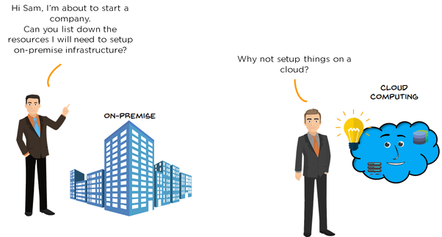
How it all began?

Slide 5
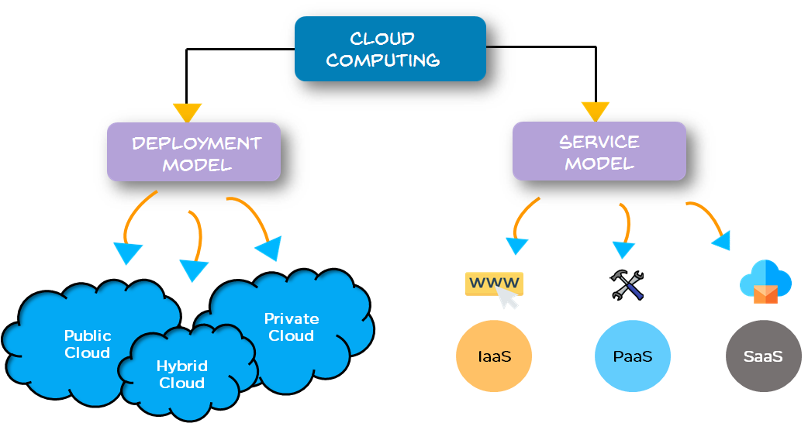
Service and Deployment

Slide 6
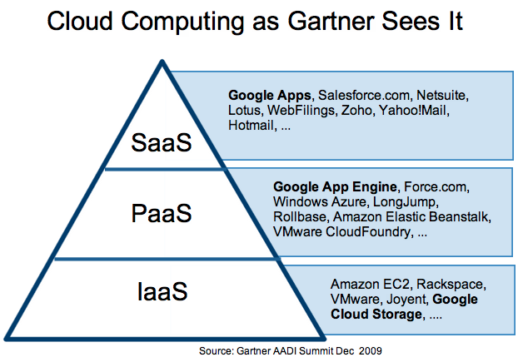
Cloud Service
SAAS
PAAS
IAAS

Slide 7
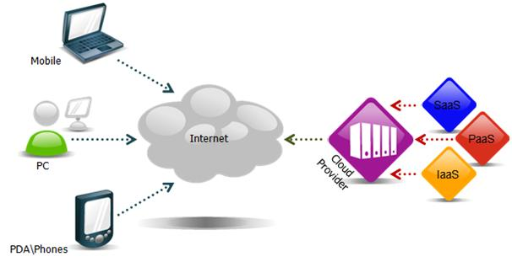
Cloud Services Overview

Slide 8
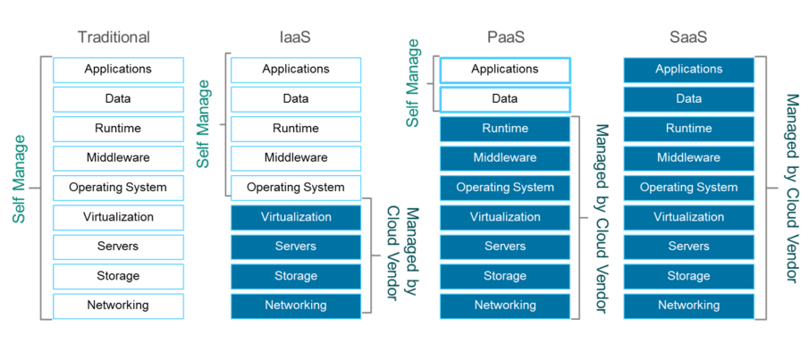
Differences b/w Services

Slide 9
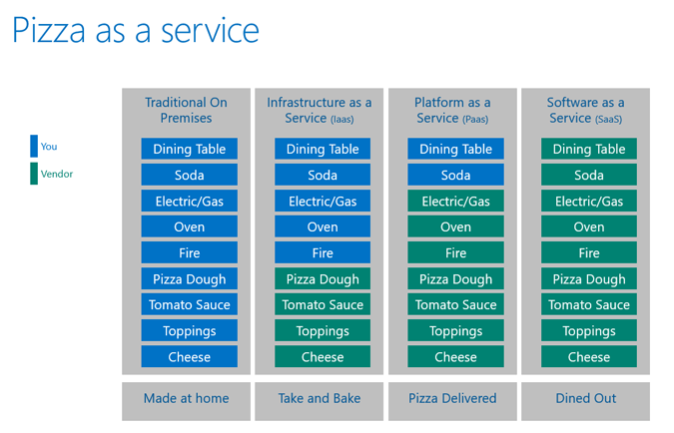

Slide 10
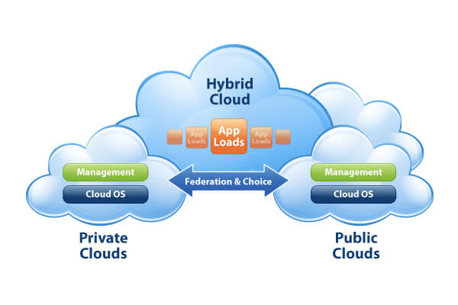
Types of Cloud
Notes:
Public Cloud
In a public cloud deployment mode, the services which are deployed are open for public use and generally public cloud services are free. Technically there maybe no difference between a public cloud and a private cloud, but the security parameters are very different, since the public cloud is accessible by anyone there is a more risk factor involved with the same.
Private Cloud
A private cloud is operated solely for a single organization, it can be done by the same organization or a third-party organization. But usually the costs are high when you are using your own cloud since the hardware would be updated periodically, security also has to be kept in check since new threats come up every day.

Slide 11
Consumer and Business cloud

Slide 12
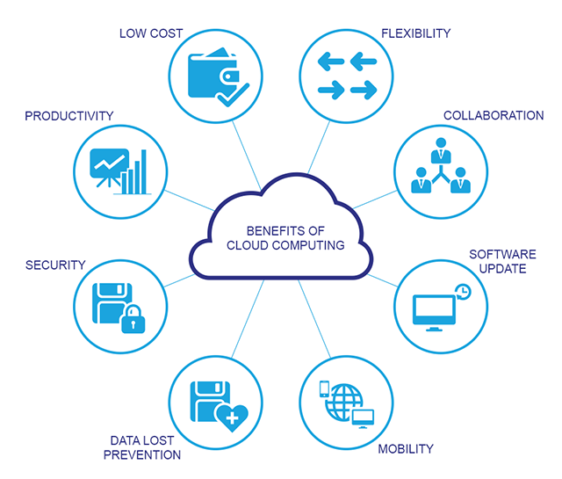
Benefits

