Slide 1
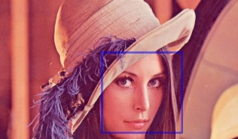
OpenCV

Slide 2

Introduction to image processing and computer vision

Slide 3
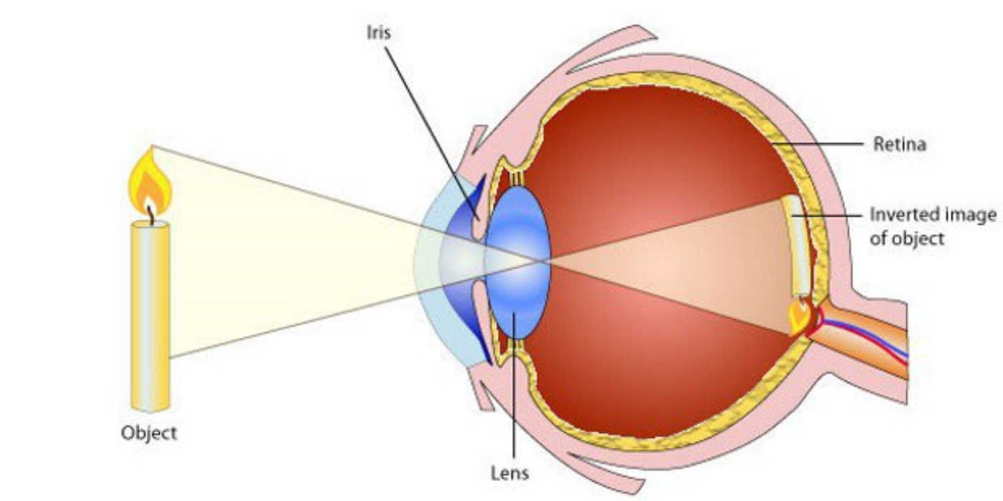
Image formation in human eyes

Slide 4


Introduction
OpenCV is an Image Processing library created by Intel and maintained by Willow Garage.
Available for C, C++, and Python
Newest update is version 2.2
Open Source and free
Easy to use and install

Slide 5
Image processing
Digital Image
— a two-dimensional function
x and y are spatial coordinates
The amplitude of f is called intensity or gray level at the point (x, y)
Digital Image Processing
— process digital images by means of computer, it covers low-, mid-, and high-level processes
low-level: inputs and outputs are images
mid-level: outputs are attributes extracted from input images
high-level: an ensemble of recognition of individual objects
Pixel
— the elements of a digital image

Slide 6
Why Convolutions
What are image convolutions?
What do they do?
Why do we use them?
How do we apply them?
And what role do convolutions play in deep learning?

Slide 7
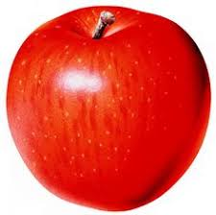
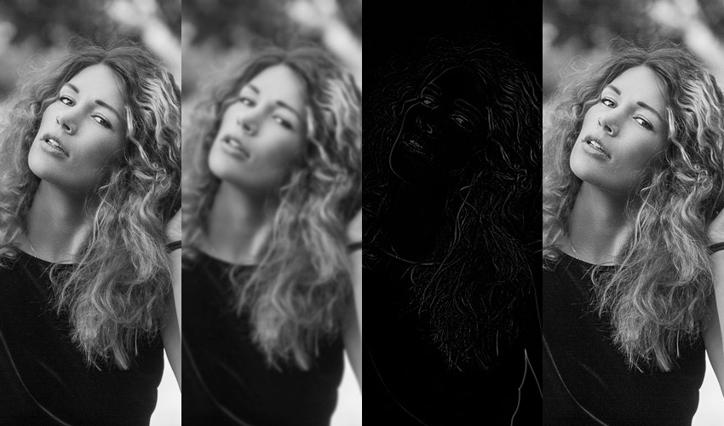

Convolution application
Ever apply blurring or smoothing? Yep, that’s a convolution.
What about edge detection? Yup, convolution.
Have you opened Photoshop or GIMP to sharpen an image? You guessed it — convolution.
Convolutions are one of the most critical, fundamental building-blocks in computer vision and image processing

Slide 8
Convolution
The word “convolution” sounds like a fancy, complicated term — but it’s really not. In fact, if you’ve ever worked with computer vision, image processing, or OpenCV before, you’ve already applied convolutions, whether you realize it or not!
convolution is simply an element-wise multiplication of two matrices followed by a sum.

Slide 9
Process of Convolution
convolution requires three components
An input image.
A kernel matrix that we are going to apply to the input image.
An output image to store the output of the input image convolved with the kernel.
Convolution itself is actually very easy. All we need to do is:
Select an (x, y)-coordinate from the original image.
Place the center of the kernel at this (x, y)-coordinate.
Take the element-wise multiplication of the input image region and the kernel, then sum up the values of these multiplication operations into a single value. The sum of these multiplications is called the kernel output.
Use the same (x, y)-coordinates from Step #1, but this time, store the kernel output in the same (x, y)-location as the output image.

Slide 10


Example of Convolution
Convolving a 3 x 3 input image region with a 3 x 3 kernel used for blurring

Slide 11
Convolution of image with Kernel
we can think of an image as a big matrix and kernel or convolutional matrix as a tiny matrix that is used for blurring, sharpening, edge detection, and other image processing functions.
Essentially, this tiny kernel sits on top of the big image and slides from left-to-right and top-to-bottom, applying a mathematical operation (i.e., a convolution) at each (x, y)-coordinate of the original image.

Slide 12
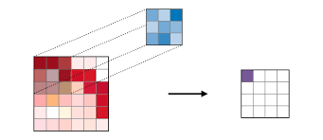
Convolutional features

Slide 13

Content Based Image retrieval

Slide 14
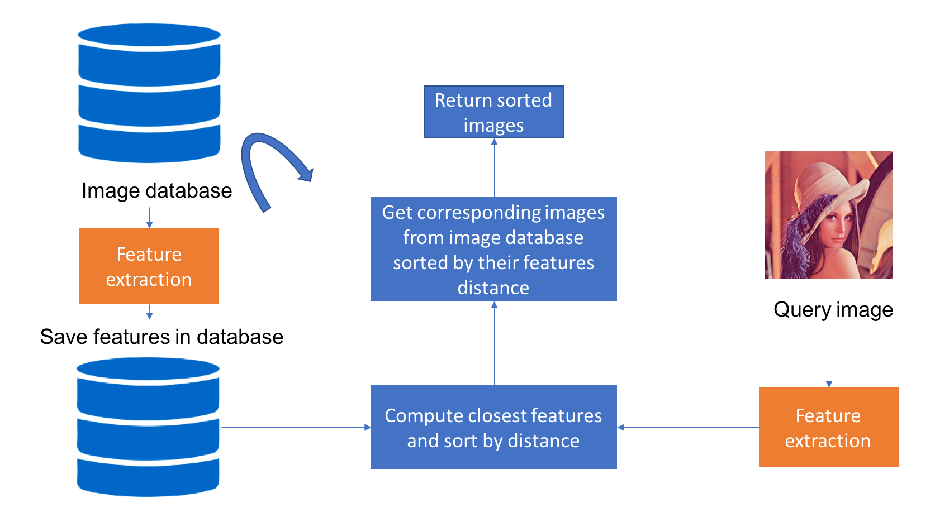
Content Based Image retrieval

Slide 15
Feature extraction for content based image retrieval
colors on an image? Its texture? The shapes on it?

Slide 16
Ways to extract features
One way is to use what we call hand crafted features. Examples are: histogram of colours to define colours, histogram of oriented gradients to define shapes.
Other descriptors like SIFT and SURF have proven to be robust for image retrieval applications.

Slide 17
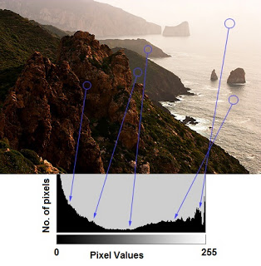
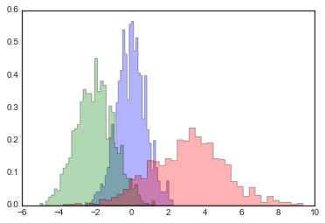
Histogram
Histogram as a graph or plot, which gives you an overall idea about the intensity distribution of an image

Slide 18
Feature Matching
A local image feature is a tiny patch in the image that's invariant to image scaling, rotation and change in illumination. It's like the tip of a tower, or the corner of a window in the image above. Unlike a random point on the background (sky) in the image above, the tip of the tower can be precise detected in most images of the same scene. It is geometrically (translation, rotation, ...) and photometrical (brightness, exposure, ...) invariant.
A good local feature is like the piece you start with when solving a jigsaw puzzle, except on a much smaller scale. It's the eye of the cat or the corner of the table, not a piece on a blank wall.
The extracted local features must be:
Repeatable and precise so they can be extracted from different images showing the same object.
Distinctive to the image, so images with different structure will not have them.
There could be hundreds or thousands of such features in an image. An image matcher algorithm could still work if some of the features are blocked by an object or badly deformed due to change in brightness or exposure. Many local feature algorithms are highly efficient and can be used in real-time applications.

Slide 19
Local Feature Detection and Description
There is a wealth of algorithms satisfying the above requirements for feature detection (finding interest points on an image) and description (generating a vector representation for them). They include Harris Corner Detection, Scale Invariant Feature Transform (SIFT), Speeded-Up Robust Features (SURF), Features from Accelerated Segment Test (FAST), and Binary Robust Independent Elementary Features (BRIEF).
we will use Oriented FAST and Rotated BRIEF (ORB) for feature detection and description. This algorithm was developed and implemented by OpenCV Labs, and it's part of their OpenCV library for computer vision.

