Slide 1
Why Categorize in Computer Vision?
Notes:
Seems like a no-brainer, and that’s how it was treated in computer vision
Categorization is clearly a complex problem

Slide 2

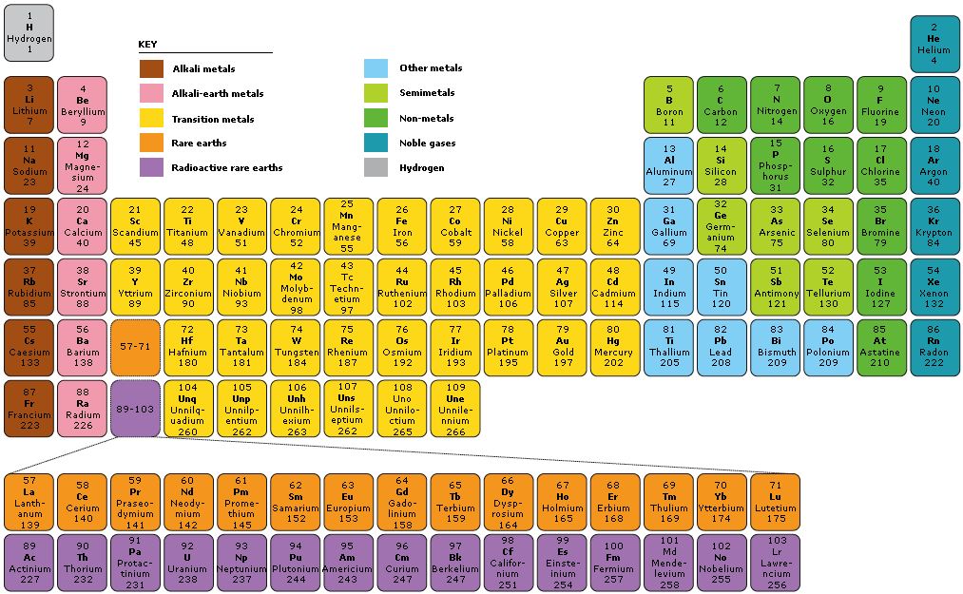
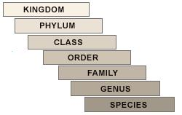
Why Use Categories?
People love categories!
Notes:
Table of elements is but one example of periodic tables
Like Josh said, we use semantic categories to convey (i.e. communicate) maximum information
How would you communicate without using categories?

Slide 3
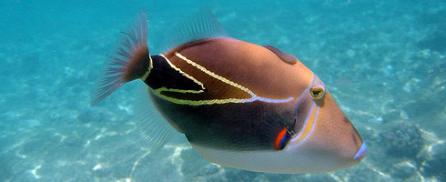
Why Use Categories?
What if we didn’t have categories?
Humuhumunukunukuapua'a – “fish that grunts like a pig”
Notes:
It’s hard to imagine how we could think and talk about things if we didn’t have categories
Polysynthetic languages
Hawaiian has more words with multiple meanings than any other language: you have to be careful what you name things

Slide 4
Why Use Categories?
Our minds work very intimately with categories
Every common noun in English is a category
Proper nouns name object instances
“this,” “that,” “the,” “my,” “yours,” etc. refer to object instances anonymously
Notes:
It’s hard to even start to think about the world without using categories
Compare the use of category names in natural language vs. programming language
This is why it categories were used without question in vision in the early days
categories are baked into natural languages
You might see that computers don’t like categories quite as much as people
common as in non-proper
Exception: “going to ‘the beach’ or ‘the mountains’” really means “a subset of the region we call ‘beach’ or ‘mountains’”

Slide 5
The Categorization Problem
Notes:
Especially useful for retrieval

Slide 6
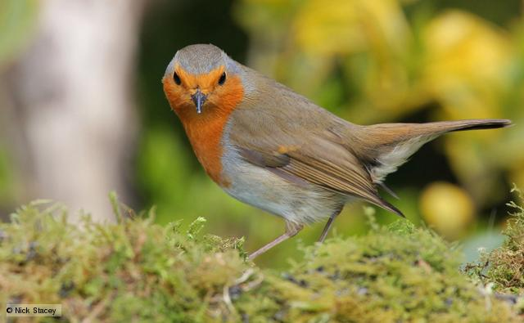
The Categorization Problem
Categorization/Classification:
Given a set of pre-defined categories, “bin” this image
Does not necessarily require object detection
Vertical Dimension:
General: “Animal”
Basic: “Bird”
Specific: “Robin”
Notes:
Does not necessarily require object detection but if you can’t make certain assumptions about your image or dataset it’s usually a good idea
Resolution <-> “taxonomy” <-> vertical categorization
Basic is the easiest for humans to learn and identify
Specific is also called “fine grain” and is generally hard for humans without special experience but is actually easy for computers due to low intra-class variation
General is hard for humans and computers

Slide 7
The Categorization Problem
What kinds of categorization are computers good at?
Basic -- especially when using context clues
Specific -- due to low intra-class variation
Notes:
By the way: scene classification is basic-level categorization

Slide 8
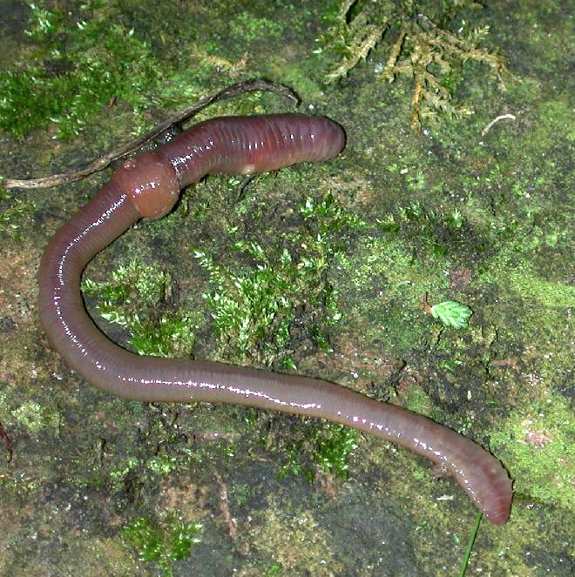
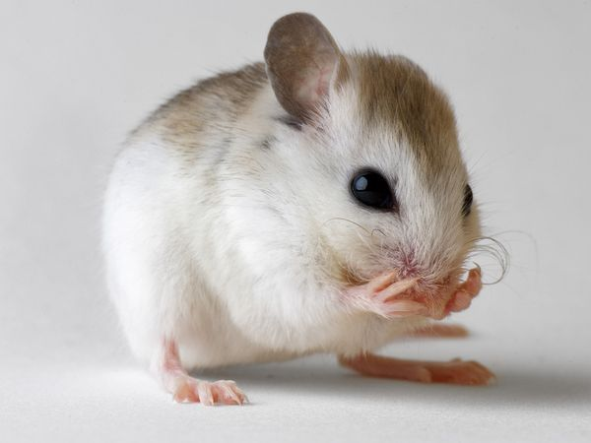
The Categorization Problem
Bad at?
General, due to high intra-class variation and a lack of visual cues
Notes:
What is an animal? A multicellular, eukaryotic organism whose cells do not have cell walls.
Do biologists look at the cells of every new organism they discover under a microscope to classify them as animals?
No!
They draw similarities between the new object instances and familiar objects, which is semantics without categorization (exemplars)
Note: animal categorization can be helped (in both humans and computers) by using background information

Slide 9

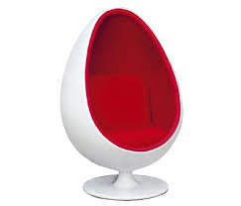
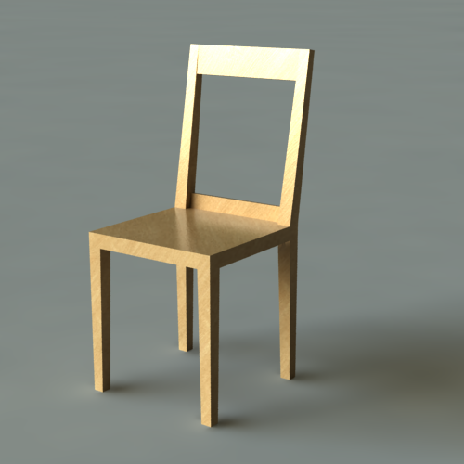
The Categorization Problem
Bad at?
Categories defined by non-visual characteristics
(like chairs)
Notes:
Defined by a human action: Something constructed for a human to sit on, and exclusively for sitting
(And how can a computer know what “constructed for” means?)
Gibson affordances

Slide 10
Summary
Semantic categories allow humans to convey a large amount of information concisely
We want computers to be able to do the same
What work has been done on this problem? Has it been successful?
Notes:
Especially for retrieval

