Slide 2
Socket Programming

Slide 3
Socket API?
Q. What would you expect when learning a new Unix command (e.g., ls) ?
Source code
Program options
Application Programming Interface (API)
Interface to a particular “service”
Abstracts away from implementation detail
Set of functions, data structures, and constants.
Socket API
Network programming interface
=> Implementation detail
=> Interface

Slide 4



Socket API
Socket API
Network programming interface
Application
Socket
API
Transport
TCP
UDP
Network
IP

Slide 5
BSD Socket API
From your university, UC Berkeley (1980s)
Most popular network API
Ported to various OSes, various languages
Windows Winsock, BSD, OS X, Linux, Solaris, …
Socket modules in Java, Python, Perl, …
Similar to Unix file I/O API
In the form of file descriptor (sort of handle).
Can share the same read()/write()/close() system calls.

Slide 6

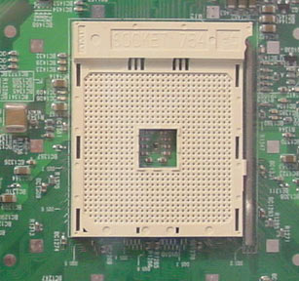
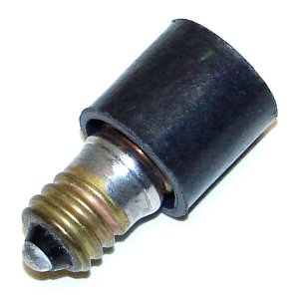
Sockets
Various sockets… Any similarity?
Endpoint of a connection
Identified by IP address and Port number
Primitive to implement high-level networking interfaces
e.g., Remote procedure call (RPC)

Slide 7
Types of Sockets
Stream socket (aka TCP)
Datagram socket (aka UDP)
Connection-oriented
Requires connection establishment & termination
Reliable delivery
In-order delivery
Retransmission
No duplicates
High variance in latency
Cost of the reliable service
File-like interface (streaming)
E.g., HTTP, SSH, FTP, …
Connection-less
“Best-effort” delivery
Possible out-of-order delivery
No retransmission
Possible duplicates
Low variance in latency
Packet-like interface
Requires packetizing
E.g., DNS, VoIP, VOD, AOD, …

Slide 8

Types of Sockets (cont’d)
When sending “Hi!” and “Hope you’re well”
TCP treats them as a single bytes stream
UDP treats them as separate messages
Bytes stream
l
l
e
w
…
e
p
o
H
!
i
H
Hope you’re well
Hi!

Slide 9
Types of Sockets (cont’d)
Thus, TCP needs application-level message boundary.
By carrying length in application-level header
E.g.
struct my_app_hdr {
int length
}
Bytes stream
l
l
e
w
…
o
H
16
!
i
H
3

Slide 10
Outline
Socket API motivation, background
Types of sockets (TCP vs. UDP)
Elementary API functions
I/O multiplexing
Project 1 – tiny World of Warcraft

Slide 11
Scenario #1 – TCP client-server
Sequence of actions
Client
Server
socket()
socket()
Initialization
bind()
listen()
Connection
Establishment
connect()
accept()
send() or write()
recv() or read()
Data transfer
…
…
recv() or read()
send() or write()
Termination
Time
close()
close()

Slide 12
Endianess
Q) You have a 16-bit number: 0x0A0B. How is it stored in memory?
Host byte order is not uniform
Some machines are Big endian, others are Little endian
Communicating between machines with different host byte orders is problematic
Transferred $256 (0x0100), but received $1 (0x0001)
Increasing address
0x0A
0x0B
Big Endian
0x0B
0x0A
Little Endian
Increasing address

Slide 13
Endianness (cont’d)
Network byte order: Big endian
To avoid the endian problem
We must use network byte order when sending 16bit, 32bit , 64bit numbers.
Utility functions for easy conversion
uint16_t htons(uint16_t host16bitvalue);
uint32_t htonl(uint32_t host32bitvalue);
uint16_t ntohs(uint16_t net16bitvalue);
uint32_t ntohl(uint32_t net32bitvalue);
Hint: h, n, s, and l stand for host byte order, network byte order, short(16bit), and long(32bit), respectively

Slide 14
Initialization Summary
Client
socket()
Server
socket()
setsockopt(sock, SOL_SOCKET, SO_REUSEADDR)
bind()
listen()
Pitfalls
The order of the functions matter
Do not forget to use htons() to handle port number

Slide 15
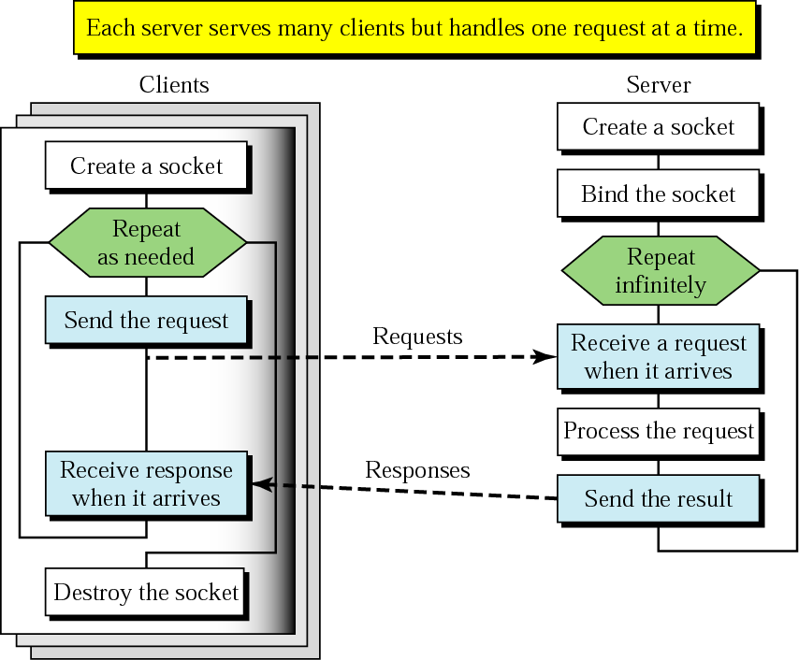
Client+server: connectionless
CREATE
BIND
SEND
RECEIVE
SEND
CLOSE

Slide 16
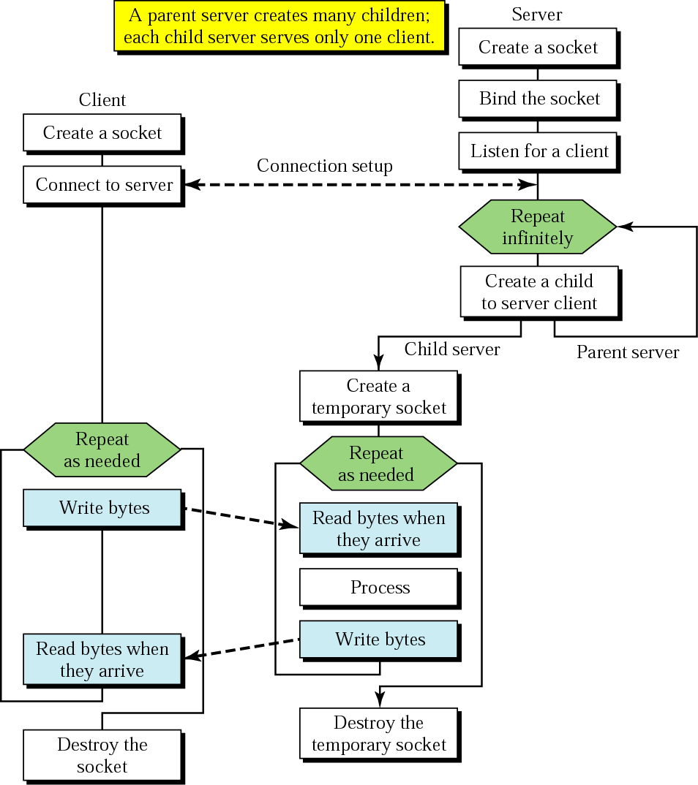
Client+server: connection-oriented
BIND
SOCKET
LISTEN
CONNECT
TCP three-way handshake
ACCEPT
SEND
RECEIVE
SEND
RECEIVE
CLOSE
Concurrent server

Slide 17
Scenario #1 – TCP client-server
Sequence of actions
Client
Server
socket()
socket()
Initialization
bind()
listen()
Connection
Establishment
connect()
accept()
send() or write()
recv() or read()
Data transfer
…
…
recv() or read()
send() or write()
Termination
Time
close()
close()

Slide 18
Host name, IP address, Port number
Host name
Human readable name (e.g., www.eecs.berkeley.edu)
Variable length
Could have multiple IP addresses
IP version 4 address
Usually represented as dotted numbers for human readability
E.g., 128.32.132.214
32 bits in network byte order
E.g., 1.2.3.4 => 0x04030201
Port number
Identifies a service (or application) on a host
E.g., TCP Port 80 => web service, UDP Port 53 => name service (DNS)
16 bit unsigned number (0~65535)

Slide 19
Scenario #1 – TCP client-server
Sequence of actions
Client
Server
socket()
socket()
Initialization
bind()
listen()
Connection
Establishment
connect()
accept()
send() or write()
recv() or read()
Data transfer
…
…
recv() or read()
send() or write()
Termination
Time
close()
close()

Slide 20
Scenario #2 – UDP client-server
Q) What must be changed?
Client
Server
socket()
socket()
Initialization
bind()
listen()
Connection
Establishment
connect()
accept()
send() or write()
recv() or read()
Data transfer
…
…
recv() or read()
send() or write()
Termination
Time
close()
close()

Slide 21
Scenario #2 – UDP client-server
A) We need a different initialization
Client
Server
socket()
socket()
Initialization
bind()
listen()
Connection
Establishment
connect()
accept()
send() or write()
recv() or read()
Data transfer
…
…
recv() or read()
send() or write()
Termination
Time
close()
close()

Slide 22
Scenario #2 – UDP client-server
Q) What else must be changed?
Client
Server
socket()
socket()
Initialization
bind()
listen()
Connection
Establishment
connect()
accept()
send() or write()
recv() or read()
Data transfer
…
…
recv() or read()
send() or write()
Termination
Time
close()
close()

Slide 23
Scenario #2 – UDP client-server
A) UDP is connection-less. We remove all connection related steps.
Client
Server
socket()
socket()
Initialization
bind()
listen()
send() or write()
recv() or read()
Data transfer
…
…
recv() or read()
send() or write()
Termination
Time
close()
close()

Slide 24
Scenario #2 – UDP client-server
A) listen() is also related to connection. Remove it.
Client
Server
socket()
socket()
Initialization
bind()
send() or write()
recv() or read()
Data transfer
…
…
recv() or read()
send() or write()
Termination
Time
close()
close()

Slide 25
Scenario #2 – UDP client-server
Q) Now it’s unclear where to send packets and from where I receive! Can we solve this?
Client
Server
socket()
socket()
Initialization
bind()
send() or write()
recv() or read()
Data transfer
…
…
recv() or read()
send() or write()
Termination
Time
close()
close()

Slide 26
Scenario #2 – UDP client-server
A) Give <address,port> information when sending a packet. That is, use sendto() and recvfrom() instead of send() and recv()
Client
Server
socket()
socket()
Initialization
bind()
sendto()
recvfrom()
Data transfer
…
…
recvfrom()
sendto()
Termination
Time
close()
close()

Slide 27
API functions Summary
TCP
UDP
Initialization
socket(AF_INET, SOCK_STREAM, 0)
setsockopt(sock, SOL_SOCKET, SO_REUSEADDR, …)
bind()
listen()
Conneciton
connect()
accept()
Data transfer
send()
recv()
Termination
close()
Initialization
socket(AF_INET, SOCK_DGRAM, 0)
setsockopt(sock, SOL_SOCKET, SO_REUSEADDR, …)
bind()
No connection
Data transfer
sendto()
recvfrom()
Termination
close()

Slide 28
Outline
Socket API motivation, background
Types of sockets (TCP vs. UDP)
Elementary API functions
I/O multiplexing
Project 1 – tiny World of Warcraft

Slide 29
How to handle multiple inputs?
Data sources
Standard input (e.g., keyboard)
Multiple sockets
Problem: asynchronous data arrival
Program does not know when it will arrive.
If no data available, recv() blocks.
If blocked on one source, cannot handle other sources
Suppose what if a web server cannot handle multiple connections
Solutions
Polling using non-blocking socket ➔ Inefficient
I/O multiplexing using select() ➔ simple
Multithreading ➔ more complex. Not covered today

Slide 30
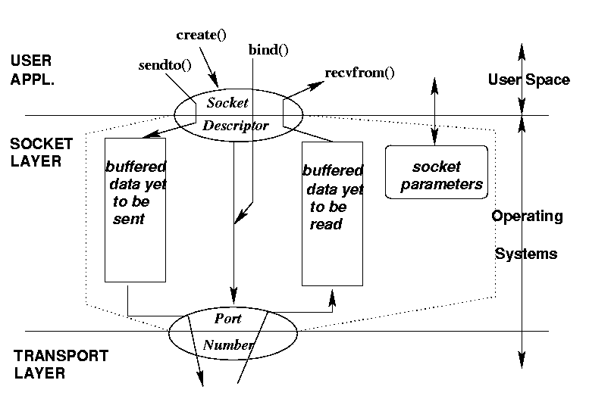

Slide 31
Two essential types of sockets
SOCK_DGRAM
a.k.a. UDP
unreliable delivery
no order guarantees
no notion of “connection” – app indicates dest. for each packet
can send or receive
SOCK_STREAM
a.k.a. TCP
reliable delivery
in-order guaranteed
connection-oriented
bidirectional
App
App
D1
3
2
1
socket
Dest.
3
2
D2
1
socket
D3

Slide 32
Types of Sockets
When sending “Hi!” and “Hope you’re well”
TCP treats them as a single bytes stream
UDP treats them as separate messages
Bytes stream
l
l
e
w
…
e
p
o
H
!
i
H
Hope you’re well
Hi!

Slide 33
Types of Sockets
When sending “Hi!” and “Hope you’re well”
TCP treats them as a single bytes stream
UDP treats them as separate messages
Bytes stream
l
l
e
w
…
e
p
o
H
!
i
H
Hope you’re well
Hi!

Slide 34
Connectionless Services
socket()
socket()
bind()
bind()
recvfrom()
sendto()
[blocked]
recvfrom()
[blocked]
sendto()
SERVER
CLIENT
Notes:
When UDP is used, the server creates a socket and binds address(es) and a port number to it. The server then waits for incoming data (remember: UDP is connectionless).
The clients also create a socket, then they bind it to the appropriate interface – typically allowing the transport layer to choose an epehemeral (short-lived) port number rather than specifying a particular port.
The client sends data to the server, which awakes from its blocked state and starts to compute its response. Meantime the client has issued a recvfrom() using the same address it sent the data to, and is blocked awaiting the response which should eventually arrive from the server.
When the server sends its result back, it goes to the address and port number the incoming data was received from. The server then loops around to wait for another request. The arrival of the server’s data unblocks the client, which can then continue.
This is something of a simplification: using a library based on the select() system call it is possible to use sockets in a non-blocking fashion. This does complicate the code somewhat, however.

Slide 35
Simple Connectionless Server
from socket import socket, AF_INET, SOCK_DGRAM
s = socket(AF_INET, SOCK_DGRAM)
s.bind(('127.0.0.1', 11111))
while True:
data, addr = s.recvfrom(1024)
print "Connection from", addr
s.sendto(data.upper(), addr)
Note that the bind() argument is a two-element tuple of address and port number
Empty -> all
Notes:
It's more usual to import the whole socket library and use qualified names, but the from statement is a convenient way to access only specific names from a module. I did this to keep code lines on the slide shorter, and hence more readable. The following code is an equivalent but rather more conventional way to create the socket:
import socket
s = socket.socket(socket.AF_INET, socket.SOCK_DGRAM)
This achieves exactly the same ends. Which style you use is largely a matter of taste and readability. The remainder of the code will run unchanged since the other features it uses are attributes of the socket, and are accessed the same way no matter how the socket was created.
Note carefully that the bind() call takes a single argument, a tuple containing an IP address string and a port number. If the IP address is the empty string then the code will bind to all interfaces, which is how most servers actually start up. The example above is a little more secure, since only local processes can connect via the local loopback interface.

Slide 36
Simple Connectionless Client
from socket import socket, AF_INET, SOCK_DGRAM
s = socket(AF_INET, SOCK_DGRAM)
s.bind(('127.0.0.1', 0)) # OS chooses port
print "using", s.getsocketname()
server = ('127.0.0.1', 11111)
s.sendto("MixedCaseString", server)
data, addr = s.recvfrom(1024)
print "received", data, "from", addr
s.close()
Notes:
The client specifies port number zero to indicate that it simply wants an ephemeral port – this is more efficient than attempting to use a specific port number because the port requested might already be in use and then the bind() call would fail.
The getsocketname() call tells the user the address and port number being used for the client end of the communication. While this isn't an essential part of the program it's useful debugging data.
The client simply sends the data and (usually) receives a reply from the server. This particular program is somewhat inadequate in terms of error checking: if the server's response is somehow lost then the client will hang forever.

Slide 37
Connection setup cont’d
Passive participant
step 1: listen (for incoming requests)
step 3: accept (a request)
step 4: data transfer
The accepted connection is on a new socket
The old socket continues to listen for other active participants
Active participant
step 2: request & establish connection
step 4: data transfer
Passive Participant
a-sock-1
l-sock
a-sock-2
Active 1
Active 2
socket
socket

Slide 38
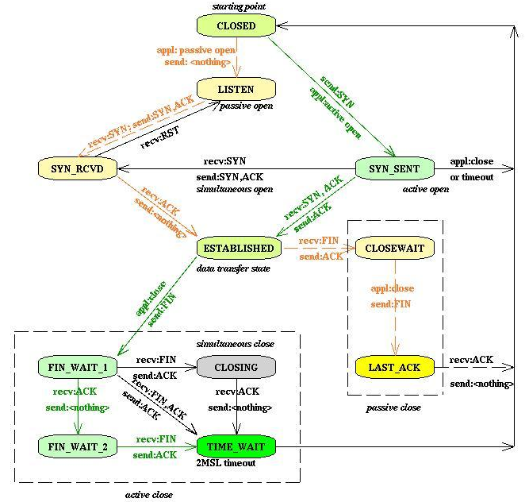

TCP state diagram

Slide 39
Connection-Oriented Services
socket()
Server
Client
bind()
socket()
listen()
connect()
accept()
write()
[blocked]
read()
read()
[blocked]
[blocked]
write()
When interaction is over, server loops to accept a new connection
Notes:
A connection-oriented server creates a socket, binds it to one or more local ports on which it will listen for connections, and then puts the socket into the listening state to wait for incoming connections. At this point the server process blocks until a connection request arrives.
A client creates its own socket, usually without specifying any particular port number, and then connects to the endpoint the server is listening on. The server’s accept() call returns a new socket that the server can use to send data across this particular connection..
The two parties then exchange data using read() and write() calls.
The major limitation of this structure is the non-overlapped nature of the request handling in the server. Theoretically it's possible for the server to use its original socket to listen for further requests while the current request is being handled, but that isn't shown here. You will learn how to overcome this limitation using standard library classes.

Slide 40
Connection-Oriented Server
from socket import socket, AF_INET, SOCK_STREAM
s = socket(AF_INET, SOCK_STREAM)
s.bind(('127.0.0.1', 9999))
s.listen(5) # max queued connections
while True:
sock, addr = s.accept() # use socket sock to communicate # with client process
Client connection creates new socket
Returned with address by accept()
Server handles one client at a time
Notes:
Connection-oriented servers are a little more complex because the connection allows clients and servers to interact across multiple send() and recv() calls.
The server blocks in accept() until a server connects. The return value from accept() is a tuple consisting of a socket and the client address (which is the usual (address, port) tuple).
The server can, if it chooses, use multitasking techniques such as creating a new thread or forking a new process to allow it to handle several concurrent connections. Either solution allows the connection to be processed while the main control loop returns to execute another accept() and deal with the next client connection.
Since each connection generates a new server-side socket there is no conflict between the different conversations, and the server can continue to use the listen()ing socket to listen for incoming connections while it serves already-connected clients.

Slide 41
Connection-Oriented Client
from socket import socket, AF_INET, SOCK_STREAM
(SERVER, PORT) = ('127.0.0.1', 9999)
s = socket(AF_INET, SOCK_STREAM)
s.connect((SERVER, PORT))
s.send('Hello, world')
data = s.recv(1024)
s.close()
print 'Received', data
This is a simple example
Sends message, receives response
Server receives 0 bytes after close()
Notes:
This very simple client just sends a single message and receives a single response.
More typical code will send a request and use its understanding of the application protocol to determine when the response to that request has been completed.
Protocols like HTTP 1.0 use a separate connection for each request. Protocols like telnet can exchange thousands of messages before the connection is closed, and the code tends to be more complex iin that case.
Under normal circumstances a recv() call guarantees that at least one byte of data will be returned. When a program seems the empty string (zero bytes) returned from the recv() it knows that the other end has terminated the connection by calling close() on its socket.

Slide 42
Some socket Utility Functions
htonl(i), htons(i)
32-bit or 16-bit integer to network format
ntohl(i), ntohs(i)
32-bit or 16-bit integer to host format
inet_aton(ipstr), inet_ntoa(packed)
Convert addresses between regular strings and 4-byte packed strings
Big-Endian
machine
Little-Endian
machine
12.40.119.128
128.119.40.12
WRONG!!!
128
119
40
12
128
119
40
12
Notes:
Although there is no formal presentation layer in the TCP/IP suite, certain data types are so commonly interchanged that it is useful to be able to transmit them in network-neutral format. This makes it easy for little-endian and big-endian machines to communicate with each other.
l stands for long, a 32-bit value, and s signifies a 16-bit short.
If you need to communicate IP addresses as a part of your application, the inet_*() functions allow you to do so efficiently.

Slide 43
Handling Names & Addresses
getfqdn(host='')
Get canonical host name for host
gethostbyaddr(ipaddr)
gethostbyname_ex(hostname)
Returns (hostname, aliases, addresses)
Hostname is canonical name
Aliases is a list of other names
Addresses is a list of IP address strings
Notes:
These utility functions are useful ways to access the domain name of the host your are running on, and other DNS services.
A typical use would be as follows:
>>> import socket
>>> socket.gethostbyaddr("10.0.0.10")
('prom01.holdenweb.com', [], ['10.0.0.10'])
This shows interactive use of the Python interpreter, which is handy for debugging purposes. If you simply enter an expression, the interpreter prints out the resulting value.

Slide 44
Treating Sockets as Files
makefile([mode[, bufsize]])
Creates a file object that references the socket
Makes it easier to program to handle data streams
No need to assemble stream from buffers
Notes:
Sometimes if the protocol involves variable-length strings it's easier to use the file-based functions like readline() and write() to handle I/O.
Calling s.makefile() on a socket s yields an object sufficiently "file-like" that it allows you to write your programs in this more familiar style. Otherwise it's sometimes necessary to assemble input strings from a sequence of recv() calls, and add line terminators to the strings you pass to send().
The socket-based file object can be closed without closing the underlying socket.
This paradigm also makes it easier to adapt existing code, written to handle files, to network applications.

Slide 45
Summary of Address Families
socket.AF_UNIX
Unix named pipe (NOT Windows…)
socket.AF_INET
Internet – IP version 4
The basis of this class
socket.AF_INET6
Internet – IP version 6
Rather more complicated …
Notes:
Mostly we are concerned with IP v4 sockets and the related services, although IPv6 is coming.
Unix named pipes are available if you need them, and work in more or less the same ways as the IP version 4 sockets.

Slide 46
Summary of Socket Types
socket.SOCK_STREAM
TCP, connection-oriented
socket.SOCK_DGRAM
UDP, connectionless
socket.SOCK_RAW
Gives access to subnetwork layer
SOCK_RDM, SOCK_SEQPACKET
Very rarely used
Notes:
Most of the services we are interested in will be TCP-based, and therefore use SOCK_STREAM sockets. We do look briefly at SOCK_DGRAM sockets. SOCK_RAW sockets have been the basis of (for example) ping programs to generate and handle ICMP traffic, but this is beyond the scope of this presentation.
Still. It's always useful to know that you can get access to the network hardware if you need it – most times you don't, but typically when you need such access you really need it.

Slide 47
Timeout Capabilities
Can set a default for all sockets
socket.setdefaulttimeout(seconds)
Argument is float # of seconds
Or None (indicates no timeout)
Can set a timeout on an existing socket s
s.settimeout(seconds)
Notes:
A big problem with network programming is: what do you do when the expected responses aren't received?
In the case of TCP connection attempts, if no reply is received to the initial connection attempt it isn't unusual for the adaptive timeout to keep retrying at exponentially larger intervals, with the result that no exception occurs for over an hour. UDP sockets will hang indefinitely if they are awaiting a message that somehow gets lost, or is never transmitted.
Timeouts are therefore a valuable way to ensure that failures are detected in a timely manner.

Slide 48
Server Libraries
SocketServer module provides basic server features
Subclass the TCPServer and UDPServer classes to serve specific protocols
Subclass BaseRequestHandler, overriding its handle() method, to handle requests
Mix-in classes allow asynchronous handling via ThreadingMixIn
Notes:
The SocketServer module is the basis for (among other things) a family of HTTP servers which are also a part of the standard Python library. It offers a framework that allows you to write some quite sophisticated servers, and is very useful for rapid network experimentation. You should be aware, though, that robustness and throughput are both somewhat below professional servers, so you should not make this the basis of production servers unless you are fairly certain the load will be light.
Having said that, the ability to build an experimental server with a (very) few lines of code is invaluable, so SocketServer should definitely be a part of your programming vocabulary if you do a lot of protocol development or similar work. Python's conciseness and readability are a real asset here.
Python's ability to handle multiple inheritance is also useful -- the module lets you add the ability to handle each request in a separate thread or a separate process by adding so-called mixin classes to your server's base classes. This is particularly useful for connection-oriented servers, which would otherwise stall additional clients until an existing session was completely terminated, as we saw in the earlier demonstration.
Creating a server requires several steps. First, you must create a request handler class by subclassing the BaseRequestHandler class and overriding its handle() method; this method will process incoming requests. Second, you must instantiate one of the server classes, passing it the server’s address and the request handler class. Finally, call the handle_request() or serve_forever() method of the server object to process one or many requests.

Slide 49
TCP/IP Components
Telnet SSH SMTP FTP NFS DNS SNMP
Application
TCP
UDP
Host-to-host
IP
Internetwork
Ethernet, Token Ring, RS232, IEEE 802.3, HDLC, Frame Relay, Satellite, Wireless Links, Wet String
Subnetwork

