Slide 1



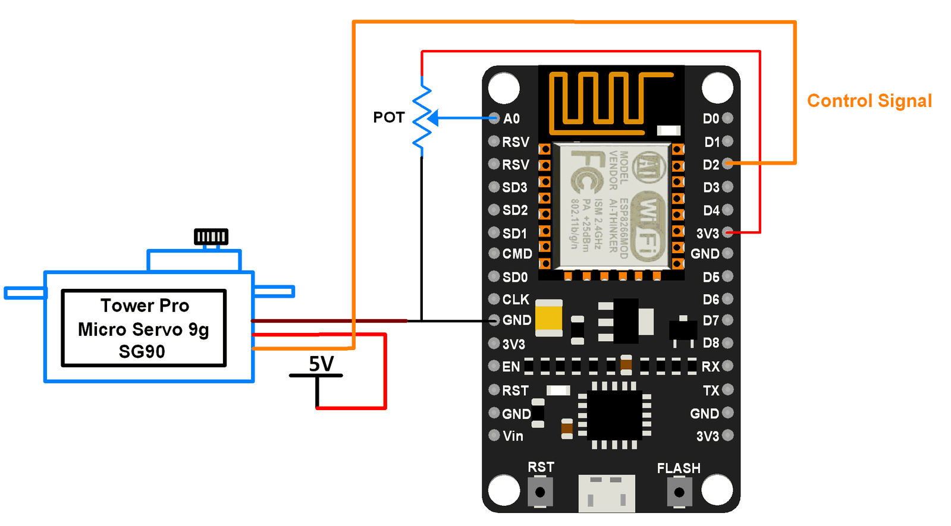

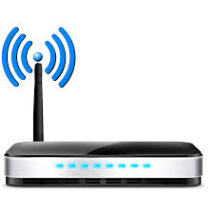
Alert based on Time Scheduled
Switch and LED indicator
ON
ON

