Slide 1
Smart Medicine Dispencer

Slide 2
Introduction
Our smart medicine dispensing system is targeted on users who regularly take drugs or vitamin supplements or nurses who take care of the older or patients.
The medicine box is programmable that allows nurses or users to specify the pill quantity to take and the serve time for each day.
The smart medicine box contains seven separate sub-boxes. Therefore, nurses or users can set information for seven different pills. When the pill quantity and serve time has been set, the medicine box will remind users or patients to take pills using sound and light.

Slide 3
Motivation
The specifications of our device based on the user needs. The device should be able to generate loud sound so that even people with impaired hearing were able to hear it. The device should demonstrate ease of use. In order to help user remember the number of pills they need to take, we also used android application that displays to indicate the number of pills the user need to take. Based on these specifications.

Slide 4
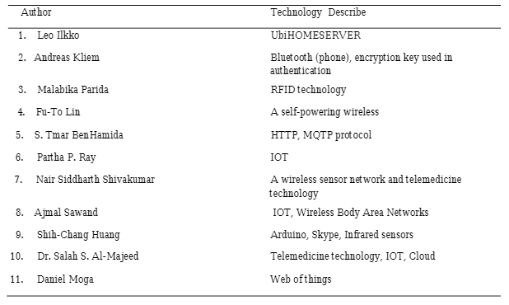
Literature Review

Slide 5
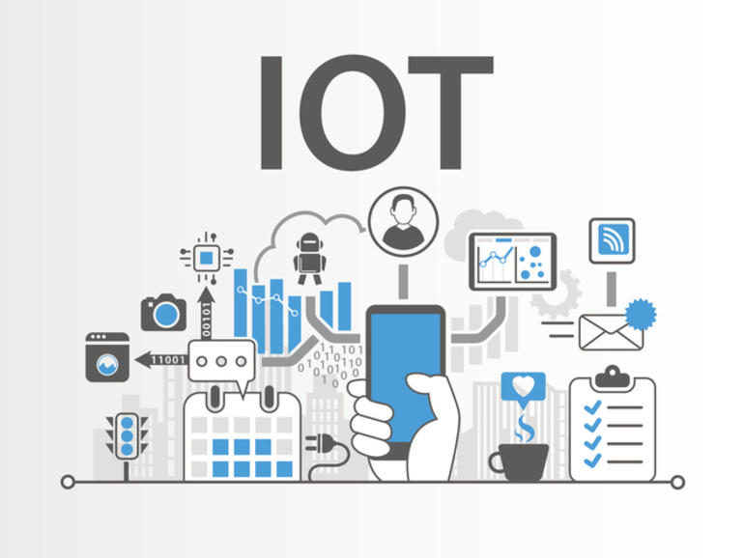
IoT Solution
The Internet of things (IoT) refers to the concept of extending Internet connectivity beyond conventional computing platforms such as personal computers and mobile devices, and into any range of traditionally "dumb" or non-internet-enabled physical devices and everyday objects. Embedded with electronics, Internet connectivity, and other forms of hardware (such as sensors), these devices can communicate and interact with others over the Internet, and they can be remotely monitored and controlled

Slide 6
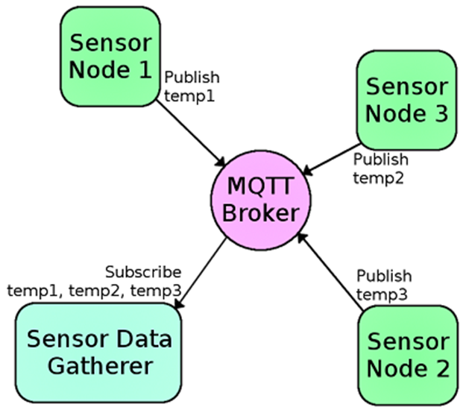
MQTT Protocol

Slide 7
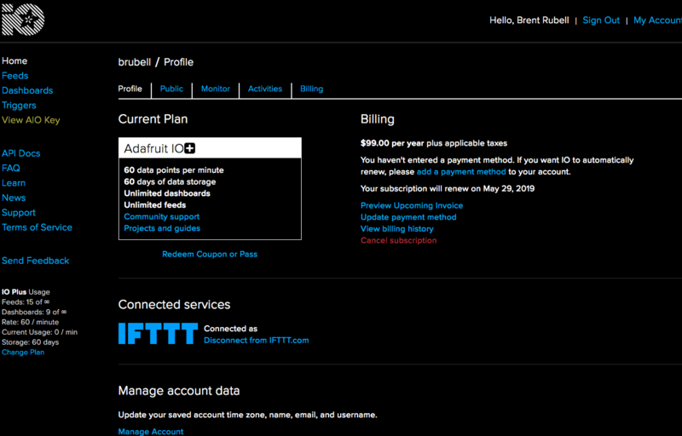
Adafruit IoT Platform

Slide 8
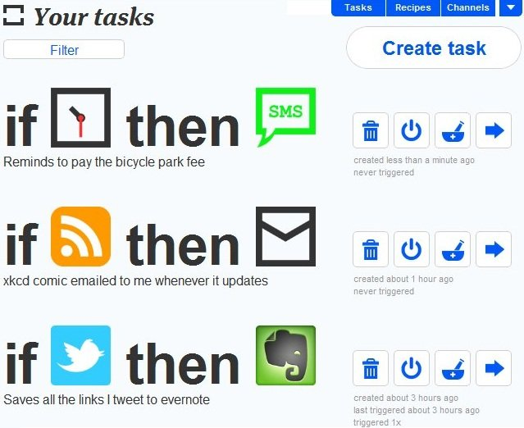
IFTTT Platform

Slide 9
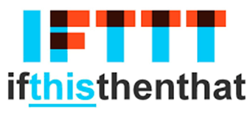


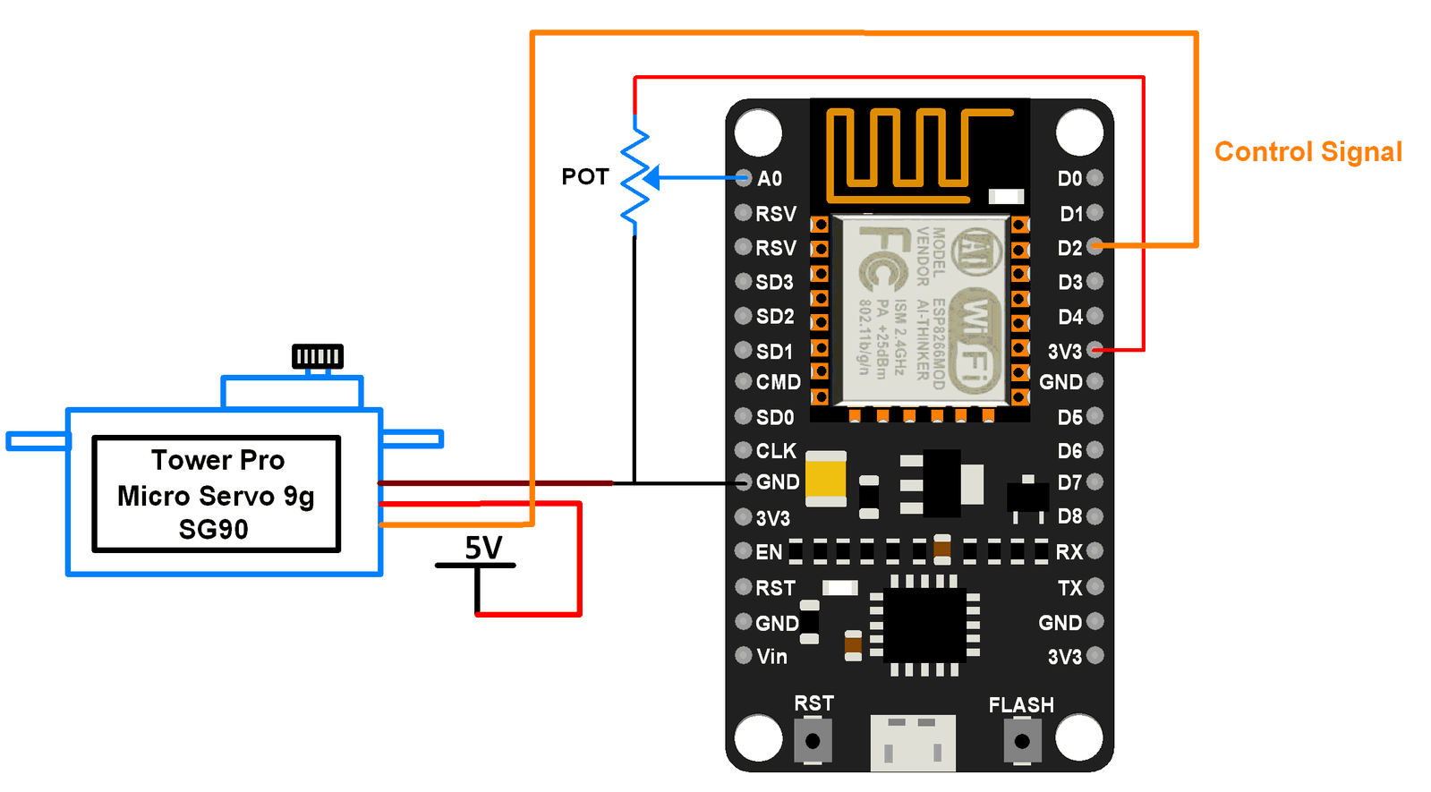
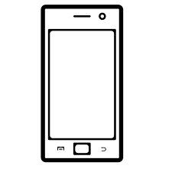
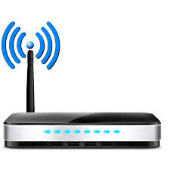
Alert based on Time Scheduled
Switch and LED indicator
ON
ON

Slide 10
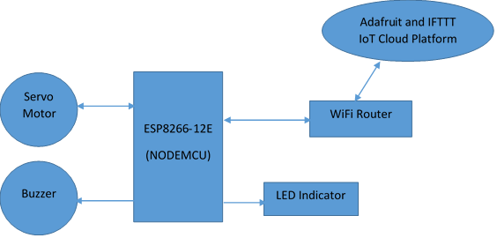
Block Diagram

Slide 11
References
A. Sawand, S. Djahel, Z. Zhang, and F. Na. Multidisciplinary Approaches to Achieving Efficient and Trustworthy eHealth Monitoring Systems. Commun. China (ICCC), 2014 IEEE/CIC Int. Conf., pp. 187–192; 2014.
D. a. Clifton, D. Wong, L. Clifton, S. Wilson, R. Way, R. Pullinger, and L. Tarassenko. A large-scale clinical validation of an integrated monitoring system in the Emergency Department. IEEE J. Biomed. Heal. Informatics vol. 17, no. 4, pp. 835–842; 2013.
M. Parida, H.-C. Yang, S.-W. Jheng, and C.-J. Kuo.Application of RFID Technology for In-House Drug Management System.15th Int. Conf.Network-Based Inf. Syst., pp. 577–581; 2012.
L. Ilkko and J. Karppinen.UbiPILL A Medicine Dose Controller of Ubiquitous Home Environment. 2009 Third Int. Conf. Mob. Ubiquitous Comput. Syst. Serv. Technol., pp. 329–333; 2009.
A. Kliem, M. Hovestadt, and O. Kao.Security and Communication Architecture for Networked Medical Devices in Mobility-Aware eHealth environments,” 2012 IEEE First Int. Conf. Mob. Serv., pp. 112–114;2012.
S. T.-B. Hamida, E. Ben Hamida, B. Ahmed, and A. Abu-Dayya.Towards efficient and secure in-home wearable insomnia monitoring and diagnosis system. 13th IEEE Int. Conf. Bioinforma. Bioeng., pp. 1–6; 2013.
P. Ray.Home Health Hub Internet of Things (H 3 IoT): An architectural framework for monitoring health of elderly people.Sci. Eng. Manag. Res. pp. 3–5, 2014.
S. Huang, H. Chang, Y. Jhu, and G. Chen.The Intelligent Pill Box - Design and Implementation. pp. 235–236; 2014.
F.-T. Lin, Y.-C. Kuo, J.-C. Hsieh, H.-Y. Tsai, Y.-T. Liao, and H. C. Lee A Self-powering Wireless Environment Monitoring System Using Soil Energy. IEEE Sens. J., vol. 15, no. c, pp. 1–1; 2015.
S. S. Al-majeed.Home Telehealth by Internet of Things (IoT). pp. 609–613; 2015.

Slide 12
Thank You

