Slide 1
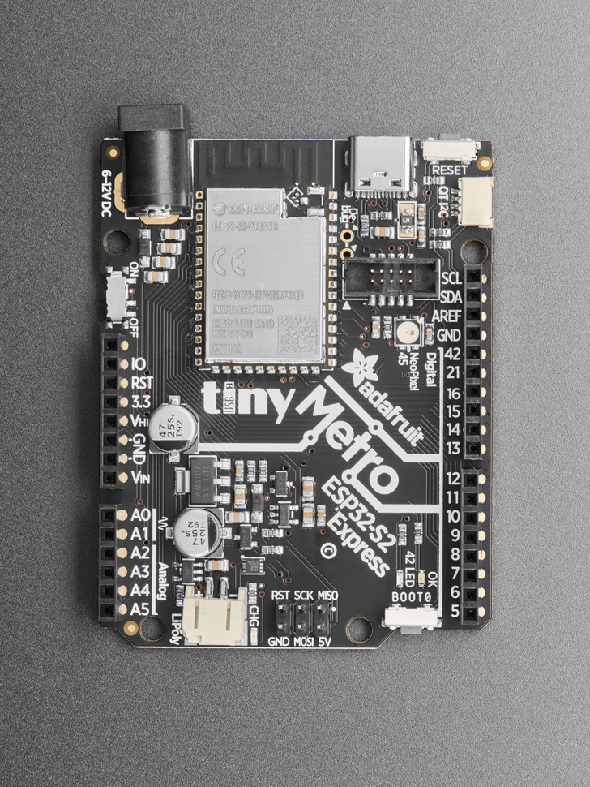
12V
12V also for
motors and such
GND
GPIO 21:switch 1 (other end to GND)
Relay module also needs a 3V3 input?
GPIO 16:switch 2 (other end to GND)(train)
5V forrelay module
GPIO 21:relay CH1
GND
relay module probably also needs GND
but its not ISP or I2C that’s for sure
GPIO 16:relay CH2 (train 12V?)
GPIO 11:LED array1 (candy cane)
GPIO 10:LED array 2 (train station)
GND

