Slide 1
Webstie Kinh Doanh Khóa Học Trực Tuyến Đơn Giản
ĐINH NGUYỄN TRỌNG NGHĨA

Slide 2
Thành viên
NGUYỄN VĂN LÀNH 2001160053
TRẦN KHÁNH NHẬT 2001160053

Slide 3
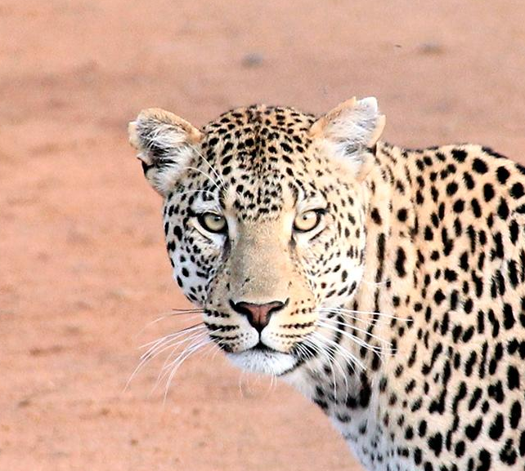
Nội Dung:
I am Jayden Smith

Slide 4
Transition headline
1
Let’s start with the first set of slides

Slide 5
Học viên đăng kí tài khoản
Mô Hình
BPM

Slide 6
Học viên lựa chọn và thanh toán khóa học
Mô Hình
BPM

Slide 7
Học viên đăng nhập và học
Mô Hình
BPM

Slide 8
Trao đổi giữa học viên và giảng viên
Mô Hình
BPM

Slide 9
Khởi tọa khóa học
Mô Hình
BPM

Slide 10
Giảng viên quản lý khóa học
Mô Hình
BPM

Slide 11
Báo cáo doanh thu
Mô Hình
BPM

Slide 12
Quản lý học viên
Mô Hình
BPM

Slide 13
Quotations are commonly printed as a means of inspiration and to invoke philosophical thoughts from the reader.

Slide 14
Mô hình thực thể kết hợp
Mô Hình
ERD

Slide 15
This is a slide title
Here you have a list of items
And some text
But remember not to overload your slides with content
Your audience will listen to you or read the content, but won’t do both.

Slide 16
Mức ngữ cảnh
Mô Hình
DFD

Slide 17
Phân rã cấp1 (mức đỉnh)
Mô Hình
DFD

Slide 18
Phân rã cấp 2 quản lý học viên
Mô Hình
DFD

Slide 19
Phân rã cấp 2 quản lý giáo viên
Mô Hình
DFD

Slide 20
Phân rã cấp 2 quản lý khóa học
Mô Hình
DFD

Slide 21
BIG concept
Bring the attention of your audience over a key concept using icons or illustrations

Slide 22
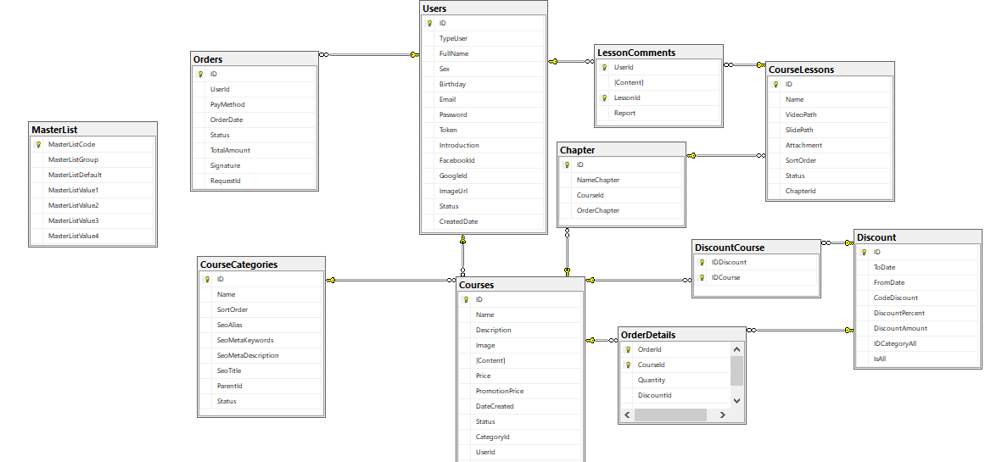
Phân rã cấp 2 quản lý khóa học
Lược đồ
Diagram

Slide 23
You can also split your content
White
Is the color of milk and fresh snow, the color produced by the combination of all the colors of the visible spectrum.
Black
Is the color of ebony and of outer space. It has been the symbolic color of elegance, solemnity and authority.

Slide 24
In two or three columns
Yellow
Is the color of gold, butter and ripe lemons. In the spectrum of visible light, yellow is found between green and orange.
Blue
Is the colour of the clear sky and the deep sea. It is located between violet and green on the optical spectrum.
Red
Is the color of blood, and because of this it has historically been associated with sacrifice, danger and courage.

Slide 25
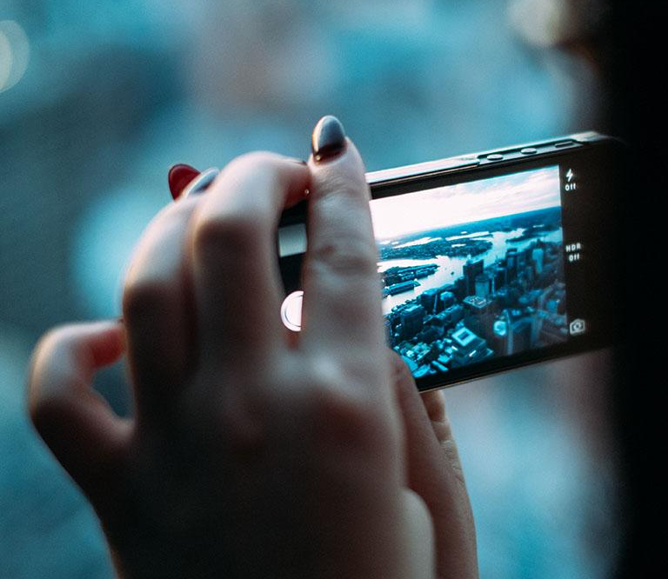
A picture is worth a thousand words
A complex idea can be conveyed with just a single still image, namely making it possible to absorb large amounts of data quickly.

Slide 26
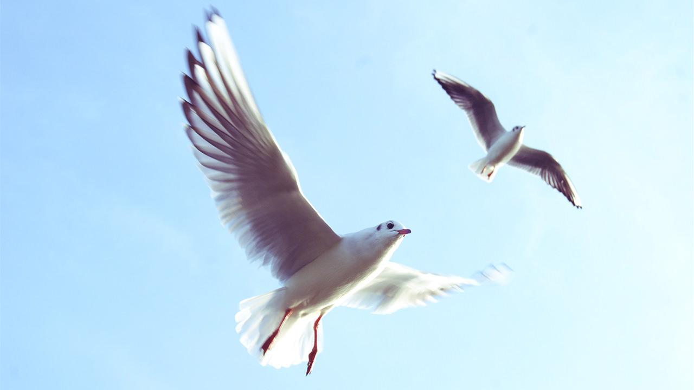
Want big impact?
Use big image.

Slide 27
Use charts to explain your ideas
White
Gray
Black

Slide 28
And tables to compare data
 | A | B | C
Yellow | 10 | 20 | 7
Blue | 30 | 15 | 10
Orange | 5 | 24 | 16

Slide 29
Maps
our office

Slide 30
89,526,124
Whoa! That’s a big number, aren’t you proud?

Slide 31
89,526,124$
185,244 users
100%
That’s a lot of money
And a lot of users
Total success!

Slide 32
Our process is easy
first
second
last

Slide 33
Our sales funnel
20%
40%
60%
80%
100%

Slide 34
Let’s review some concepts
Yellow
Is the color of gold, butter and ripe lemons. In the spectrum of visible light, yellow is found between green and orange.
Blue
Is the colour of the clear sky and the deep sea. It is located between violet and green on the optical spectrum.
Red
Is the color of blood, and because of this it has historically been associated with sacrifice, danger and courage.
Yellow
Is the color of gold, butter and ripe lemons. In the spectrum of visible light, yellow is found between green and orange.
Blue
Is the colour of the clear sky and the deep sea. It is located between violet and green on the optical spectrum.
Red
Is the color of blood, and because of this it has historically been associated with sacrifice, danger and courage.

Slide 35
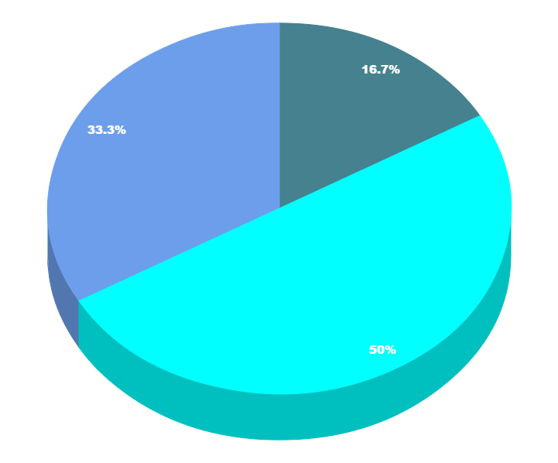
You can copy&paste graphs from Google Sheets

Slide 36
Place your screenshot here
Android project
Show and explain your web, app or software projects using these gadget templates.

Slide 37
Place your screenshot here
iPhone project
Show and explain your web, app or software projects using these gadget templates.

Slide 38
Place your screenshot here
Tablet project
Show and explain your web, app or software projects using these gadget templates.

Slide 39
Place your screenshot here
Desktop project
Show and explain your web, app or software projects using these gadget templates.

Slide 40
Thanks!
Any questions?
You can find me at:
@username
user@mail.me

Slide 41
Credits
Special thanks to all the people who made and released these awesome resources for free:
Presentation template by SlidesCarnival
Photographs by Unsplash

Slide 42
Presentation design
This presentation uses the following typographies and colors:
Titles: Nixie One
Body copy: Muli
You can download the fonts on this page:
https://www.fontsquirrel.com/fonts/nixie-one
https://www.fontsquirrel.com/fonts/muli
Aquamarina #00e1c6 / Turquoise #19bbd5 / Skyblue #2c9dde /
Light gray #c6daec / Dark blue #0e293c
You don’t need to keep this slide in your presentation. It’s only here to serve you as a design guide if you need to create new slides or download the fonts to edit the presentation in PowerPoint®

Slide 43
SlidesCarnival icons are editable shapes.
This means that you can:
Resize them without losing quality.
Change fill color and opacity.
Change line color, width and style.
Isn’t that nice? :)
Examples:

Slide 44
Diagrams and infographics

Slide 45
😉
Now you can use any emoji as an icon!
And of course it resizes without losing quality and you can change the color.
How? Follow Google instructions https://twitter.com/googledocs/status/730087240156643328
✋👆👉👍👤👦👧👨👩👪💃🏃💑❤😂😉😋😒😭👶😸🐟🍒🍔💣📌📖🔨🎃🎈🎨🏈🏰🌏🔌🔑 and many more...

Slide 46

Free templates for all your presentation needs
For PowerPoint and Google Slides
100% free for personal or commercial use
Ready to use, professional and customizable
Blow your audience away with attractive visuals

