Slide 1
RESTAURANT MENU CRAWLER & CLASSIFIER
Kiranmayee Nimashakavi (cs410 COURSE PROJECT)

Slide 2
PROJECT OVERVIEW
Context & Objective
A restaurant review company would like to provide recommendation on menu items across the world.
To accomplish this goal, the first stage of the pipeline is to identify the URLs that relevant (i.e. find the URLs that contain menu information)
This tool crawls the URLs, classifies the pages that contain menu.

Slide 3
Components
Scrapy
An open source and collaborative framework (python based) for extracting the data you need from websites.
BeautifulSoup
Beautiful Soup is a Python library for pulling data out of HTML and XML file
Metapy
Python bindings for MeTA toolkit that tokenizes documents, creates indexes, inverted indexes, classifies, creates topic models etc.,

Slide 4
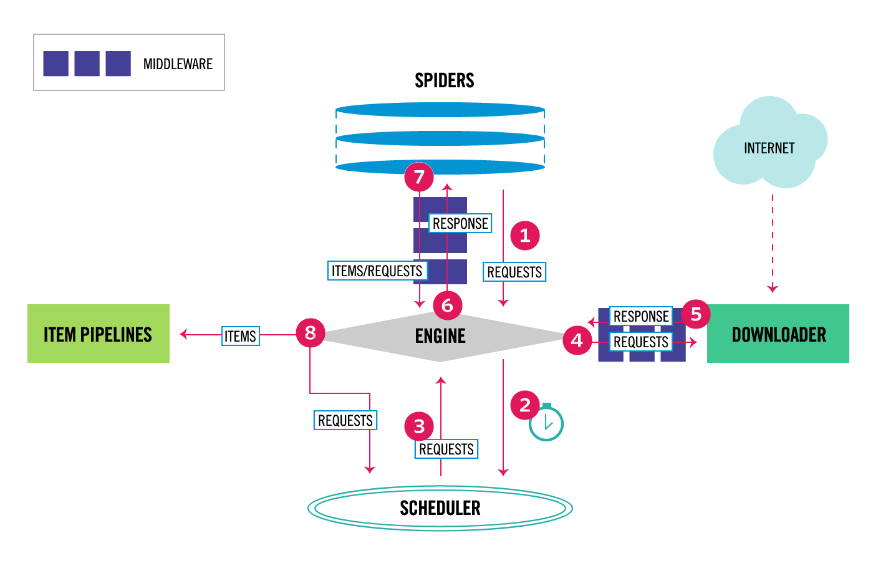
Scrapy architecture

Slide 5
Project design
4. Classify using Page Data
Menu Classifier
Meta Py
Menu Spider
5. Uses MetaPy to classify
Spiders
6. Uses pre-indexed training data set
2b. Downloaded Content
3. Extract Text data from Page
Scrapy Engine
Beautiful Soup
Training Dataset + Indexes
Down loader
2a. Download pages
Duplink Remover
1. List of URLs
PageDataOutput
8. Save Menu Links, processed links
Final results
Main.py
7. Save Menu Links, processed links
Pipelines

Slide 6
Design/code level overview
Contains all scrapy plug-ins
Project Structure
menucrawler
Data set
final results
Spiders
log
sample
Contains custom spider code
Stores log files
Contains the pre-classified
seed data
Contains
All URLs that were crawled
URLs classified as MenuPages

Slide 7
demo

