Slide 2
In real world,
There is 1 to Many relation between problem and solution
There are many predictive models, sharing info, back & forth with each other
Working together in a decision management system
Notes:
Machine Learning and AI Foundations: Classification Modeling

Slide 3
The goal of Predictive Analytics:
To have a ONE BEST Algorithm
To have a single Predictive Model (which tells when to take action and when to Not)
Predictive Analytics Accuracy
Accuracy in prediction is depending upon categories of population (statistics population)
Notes:
Machine Learning and AI Foundations: Classification Modeling

Slide 4

Binary vs Multinomial
If we are predicting in two categories then chances of accuracy are 50%
Here binary classification is playing a vital role (yes or no)
Notes:
Machine Learning and AI Foundations: Classification Modeling

Slide 5

Binary vs Multinomial
In advanced world, we are facing challenges of having Multi categories
If we are predicting in 3, 4, 5 Categories then chances of guessing are getting lower
Our target with more than 2-categories should be rare
Notes:
Machine Learning and AI Foundations: Classification Modeling

Slide 6
To have less Categories
If it seems that there are more categories exists in business problem
Try to “divide and conquer”
Notes:
Machine Learning and AI Foundations: Classification Modeling

Slide 7
To have less Categories
Example: Customers Data
Customer with Business
Customer with NGO/NP
Customer with pvt
Customer with Business Customer with Business
Customer with NGO/NP Customer with NGO/NP Customer with PVT
Customer with Business
Customer with PVT
Notes:
Machine Learning and AI Foundations: Classification Modeling

Slide 8
Classic Statistics & Algorithm
Experts are still using them in data modeling
They are transparent
Scalable and checked

Slide 9
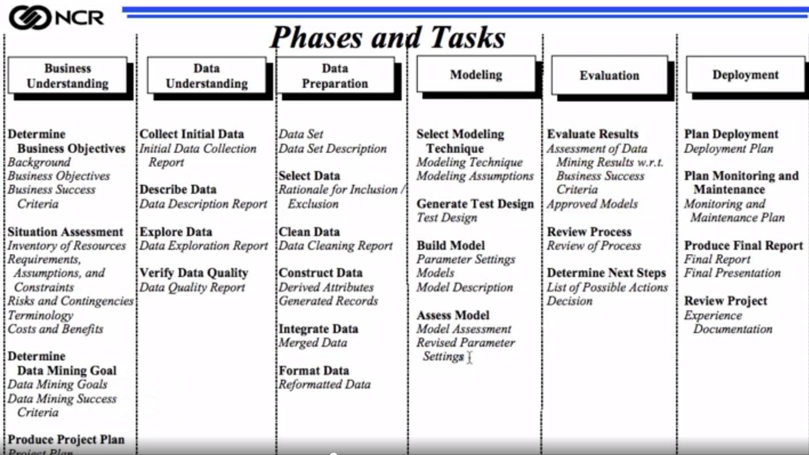
Model Assessment

Slide 10
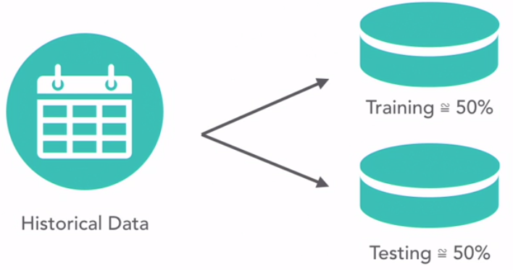
Developing Model
Develop Model on Training Data
Check Model performance on Test Data
After doing many iteration, tests, technical measures (accuracy, RoI) Current/Final Data

Slide 11
Model Performance Analysis What Model says about Data
Lift Charts:
Gain Tables: Sometime s/w can generate this table
Confusing Matrix: Model is making error, Assessing model performance

Slide 12
Algorithm 1
Linear Discriminate Analysis: Be strong in Statistics ‘Regression’ concepts
It helps in Complex/Multi-Categories/Dimension data
When data is with TWO categories/2-Dimen:
We need Min 01-Functions
For two categories, we prepare a single dedicated function
When data is with Three categories/3-Dimen:
We need Min 02-Functions
For two categories, we prepare a single dedicated function
For third category, we prepare another dedicated function
Notes:
Regression related:
Discriminate Analysis,
Binary Logistic regression
ML-Algorithms (Course: Clustering & Association)
Decision tree,KNN

Slide 13
Algorithm 2
Decision Tree a technique:
Its implementation are with different algorithms
K-Nearest Neighbors:
“Lazy” Learner
Neighbors of a person in Titanic ship
Support Vector Machine (SVM): Very accurate, popular
Neural Network (NN) / Deep learning:
Multimedia, all input is being used, backward propagation
Bayesian Network (BN): Combining probabilities
Ensemble: Various models exists, you extract another final model or an average model. However, your target is to have “most confident” model.

