Slide 1

Git
What?
Why?
How?
source_control

Slide 2

Github
What?
Why?
How?
remote_git_service

Slide 3
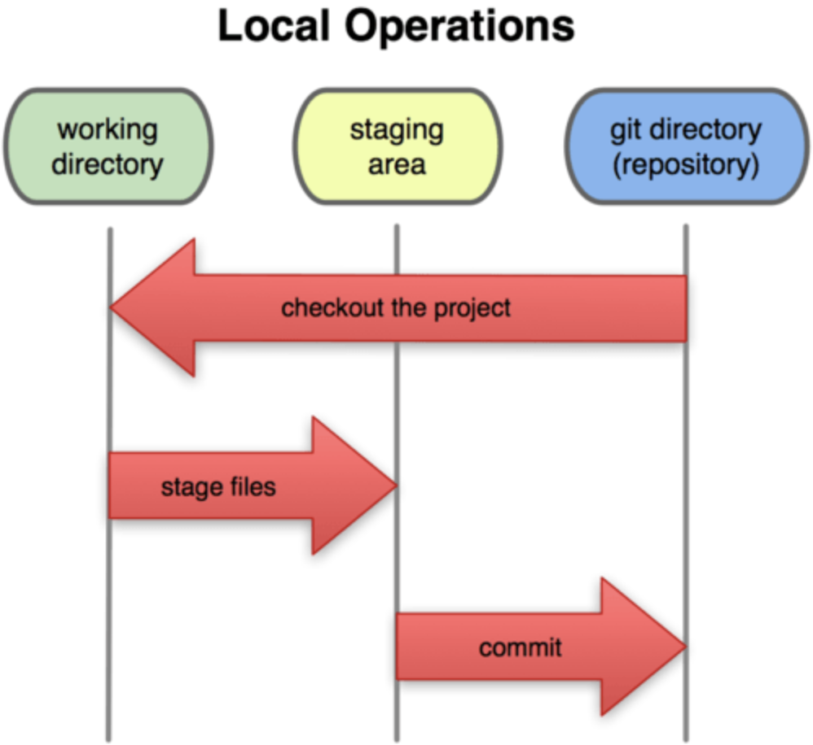
Concepts

Slide 4
Basic Commands
Git init/clone
Git status
Git log
Git add
Git remove
Git commit
Git push
Git fetch
Git merge
Git pull

Slide 5
Branching & Merging
Branch
Checkout
List/info
Merge

Slide 6
Good Workflows
Pull workflow
Push workflow
Production Pulls
Clean working directories
DO NOT FORCE PUSH ;(
Pull before push, rather fetch before commit

Slide 7
Helpful tips/tricks
Config
Alias
Git Remote/Info
Git reverts/resets

Slide 8
Next Session?
Advanced Topics include:
Merge conflicts
Stashing
Pretty logs
Git incoming/outgoing
Git ACL control
Git Hooks
Git Tags
Git Rebase
SSH vs HTTPS
Git repo types

