Slide 1
Understanding the Factors for Accident Severity
Team 233: Nathan Rugge, Robert King, Anna Lan, and Kareem Naguib​​

Slide 2
Introduction
First responders are called to the scene of an accident based on the description provided by the 911caller. After classifying the incident, first responders are dispatched, and the scene is managed to restore the roadways as safely and quickly as possible.
Operators face the challenge of inaccurate reports and overload from multiple callers.
Transportation agencies have different criteria for determining the accident severity and its categorization.
Traffic severity is a key component used across agencies for determining the classification of the incident – this impacts the response, traffic control planning, resource optimization, and operational improvements.

Slide 3
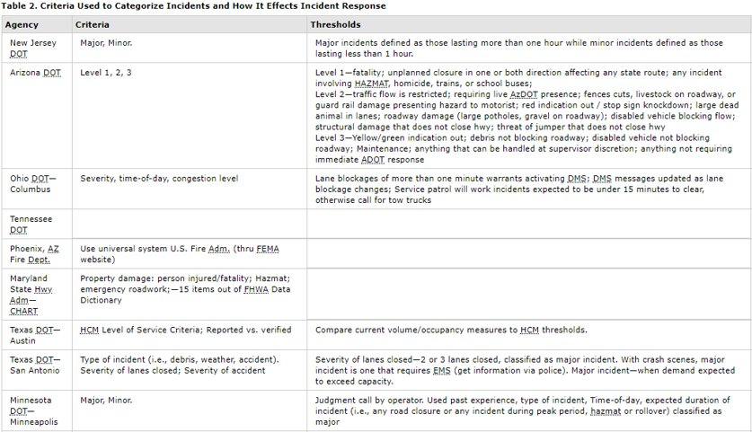
How is Severity Determined Today?
Kevin Balke, David Fenmo, and Brooke Ullman. 2017. Criteria Usd to Categorize Incidents and How It Effects Incident Response [table]. US DOT Federal Highway Administration. https://ops.fhwa.dot.gov/eto_tim_pse/docs/incident_mgmt_perf/section3.htm#table2

Slide 4
Project Overview
Our project intends to provide a tool that will help people understand and explore the factors of accident severity on traffic. The tool will -
Predict severity will be based on immediately available information including time of day, weather conditions, and similar accidents in the area, as well as using features unique to the location itself (e.g., whether there is an amenity, railway, roundabout or even speed bump nearby).
Provide interactive visualization for users to compare different scenario.

Slide 5
Project Benefits
The impact of our study should provide benefits to first responders, transportation agencies, roadway designers and GPS developers and users alike, to mention a few.
Stakeholder | Potential Improvement | Measurement
First Responders | Response decisions | - Response time - Site cleanup times
Transportation Agencies | Planning and resource optimization
Roadway Designers | Identification of accident-prone locations | Relative accident frequencies post construction
GPS Developers | Estimating delays for routing | change in accuracy of delay estimates

Slide 6
Project Management
Our project risks primarily consist of inability to discover new findings that would bring benefits to our stakeholders⁶.
The project team has identified free dataset(s) and will be able to conduct the analysis with minimal or no cost via leveraging team members computing resources and open source software packages⁷.

Slide 7
Project Timeline
The project timeline will run over six weeks between 28 February 2020 and 17 April 2020 with milestones expected to be completed as follows⁸.
28 February - Project Proposal submitted.
13 March - Exploratory Data Analysis completed and results reviewed by team members ; analysis methodology chosen and assigned.
27 March - Analysis completed and results reviewed by team members; Final Report sections assigned.
17 April - Final Report completed and submitted.
It is expected that there may be instances of rework or shifts in the analysis trajectory based on findings during the analysis. Success at each of the milestones will be measured by completion of each interim deliverable, with results shared with all team members⁹. It is expected that responsibility for all deliverables will be shared equally by team members, but ownership of specific items may be assigned as the project progresses.

Slide 8
Related Work
Useful
Somewhat useful
Not useful
Human Factors
Summary:
High degree of accuracy using neural networks to understand human factors impact to severities of accidents occurring on the highways of Tehran, Iran.
Factors of PTSD symptoms following severe injuries sustained in accidents.
Potential use and shortcomings:
Limited use for project Driver-specific characteristics and actions led to higher severities – these data points will not be available to first responders.
Project will take into consideration other factors that resulted in the accident that caused these injuries.
Roadway Design
Summary:
Findings dialed in on road design, safety treatment and improvements.
Model accident frequencies and severity (in one study)
Identify sections of the roadway that were prone to accidents.
Potential use and shortcomings:
Some of the findings were based on limited data – our project may expand or provide additional support for their findings.
Useful approach on model selection and predictors for our project.
Project will be using a much larger data set and predict severity.
Feature Selection and Model Performance
Summary:
Comparison of various models to predict accident severity.
Potential use and shortcomings:
Approach and variables could be leveraged; provides a model framework to explore.
Some of the model accuracy fell off substantially as severity increased.
Project will focus on understanding the factors for accident severity; potentially identify additional relevant predictors due to larger dataset.

Slide 9
Related Work: Human Factor
Useful
Somewhat useful
Not useful
Moghaddam et al [2] trained artificial neural networks to understand drivers of severities of accidents occurring on the highways of Tehran, Iran. Their study had a high degree of accuracy but noted many driver-specific characteristics and actions that led to higher severities. These data points would not be available for first responders, a focus of our study.
Schnyder et al [5] dug into drivers of PTSD symptoms following severe injuries sustained in accidents. It is not useful for our project, as it did not include any information on outside factors that resulted in the accident that caused these injuries. While accident-related injuries are related to our study, our focus is on using readily available information to predict traffic delays from accidents.

Slide 10
Related Work: Roadway Design
Useful
Somewhat useful
Not useful
Beshah and Hill [3] studied accident severities in Ethiopia, using a variety of classification models including decision trees, naive Bayes, and KNN. Their findings dialed in on road design, but seemed very limited in terms of data they were able to source. It likely will not be useful for our project, which should be able to deliver a more meaningful output given the additional data available to us.
Ma et al [7] took a novel approach to modeling accident frequencies, which led to recommendations for safety treatment and design of highways. Knowledge of the types of road design associated with higher accident rates will benefit our analysis, and we intend to take this a step further to understand the impact these have on severities, as well as uncovering additional drivers.
Ratanavaraha and Suangka [11] modeled severities of accidents occurring on highways in Thailand. Their main finding was that an increase in speed led to an increase in accident severity. Speed should be a valuable predictor in our model as well, but we expect to find more than just one variable associated with accident severities.
Wang et al [9] combined accident frequency and severity models to identify sections of roadway that were prone to accidents, ranking their results by monetary cost of accidents by location. This study will be beneficial to our project, as the general approach and variables considered should also be valuable and predictive in our analysis. Its scope was fairly limited, looking at 12,254 accidents in the London vicinity. Our study will be much larger in scale.
Abbas [13] studied causes of accidents occurring in Egypt, with a goal of recommending improvements to lower their overall frequency. Abbas specifically tested whether his data could be combined, or if each roadway needed to be studied separately. He found the former to be the case, which is useful for our project. We will improve on his findings by going beyond accident counts to prediction of severities, giving our results more practical applications.

Slide 11
Related Work: Model Performance
Useful
Somewhat useful
Not useful
Garrido et al [4] looked at factors impacting the severity of injury in accidents in Portugal. Their study is useful for our project and notes some predictors and a methodology that we can start with in our analysis. The main shortcoming of their study was a limited dataset of just 4,528 records, which could easily lead to overfitting issues and unjustified extrapolation. Our dataset includes millions of records, providing a significantly more credible base.
Zong et al [6] used an automobile accident dataset to determine which model worked better for predicting severities, the Bayesian network or regression models, ultimately finding the former to be superior. This finding is useful for our study and can help guide our selection of models to use. Our study will improve upon this by using a far bigger dataset, as well as identifying drivers of accident severity, as opposed to only looking at which modeling approach produces better results.
Al-Ghamdi [8] took a binary view to studying accident severities, limiting his analysis to comparing fatal versus non-fatal accidents using logistic regression. His approach is not going to be useful for our project, as we intend to consider more than two possible outcomes. Further, he had access to just 9 independent variables to consider, limiting his scope considerably compared to what we should be able to achieve.
Alkheder et al [10] used an artificial neural network to predict accident severities in Abu Dhabi using 4 severity groupings: Minor, Moderate, Severe, and Death. While their approach and variables considered could be leverage for our project, their model accuracy fell off substantially as accident severity increased. The additional data available for our study should lead to much higher levels of accuracy.
Sameen and Pradhan [12] improved on previous artificial neural network models for predicting accident severity by leveraging recurrent neural networks, which are more effective when your data is sequential. This result could be useful for our project, insofar as providing a model framework to explore. The focus of this paper was more about finding the right model for predicting severities as opposed to the predictions themselves. We expect our model will provide more valuable insight and potential social benefit with a focus on identifying drivers that could be mitigated.

Slide 12
References
US Accidents: A Countrywide Traffic Accident Dataset (2016-2019)
https://www.kaggle.com/sobhanmoosavi/us-accidents
Additional citations for dataset:
Moosavi, Sobhan, Mohammad Hossein Samavatian, Srinivasan Parthasarathy, and Rajiv Ramnath. “A Countrywide Traffic Accident Dataset.”, 2019. (https://arxiv.org/abs/1906.05409)
Moosavi, Sobhan, Mohammad Hossein Samavatian, Srinivasan Parthasarathy, Radu Teodorescu, and Rajiv Ramnath. “Accident Risk Prediction based on Heterogeneous Sparse Data: New Dataset and Insights.” In proceedings of the 27th ACM SIGSPATIAL International Conference on Advances in Geographic Information Systems, ACM, 2019. (https://arxiv.org/abs/1909.09638)
Rezaie Moghaddam F, Afandizadeh S, Ziyadi M. “Prediction of accident severity using artificial neural networks.” IJCE. 2011; 9 (1) :41-48 (http://ijce.iust.ac.ir/article-1-544-en.html)
Tibebe Beshah, Shawndra Hill. “Mining Road Traffic Accident Data to Improve Safety: Role of Road-Related Factors on Accident Severity in Ethiopia.” AAAI Spring Symposium Series (2010) (https://www.aaai.org/ocs/index.php/SSS/SSS10/paper/viewPaper/1173)
Rui Garrido, Ana Bastos, Ana de Almeida, Jose Paulo Elvas. “Prediction of road accident severity using the ordered probit model.” (https://www.sciencedirect.com/science/article/pii/S2352146514002701)
Ulrich Schnyder, M.D.; Hanspeter Moergeli, M.A., M.Sc.; Richard Klaghofer, Ph.D.; and Claus Buddeberg, M.D. “Incidence and Prediction of Posttraumatic Stress Disorder Symptoms in Severely Injured Accident Victims.” (https://ajp.psychiatryonline.org/doi/full/10.1176/appi.ajp.158.4.594)
Fang Zong, Hongguo Xu, and Huiyong Zhang. “Prediction for Traffic Accident Severity: Comparing the Bayesian Network and Regression Models.” (https://www.hindawi.com/journals/mpe/2013/475194/)

Slide 13
References Cont’d
Jianming Ma, Kara Kockelman, Paul Damien. “A Multivariate Poisson-Lognormal Regression Model for Prediction of Crash Counts by Severity, using Bayesian Methods.” (https://www.caee.utexas.edu/prof/kockelman/public_html/TRB07MVPLN.pdf)
Ali S Al-Ghamdi. “Using logistic regression to estimate the influence of accident factors on accident severity.” (https://www.sciencedirect.com/science/article/abs/pii/S0001457501000732)
Chao Wang, Mohammed A Quddus, Stephen G Ison. “Predicting accident frequency at their severity levels and its application in site ranking using a two-stage mixed multivariate model.” (https://www.sciencedirect.com/science/article/abs/pii/S0001457511001357)
Sharaf Alkheder, Madhar Taamneh, Salah Taamneh. “Severity Prediction of Traffic Accident Using an Artificial Neural Network.” (https://onlinelibrary.wiley.com/doi/abs/10.1002/for.2425)
Vatanavongs Ratanavaraha, Sonnarong Suangka. “Impacts of accident severity factors and loss values of crashes on expressways in Thailand.” (https://www.sciencedirect.com/science/article/pii/S038611121300023X)
Maher Ibrahim Sameen, Biswajeet Pradhan. “Severity Prediction of Traffic Accidents with Recurrent Neural Networks.” (https://www.mdpi.com/2076-3417/7/6/476)
Khaled A Abbas. “Traffic safety assessment and development of predictive models for accidents on rural roads in Egypt.” (https://www.sciencedirect.com/science/article/abs/pii/S0001457502001458)

