Slide 1
Blockchain in a nutshell
Blockchain …
“is a distributed ledger technology, eliminating the need for trusted third parties
“reduces integration complexity and the need for intermediation whilst increasing efficiency
“Smart contracts running on the Blockchain drastically reduce risk of errors and fraud
“Is immutable and creates an automatic audit trail
“Offers disruptive business challenges and opportunities, across every industry
Key Benefits…
“”Reduces settlement time from days to near instantaneous
“Removes overhead and cost intermediaries
“Reduces risk of collusion and tampering
“Increases trust through shared processes and record keeping
“eliminates fraud
“reduces integration complexity and the need for intermediation whilst increasing efficiency

Slide 2
Hyperledger Fabric Blockchain...Permissioned Blockchain
Hyperledger Fabric is a blockchain framework implementation hosted by The Linux Foundation
Is a trusted distributed ledger technology, eliminating the need for trusted third parties
Capabilities includes Consensus,Provenance,Immutability and Finality.
Permissioned networks, where all participants have known identities
Hyperledger has open governance
Hyperledger Fabric is fully open source – no missing components
Hyperledger has a large, diverse developer community
Hyperledger Fabric is modular and resilient
159 engineers from 28 organizations contributed to project to advance open blockchain products and services
Hyperledger holds the distinction as the fastest growing. 200+ Corporate and Associate Member Organization
** Boeing Prefered HyperLedger as Blockchain Platform
https://blokt.com/news/boeing-is-scaling-out-their-blockchain-team-and-probably-building-on-hyperledger

Slide 3
Boeing Use Case
Use Case Background:
Boeing has different subsidiareis companies to run its business in different geographies and different business sector(e.g.Boeing capital,Boeing commercial vehicle(BCA),Boeing defence,space & security(BDS)) .So its critical to verify employee certification ,subsidiary change time to time. Maintaining employee information and information sync with other subsidiary comapnies are huge and complex task ,chances of dispute and non-transparency in the current system. Boeing designs, manufactures, and sells airplanes, rotorcraft, rockets, satellites, and missiles worldwide so it always need to maintain correct information of the employee and right skilled engineer deployed to right kind of project to ensure great customer satisfaction.
Blockchain shared ledger and consensus mechanism can be used to address business challanges in verifying employee certification between boeing subsidiaries companies.All boeing subsidiaries will share the shared ledger with each other and will be updated only subsidiary on the blockchain approve the information of the employee.There can be smart contract in place to auto-trigger notification to Boeing if any unskilled empoyee deployed to project.

Slide 4
Boeing Subsidiaries
Three main boeig divisions are :-
Boeing Capital(BC)
Boeing Commercial Airplanes (BCA)
Boeing Defense, Space & Security (BDS)
Boeing divided its business in below subsidiaries-
Boeing Aircraft Holding Company
Boeing Australia
Boeing Canada
Boeing Capital Corporation
Boeing Commercial Space Company
Boeing Defence UK
Boeing Intelligence & Analytics

Slide 5


Boeing Employee Information Sharing BC Solution
What
There is no reliable source for the Boeing to check employee information, Boeing has different subsidiareis companies to run its business in different geographies and different business sector(e.g.Boeing capital,Boeing commercial vehicle(BCA),Boeing defence,space & security(BDS)) .So its critical to verify employee certification ,subsidiary change time to time .Maintaining employee information sync with other subsidiary comapnies is huge and complex task ,chances of dispute and non-transparency in the current system.
How
Blockchain distributed shared ledger will insure all the records in sync between the subsidiary companies for an employee. The consensus mechanism will help to reduce the dispute between the parties. It will help to reduce the cost in audit as all the employee information udpate transaction history will be kept in the blockchain database(as Blocks). The customer trust will increase, as the data once register in blockchain cannot be change.

Slide 6
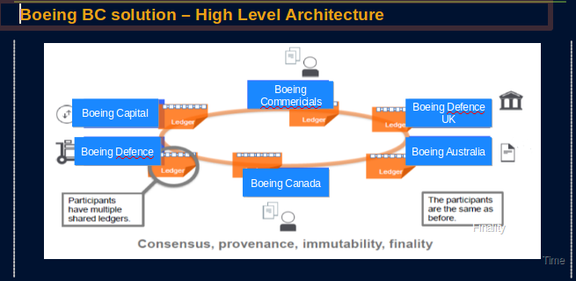
Solution Achitecture

Slide 7
Architecture Overview
HTML / ANGULARJS →
Web UI
REST API
NodeJS →
Business App Back-End
SDK / REST API
Contract API
Blockchain API
Certifcates API
HyperLedger Fabric
‘read’
‘write’
Ledger State
User Enrollment
Chaincode
← Go
block
txn
txn
…
txn
Development / Deployment Infrastructure
Bluemix / Local Server →
Customized for Application
HyperLedger Fabric V1.2

Slide 8
Benefits with Blockchain Technology
Ensure trusted record-keeping
By design, nobody can modify, delete, or even append any record to the ledger without the consensus from others subsidiary company on the network, making the system useful for ensuring the immutability of contracts and other legal documents, and reduce risk of tampering, fraud.
Trust & Transparency
All participants share one ledger, and each employee information update transaction is transparent across the Boeing subsidiary companies.
Cost-saving
Remove the cost of overheads and intermediaries in maintaning employee information across the Boeing subsidiary companies.
Gain Customer faith
- Employee information shared and immutable ,it will increase the trust and transparency in the system.

Slide 9
Boeing Use case examples
https://www.altoros.com/blog/boeing-improves-operations-with-blockchain-and-the-internet-of-things/
https://www.coindesk.com/boeing-proposes-blockchain-based-gps-backup-use-case/
https://www.ainonline.com/aviation-news/business-aviation/2018-02-04/beyond-hype-blockchain-and-its- Applications-business-aviation
https://blokt.com/news/boeing-is-scaling-out-their-blockchain-team-and-probably-building-on-hyperledger

