Slide 1




Terra-Audit
Institute of Information Technology
University of Dhaka
terra-audit.vercel.app
SE801 · SOFTWARE PROJECT LAB 3 · FINAL DEFENSE
Signal analytics · Sentinel-1 AWD detection
AI-Assisted Digital MRV Platform for AWD Rice Irrigation and Agricultural Land Management Carbon Credits
PRESENTED BY
Kazi Nahid
BSSE Roll 1437
SUPERVISED BY
Dr. Emon Kumar Dey
Professor, IIT, DU
DATE
October 2026
Final defense
2 AWD drydowns
→ 2.12 tCO₂e / ha
Verra VM0051 · VM0042
Notes:
[0:15 · builds automatically] Good morning. I'm Kazi Nahid; my project is Terra-Audit — a platform that turns a rice field into an auditable carbon claim, with every number traceable to its evidence.

Slide 2






Flooded rice emits methane — and AWD reductions are hard to prove
INTRODUCTION
SYSTEM
DESIGN
CODE & TESTS
REFLECTION
METHANE EMISSION FACTOR
Practice claims are hard to verify
Farmer irrigation logs are incomplete; sensors on every smallholder plot are too costly.
1.00 → 0.55
Alternate Wetting & Drying (AWD) — draining the field at least twice per season — cuts the daily methane factor by 45% versus continuous flooding.
Evidence gets separated from the number
Spreadsheets lose the factors, methodology version and history behind a result.
Verification needs traceability
Verifiers and buyers must trace each tonne of CO₂e back to its evidence.
IPCC 2019 Table 5.12, used by Verra VM0051
Terra-Audit · SE801 Final Presentation
2
Notes:
[0:35] Flooded paddies are a major methane source. AWD is a proven fix — the IPCC factor drops from 1.00 to 0.55. [click] The problem is MRV: proving the practice happened, and keeping the carbon number traceable to evidence.

Slide 3


Terra-Audit links every carbon number to its evidence
INTRODUCTION
SYSTEM
DESIGN
CODE & TESTS
REFLECTION
An evidence-first digital MRV platform — from field boundary to a verifier-ready MRV report.
1
2
3
4
5
6
7
Register field
Seasons & evidence
Satellite analytics
Readiness check
Calculate & commit
Internal review
MRV report
draw / upload boundary
practices · files
background job
per requirement
frozen snapshot
approve / changes
PDF + evidence ZIP
Rice — Alternate Wetting & Drying
Verra VM0051 v1.1
Satellite-detected drydowns cut methane; 15% QA3 uncertainty and the N₂O penalty are deducted.
Agricultural Land Management
Verra VM0042 v2.2 + VMD0054 v1.1
Measured soil-carbon change plus N₂O, fire and fuel terms, minus leakage and a non-permanence buffer; missing leakage evidence blocks the result.
Terra-Audit · SE801 Final Presentation
3
Notes:
[0:40] One sentence: an evidence pipeline, not a black-box calculator. [click] Seven steps — the highlighted ones, satellite analytics and the calculation, are the two engines I'll open up next. [click] Two Verra methodologies implemented in deterministic code: rice AWD and agricultural land management.

Slide 4
Sentinel-1 radar detects AWD drydowns without field sensors
INTRODUCTION
SYSTEM
DESIGN
CODE & TESTS
REFLECTION
Flooded
VV z-score below −0.8
Drydown
VV rises > 1.2σ right after a flooded date
Season
VH minimum = sowing; sharpest VH drop after the peak = harvest
Result fed to the calculation
2 AWD events · 84-day season
Live run on the deployed app · Sentinel-1 via Google Earth Engine · 12 observations, Jan–May 2026 · rule engine: AdaptiveAWDGate
Terra-Audit · SE801 Final Presentation
4
Notes:
[0:45] Radar sees through monsoon clouds. [click] The chart draws: flooded fields reflect less, so VV drops; when the field drains, VV jumps. [click] The three rules — below −0.8 is flooded; a jump right after a flooded date is a drydown; VH gives sowing and harvest. This live run found two drydowns and an 84-day season.

Slide 5
A model trained on real AWD plots cross-checks the detector
INTRODUCTION
SYSTEM
DESIGN
CODE & TESTS
REFLECTION
AWD practice model
Random forest · Sentinel-1 radar + Satellite Embedding · Microsoft rice-irrigation-mapping (Punjab)
Why add ML?
Rules are explainable but brittle. A model trained on independently labelled AWD plots checks each field's drydown result from a second angle.
64 / 90
AWD plots correctly identified
on unseen held-out test plots
72.7%
AWD precision
71.1%
AWD recall
0.719
AWD F1
0.754
ROC-AUC (AWD score)
Honest limitation
Labels come from Punjab, not Bangladesh, and the model is right on about 71% of unseen plots. It stays advisory — it flags disagreement and never changes a calculation.
863
plots labelled by irrigation practice
688 / 172
train / held-out test split
Every field
run on its Signal Analytics window
→
→
AI Validation page · data: microsoft/rice-irrigation-mapping-s1s2 · 172 held-out plots (90 AWD) · repeated 5×5 cross-validation 66.3% ± 4.2%
Terra-Audit · SE801 Final Presentation
5
Notes:
[0:30] [click] Two models cross-check the rule engine: 75% and 69% agreement. [click] And I say upfront what this is not — there's no independent field ground truth yet, so these are agreement scores and ML stays advisory.

Slide 6
A deterministic VM0051 engine turns evidence into tCO₂e
INTRODUCTION
SYSTEM
DESIGN
CODE & TESTS
REFLECTION
E = EFc × SFw × SFp × SFo × days × area
Worked example
1 ha · 84 days · 2 drydowns · 100 kg N/ha
ΔCH₄ = Ebaseline − Eproject
Baseline CH₄
205.5 kg
ΔCO₂e = ΔCH₄ × 28 ÷ 1000
Project CH₄
113.0 kg
ER = ΔCO₂e × (1 − 15%) − PEN₂O
Avoided CH₄
92.5 kg
VM0051 Eq. 6–8, 29 (QA3) · EFc = 0.85 kg CH₄/ha/day (IPCC 2019, South Asia) · GWP CH₄ = 28 (AR5)
As CO₂e
2.59 t
− 15% uncertainty
− 0.39 t
WATER-REGIME FACTOR SFw — WHERE AWD'S BENEFIT COMES FROM
− N₂O penalty
− 0.08 t
1.00
0.71
0.55
2.12 tCO₂e
Net reduction
Continuous flooding
0 drydowns
Single aeration
1 drydown
True AWD
≥ 2 drydowns
Above 60,000 tCO₂e/yr the engine blocks instead of guessing.
Worked example computed by CarbonAssetEngine.calculate_credits() (src/carbon/rice.py)
Terra-Audit · SE801 Final Presentation
6
Notes:
[0:45] Plain deterministic code, not AI. [click] The four lines appear in order: emissions, the difference, CO2e, and the net reduction. [click] The 0.55 factor — two or more drydowns — is where AWD's benefit comes from. [click] Worked example: one hectare, 84 days, two drydowns gives 2.12 tonnes CO2e, computed by the engine itself.

Slide 7


Readiness gates never let an unsupported requirement pass silently
INTRODUCTION
SYSTEM
DESIGN
CODE & TESTS
REFLECTION
Readiness checklist — VM0051 field
AT COMMIT, THE SYSTEM FREEZES
Field boundary & area
satisfied
common.monitoring_period_coverage
Crop seasons cover the monitoring period
Crop seasons & engine inputs
needs review
common.methodology_applicability
Declared crop outside usual scope — reviewer confirms
Methodology bundle & factors
common.evidence_review_status
Field observations not yet accepted by a second person
Readiness result
needs review
vm0051.required_measurement_inputs
AWD events and season length not yet supplied
INTERNAL REVIEW
missing
submitted
unsupported
vm0051.leakage_assessment
Not implemented — stays blocking
in_review
unsupported
vm0051.n2o_baseline_fertilizer
Not implemented — shown to the verifier, never hidden
internally_approved
1 satisfied
3 needs review
1 missing
3 unsupported
or changes requested / rejected / withdrawn
Example readiness run on the deployed app (6 of 8 checks shown) · internal approval is not VVB verification or Verra issuance
Terra-Audit · SE801 Final Presentation
7
Notes:
[0:40] [click] Every methodology requirement gets an explicit state. The bottom two — leakage and additionality — are unsupported and stay blocking: the system tells you what it cannot check. [click] At commit everything is frozen into a snapshot so the number is reproducible, then it goes through internal review.

Slide 8
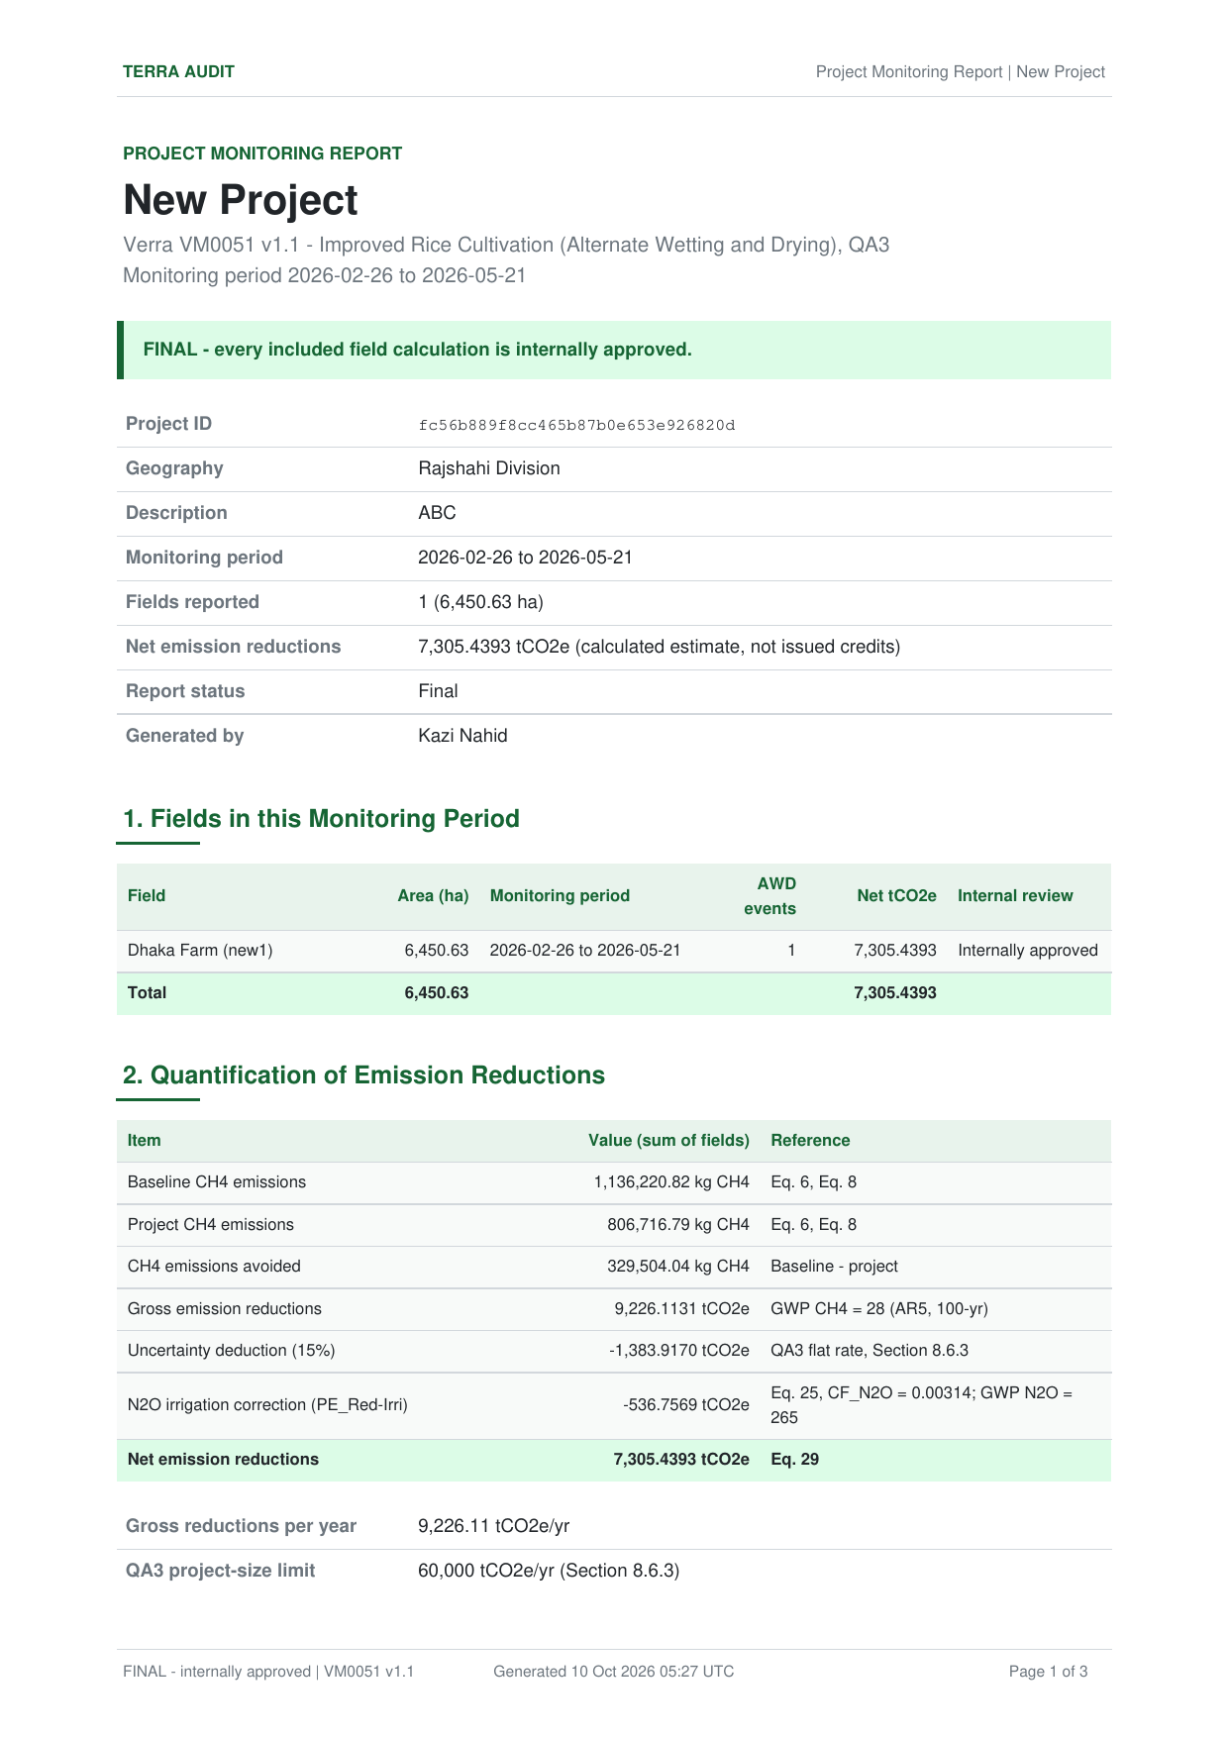
Internal review turns a calculation into a verifier-ready MRV report
INTRODUCTION
SYSTEM
DESIGN
CODE & TESTS
REFLECTION
Nothing reaches the report unreviewed — and everything in it can be checked.
1
2
3
4
5
6
7
Save calculation
Submit for review
Reviewer checks
Decision
Project MRV report
Evidence package
Verifier (VVB)
frozen snapshot
lead / contributor
findings · diff
approve / changes
final when approved
ZIP · SHA-256
validation & verification
REAL OUTPUT
Page 1 of the project report — FINAL once every field is approved.
Project MRV report (PDF)
VM0051 monitoring-report structure
All fields summed, QA3 checked per year, QA/QC trail, requirements, project documents and sign-off.
Evidence package (ZIP)
Everything a verifier needs, hashed
Field reports, frozen snapshots, Sentinel-1 results, documents and a SHA-256 manifest of every file.
Terra-Audit · SE801 Final Presentation
8

Slide 9

AI explains, code calculates, humans approve
INTRODUCTION
SYSTEM
DESIGN
CODE & TESTS
REFLECTION
AUTHORITATIVE · DETERMINISTIC
Project & evidence
Data validation
VM0051 / VM0042 engine
Results & readiness
ADVISORY · AI
Satellite, ML & crop models
Bundle-scoped context packet
LLM provider
Output validator
Draft explanation
Bounded context
AI only sees the active methodology bundle, evidence and calculation.
Validated output
Citations must exist and numbers must match; “certified” or “approved” claims are rejected.
Fail closed
One retry, then fail — nothing partial is saved.
Human reviewer
No AI component can change a calculated value, mark a requirement compliant, or create registry credits
Terra-Audit · SE801 Final Presentation
9
Notes:
[0:30] [click] The top lane is deterministic and authoritative — it owns every number. [click] The bottom lane is AI: bounded context, an LLM, and a validator; the output is only a draft for a human reviewer. [click] Three guardrails — test case TC-06 proves the validator.

Slide 10
Layered components, deployed as web, API and worker
INTRODUCTION
SYSTEM
DESIGN
CODE & TESTS
REFLECTION
COMPONENT LAYERS
DEPLOYMENT
Next.js
Browser
HTTPS
Vercel
Next.js 16 · React 19
Railway
Docker · FastAPI
Web app
API proxy
FastAPI
Routers & schemas
JWT · roles
Database
SQLite · PostgreSQL*
Evidence files
local · S3-compatible*
Python worker
durable job queue
Domain (src/)
Evidence
Methodology
Carbon
Signals & AI
Google Earth Engine
Sentinel-1
LLM providers
Groq / OpenAI-compatible
Persistence
SQL · private files
Durable jobs
queue · worker
External
Earth Engine · LLMs
Solid = verified in the recorded run · dashed = configured external service · * supported hosted option
DESIGN EVOLUTION
midterm → final
Streamlit monolith → Next.js + FastAPI
Request-coupled jobs → Durable queue + worker
Scalar results → Versioned snapshots
Deployment as recorded in the final report (§5.5) · production worker and storage provenance not yet verified end to end
Terra-Audit · SE801 Final Presentation
10
Notes:
[0:35] [click] Three layers: Next.js talks to FastAPI through an authenticated proxy; FastAPI enforces roles; domain logic lives in shared components. [click] Deployed on Vercel and Railway, with a separate worker for long satellite and AI jobs. [click] And how it evolved from the midterm Streamlit prototype.

Slide 11

Design classes, persistent data and behaviour
INTRODUCTION
SYSTEM
DESIGN
CODE & TESTS
REFLECTION
KEY DESIGN CLASSES & MODULES
PERSISTENT DATA (50+ TABLES)
BEHAVIOUR (STATE MACHINES)
AdaptiveAWDGate
analyze_irrigation_behavior()
extract_phenology()
SpatialDataEngine
extract_clean_timeseries()
Sentinel-1 via Earth Engine
Identity
organizations · users · project_members
Calculation version
draft
ready_for_review
Fields & evidence
fields · crop_seasons · practice_events · attachments
decided by blocking readiness items
CarbonAssetEngine
calculate_credits()
VM0051 rice AWD
AlmCarbonEngine
calculate_credits()
VM0042 + VMD0054 leakage
superseded
Methodology
methodology_bundles · methodology_requirements · readiness_determinations
new evidence → new version
methodology.readiness
build_readiness_checklist()
per-requirement states
carbon.snapshot
build_snapshot()
calculate_from_snapshot()
Background job
Calculation & review
calculations · review_submissions · findings
pending
running
done
or error (retry / invalid) · cancel_requested → cancelled · heartbeat-monitored workers
WorkerContext · jobs
create_job()
claim_next_job()
AttachmentStorage
LocalFilesystemStorage
S3Storage (strategy)
Jobs & AI
background_jobs · workers · ai_records
Names as in the source code (src/, backend/worker.py) · review states shown on the readiness slide · full ER model in the report (§4)
Terra-Audit · SE801 Final Presentation
11
Notes:
[0:40] Component-level design. [click] The key classes and modules with their main operations — each maps to one responsibility, and storage is a strategy: local filesystem or S3. [click] Over fifty tables, grouped by domain. [click] Behaviour: a calculation is draft or ready-for-review depending on blocking readiness items, and is superseded, never edited; jobs move pending → running → done, with cancellation and retries.

Slide 12



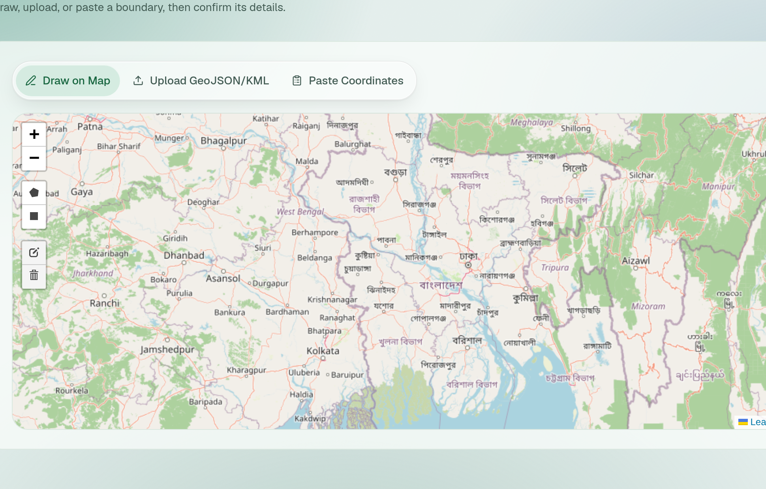
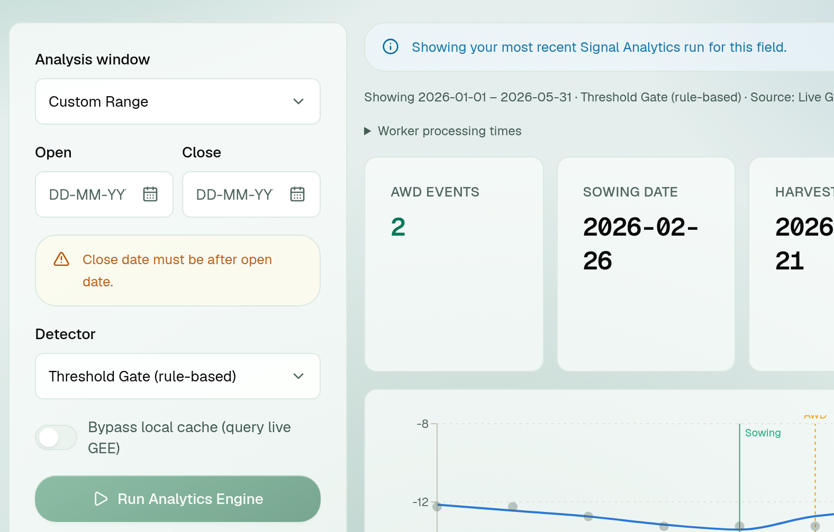
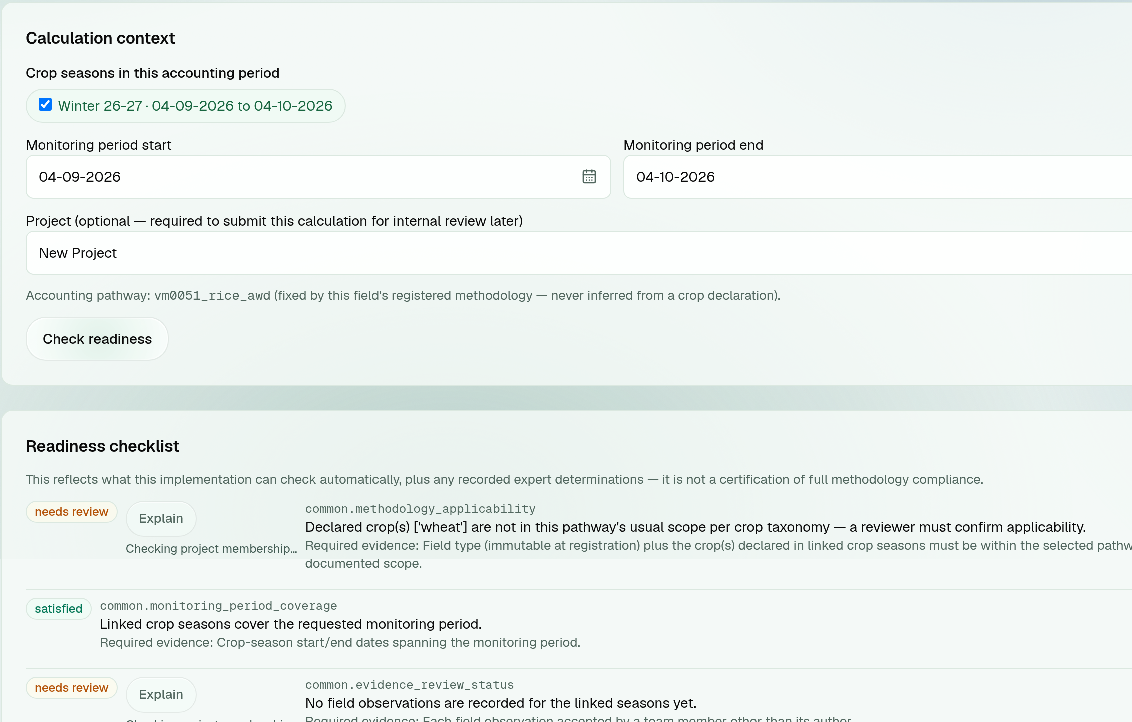
Interface design: every user action has a visible state
INTRODUCTION
SYSTEM
DESIGN
CODE & TESTS
REFLECTION
Register a field
Signal analytics
Calculation & readiness
OBJECTS
map canvas · input-mode tabs
OBJECTS
analysis window · detector · Run
OBJECTS
seasons · period · Check readiness
ACTION
draw / upload GeoJSON-KML / paste
EVENT
close < open → inline error
EVENT
Check readiness → checklist
STATE
boundary → confirm details → field saved
STATE
job pending → results + audit trail
STATE
Commit → draft / ready_for_review
Shared labelled controls · inline validation · text + colour status cues · DD-MM-YYYY dates · keyboard-aware controls · responsive layouts
Terra-Audit · SE801 Final Presentation
12
Notes:
[0:35] Interface design as the user sees it. [click] Registering a field: three input modes, the map previews the boundary and area. [click] Signal analytics: validation is inline — here an invalid date range — and running the engine creates a background job. [click] Calculation: Check readiness renders the checklist; commit freezes a version.

Slide 13
Code: the AWD rule engine produces an auditable trail
INTRODUCTION
SYSTEM
DESIGN
CODE & TESTS
REFLECTION
Date | VV z-score | Flooded | Drydown
09 Jan | 1.023
21 Jan | 0.441
02 Feb | -0.140
14 Feb | -0.942 | ✓
26 Feb | -1.440 | ✓
10 Mar | -0.111 |  | ✓
22 Mar | 0.390
03 Apr | -0.606
15 Apr | -1.326 | ✓
27 Apr | -0.083 |  | ✓
09 May | 0.857
21 May | 1.936
src/signals/threshold_gate.py · AdaptiveAWDGate (excerpt)
# Field-level statistical baseline
vv_mean = df["vv_smoothed"].mean()
vv_std = df["vv_smoothed"].std()
if vv_std == 0 or np.isnan(vv_std):
vv_std = 0.1 # Prevent division by zero on flat test data
# Z-score flood state detection
df["vv_zscore"] = (df["vv_smoothed"] - vv_mean) / vv_std
df["is_flooded"] = np.where(
df["vv_zscore"] < self.z_flood_threshold, 1, 0)
# Drydown event = sharp positive jump following a flooded state
df["vv_diff"] = df["vv_smoothed"].diff().fillna(0)
threshold_jump = self.dynamic_delta_sigma * vv_std
df["drydown_event"] = np.where(
(df["vv_diff"] > threshold_jump)
& (df["is_flooded"].shift(1) == 1), 1, 0)
Left: the columns this code produces, from the live run (audit-trail table in the app) · z_flood_threshold = −0.8, dynamic_delta_sigma = 1.2
Terra-Audit · SE801 Final Presentation
13
Notes:
[0:35 · no builds] Code review. Highlighted lines are the two rules. The table on the left is exactly what this code outputs for the live field — z-score, flooded flag and drydown flag — so a reviewer can verify each event by hand.

Slide 14
Code: the credit engine blocks instead of guessing — and a test proves it
INTRODUCTION
SYSTEM
DESIGN
CODE & TESTS
REFLECTION
src/carbon/rice.py · calculate_credits() (condensed)
tests/test_carbon_calculator.py
# Baseline vs project CH4 (Eq. 6/8)
e_baseline = self.ef_c * 1.0 * sc_p * sc_o_bsl * days * area_ha
e_project = self.ef_c * sf_w_project * sc_p * sc_o_wp * days * area_ha
delta_e_co2e = (e_baseline - e_project) * self.gwp_ch4 / 1000.0
# QA3 project-size gate (§8.6.3)
if delta_e_co2e > self.QA3_PROJECT_SIZE_GATE_TCO2E_YR:
return {"qa3_pathway_valid": False,
"final_issuance": None, ...}
# 15% uncertainty, N2O penalty (Eq. 25), net (Eq. 29)
ch4_after_unc = delta_e_co2e * (1 - self.UNC_QA3_DEFAULT)
pe_n2o = (self._n2o_irrigation_penalty(q_n, area_ha)
if awd_events > 0 else 0.0)
final_issuance = max(0.0, ch4_after_unc - pe_n2o)
def test_qa3_project_size_gate_blocks_oversized_projects(
engine):
r = engine.calculate_credits(
awd_events=2, season_length_days=120,
area_ha=500_000.0, q_n_kg_per_ha=0.0)
assert r["qa3_pathway_valid"] is False
assert r["final_issuance"] is None
• Every factor is a named constant cited to its VM0051 / IPCC table
• All intermediate values are returned for the audit trail
• Snapshot calculation never re-reads the live database
Engine code condensed for the slide — full function in src/carbon/rice.py · test passes in the 184-test backend suite
Terra-Audit · SE801 Final Presentation
14
Notes:
[0:35 · no builds] The engine mirrors the equation slide. Highlighted: the QA3 gate — above 60,000 tonnes per year it returns None rather than a wrong number. On the right, the actual unit test proving it with a 500,000-hectare input.

Slide 15
184 backend tests pass — layered from equations to tenant isolation
INTRODUCTION
SYSTEM
DESIGN
CODE & TESTS
REFLECTION
184
4 / 4
✓
✓
0
backend tests
frontend tests
production build
type check
lint errors
0 failed · pytest
npm test
next build
TypeScript
ESLint
Unit / regression
equations · golden values · hard gates
API / integration
auth · tenant isolation · jobs · exports
Frontend
tests · types · lint · build
Operational
deployment · external services
Pass criterion
0 failures, no unjustified skips — and unsupported states must stay explicit, never silently satisfied.
Risks → contingency
No ground truth → ML advisory · unimplemented rules → blocking checks · live services → isolated fixtures.
All five checks re-run on the current code, 10 Oct 2026 · ESLint: 0 errors, 4 warnings
Terra-Audit · SE801 Final Presentation
15
Notes:
[0:30] 177 backend tests, zero failures — re-run this week — plus frontend tests, build, type check and lint. [click] Tests are layered so a green calculator can't hide a broken permission check. [click] Pass criteria and risks.

Slide 16
Key test cases prove gates, isolation and reproducibility
INTRODUCTION
SYSTEM
DESIGN
CODE & TESTS
REFLECTION
ID | Scenario | Expected | Observed | Result
TC-01 | QA3 size gate — 500,000 ha field | Reject above 60,000 tCO₂e/yr | qa3_pathway_valid = False, no issuance | PASS
TC-03 | Another organization reads a field | Cannot list or open it | empty list · direct GET → 404 | PASS
TC-04 | PDF after live evidence is edited | Built from the frozen snapshot | owner 200 · viewer 403 · other org 404 | PASS
TC-06 | AI output claims “certified” | Reject; one retry, then fail | validation error · nothing saved | PASS
Evidence: tests/test_carbon_calculator.py · tests/backend/test_fields_endpoints.py · test_evidence_verification.py · tests/test_ai_validate.py
Terra-Audit · SE801 Final Presentation
16
Notes:
[0:30 · no builds] Four cases, one per risk: the calculator refuses an invalid pathway, tenants are isolated, exports stay reproducible after edits, and AI cannot claim certification. All pass in the suite.

Slide 17




Challenges solved — and what remains
INTRODUCTION
SYSTEM
DESIGN
CODE & TESTS
REFLECTION
CHALLENGE → SOLUTION
STILL OPEN
Methodology fidelity
Factors cited to tables + golden-value tests — caught a wrong EF (1.4 → 0.85).
• VM0051 leakage not yet modelled
• No independent AWD ground truth
• AI evaluation set incomplete
• Production provenance unverified
Slow satellite & AI work
Durable job queue with a separate Python worker.
NEXT
• Field ground-truth campaign
• Eq. 38 uncertainty for large projects
• Remaining VM0051 terms
Numbers drifting after edits
Immutable snapshots; edits create a new version.
Software verification ≠ VVB verification ≠ Verra registration or issuance
Terra-Audit · SE801 Final Presentation
17
Notes:
[0:40] [click] Three hard problems and how I solved them — the emission-factor correction is the best story: code-level citations plus tests caught a value that inflated every result by about 1.65×. [click] Then state the limitations confidently — they are documented in the product itself, not hidden.

Slide 18


Thank you
Questions are welcome
Live app
GitHub
Live app terra-audit.vercel.app
Repository github.com/knah1d/terra-audit
Presenter Kazi Nahid · BSSE 1437
Supervisor Dr. Emon Kumar Dey, Professor, IIT, DU
Notes:
Leave this slide up during Q&A.

