Slide 1



INSTITUTE OF INFORMATION TECHNOLOGY • UNIVERSITY OF DHAKA
SE801 PROJECT MIDTERM REPORT
TERRA-AUDIT
AI-Assisted Digital MRV Platform for AWD Rice Irrigation and Agricultural Land Management Carbon Credits
SUBMITTED AS
SUBMITTED BY
SUPERVISED BY
Technical Report
SE801 Project Midterm Report
Kazi Nahid
BSSE Roll: 1437
Dr. Emon Kumar Dey
Professor, Institute of Information Technology
University of Dhaka
DATE OF PRESENTATION
2 August 2026
AGRICULTURAL MRV • SATELLITE EVIDENCE • TRANSPARENT ACCOUNTING
Notes:
Use the exact cover identity from the V3 report: Kazi Nahid, BSSE Roll 1437, supervised by Dr. Emon Kumar Dey, submitted 2 August 2026. Introduce Terra-Audit as an evidence-first agricultural MRV software project. Sentinel-1 supplies observations; the project contribution is field-specific processing, methodology calculation, persistence, and auditable reporting.

Slide 2
PROJECT OVERVIEW
Why agricultural carbon MRV is difficult
The obstacle is not data availability alone — it is trustworthy interpretation and evidence.
01
02
03
Unverifiable practice records
Expensive field hardware
Opaque calculations
Farmer logs are difficult for an auditor to verify consistently across many small plots.
Water-level sensors and repeated field visits are costly to deploy and maintain at scale.
Disconnected spreadsheets hide assumptions, intermediate values, and methodology constraints.
TERRA-AUDIT RESPONSE
Connect field evidence → methodology logic → auditor-ready outputs in one traceable workflow.
Output is an auditable estimate — not an issued Verra credit.
TERRA-AUDIT • SE801 MIDTERM
2
Notes:
Explain that raw satellite observations and methodology PDFs already exist, but they do not form a usable MRV workflow by themselves. The engineering contribution is converting evidence into a field-specific, reproducible calculation with limitations disclosed. Do not claim formal verification or issuance.

Slide 3
PROJECT OVERVIEW
One platform, two agricultural methodology paths
Shared field registry, persistence, evidence exports and portfolio; methodology-specific inputs remain separate.
RICE AWD • VM0051
CROPLAND ALM • VM0042
Satellite evidence path
Practice and soil path
Boundary and monitoring window
Baseline and project schedules
Sentinel-1 VV/VH observations
Lab-measured SOC samples
Flooded-state and drydown gate
Yield, fuel and livestock inputs
VM0051 QA3 / Tier 1 defaults
Scoped VM0042 quantification
PDF • JSON • time-series CSV
PDF • JSON • practice/SOC CSV
Architecture rule: share infrastructure — never silently share methodology assumptions.
Notes:
Start with the routing decision. Rice uses SAR-derived evidence; cropland ALM uses practice schedules and SOC measurements. Both paths share field identity, persistence, reporting, calculation history and portfolio aggregation.

Slide 4
REQUIREMENTS
Eighteen functional requirements — grouped for the defense
FR1–FR18 are organized into six capability groups for readability.
FR1–2, 12, 17
FIELD & ROUTING
FR3–5
RICE EVIDENCE
Register geometry • choose methodology • select/delete • edit field metadata
Retrieve/cache Sentinel-1 • smooth and detect AWD • infer season dates
FR6, 13–14
ALM EVIDENCE
FR7–8
ACCOUNTING
Practice/SOC schedules • livestock inputs • production-decline leakage screen
VM0051 QA3 calculation • scoped VM0042 calculation and deductions
FR9–10
AI ASSISTANCE
FR11, 15–16, 18
AUDITABILITY
Optional RF/XGBoost detector • validation dashboard and fallback
PDF/JSON/CSV evidence • history • portfolio • export completeness disclosure
NFR focus: traceability • cache-first reliability • local prototype security disclosure • maintainable field-type registry.
Notes:
Do not read all eighteen requirements. Explain the six capability groups and give one example from each. State that FR18 is not fully complete because the current CSV does not include livestock data; PDF and JSON remain the complete audit formats.

Slide 5
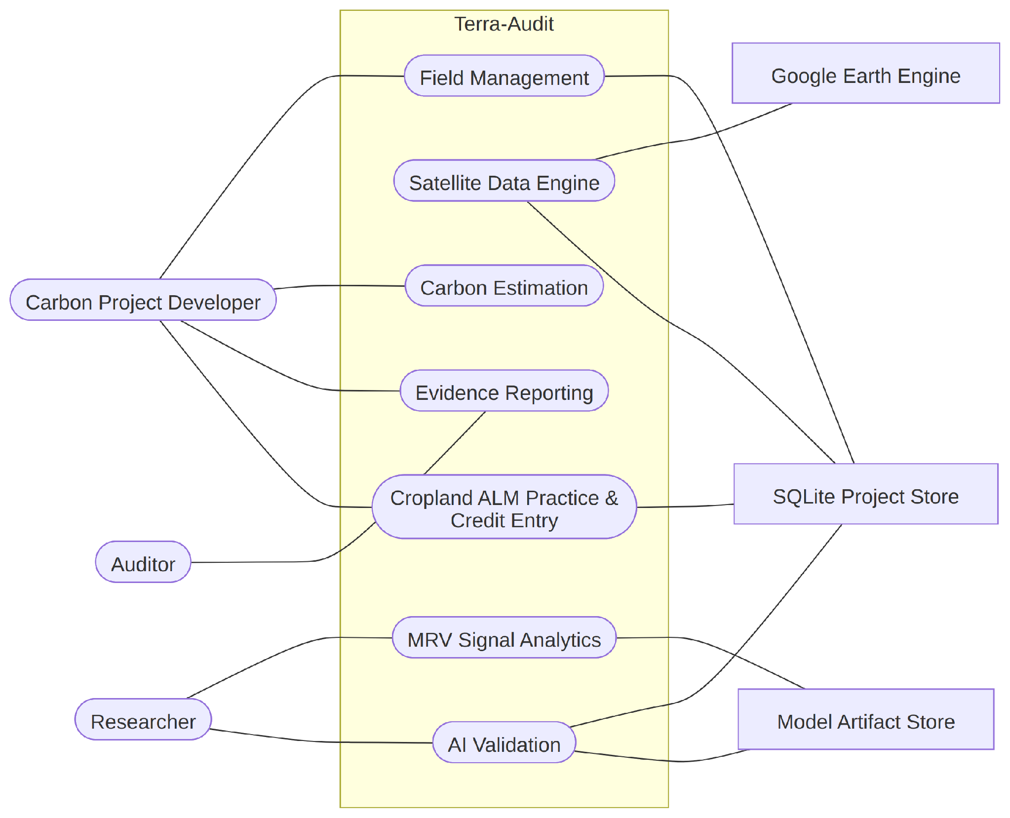
SYSTEM MODELING
Use case diagram — complete system scope
Level-1 view of actors, system capabilities and supporting services.
Actors
Project developer, researcher and auditor use different parts of the workflow.
External service
Earth Engine supplies observations; it does not perform Terra-Audit accounting.
Method split
Rice and cropland evidence paths converge at calculation and reporting.
Level-1 use case diagram
Open complete diagram
Notes:
Walk from the actors to field management, evidence collection, analysis, methodology calculation and reporting. Point out that the system supports two field types without merging their evidence assumptions.

Slide 6
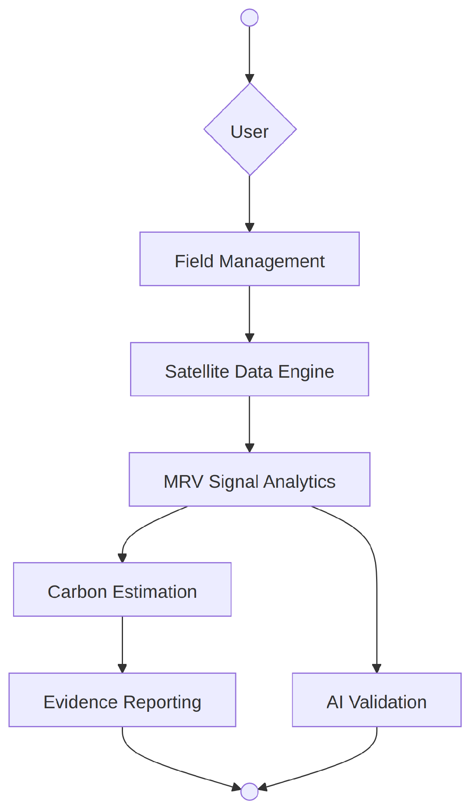
SYSTEM MODELING
Activity diagram — end-to-end control flow
Top-level flow from field selection to evidence export.
Start
Register or select a field and validate its geometry.
Branch
Route by field type to SAR analytics or practice/SOC validation.
Finish
Calculate, disclose limitations and export evidence.
Top-level activity flow
Open complete diagram
Notes:
Explain the happy path first. Then point out that validation failures, missing evidence and methodology constraints are visible outcomes rather than hidden exceptions.

Slide 7
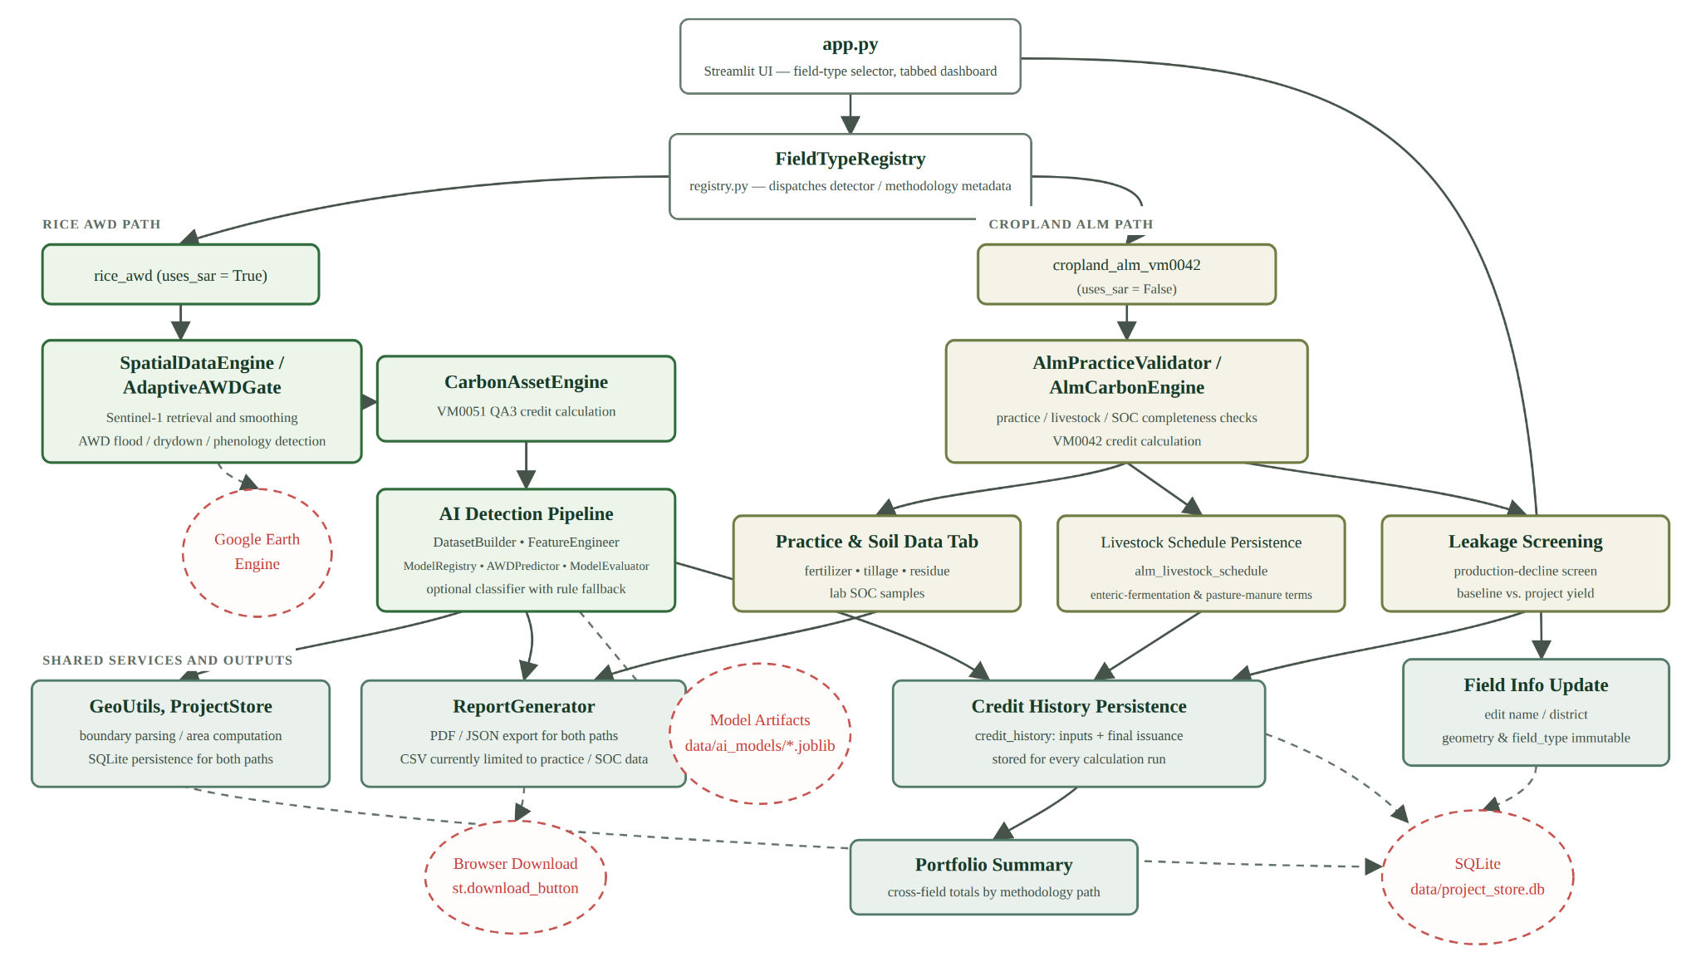
SOFTWARE DESIGN
Component architecture — extensible by field type
Notes:
This is the strongest software-engineering slide. Explain the registry dispatch: field type selects the correct evidence processor and methodology engine while reporting and persistence stay shared.

Slide 8
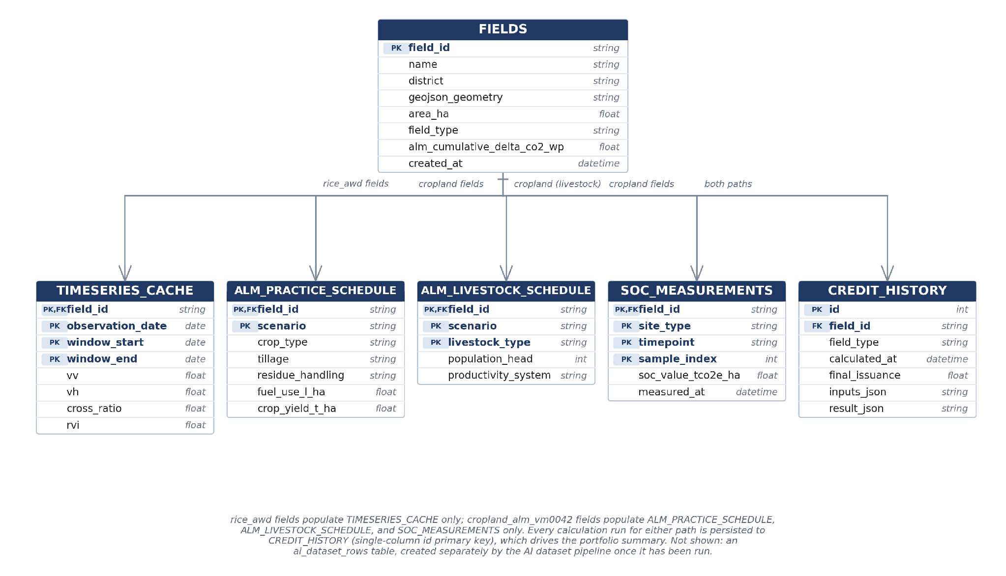
DATA MODELING
ER diagram — evidence remains linked to each field
Core entities preserve field identity, evidence provenance and calculation history.
Stable identity
field_id connects methodology evidence and calculation history.
Window-safe cache
Rice observations are keyed by field and monitoring window.
Audit history
Prior calculation runs remain available for inspection.
Entity relationship diagram
Open complete diagram
Notes:
Explain why this is not just storage. The schema keeps evidence tied to a field and preserves previous calculations. Rice time series, ALM schedules, SOC samples and livestock records remain separate because their provenance differs.

Slide 9
PROTOTYPE WALKTHROUGH
Defense roadmap — show the project as one evidence chain
The next slides use real screenshots from the running local application.
01
02
03
04
05
06
07
REGISTER
COLLECT
VALIDATE
CALCULATE
EXPLAIN
EXPORT
REVIEW
Boundary + field type
SAR or ALM evidence
Rules + optional AI
VM0051 / VM0042
Audit trail + warnings
PDF • JSON • CSV
History + portfolio
Presentation rule: for every screen, explain the user action, the software work, and the evidence or limitation produced.
Notes:
Use this slide to orient the teacher. The demo is not a tour of buttons. It is an evidence chain: create a spatial asset, collect methodology-specific evidence, validate it, calculate, expose the audit trail, export and review at portfolio level.

Slide 10
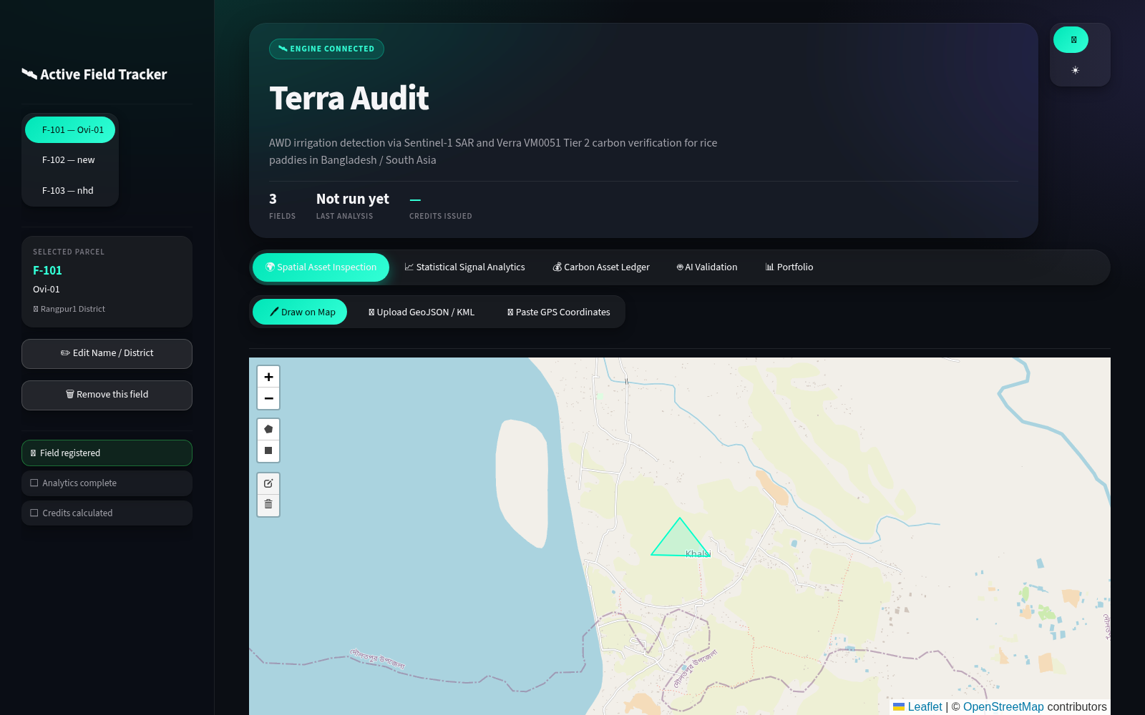
PROTOTYPE WALKTHROUGH
STEP 1 • SHARED
Register and select a field
The sidebar is the persistent project registry and the starting point for either methodology.
Real application screen — field registry and selected field
USER ACTION
Choose an existing field or start registration.
SYSTEM WORK
Load geometry, metadata, field type and stored evidence by field_id.
Notes:
Show the registered fields and select one. Explain that field_type is more than a label: the registry uses it to route the user to rice AWD or cropland ALM components.

Slide 11
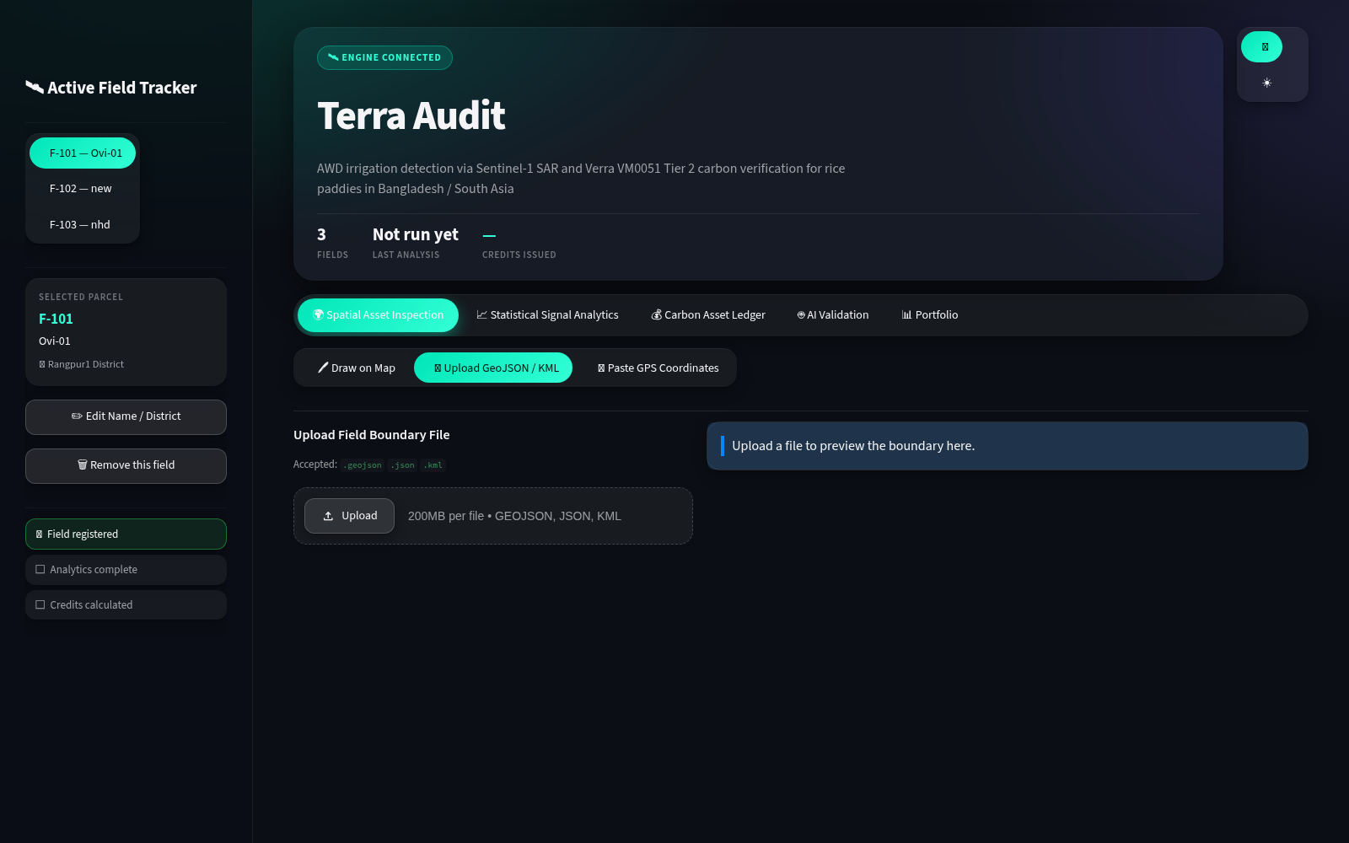
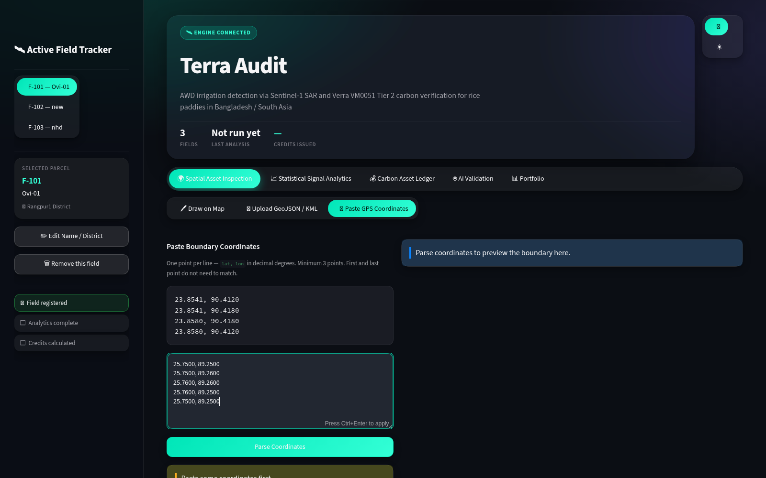
PROTOTYPE WALKTHROUGH
STEP 2 • SHARED
Create a valid spatial boundary
Terra-Audit supports file upload and direct coordinate input; geometry is validated before persistence.
Upload GeoJSON / KML
Paste coordinates and preview the polygon
USER ACTION
Upload a boundary or paste latitude/longitude pairs.
SYSTEM WORK
Parse safely, validate the polygon and compute area before save.
Notes:
Explain that this is your work, not Sentinel output. Terra-Audit accepts several boundary formats, handles malformed input without crashing, calculates area and persists the spatial asset used by later evidence retrieval.

Slide 12
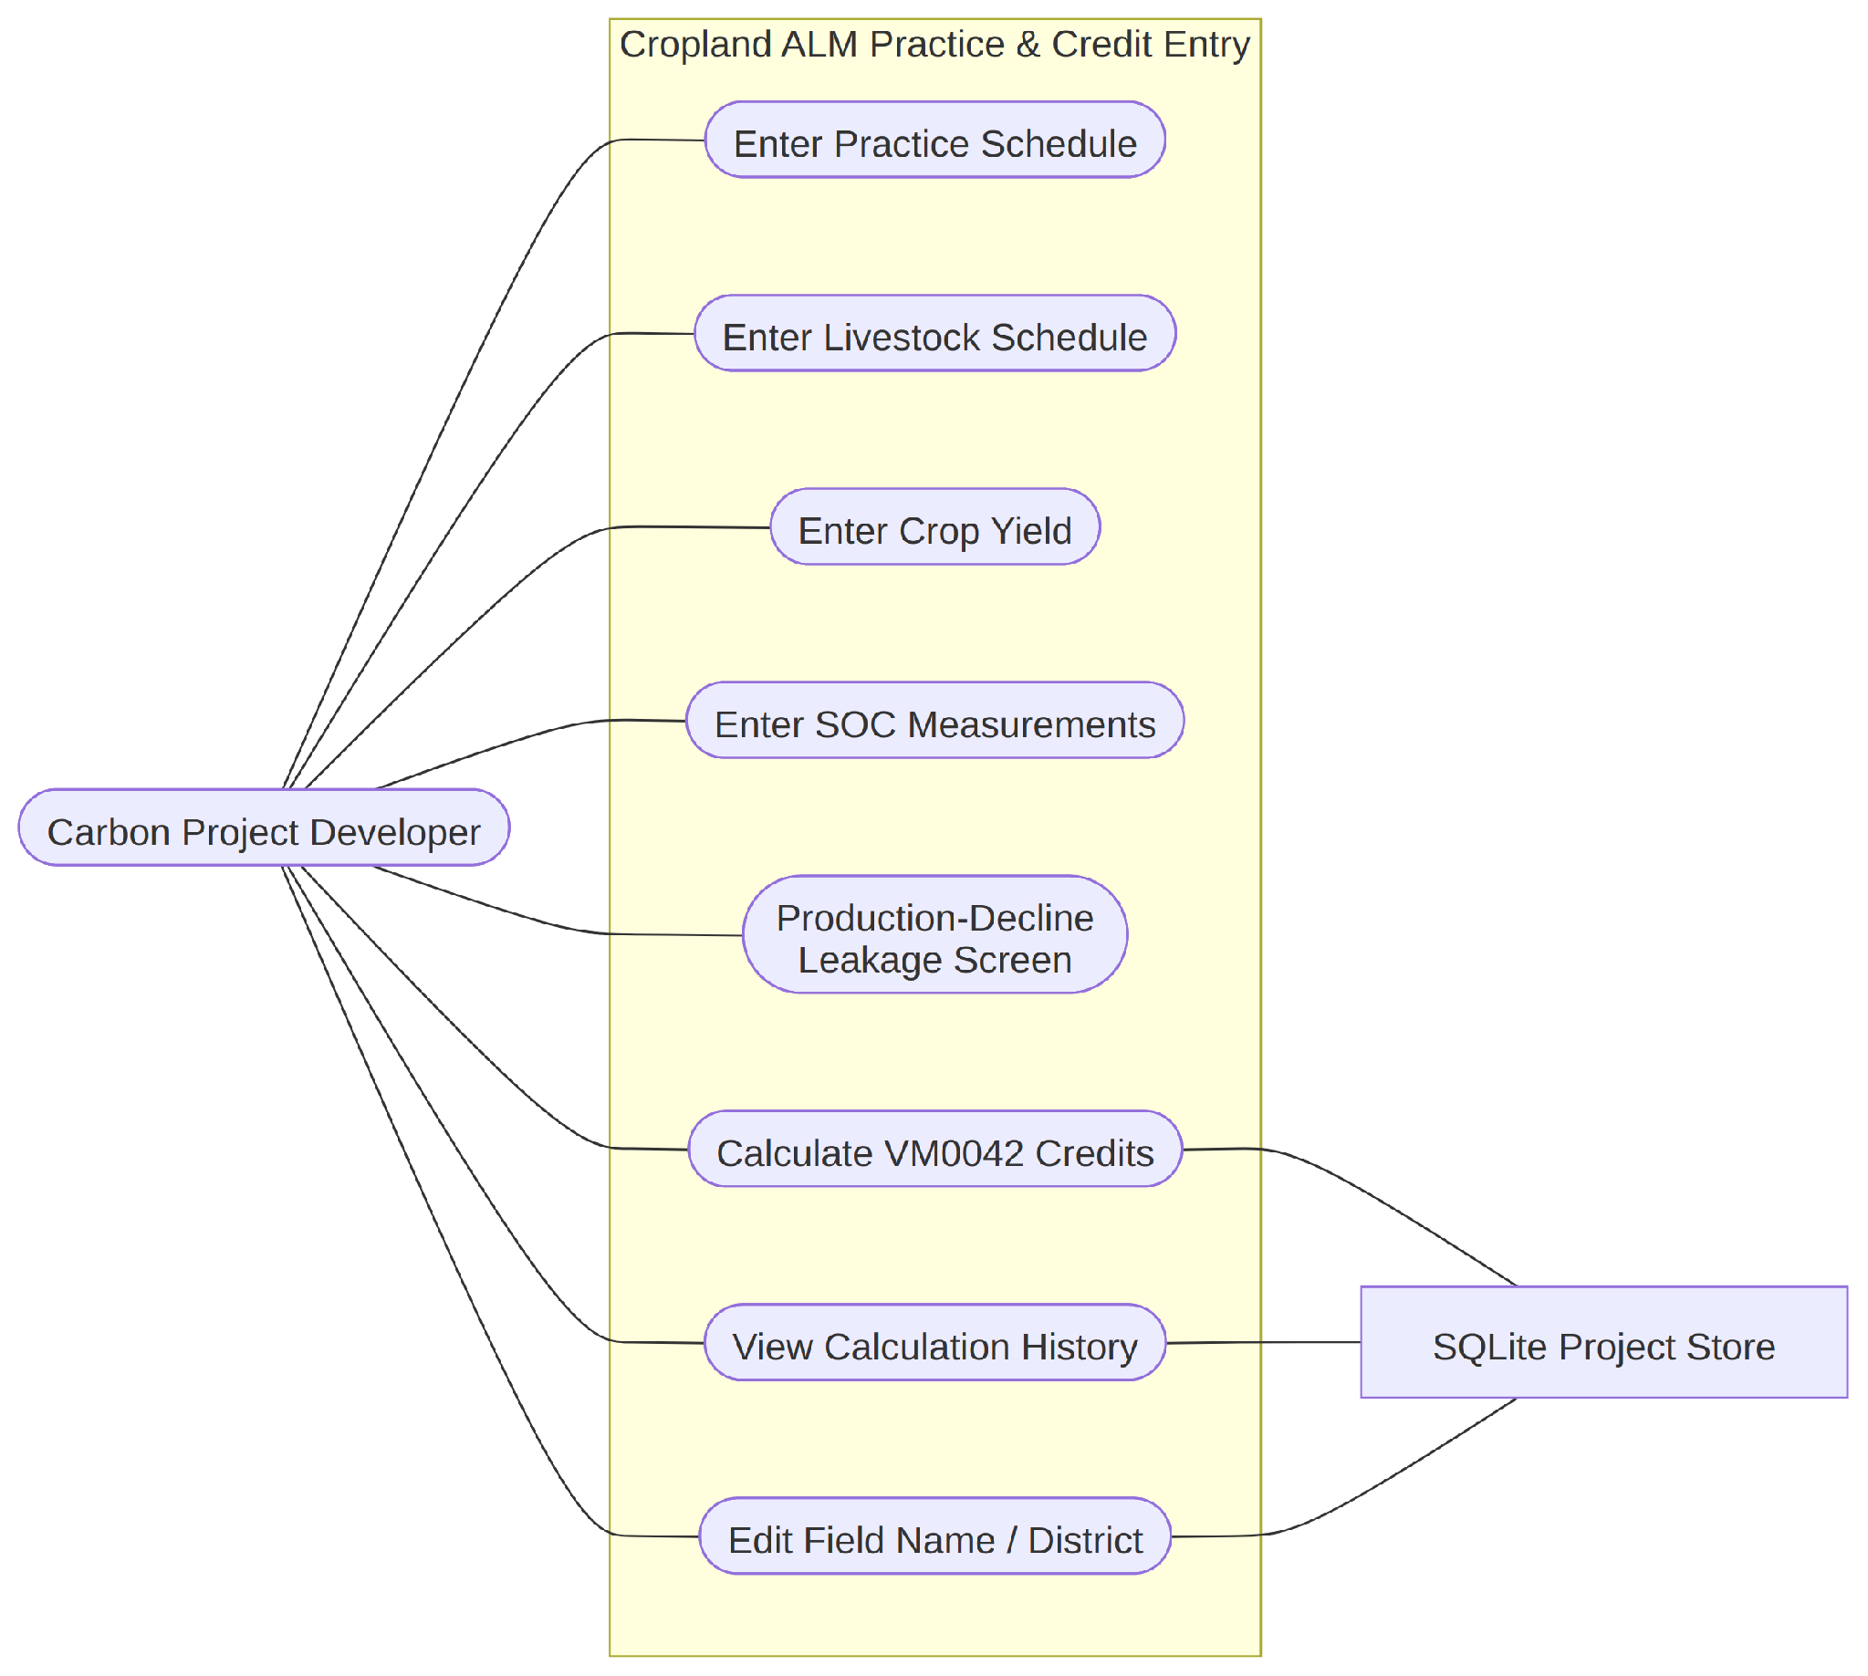
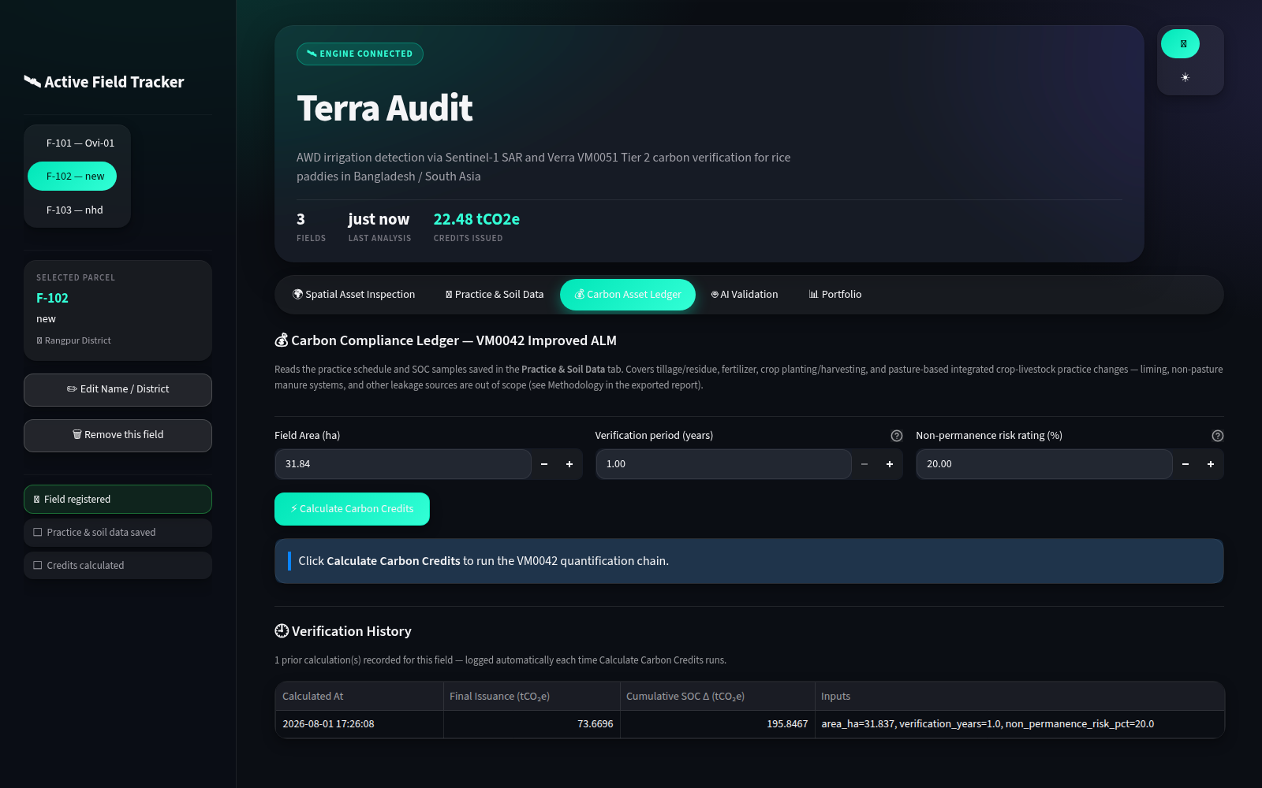
PROTOTYPE WALKTHROUGH
STEP 3 • CROPLAND
Route the workflow by agricultural project type
Selecting Cropland ALM changes the available evidence and calculation components.
Real UI — Cropland ALM field selected
Cropland ALM use case
USER ACTION
Select rice_awd or cropland_alm_vm0042 during registration.
SYSTEM WORK
Dispatch the correct tabs, validators, engine and report content.
Notes:
Use this slide to explain the extensibility contribution. The same application hosts two methodology paths, but it does not pretend that Sentinel-1 is evidence for cropland SOC accounting.

Slide 13
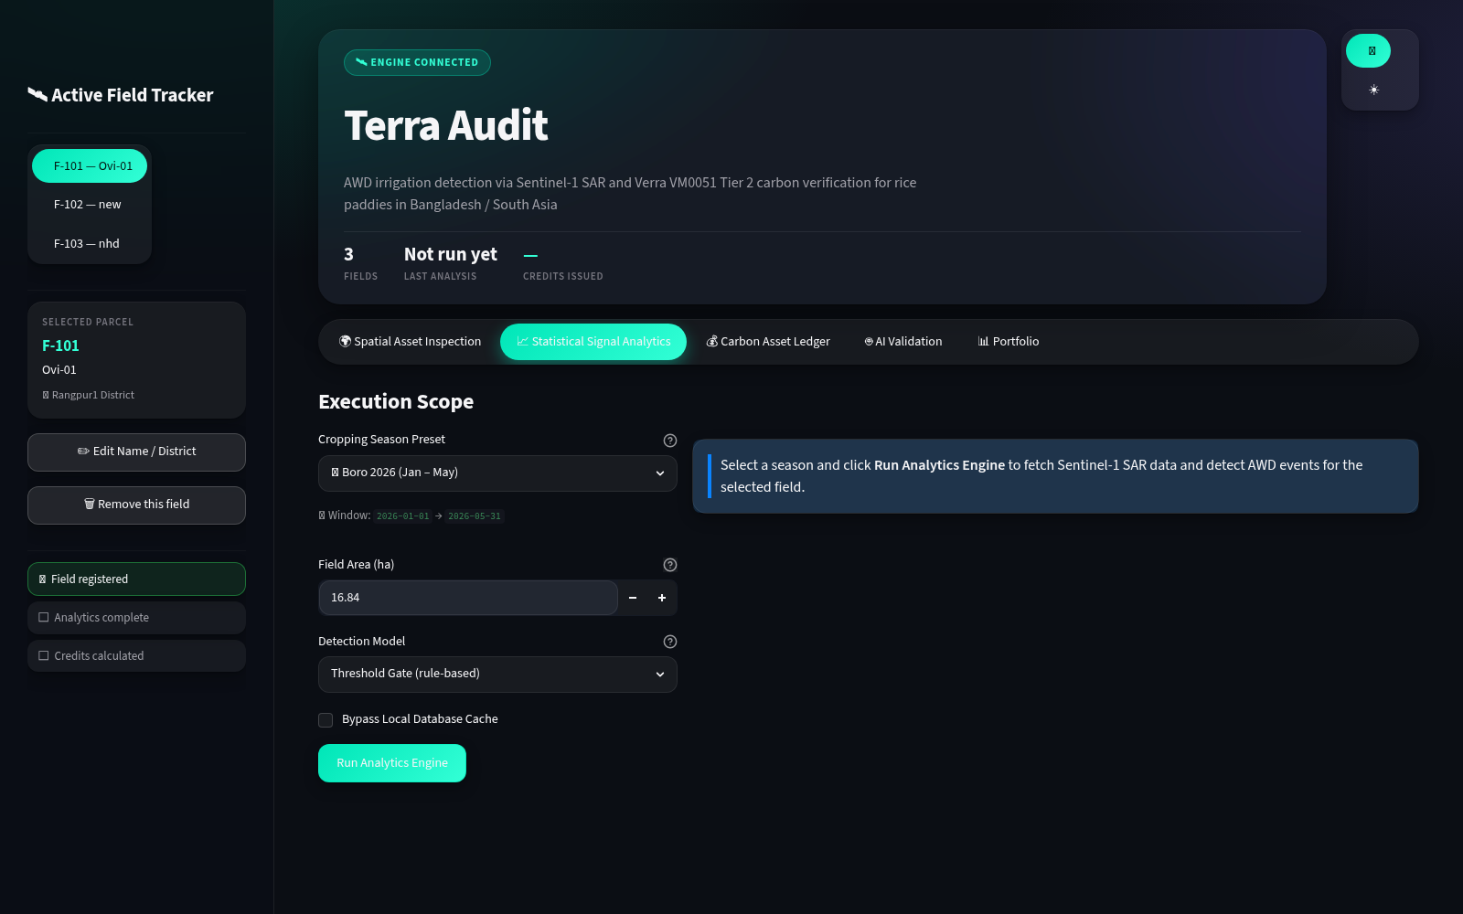
PROTOTYPE WALKTHROUGH
STEP 4 • RICE
Define the rice monitoring window
The execution scope is explicit so cached observations remain reproducible.
Real application screen — selected field and monitoring window
USER ACTION
Select dates and run the signal analytics workflow.
SYSTEM WORK
Check SQLite first; call Earth Engine only on a cache miss.
Notes:
Explain the cache-first design. It makes repeated demonstrations reliable, reduces external calls and keeps each field/window data set separate. Sentinel supplies VV/VH observations; Terra-Audit controls spatial extraction, windowing and persistence.

Slide 14
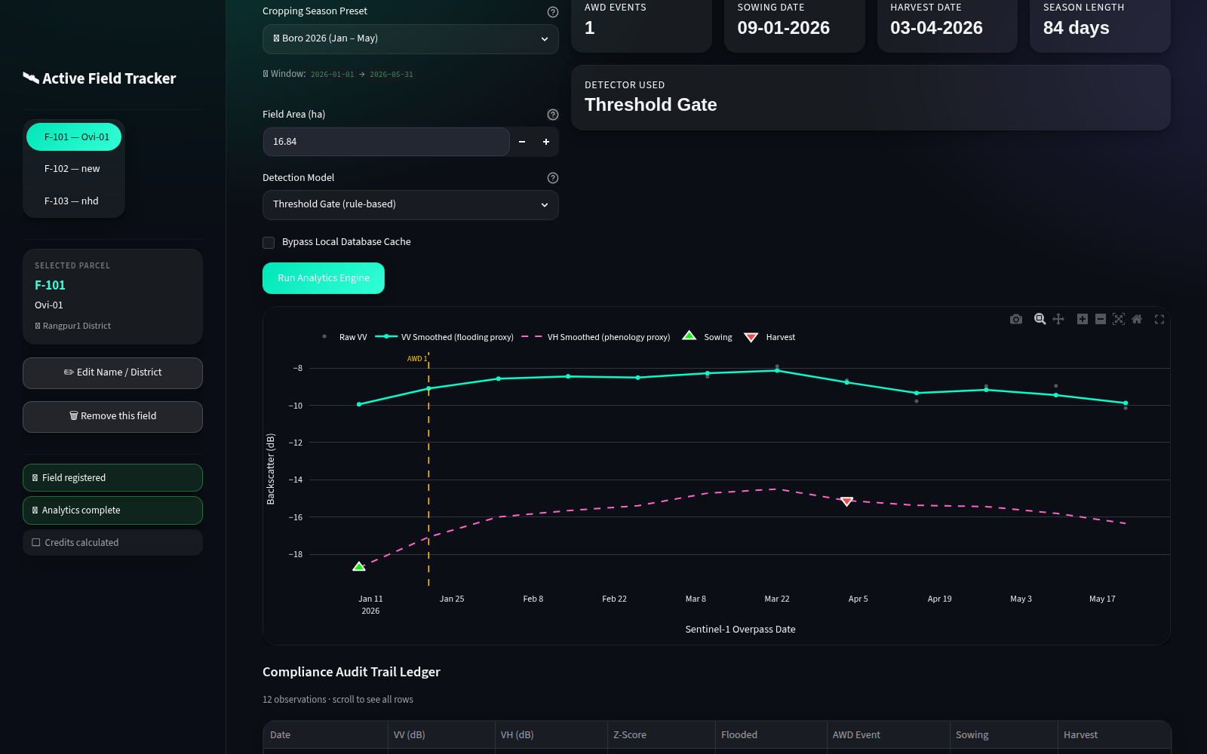
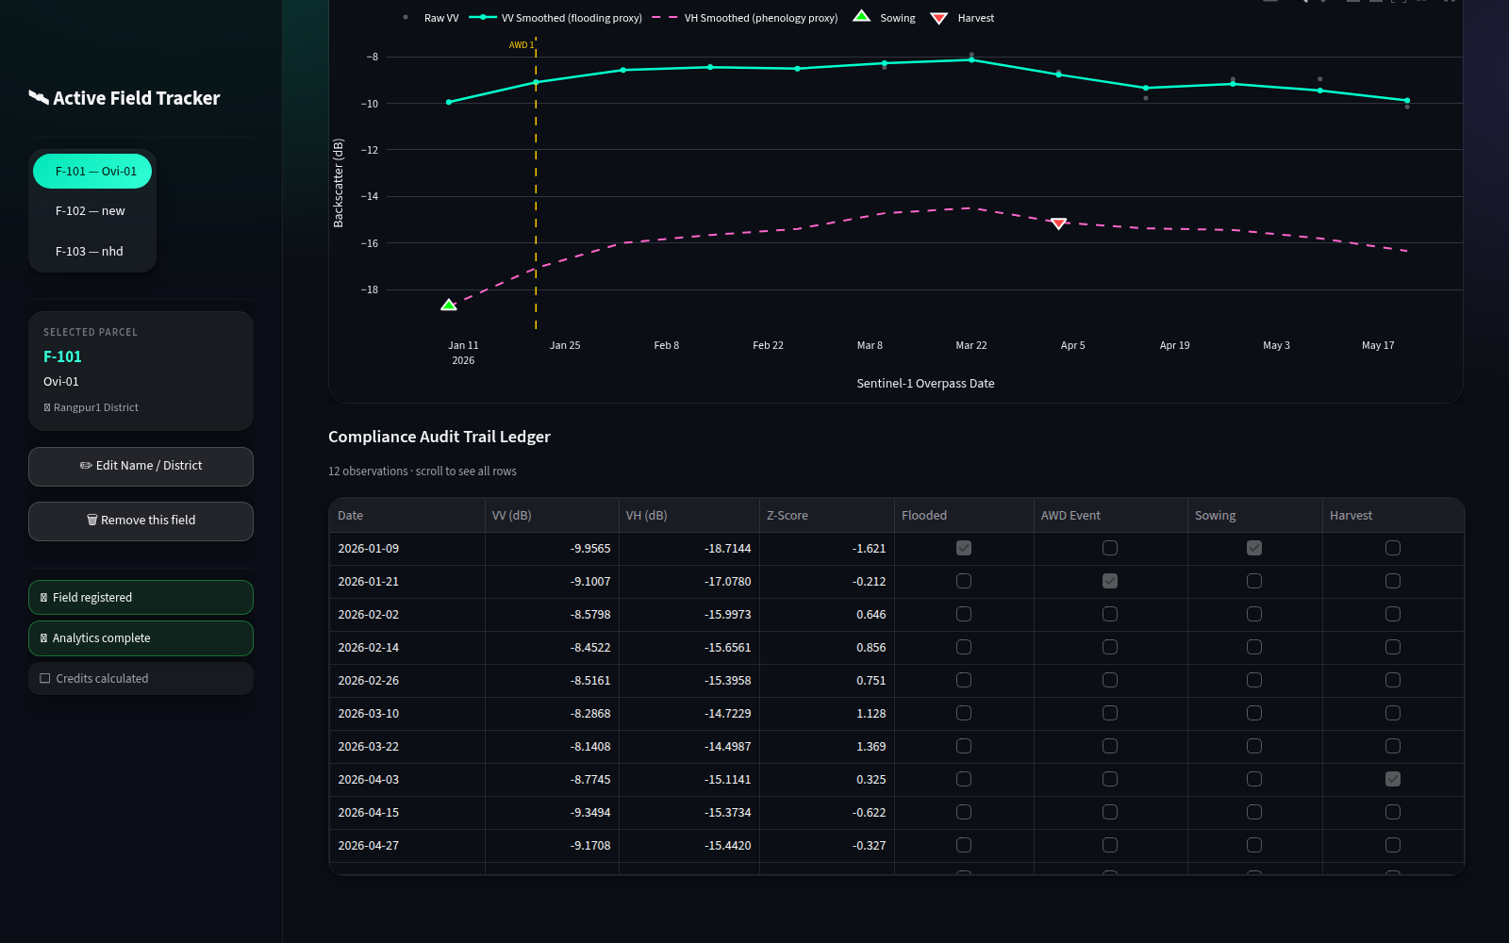
PROTOTYPE WALKTHROUGH
STEP 5 • RICE
Interpret Sentinel-1 as auditable AWD evidence
The application turns a time series into flooded states, drydown events and an observation ledger.
Signal analytics and detected events
Observation-level evidence ledger
USER ACTION
Review the chart, derived season and detected AWD events.
SYSTEM WORK
Smooth VV/VH, apply the transparent gate and retain each observation.
Notes:
This is a central contribution. Raw VV and VH are not carbon credits. Terra-Audit smooths signals, calculates z-scores, identifies flooded and drydown states, derives season dates with fallback and exposes the underlying ledger for audit.

Slide 15
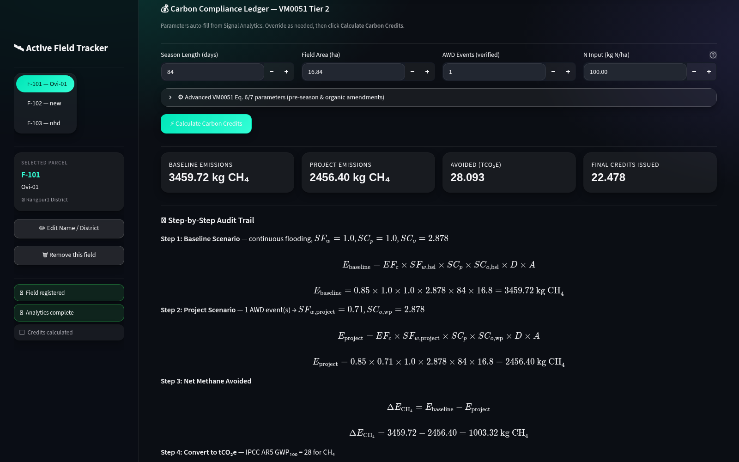
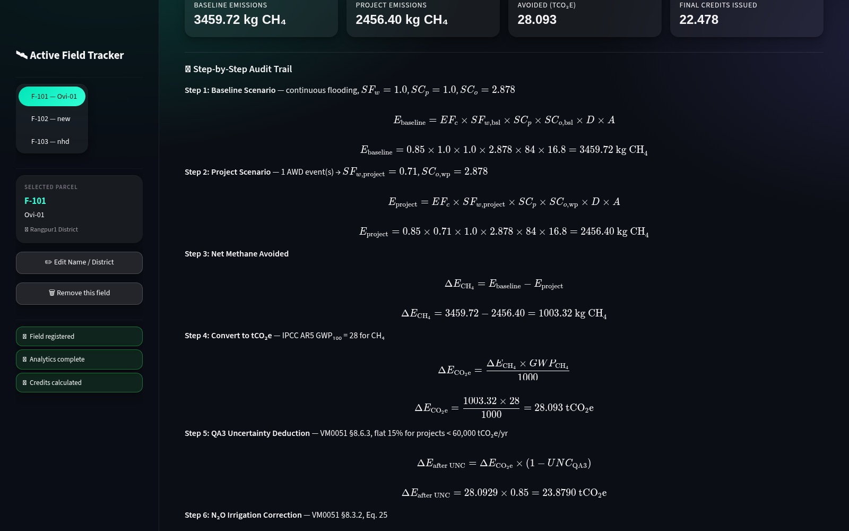
PROTOTYPE WALKTHROUGH
STEP 6 • RICE
Calculate the VM0051 rice estimate
Inputs and intermediate values remain visible before the final estimate.
VM0051 inputs populated from field and analytics
Calculated baseline, project and deduction values
USER ACTION
Review assumptions, then run the rice accounting engine.
DISCLOSURE
Known UI defect: the visible “Tier 2” label should read QA3 / Tier 1 regional defaults.
Notes:
Describe the implemented calculation correctly as VM0051 QA3 using Tier 1 regional defaults. Do not repeat the incorrect Tier 2 label visible in the current UI. Show how area, season, events, factors and deductions lead to the final estimate.

Slide 16
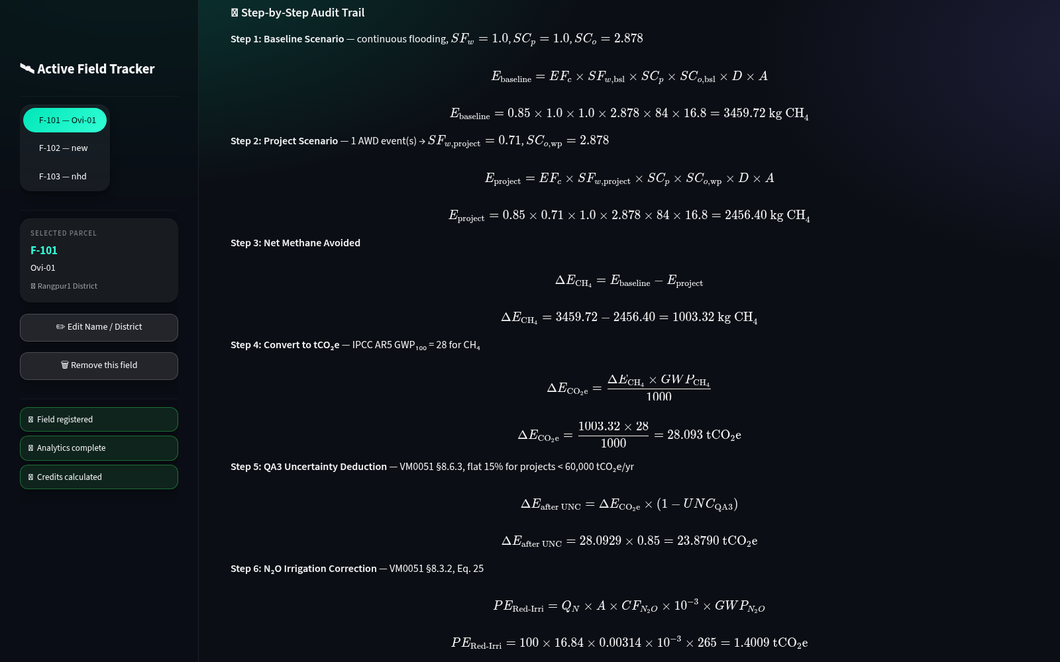
PROTOTYPE WALKTHROUGH
STEP 7 • RICE
Expose the VM0051 audit trail
A reviewer can reconstruct the estimate from disclosed equations and intermediate values.
Real application screen — VM0051 equations, factors and audit steps
USER ACTION
Open the methodology audit section and inspect each step.
SYSTEM WORK
Present equations, factor choices, deductions and final floor-at-zero logic.
Notes:
This is where you answer what your work is. The platform does not merely display a number. It makes the accounting path reconstructable, including factors, intermediate emissions, uncertainty and penalties.

Slide 17
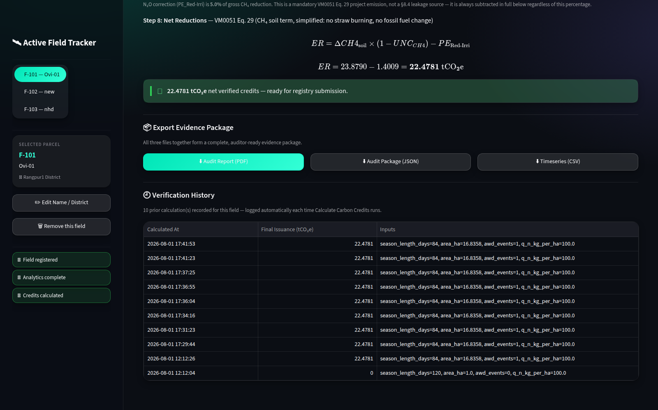
PROTOTYPE WALKTHROUGH
STEP 8 • RICE
Export the rice evidence package
The calculation can leave the dashboard as auditor-readable and machine-readable evidence.
Real application screen — VM0051 PDF, JSON and time-series downloads
USER ACTION
Download the report, audit JSON and observation CSV.
SYSTEM WORK
Bind current inputs, outputs and observation provenance into export files.
Notes:
Explain why there are multiple formats. PDF supports human review, JSON supports exact reconstruction and integration, and CSV exposes the rice time series used by the detector. Terra-Audit estimates and documents; it does not issue Verra credits.

Slide 18
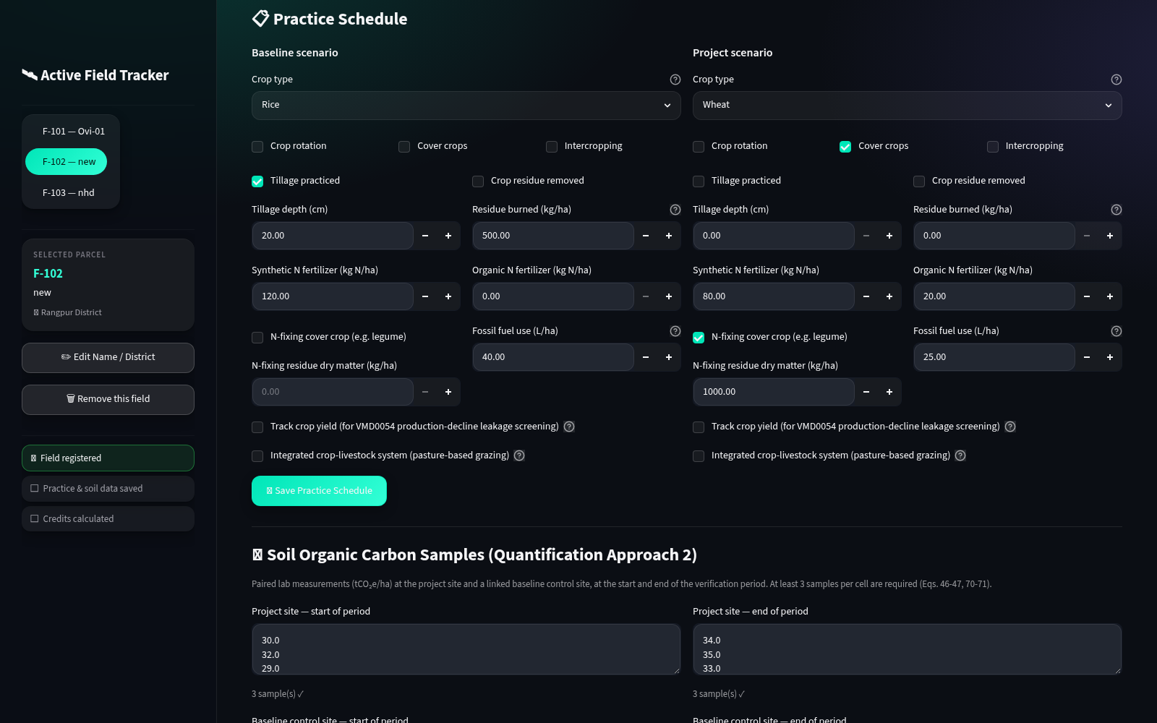
PROTOTYPE WALKTHROUGH
STEP 9 • CROPLAND
Record baseline and project management practices
Cropland ALM uses explicit practice evidence rather than the rice SAR detector.
Real application screen — baseline/project practice schedule
USER ACTION
Enter crop, tillage, residue, fertilizer, fuel and yield data.
SYSTEM WORK
Validate completeness and persist evidence separately by scenario and year.
Notes:
Explain the baseline-versus-project structure. The platform stores the management evidence needed by VM0042 and keeps it distinct from the rice time series. Livestock inputs are supported, but the current sample project contains no livestock records.

Slide 19
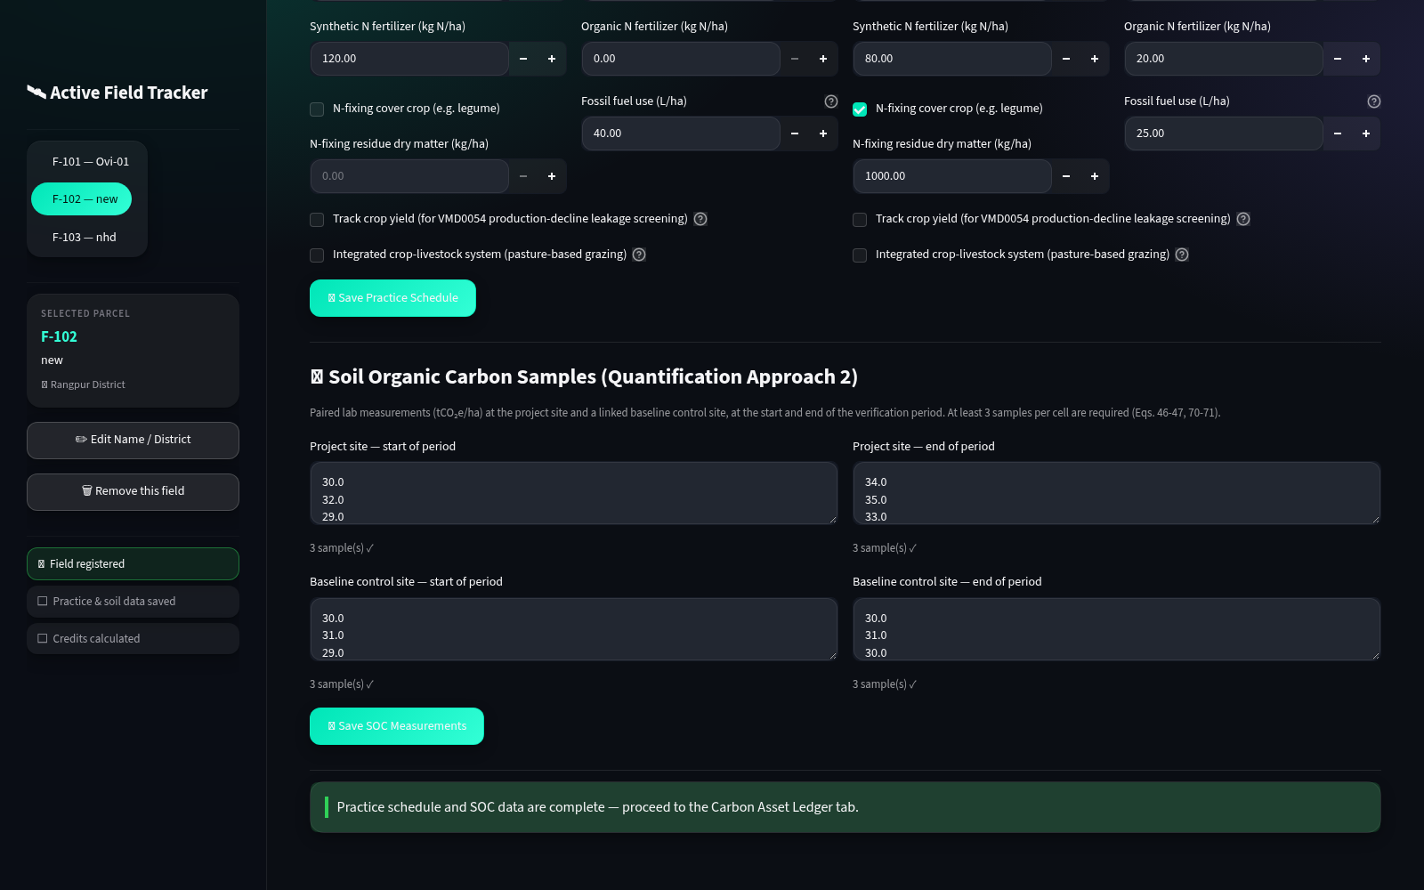
PROTOTYPE WALKTHROUGH
STEP 10 • CROPLAND
Attach laboratory SOC measurements
SOC samples are recorded by scenario, sampling year and soil layer.
Real application screen — complete SOC sample cells
USER ACTION
Enter replicate SOC values for baseline and project sampling cells.
SYSTEM WORK
Check sample completeness and prepare soil-stock change inputs.
Notes:
Emphasize that these are manually entered laboratory measurements, not invented satellite estimates. The application validates the sample structure before allowing the SOC quantification path to proceed.

Slide 20

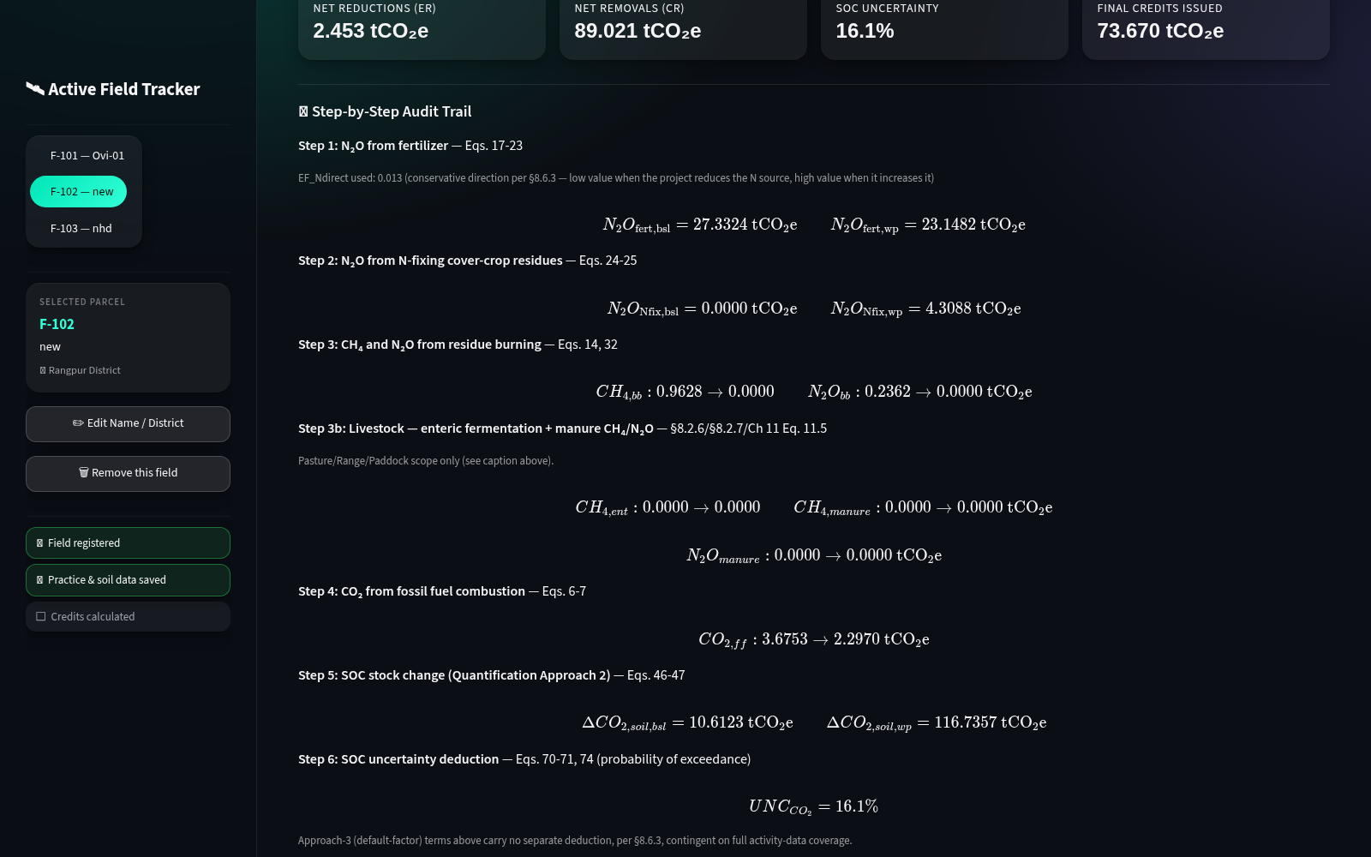
PROTOTYPE WALKTHROUGH
STEP 11 • CROPLAND
Calculate the scoped VM0042 estimate
The engine combines soil stock change with non-CO₂ sources and risk deductions.
VM0042 verification and risk inputs
VM0042 component results and final estimate
USER ACTION
Review the verification period and risk inputs, then calculate.
SYSTEM WORK
Combine SOC, fertilizer, residue, fuel, burning and supported livestock terms.
Notes:
Explain the calculation as a scoped implementation. The engine handles SOC stock change, selected N2O and CH4 terms, fossil fuel CO2, uncertainty and non-permanence buffer. Do not claim complete methodology conformity where leakage data are missing.

Slide 21
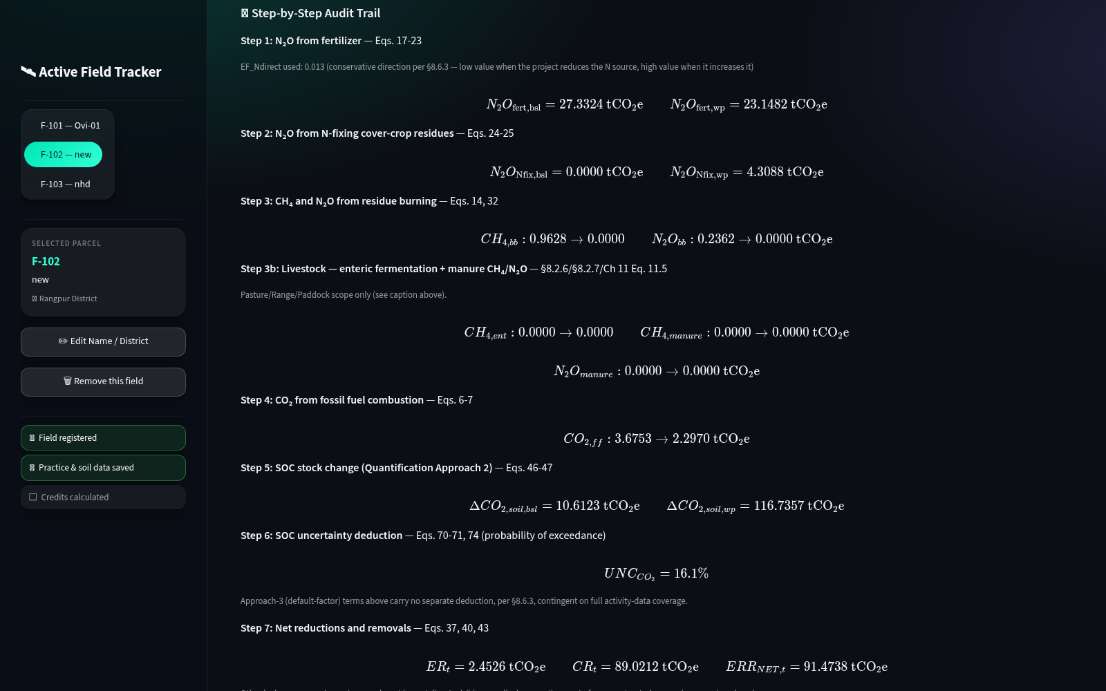
PROTOTYPE WALKTHROUGH
STEP 12 • CROPLAND
Keep VM0042 uncertainty and gaps visible
The audit view discloses screening status and avoids silently treating missing evidence as zero.
Real application screen — VM0042 audit trail and limitation messages
USER ACTION
Inspect component equations, uncertainty and leakage disclosures.
DISCLOSURE
A displayed estimate is not formal eligibility; incomplete leakage evidence remains disclosed.
Notes:
This slide demonstrates conservative software behavior. Missing or incomplete leakage evidence is surfaced to the user. The prototype provides an estimate with disclosures; it does not certify a project or issue credits.

Slide 22
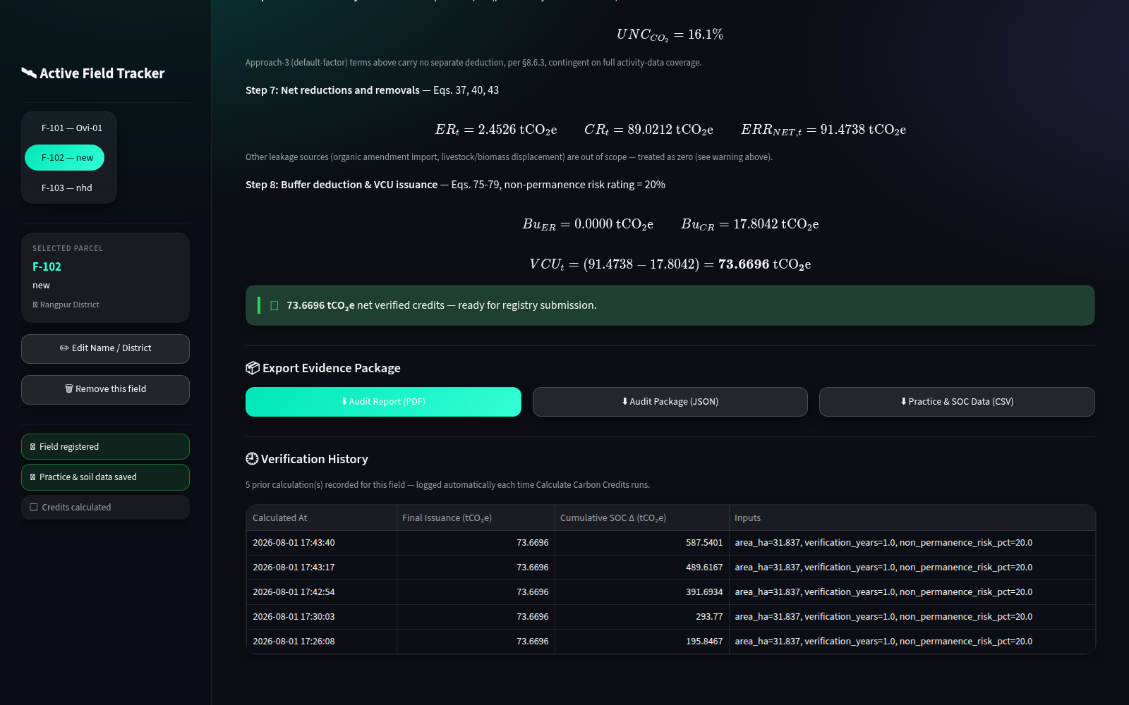
PROTOTYPE WALKTHROUGH
STEP 13 • CROPLAND
Export the cropland evidence package
VM0042 outputs use the same audit pattern while preserving methodology-specific evidence.
Real application screen — VM0042 evidence downloads
USER ACTION
Download the PDF report, audit JSON and practice/SOC CSV.
DISCLOSURE
Current CSV scope is practice/SOC only; livestock is included in PDF/JSON, not the CSV.
Notes:
Be precise about export completeness. The PDF and JSON include material inputs. The CSV currently covers practice and SOC data only; this is tracked under FR18 and should not be described as a complete evidence CSV.

Slide 23
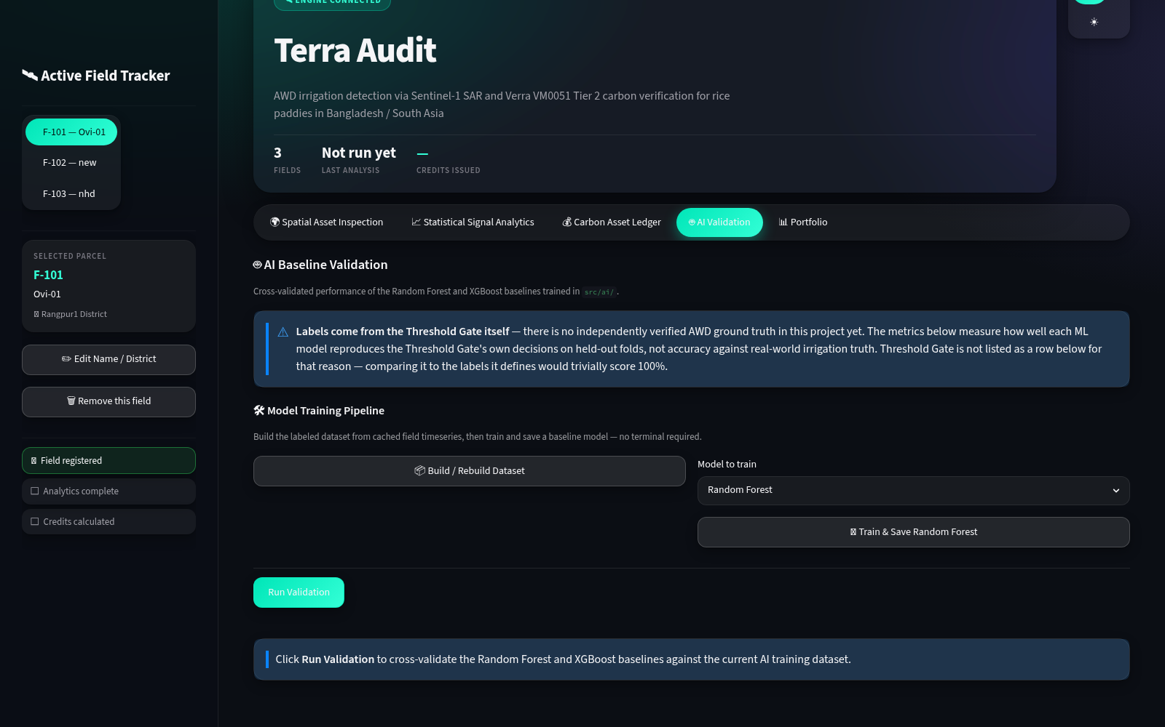
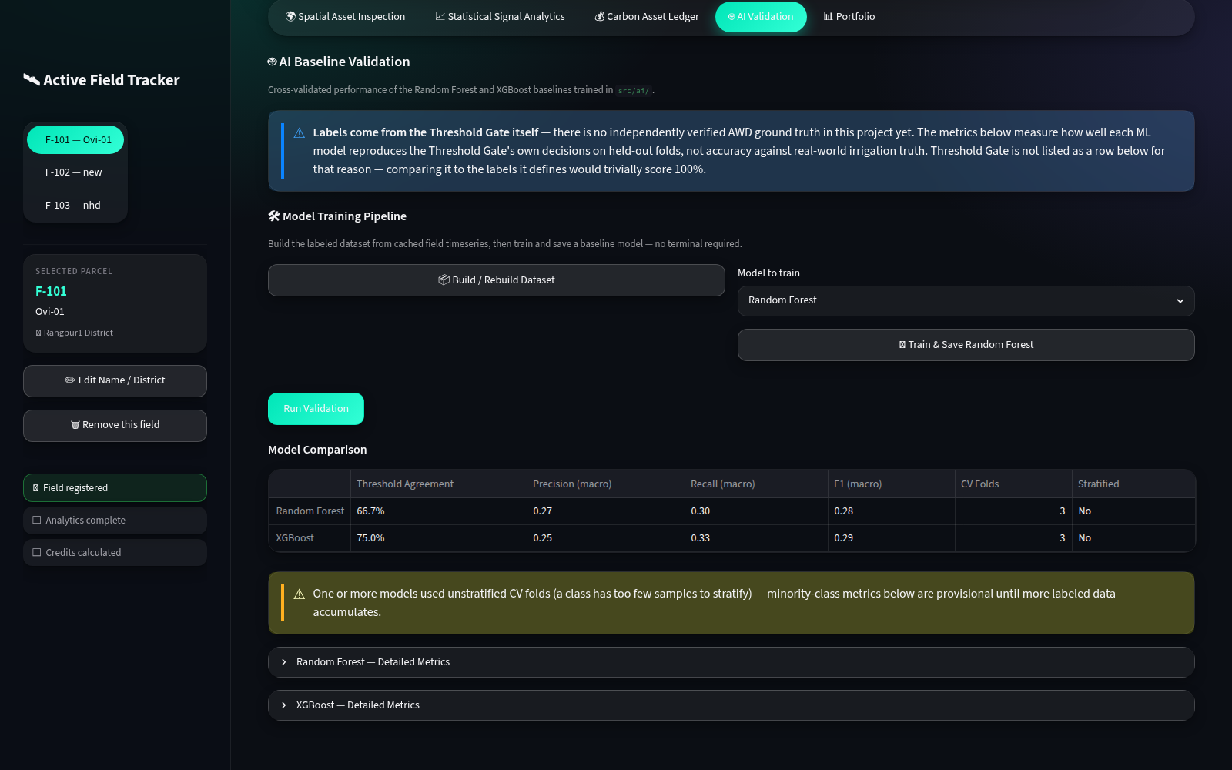
PROTOTYPE WALKTHROUGH
STEP 14 • AI
Train and compare the experimental AWD classifiers
The engineering pipeline works; the current metrics measure rule agreement, not independent field accuracy.
Training controls and saved model artifacts
RF/XGBoost comparison and explicit label warning
USER ACTION
Train RF/XGBoost from cached rice observations and compare metrics.
DISCLOSURE
Labels come from the threshold gate; no independent irrigation ground truth is available yet.
Notes:
Be fully honest. This is an experimental extension, not a validated agronomic AI result. The current data set is small and labels originate from the rule-based gate, so the metrics show agreement with that rule. Your defensible work is the training/evaluation/persistence pipeline and transparent fallback.

Slide 24
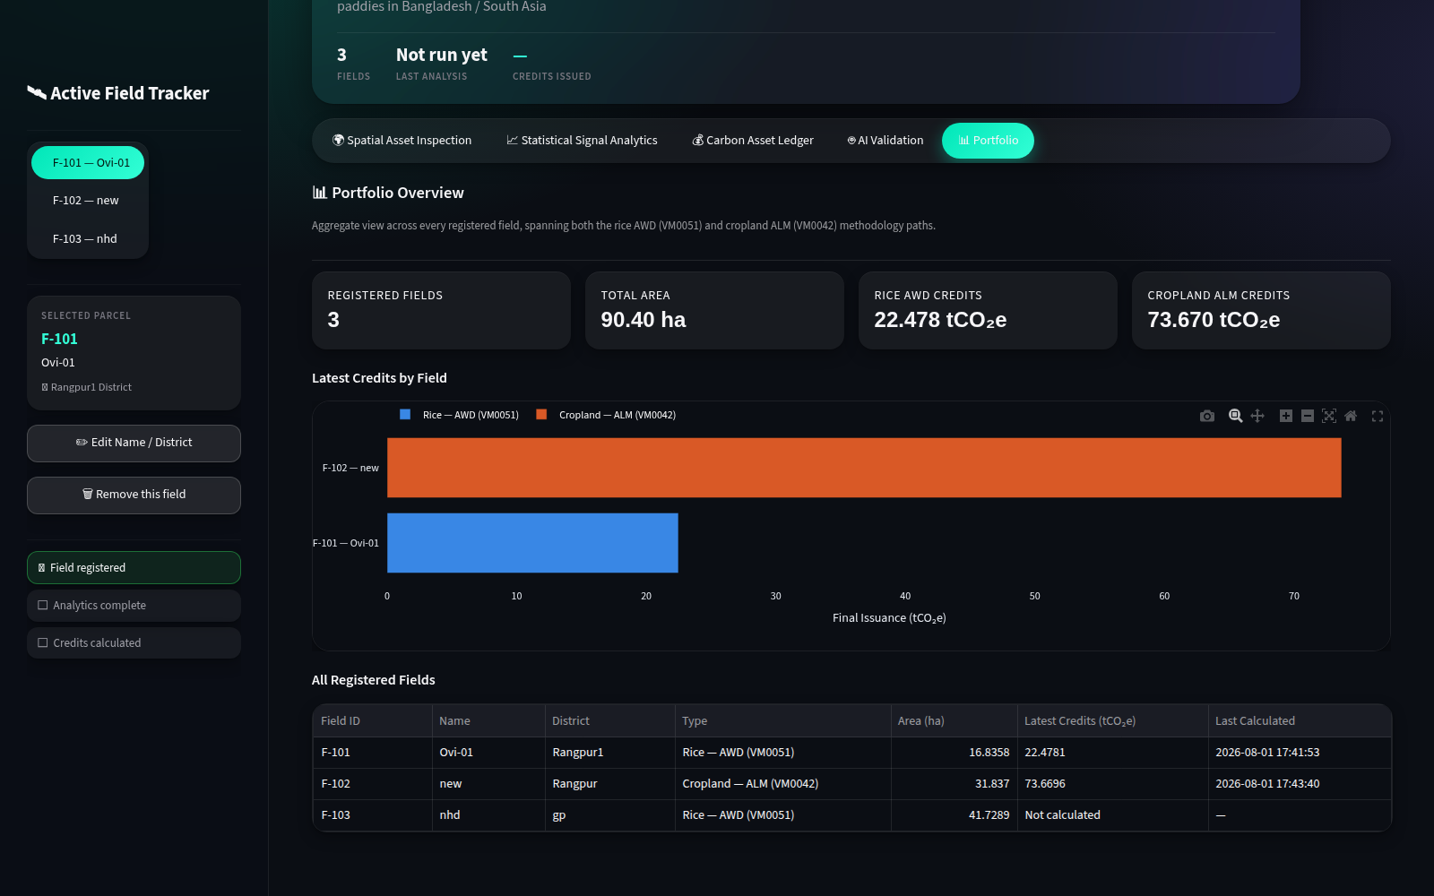

PROTOTYPE WALKTHROUGH
STEP 15 • SHARED
Review the project portfolio and registered assets
The final view connects methodology results back to persistent fields and calculation history.
Portfolio summary by methodology
Registered fields and field metadata
USER ACTION
Compare latest field results and inspect the asset registry.
SYSTEM WORK
Aggregate latest stored runs without replacing the underlying history.
Notes:
End the demo here. The portfolio proves that the prototype is a project system rather than a one-off notebook: it manages multiple fields, two methodology types and persistent calculation history. Values shown are local prototype estimates, not issued credits.

Slide 25
IMPLEMENTATION PROGRESS
What is working at the midterm checkpoint
Conservative status: implemented does not automatically mean independently validated.
Field registry, geometry parsing and routing
IMPLEMENTED
Sentinel-1 cache and transparent AWD gate
IMPLEMENTED • MANUAL CHECK
VM0051 and scoped VM0042 engines
AUTOMATED TESTS
PDF/JSON evidence and methodology CSVs
PARTIAL CSV SCOPE
Calculation history and portfolio
IMPLEMENTED • TESTS PENDING
RF/XGBoost pipeline and saved artifacts
EXPERIMENTAL
Independent AWD ground-truth validation
NOT COMPLETED
Strongest verified area: accounting-engine regression tests. Largest evidence gap: independent AWD ground truth.
Notes:
Use status language exactly. The accounting engines have automated regression coverage. Several UI, persistence and reporting components are implemented but need broader automated system tests. The AI pipeline is experimental.

Slide 26
CHALLENGES AND NEXT WORK
Known risks — and the engineering response
A credible capstone makes uncertainty visible and testable.
Independent AWD truth
Small drydown class
Collect irrigation/field observations and validate by field and season.
Expand seasons and use grouped validation to prevent leakage.
Earth Engine dependency
VM0042 scope gaps
Cache-first operation, readable errors and documented authentication.
Implement, quantify or explicitly block each applicable leakage category.
Local-only deployment
Known label/export defects
Add authentication, backups and hosted persistence before deployment.
Correct VM0051 wording and complete livestock CSV coverage.
Notes:
Choose the two most important risks: independent ground truth and methodology completeness. Explain concrete next steps rather than claiming that the limitations are already solved.

Slide 27
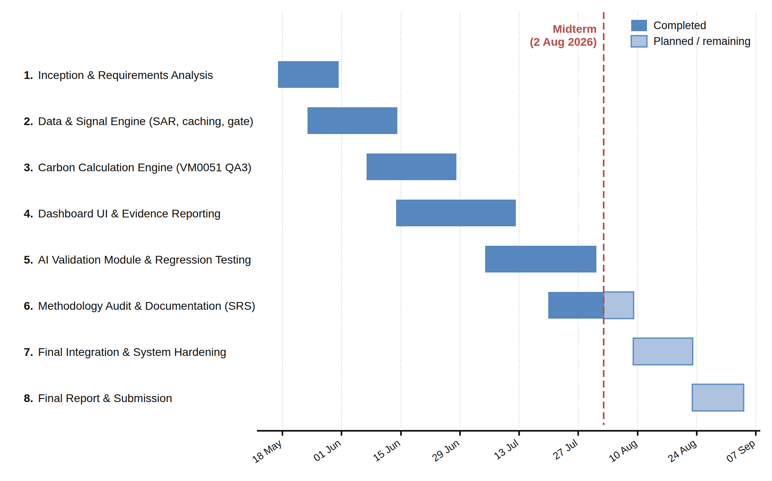
TIMELINE
Progress against the project plan
Corrected Gantt chart with the 2 August 2026 midterm checkpoint.
Corrected project Gantt chart
Open corrected Gantt chart
Notes:
Explain progress against plan rather than reading every date. The midterm checkpoint falls during methodology audit and documentation. Remaining work is final integration, hardening, evidence review and final submission.

Slide 28
FIELD → EVIDENCE → ACCOUNTING
Terra-Audit turns agricultural evidence into a reproducible carbon estimate.
Field-specific evidence processing
Transparent methodology calculations
Persistent audit trail and exports
AI remains experimental. The core contribution is the modular, auditable MRV workflow.
QUESTIONS?
Notes:
Close with the exact contribution. Sentinel-1 provides observations. Terra-Audit contributes field management, evidence processing, methodology calculations, persistence, audit trails, exports and an extensible architecture. It does not issue credits, and the AI extension is not independently validated.

Slide 29
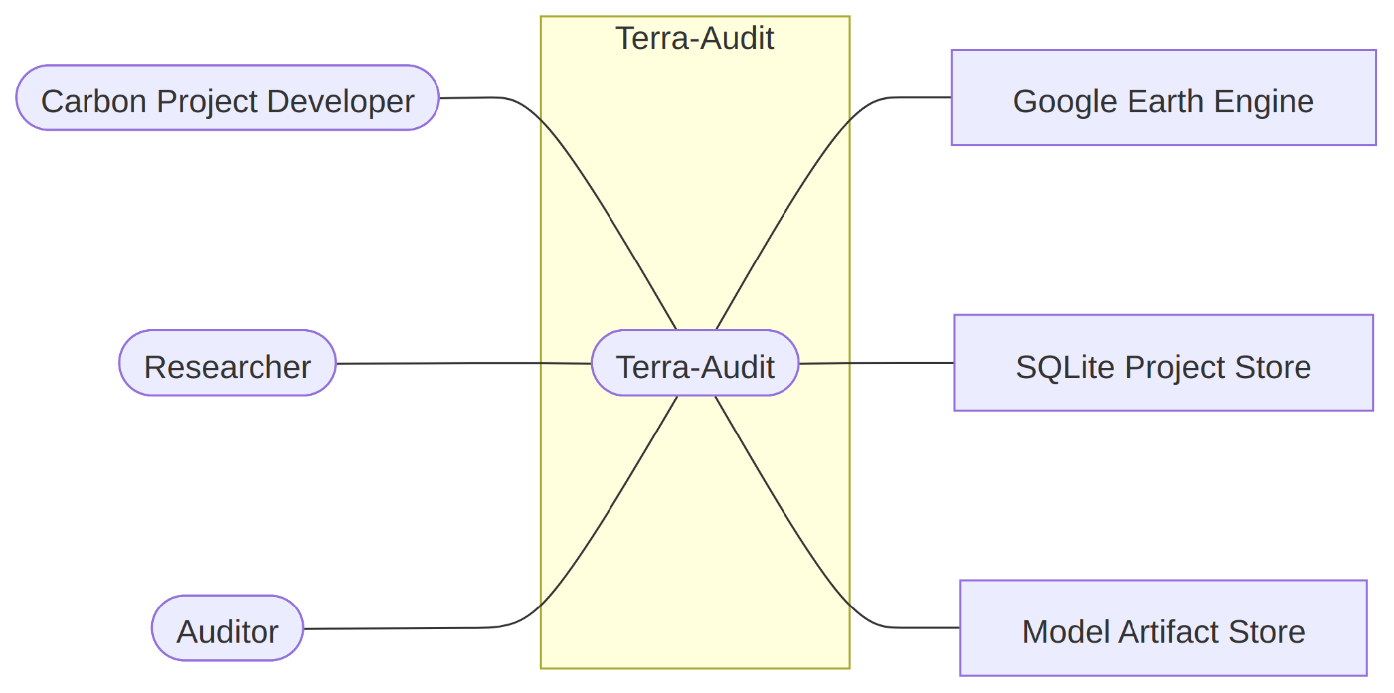
APPENDIX • DETAILED DIAGRAMS
System scope diagrams
Use these only if the examiner asks for the less-detailed system boundary.
Figure 1 — Level-0 use case
Figure 2 — Level-1 use case
Notes:
Appendix reference. Figure 1 summarizes the system boundary; Figure 2 decomposes the main capabilities.

Slide 30
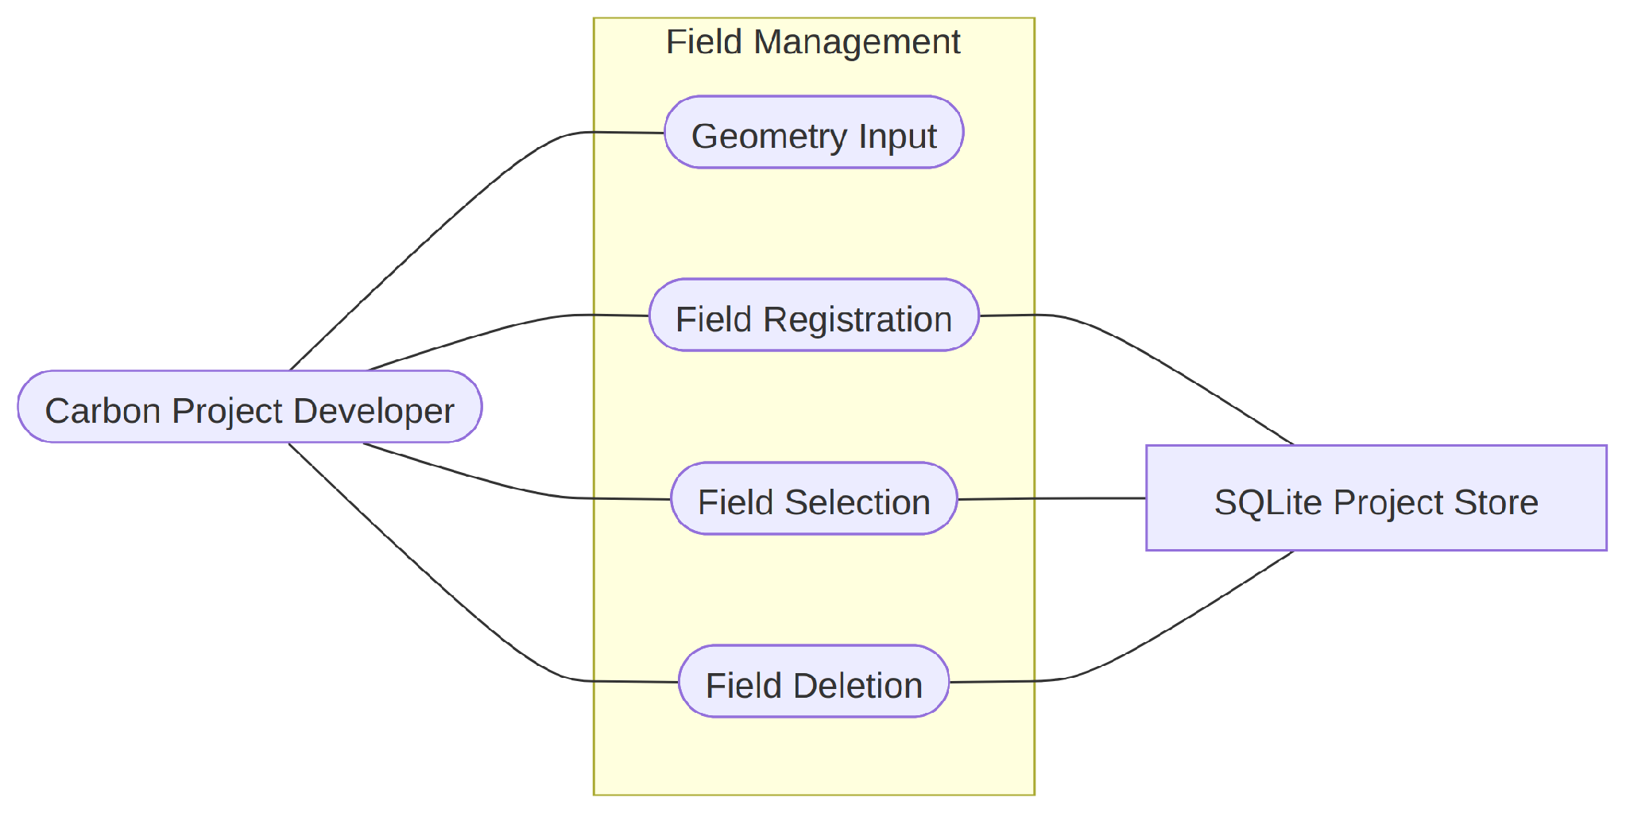
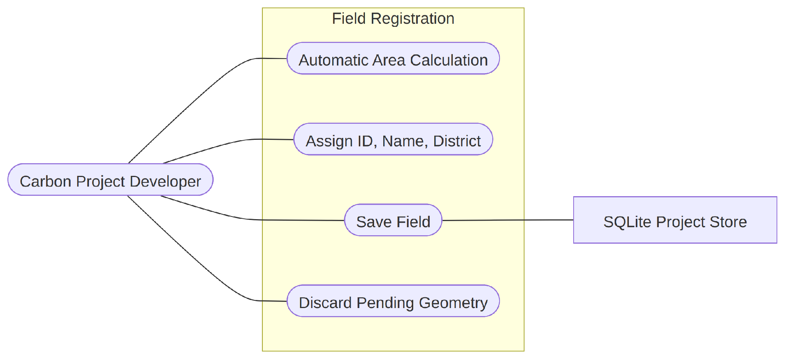
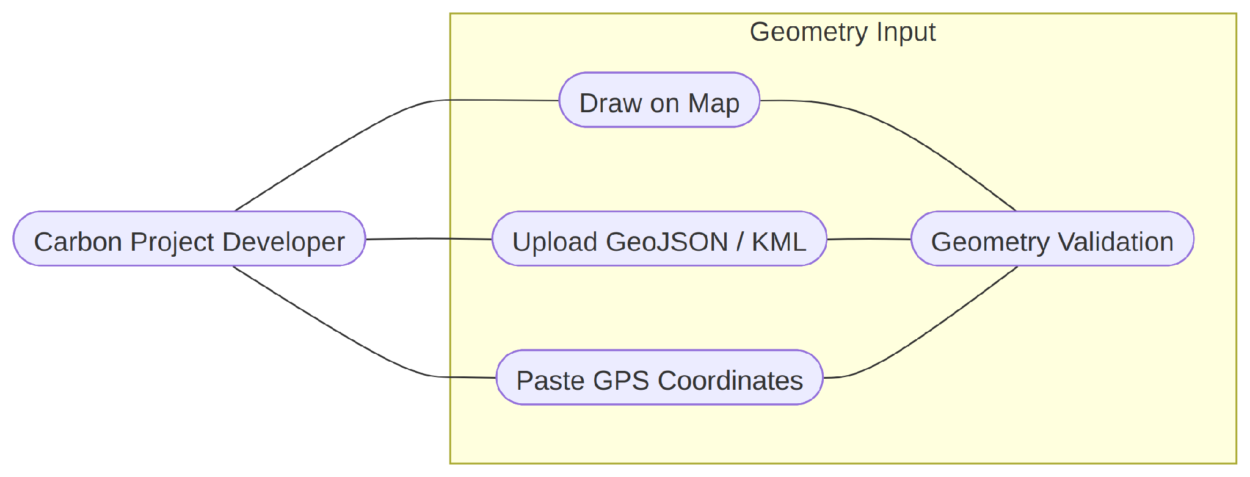
APPENDIX • DETAILED DIAGRAMS
Field-management diagrams
Registration is decomposed into field management, geometry input and persistence.
Figure 3 — Field management
Figure 4 — Geometry input
Figure 5 — Field registration
Notes:
Appendix reference. These diagrams support detailed questions about geometry formats, area computation, validation and database persistence.

Slide 31
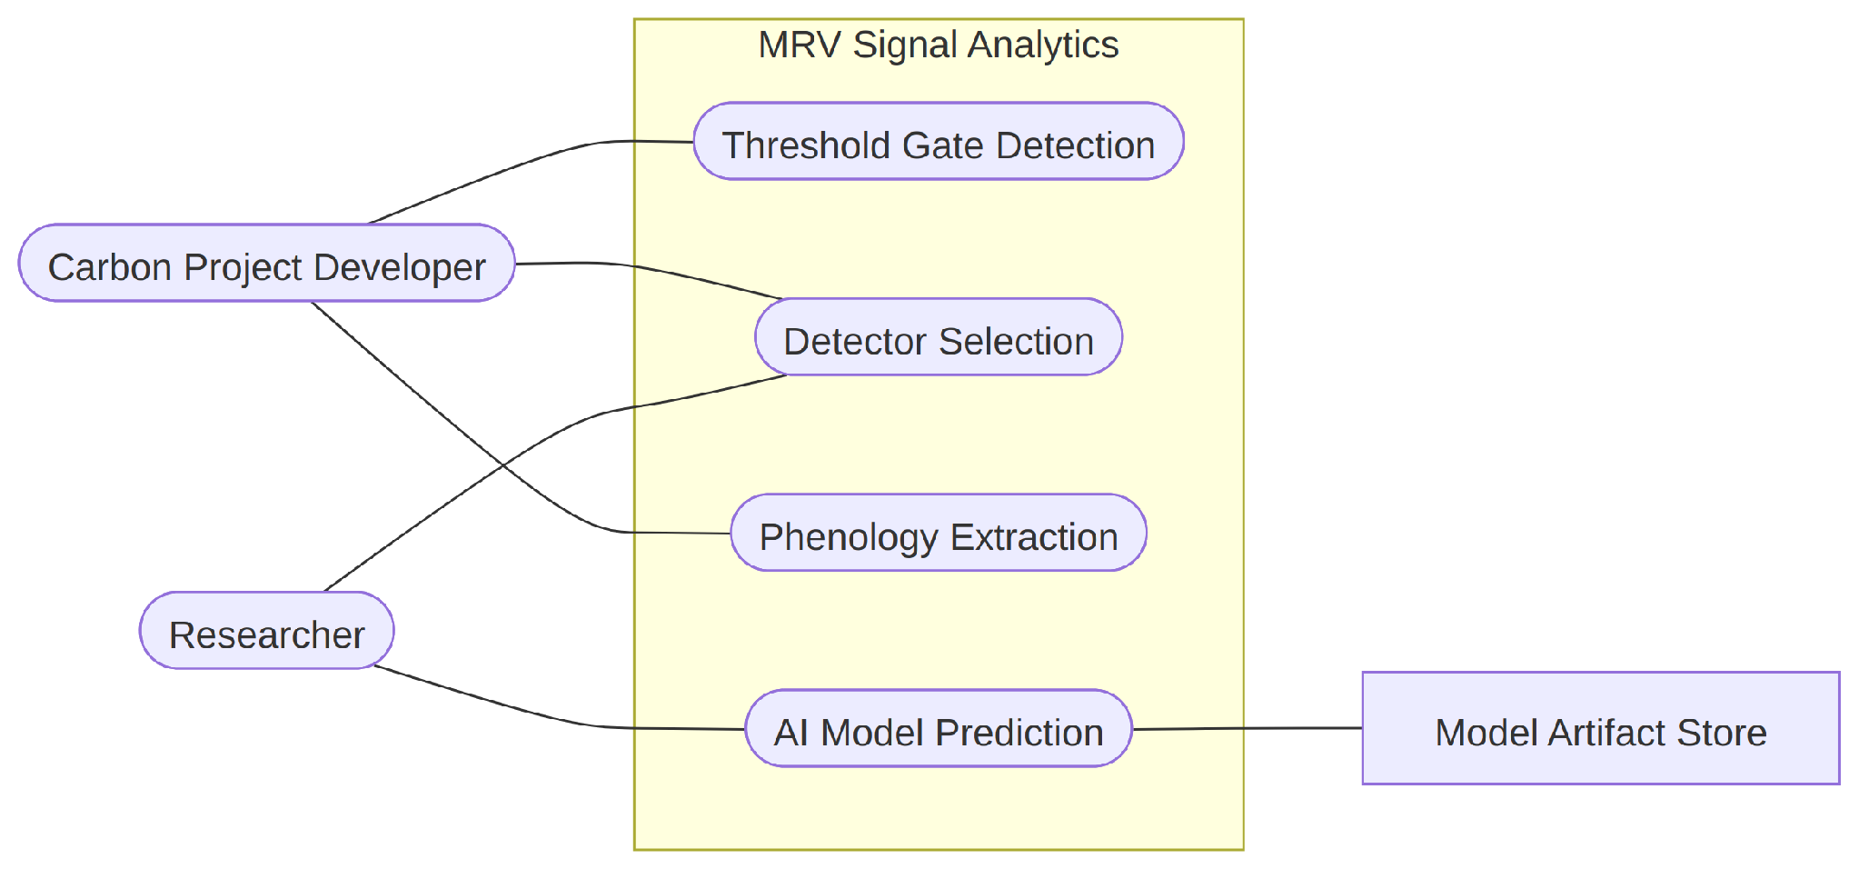
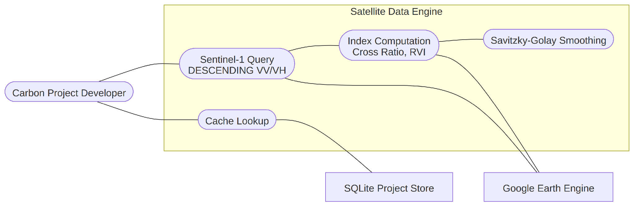
APPENDIX • DETAILED DIAGRAMS
Rice evidence-engine diagrams
Satellite acquisition and signal interpretation are separate responsibilities.
Figure 6 — Satellite data engine
Figure 7 — Signal analytics
Notes:
Appendix reference. Explain that the data engine retrieves and caches observations, while the analytics component interprets them.

Slide 32
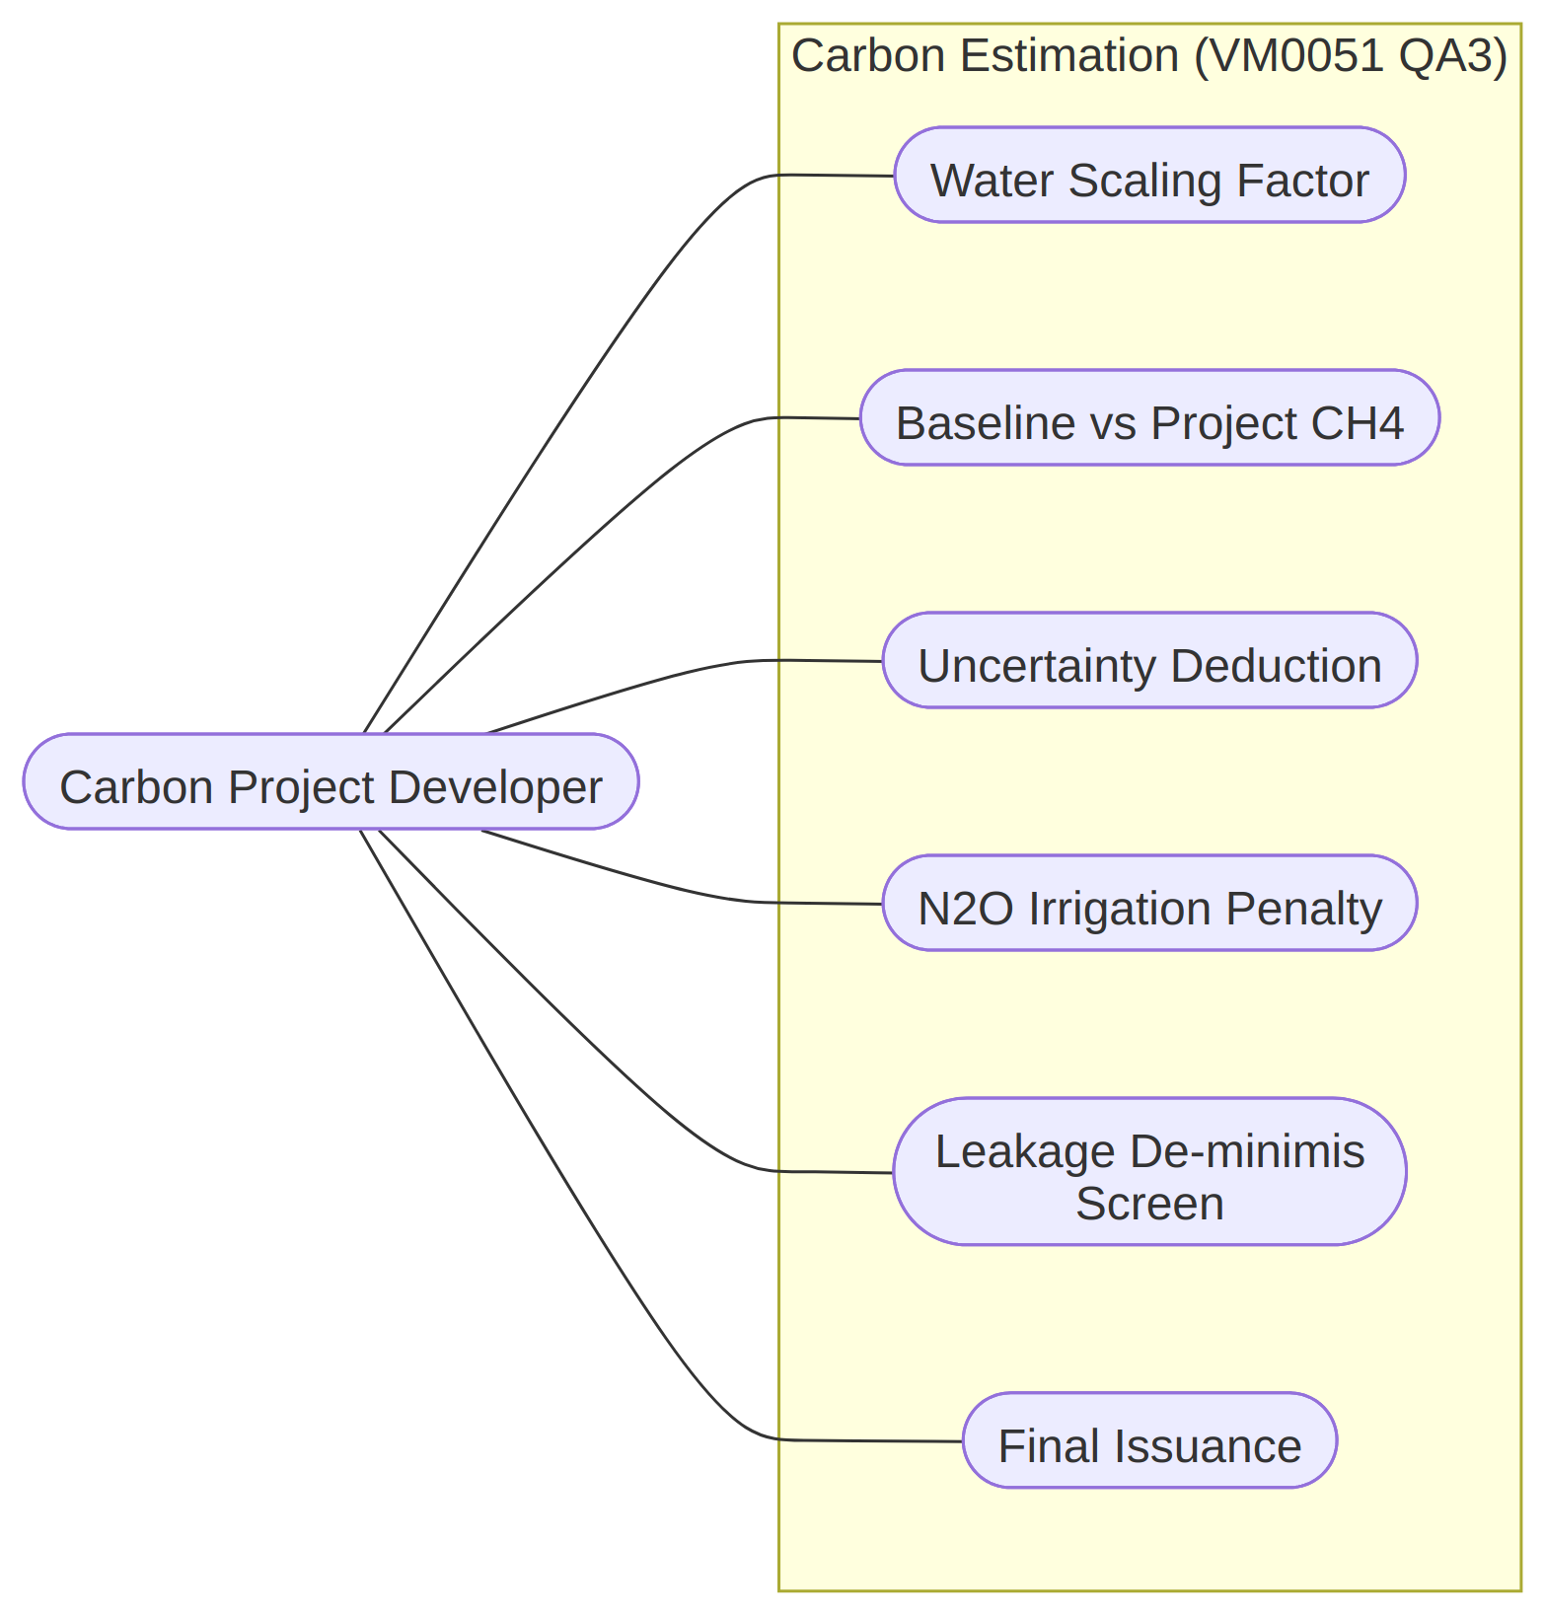
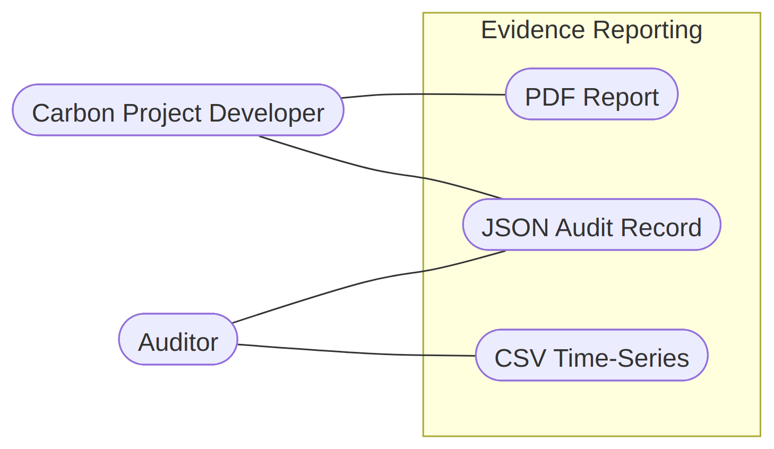
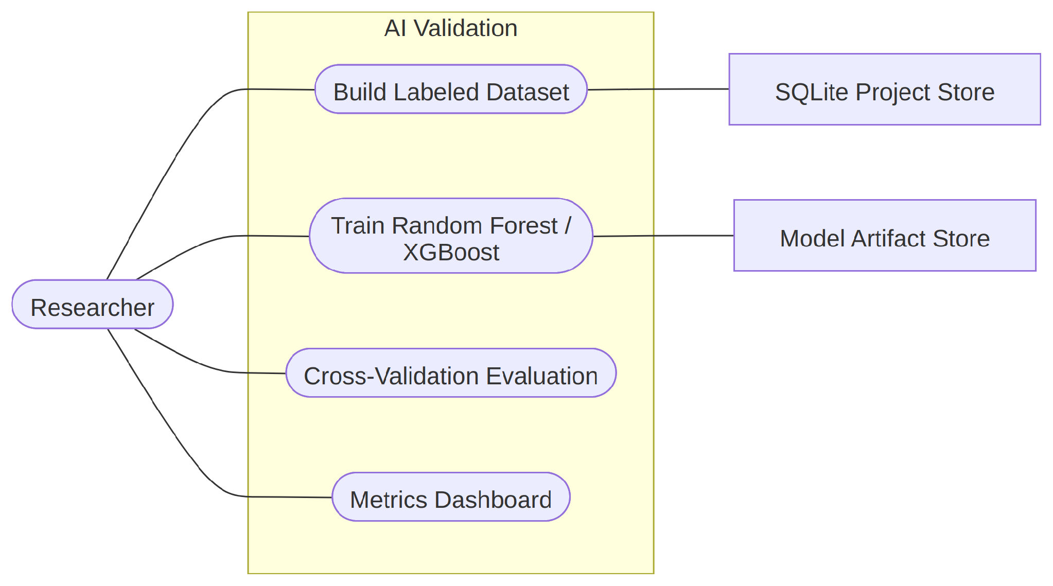
APPENDIX • DETAILED DIAGRAMS
Calculation, reporting and AI diagrams
Detailed use cases for the calculation, reporting, AI and cropland subsystems.
Figure 8 — Carbon estimation
Figure 9 — Evidence reporting
Figure 10 — AI validation
Figure 11 — Cropland ALM
Notes:
Appendix reference. Use one relevant diagram if the examiner asks about a particular subsystem; do not attempt to explain all four at once.

Slide 33
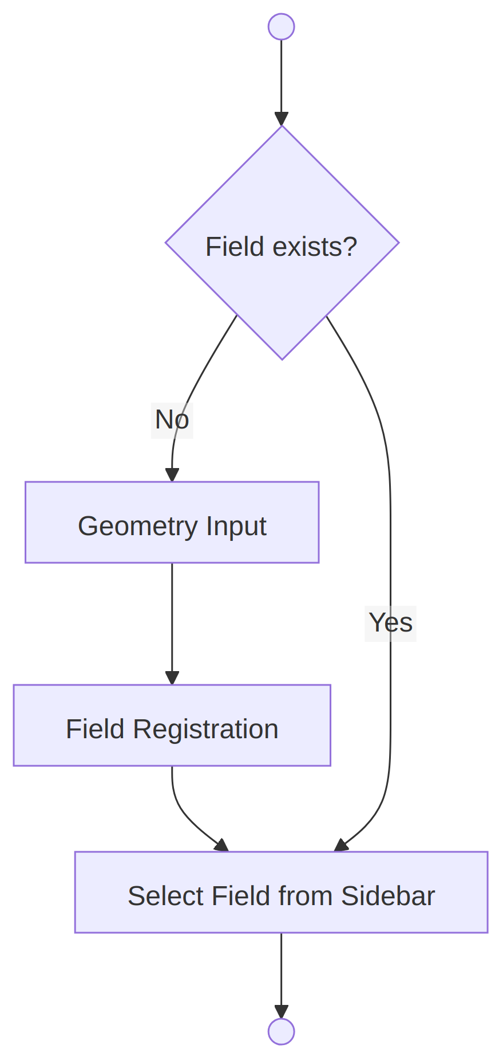
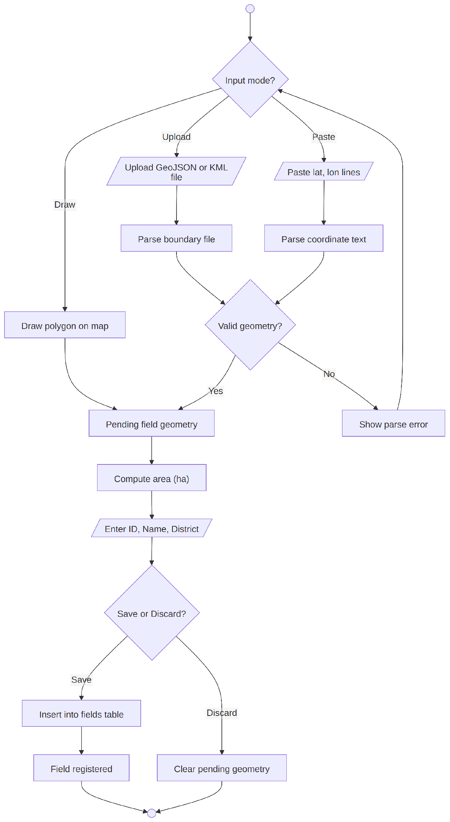
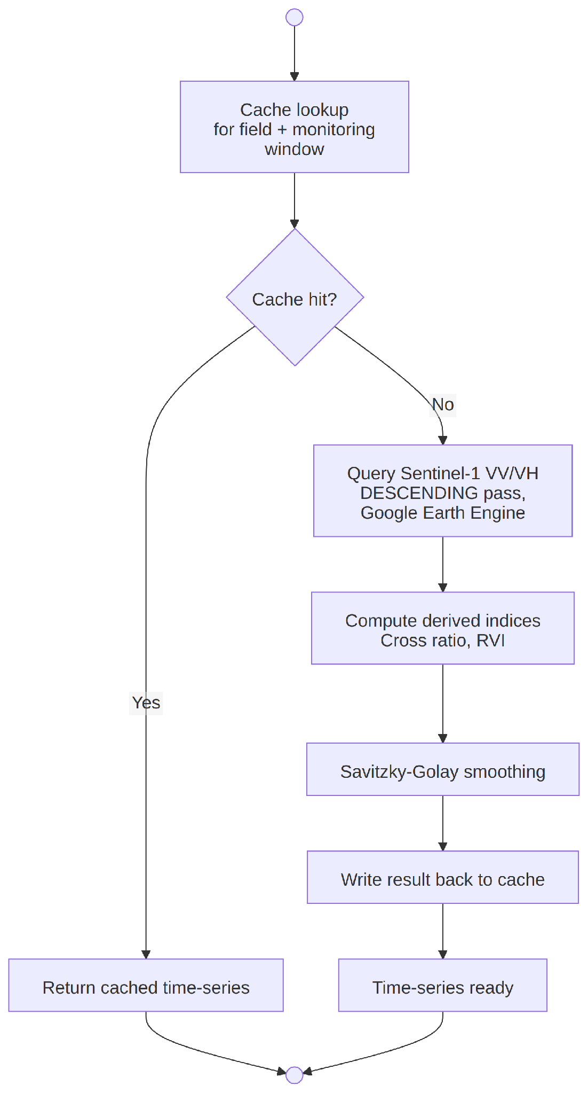
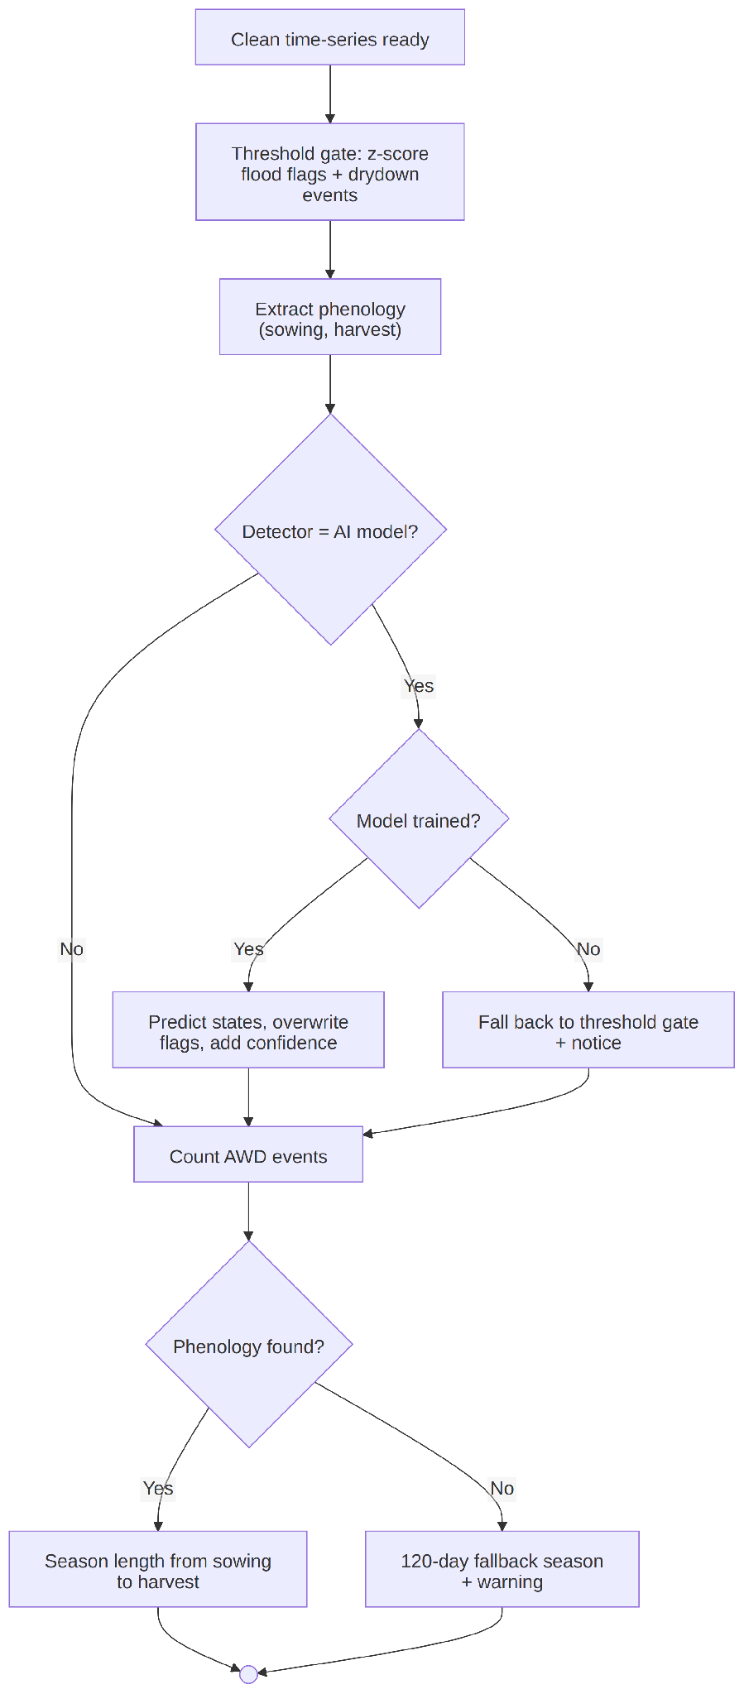
APPENDIX • DETAILED DIAGRAMS
Detailed activity diagrams — evidence collection
Subsystem flows for field management, geometry, satellite and signal analytics.
Figure 13 — Field management activity
Figure 14 — Geometry activity
Figure 15 — Satellite activity
Figure 16 — Signal analytics activity
Notes:
Appendix reference. These activity diagrams show validations and controlled failure paths in the evidence-collection workflow.

Slide 34
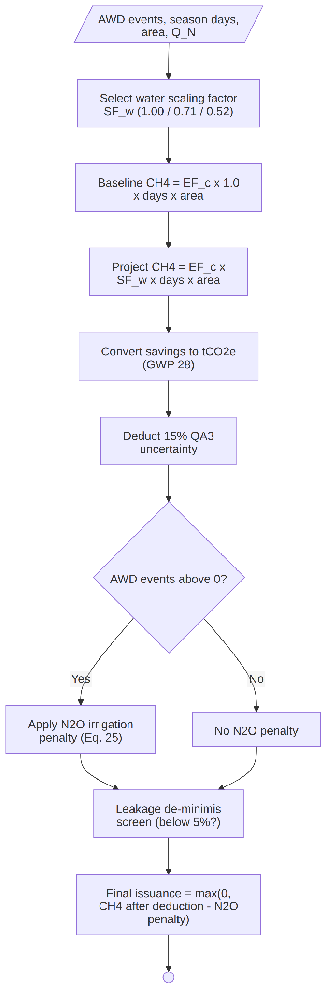
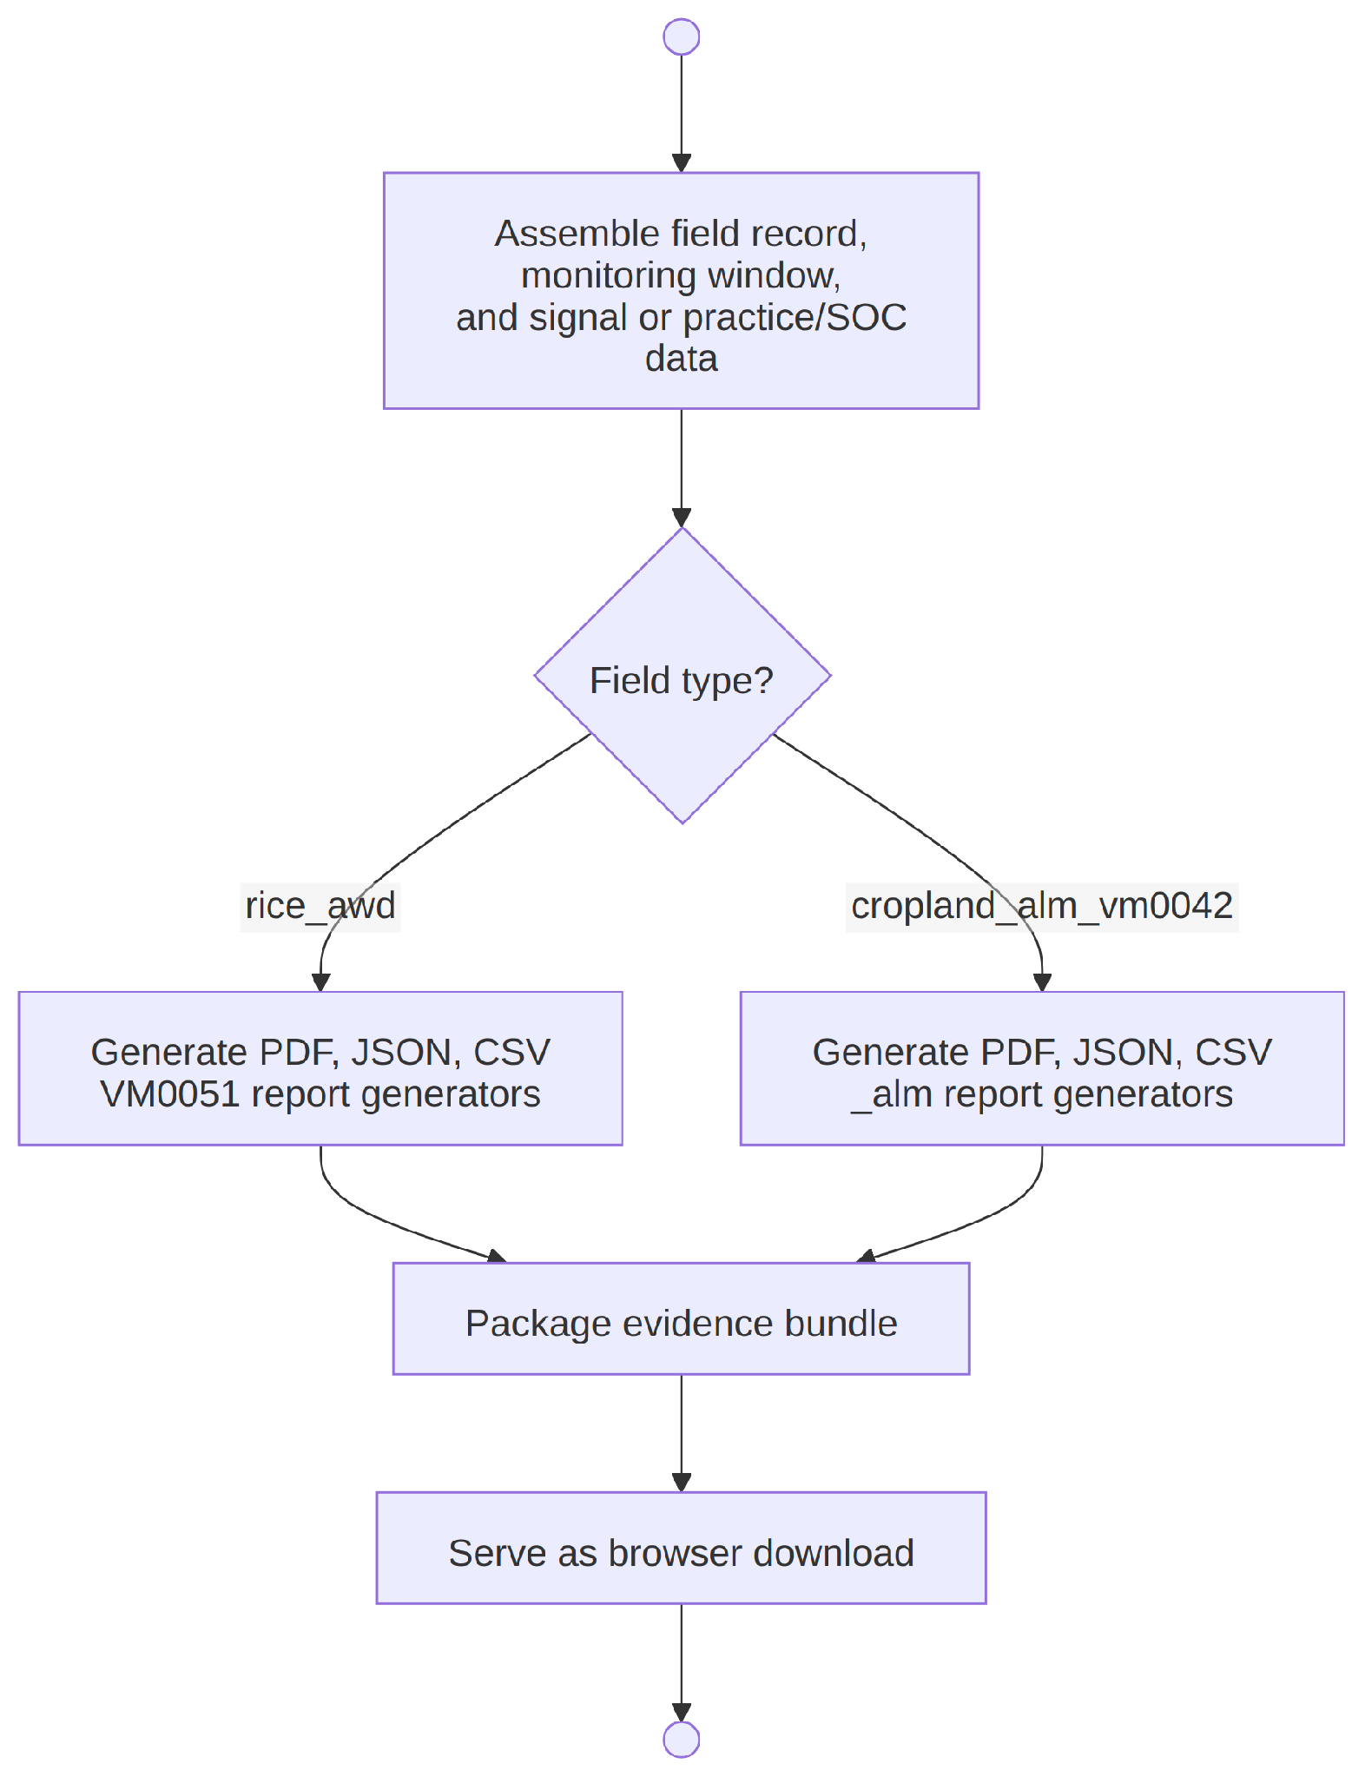
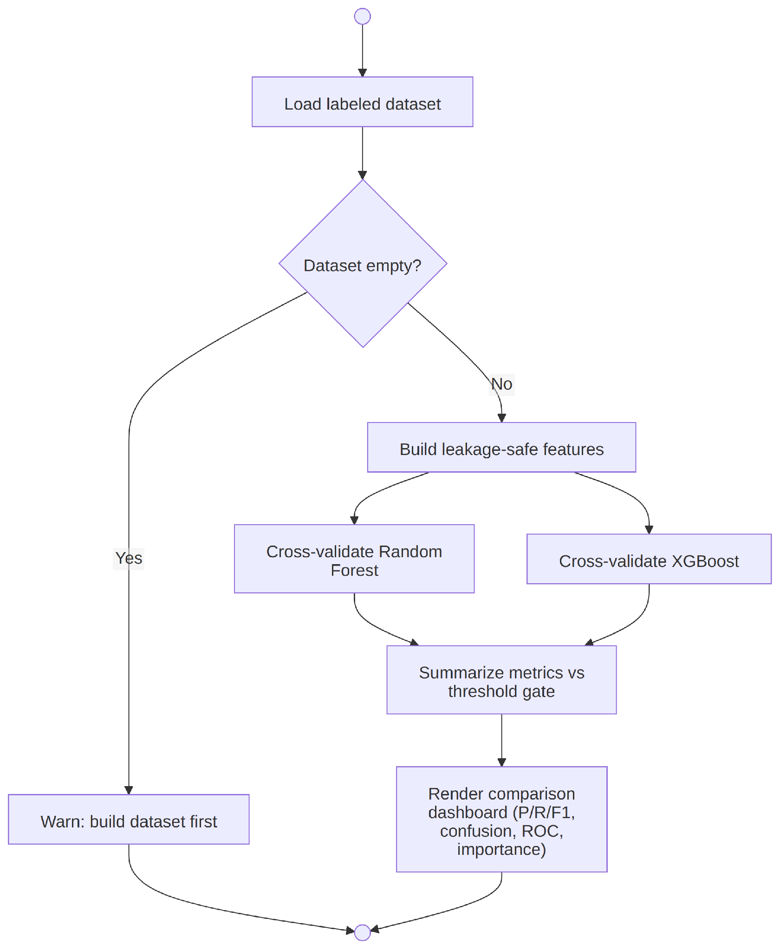
APPENDIX • DETAILED DIAGRAMS
Detailed activity diagrams — calculation and audit
Subsystem flows for carbon estimation, evidence reporting and AI validation.
Figure 17 — Carbon estimation activity
Figure 18 — Evidence reporting activity
Figure 19 — AI validation activity
Notes:
Appendix reference. These diagrams support questions about calculation decisions, export generation and AI fallback behavior.

