Slide 1
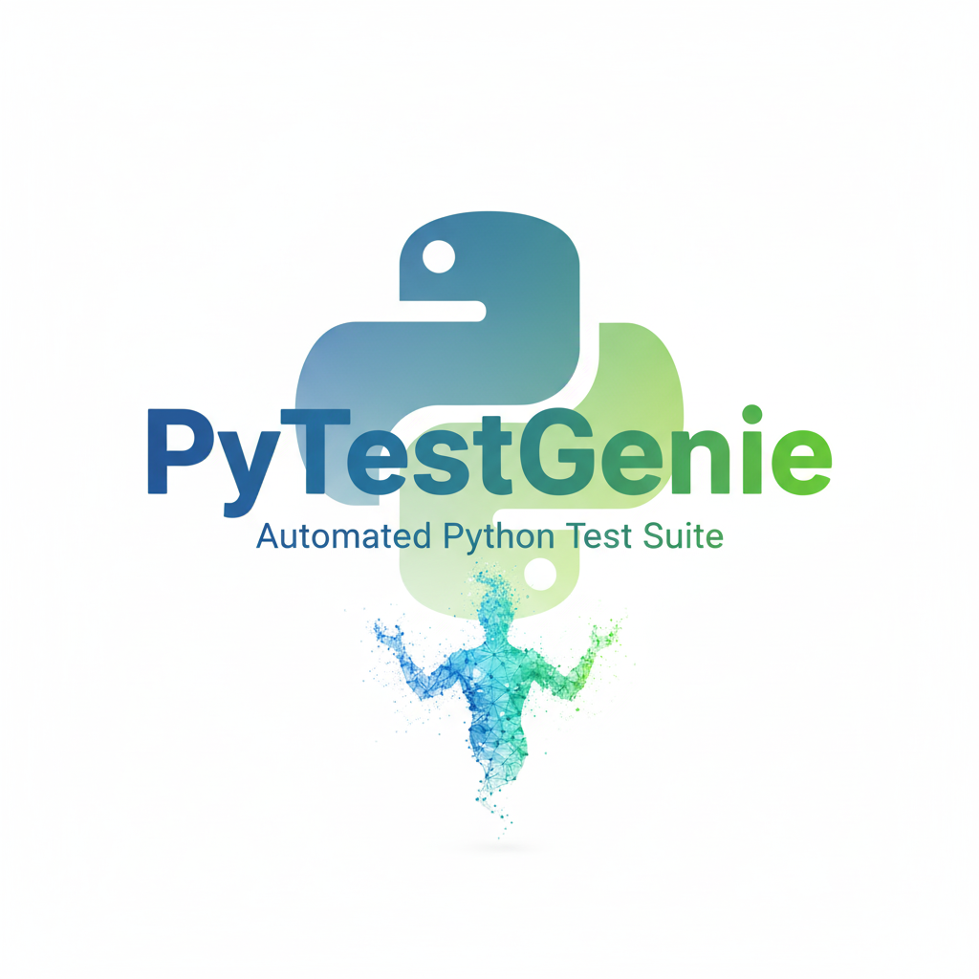
A Web tool for Automated Unit Test Generation, Test Smell Detection & Refactoring for Python
Presented by
Amit Kumar Roy
BSSE Roll: 1314
IIT, DU
Supervised by
Toukir Ahammed
Lecturer
IIT, DU

Slide 2
Why PyTestGenie ?

Slide 3
Motivation
Unit testing is essential
Manual unit
test creation
Gap in rule based analysis
for software reliability and maintainability
time-consuming, and verifying correctness is challenging
hard to adapt to new smells or refactor
Existing tools are limited
Agentic LLM workflows
Complete pipeline
Often tied to specific IDEs & few support automated refactoring
Few tools support multiple AI agents working together (detector, refactorer, validator)
for test generation , test smell detection, automated refactoring

Slide 4
What is PyTestGenie ?

Slide 5
Rule Based & Multi-Agent LLM-Powered Framework
Target users:
Developers
Researchers
Students/ Teachers
Complete Testing Pipeline
Unit Test Generator
Test Refactorer
Test Smell Detector

Slide 6
Workflow…

Slide 7
Normal Requirements
Allow users to upload Python files/folders or paste Python code
Parse and analyze the input source code
Generate unit tests using rule-based techniques
Detect common test smells in generated or existing test cases
Refactor detected test smells to produce clean, executable unit tests

Slide 8
Expected Requirements
Support LLM-based unit test generation alongside rule-based methods
Enable ruled-based and LLM-based approach for test smell detection and refactoring
Provide clear explanations of detected test smells and applied refactorings
Display analysis and refactoring results to the user
Generate evaluation reports, including:
Test smell detection accuracy
Refactoring success rate

Slide 9
Exciting Requirement
Allow users to choose between:
Single-agent
Multi-agent (role-based, persona-driven) configurations
Support side-by-side comparison of multiple LLMs and workflow setups
Provide interactive user feedback to guide or refine refactoring decisions
Extend test smell detection to multiple languages (e.g., Java, C++)
Execute full test suites within a single integrated pipeline

Slide 10
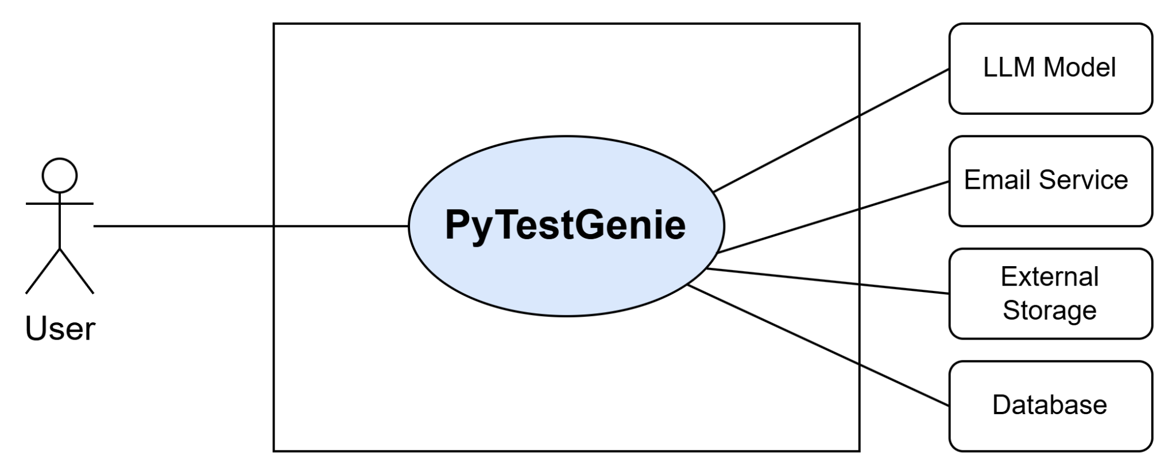
Use case diagram (Level-0)
Level- 0 Use case diagram

Slide 11
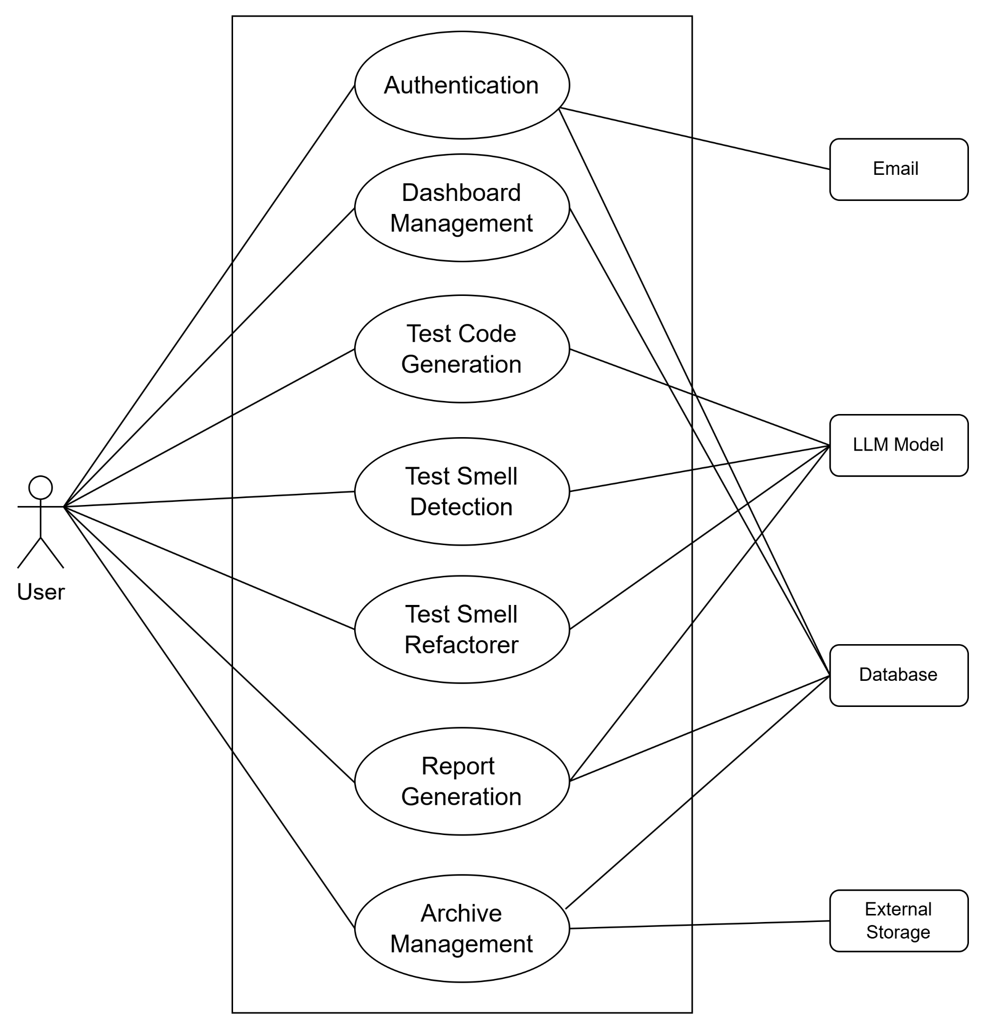
Use case diagram (Level-1)
Level- 1 Use case diagram

Slide 12
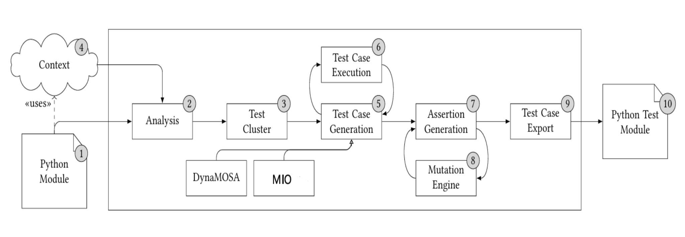
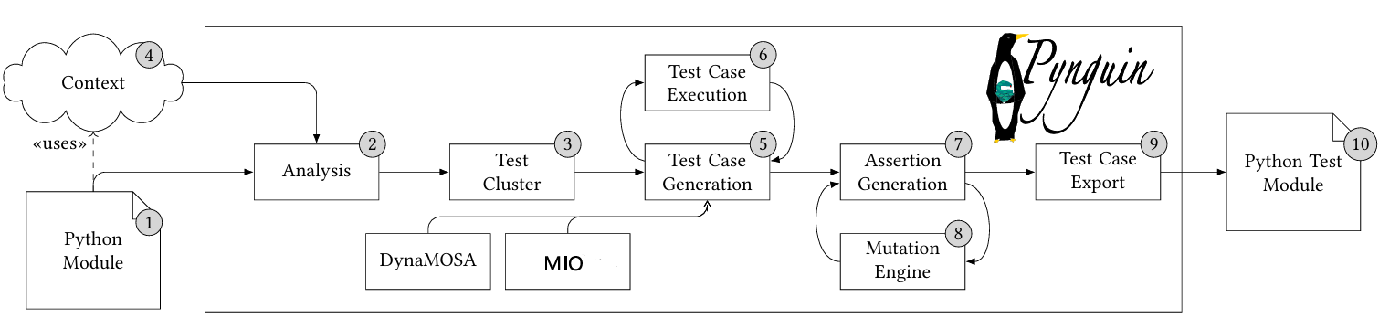
Unit test generation
Rule Based Approach
(Algorithm: Dynamic Many-Objective Sorting , Many Independent Objective)

Slide 13
DynaMOSA Algorithm
MIO Algorithm
Each branch or statement in the code is a goal.
Create random test cases.
Run tests and measure which goals are covered.
Mutate and combine tests to cover uncovered branches.
Ignore branches already covered; focus on remaining ones.
Continue until all branches are covered or time runs out.
Example: If function has 3 branches (A, B, C).DynaMOSA first focuses on uncovered branch A, then B, then C, avoiding repetition.
Treat each branch as a separate objective.
Each goal has its own small test group.
Run tests for each goal and measure coverage.
Improve tests in each group for its goal.
Keep the best tests in archive for each branch.
Stop when all goals are covered or time ends.
Example: If function has 5 branches (A, B, C, D, E), MIO maintains 5 groups of tests where each evolves to cover its branch independently, ensuring all branches are covered efficiently.

Slide 14
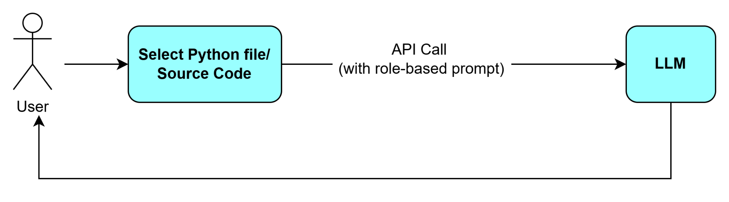
Unit test generation (cont.)
LLM-Based Approach

Slide 15
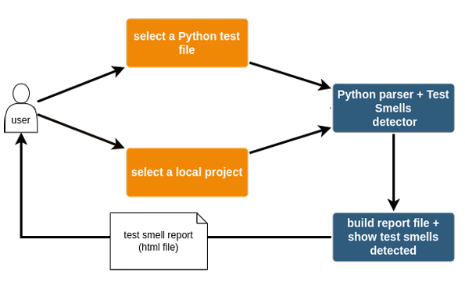
Test smell detection
Rule-Based Approach

Slide 16
TemPy Framework Workflow
1. Parsing : Converts each test file into an Abstract Syntax Tree (AST) & represents the code’s syntax as a tree structure.
2. Traversal: Visits each node in the AST (functions, statements, method calls).
3. Pattern Matching: Applies rules for known test smells: e.g.
  time.sleep() → Sleepy Test
  Test methods without asserts → Undefined Test
4. Data Recording: smell type, method name, line number
5. Report Generation

Slide 17
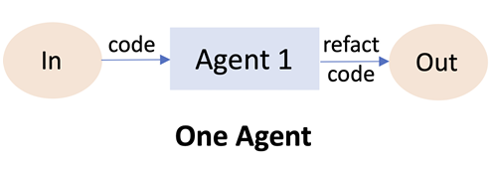
Test smell detection & Refactoring
Single Agent Workflow (LLM Based Approach)
Uses role-based, persona-driven agents

Slide 18
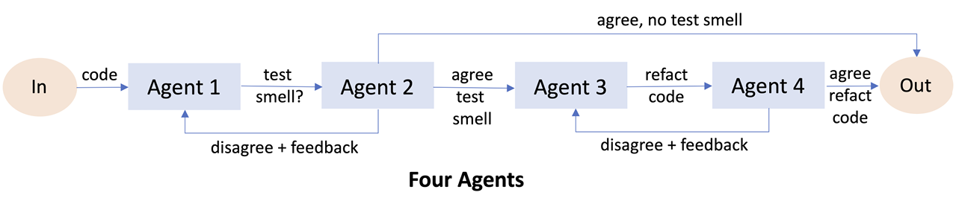
Test smell detection & Refactoring (cont.)
Multi Agent Workflow (LLM Based Approach))

Slide 19
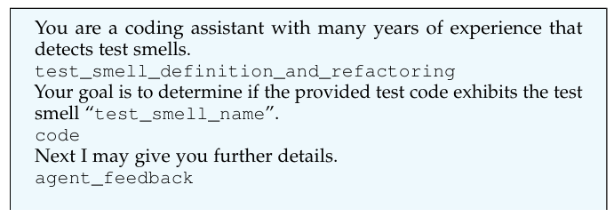
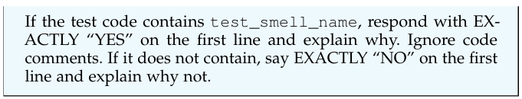
Persona-Driven Agent (Example)

Slide 20
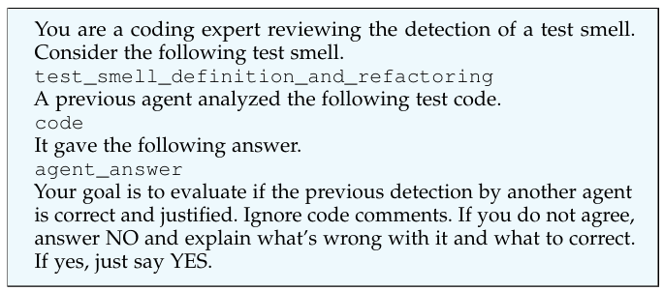
Persona-Driven Agent (Example)

Slide 21
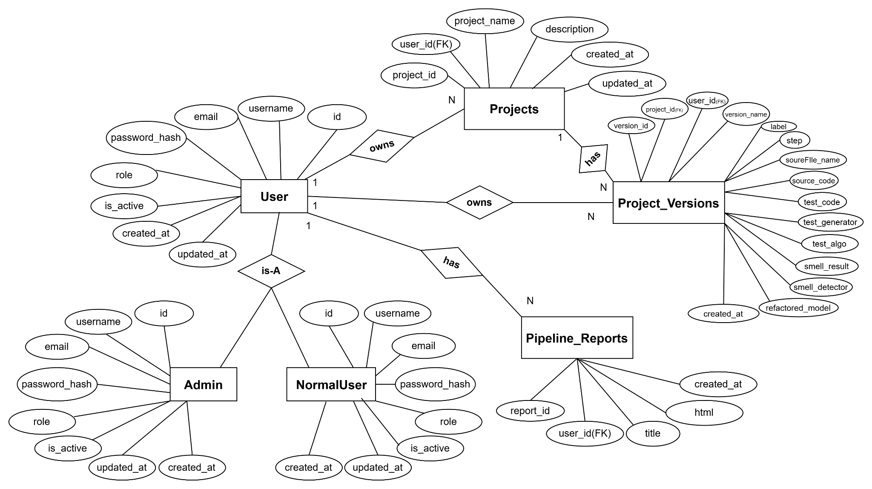
ER Diagram

Slide 22
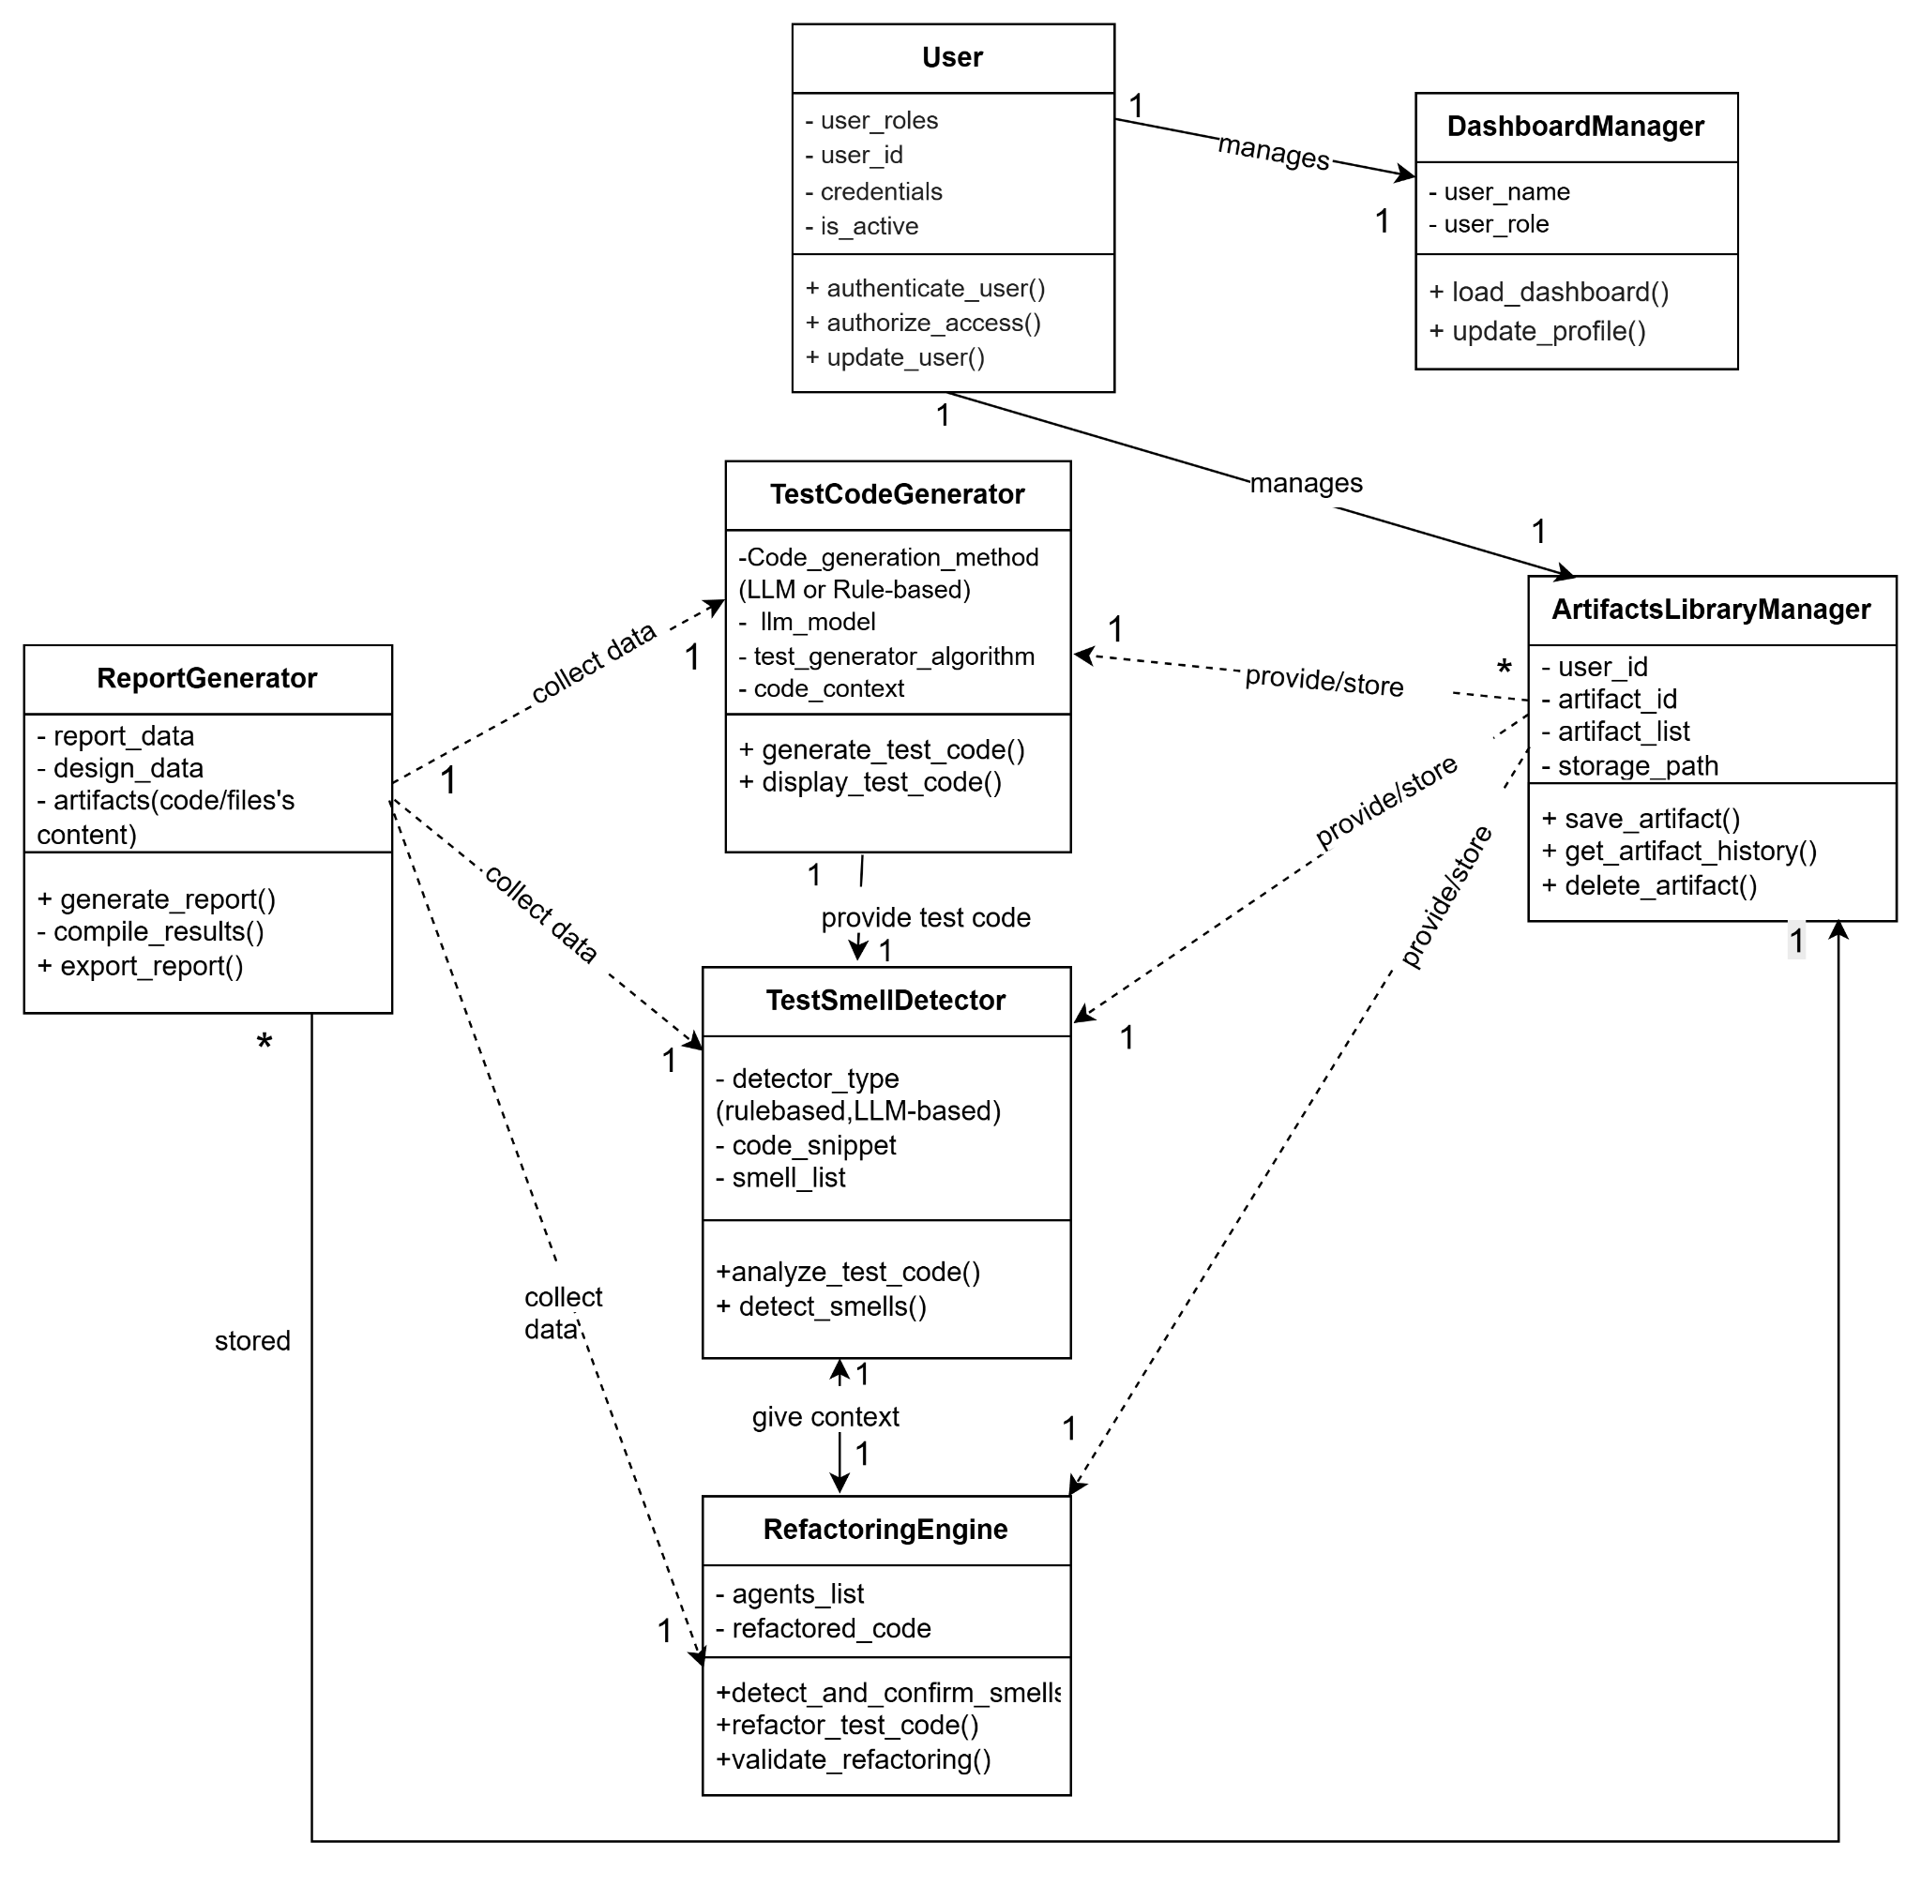
CRC Diagram

Slide 23
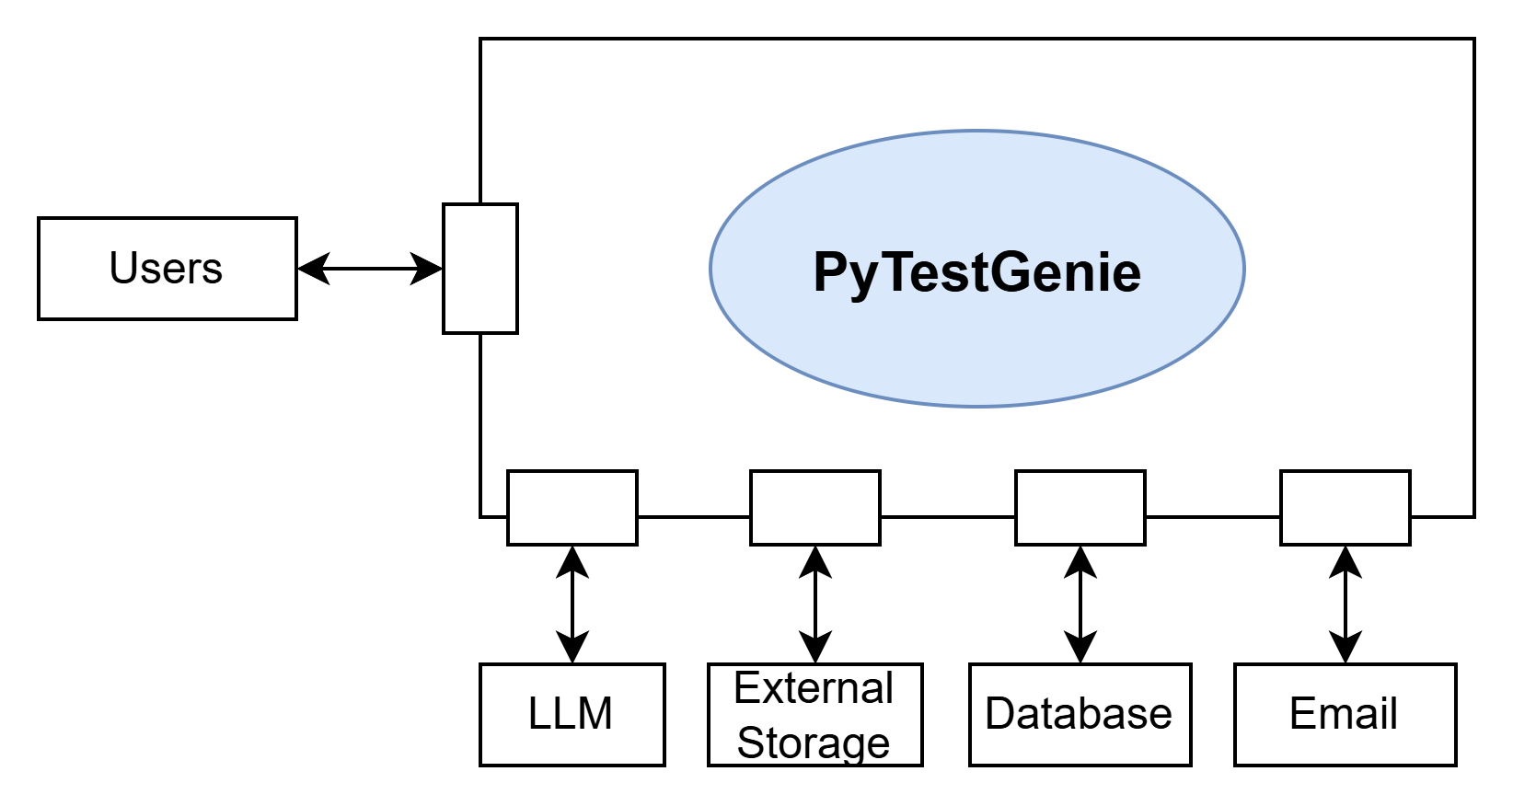
Architectural Context Diagram

Slide 24
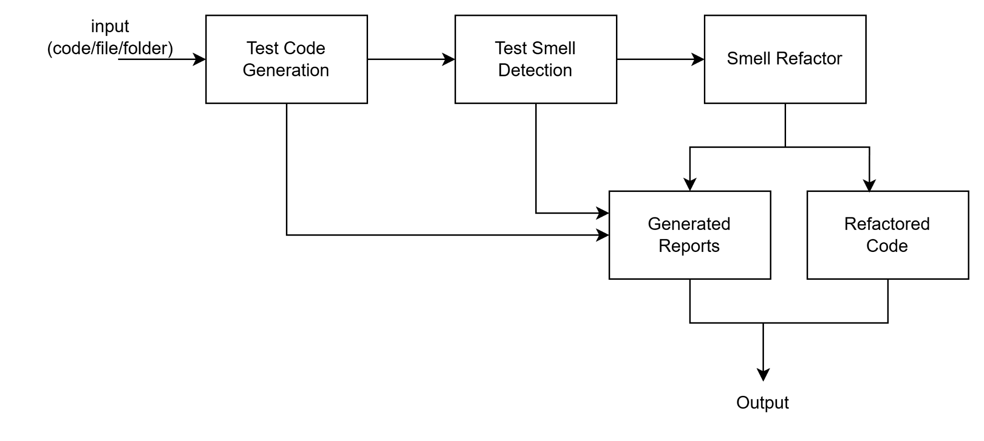
Pipe and Filter Architecture

Slide 25
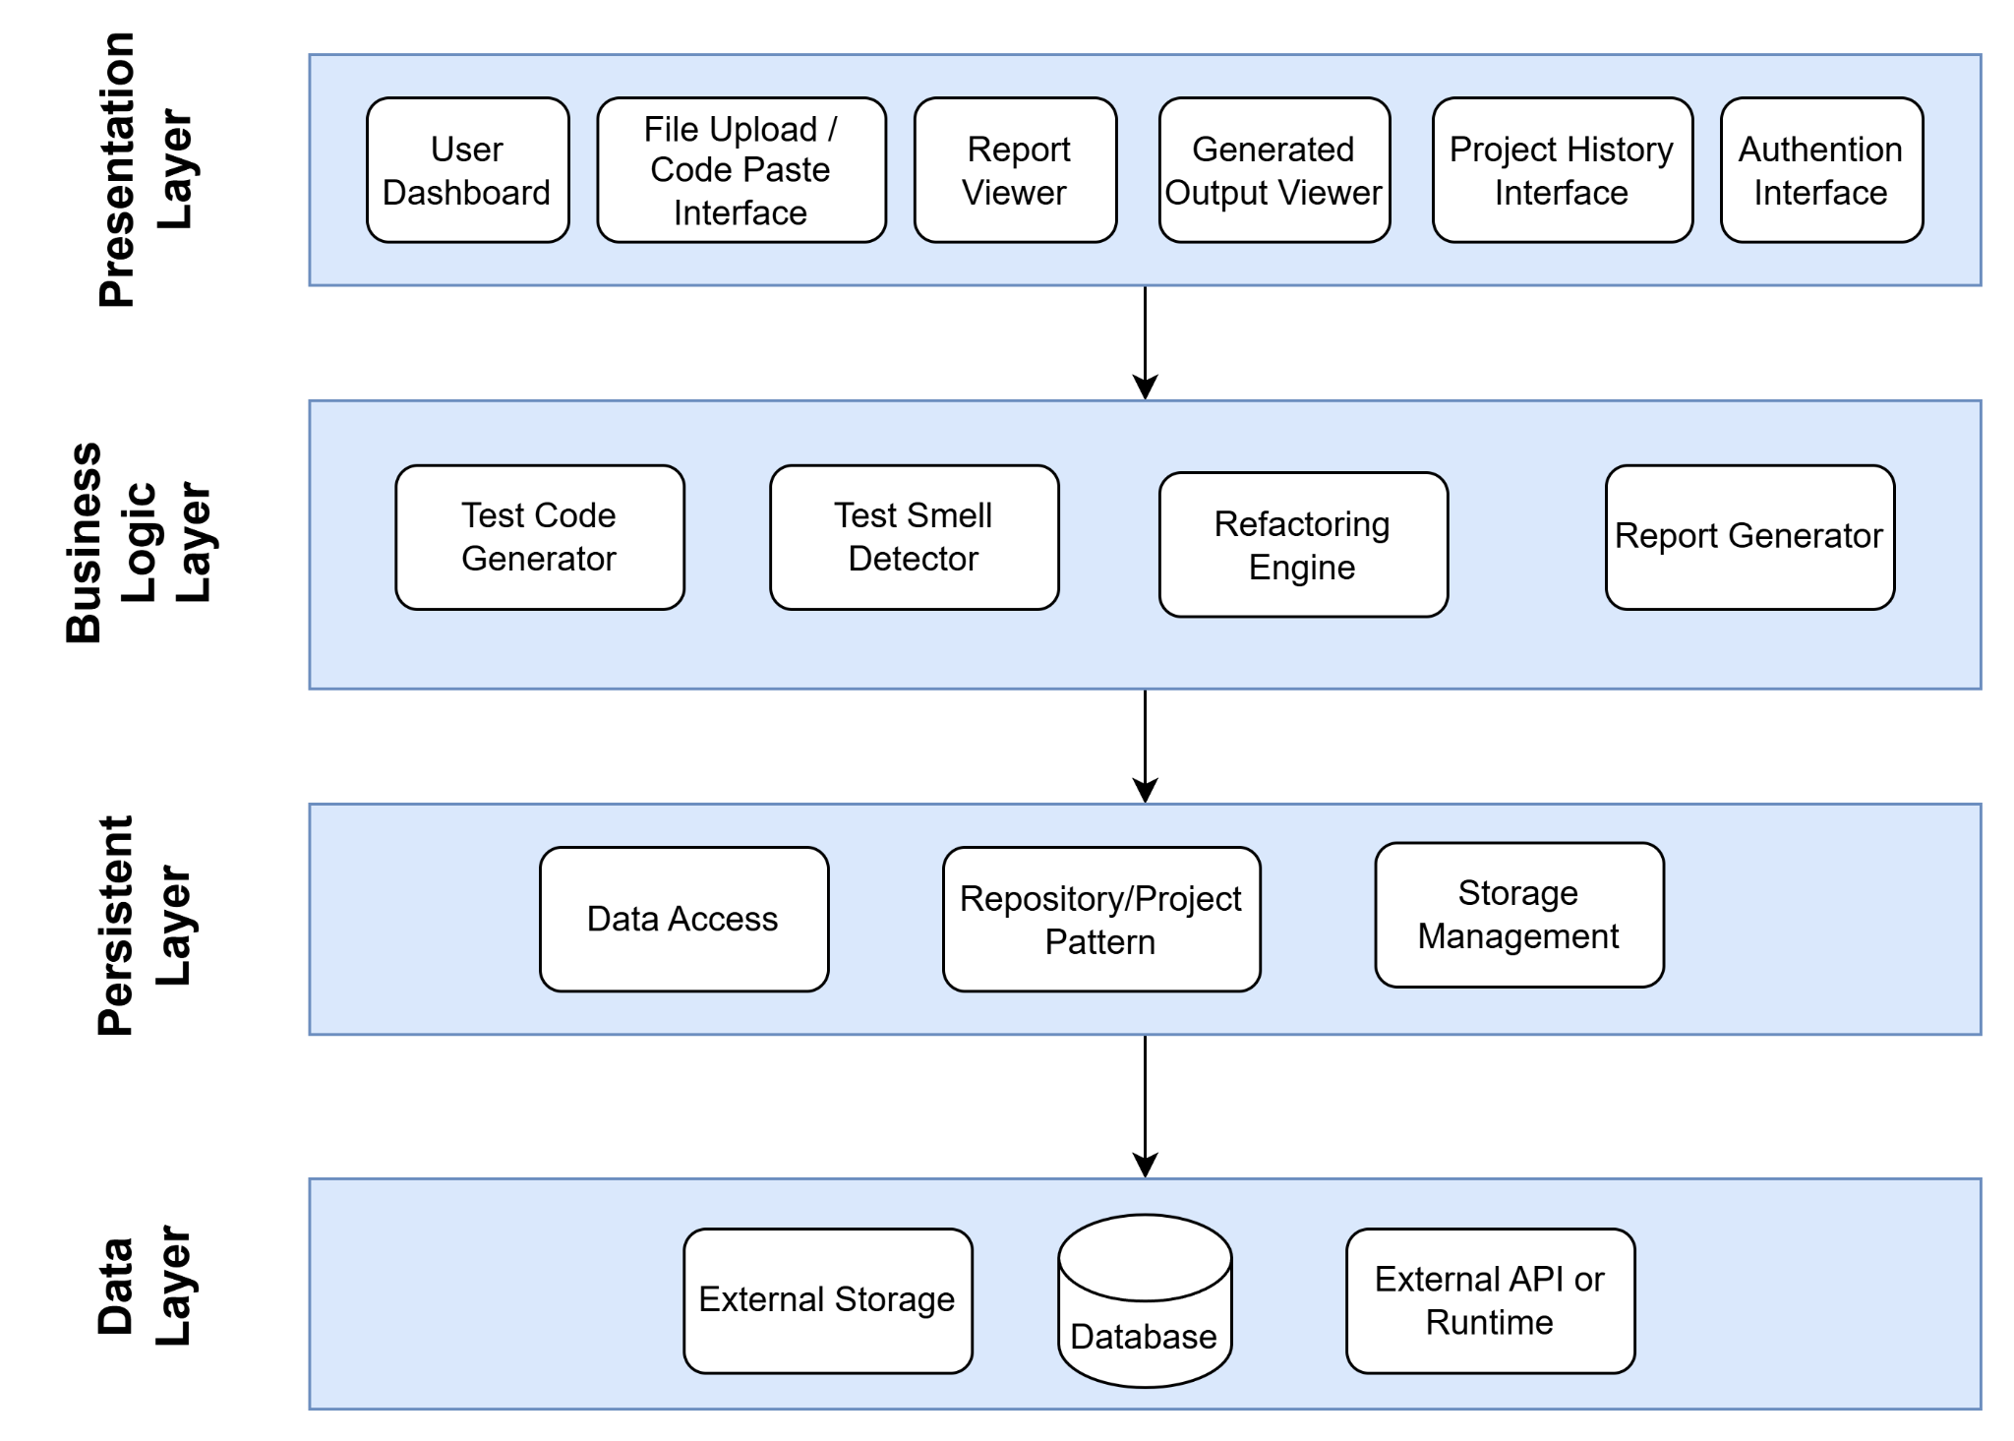
Layered Architecture

Slide 26
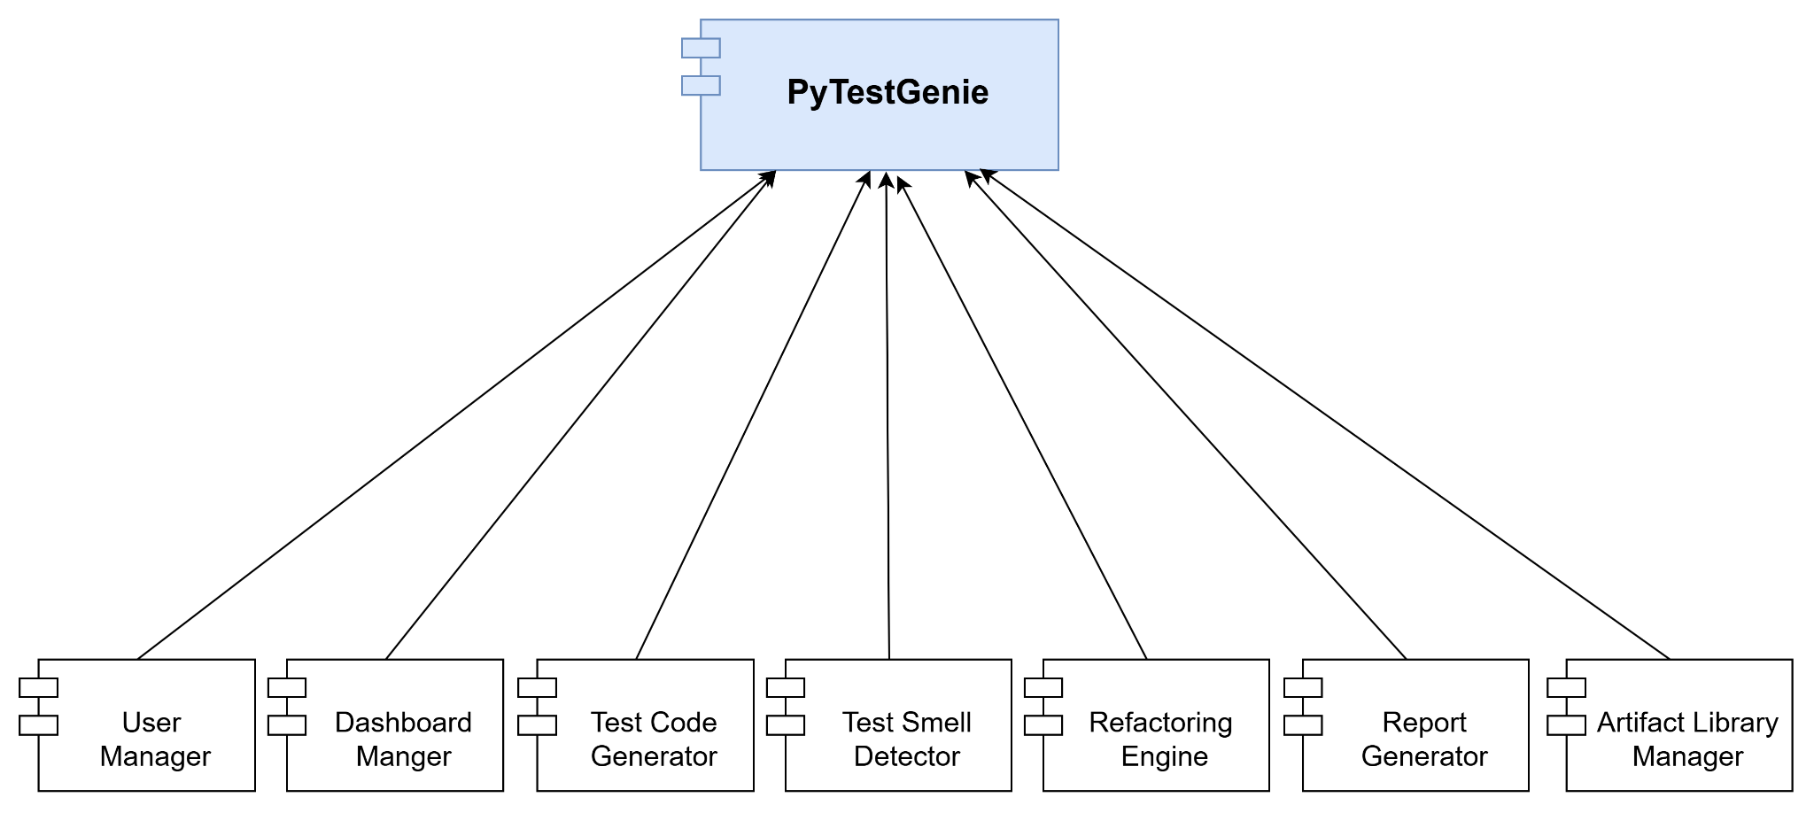
Top level Components Basic Architecture

Slide 27
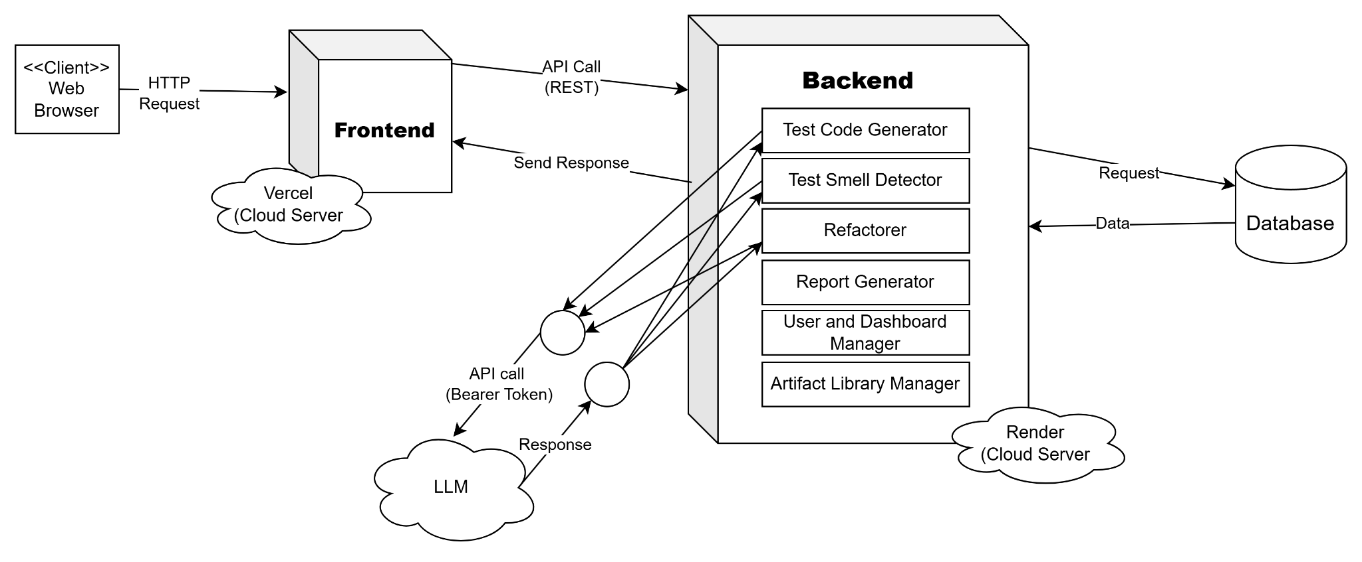
Deployment Diagram

Slide 28



Tools & Technologies

Slide 29
Let’s see what the reports say
Public URL of the web tool: https://py-test-genie-v1.vercel.app/
Github Repository link: https://github.com/AmitRoy01/PyTestGenie
Implementation Details
User Interfaces
User Manual
Test reports (Test Report )

Slide 30
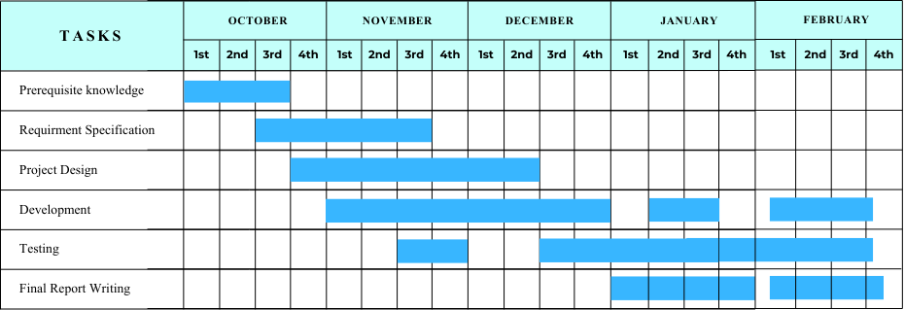
Timeline

Slide 31
References
[1] S. Lukasczyk and G. Fraser, “Pynguin: Automated unit test generation for python,” in Proceedings of the ACM/IEEE 44th International Conference on Software Engineering: Companion Proceedings, ser. ICSE ’22, Pittsburgh, Pennsylvania: Association for Computing Machinery, 2022, pp. 168–172, isbn: 9781450392235. doi: 10.1145/3510454.3516829. [Online]. Available: https: //doi.org/10.1145/3510454.3516829
[2] R Melo, P Simões, R Gheyi, M d'Amorim, M Ribeiro, G Soares, E Almeida, E Soares, “Agentic LMs: Hunting Down Test Smells”arXiv preprint arXiv:2504.07277, 2025.
[3] D Fernandes, I Machado, R Maciel, “TEMPY: Test smell detector for Python”. Proceedings of the XXXVI Brazilian Symposium on Software Engineering, 2022
[4] Automated Test Case Generation as a Many-Objective Optimisation Problem with Dynamic Selection of the Targets
[5] Many Independent Objective (MIO) Algorithm for Test Suite Generation
[6]PyNose: A Test Smell Detector For Python, Tongjie Wang, Yaroslav Golubev, Oleg Smirnov, Jiawei Li, Timofey Bryksin, Iftekhar Ahmed.

Slide 32
Thanks!
Please let me know if you have any questions…

