Slide 1

Low-Light Image Enhancement via Multi-Scale Feature Fusion
Soumitra Paul
BSSE 1317
Supervised By
Dr. Emon Kumar Dey
ENTER

Slide 2



TABLE OF CONTENTS
INTRODUCTION
METHODOLOGY
01
Motivation, Purpose, and Features
Methodology
02
03
04
RESULT
FUTURE SCOPE
& LIMITATIONS
Comparison
Limitations & Scope

Slide 3
01.
INTRODUCTION
01
02
03
04
What is this Project ?

Slide 4
PROJECT INTRODUCTION
A locally hosted web application built with multi-scale fusion architeture, featuring enhancing low light image with output calibration controls.
01
02
03
04

Slide 5
MOTIVATION
01
02
03
04
Research based
Image restoration
Evaluating model
generalization

Slide 6
FEATURES
01
User
adjustable
preference
Users can input multiple images
at a time
Download
option
02
03
04
Simple UI

Slide 7
02.
METHODOLOGY
01
02
03
04
Features of the project

Slide 8
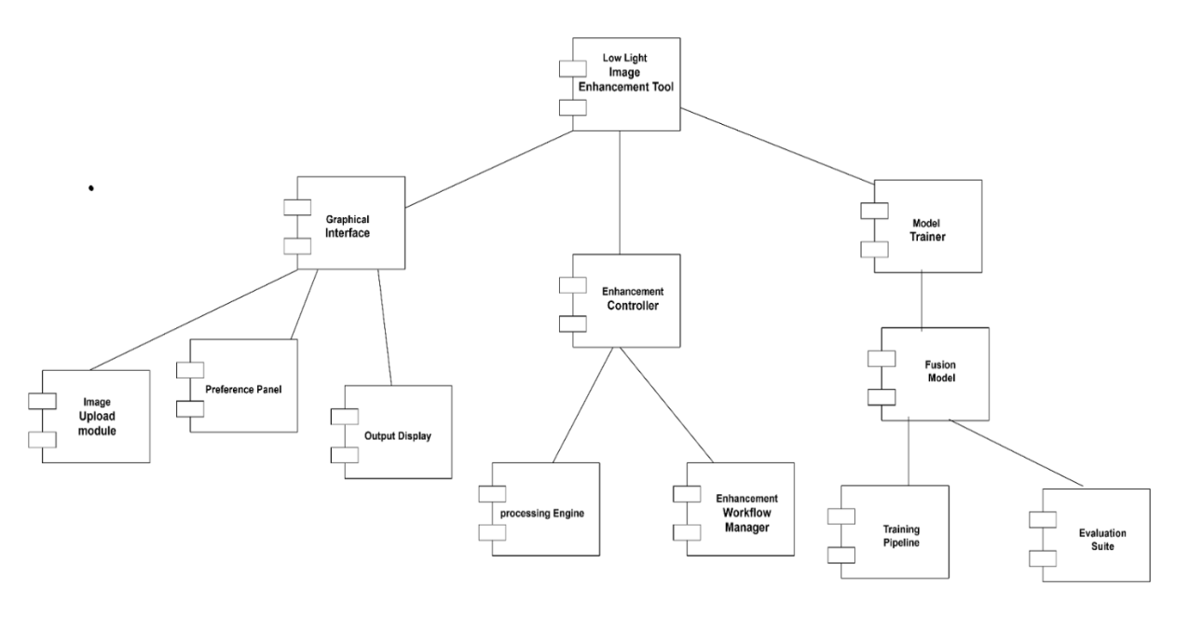
COMPONENTS
01
02
03
04

Slide 9
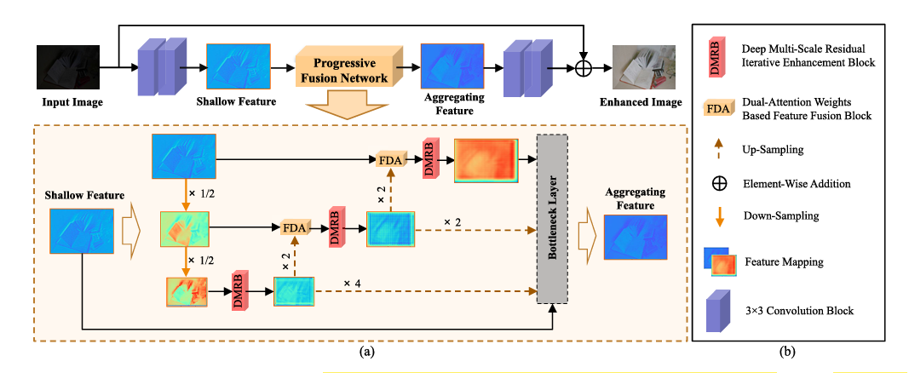
Model architecture
01
02
03
04

Slide 10
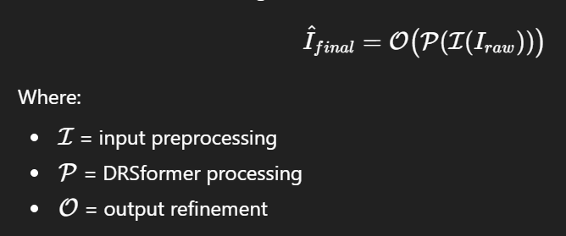
SYSTEM OVERVIEW
01
02
03
04

Slide 11
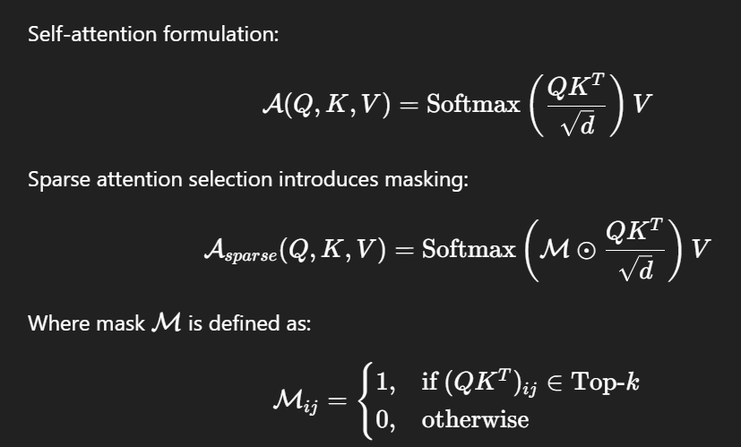
BRAIN OF THE PROJECT
01
02
03
04

Slide 12
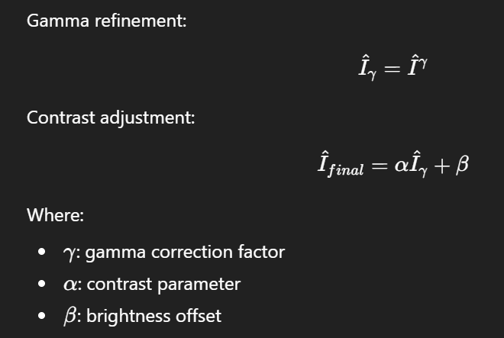
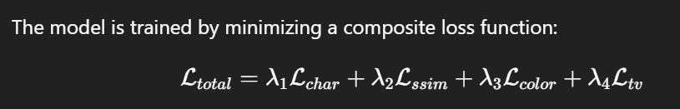
Tuning
01
02
03
04

Slide 13
Dataset
Dataset: LOL (Low-Light) dataset (v1 and v2).
Structure: Paired images consisting of low-light inputs and normal-light ground truths.
Split: 90% for training and 10% for validation/testing.
Purpose: Providing a supervised learning environment to teach the model lighting restoration.
01
02
03
04

Slide 14
03.
RESULTS
01
02
03
04
How much has it improved?

Slide 15
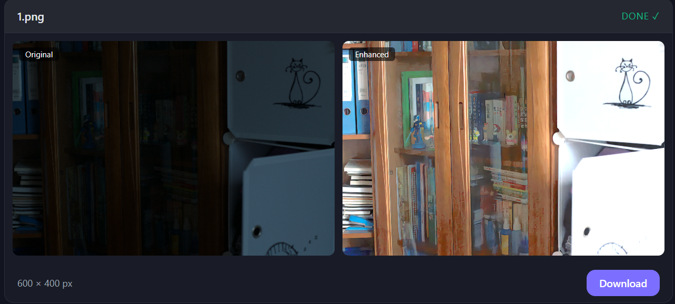
Outcome
01
02
03
04

Slide 16
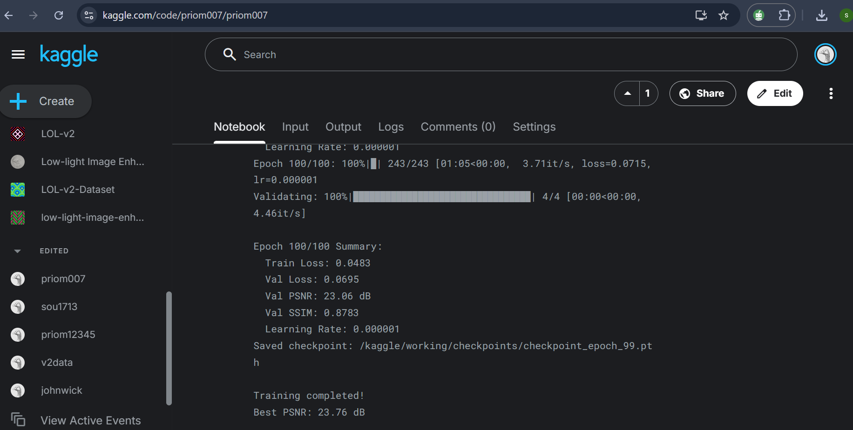
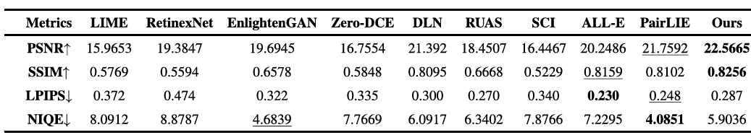
COMPARISON
01
02
03
04

Slide 17
04.
CHALLENGES FACED
01
02
03
04
Future Plans for Improvement

Slide 18
CHALLENGES FACED
01
Complexity
of Hybrid
Architecture
Training
Hardware Limitation
02
03
04
Output Calibration
Batch processing
Researching

Slide 19
Future Scope & Limitations
Limitations
Scope
01
02
1. Unsupervised learning
2. Real-time video
1.Hardware dependency
2.Resolution Constraints
3.Dataset bias
4.Static image only
03
04

Slide 20
References
[1] Zhang, Hongxin, Teng Ran, Wendong Xiac, Kai Lv, Song Peng, Liang Yuan, and Jingchuan Wang. "Multi-Scale Progressive Fusion Network for Low-Light Image Enhancement." IEEE Transactions on Instrumentation and Measurement (2025).
[2]Zhang, Kaibing, Cheng Yuan, Jie Li, Xinbo Gao, and Minqi Li. "Multi-branch and progressive network for low-light image enhancement." IEEE Transactions on Image Processing 32 (2023): 2295-2308.
[3]CHATGPT(for image of formula)

Slide 21
THANKS!
01
Do you have any questions?
02
03
Supervised By
Dr.Emon Kumar Dey
Associate Professor ,IIT, DU
Presented By
Soumitra Paul
BSSE 1317
04
Please keep this slide for attribution

