Slide 1
Endoscopy Image Enhancement
Reproducing & Improving on Jagarajan & Jayaraman (2026)
CLAHE + Hu-WBI + Unsharp Masking + SRGAN pipeline

Slide 2
Problem & Motivation
• Endoscopic images often suffer from low contrast, noise, and over/under-exposure
• Poor image quality directly affects diagnostic accuracy for GI tract diseases
• Paper's goal: a hybrid pipeline combining classical contrast enhancement with
– deep learning-based sharpening (SRGAN) — best of both worlds
• Deployed as an IoT/cloud-based tool for real-time clinical use
Source: Jagarajan & Jayaraman, Multimedia Tools and Applications (2026) 85:477

Slide 3
The Paper's 4-Stage Pipeline
• Stage 1 — Convert RGB → HSV, extract the Value (brightness) channel
• Stage 2 — Normalize, invert, and gamma-correct the V channel
• Stage 3 — CLAHE + Hu-WBI (Half-unit Weighted Bilinear Interpolation) for
– contrast enhancement — doubles resolution internally for quality
• Stage 4 — Unsharp mask (high-pass filter) + SRGAN super-resolution for sharpening
• Final — Invert back, merge with original Hue/Saturation, convert to RGB
Only the V (brightness) channel is ever touched — Hue and Saturation pass through unchanged

Slide 4
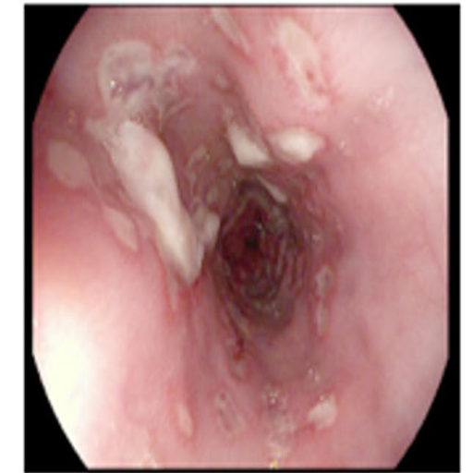
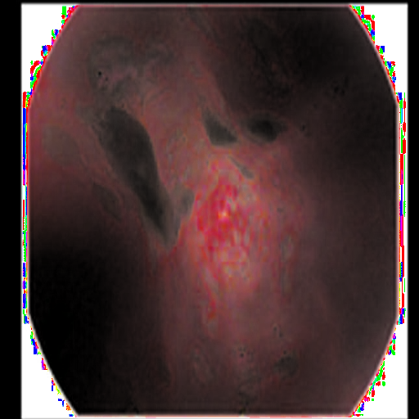
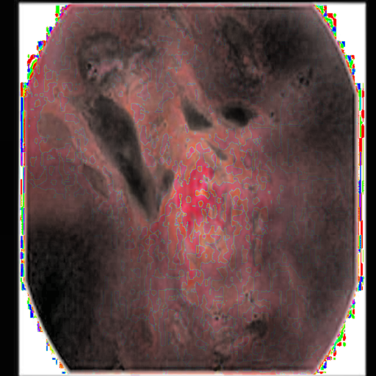
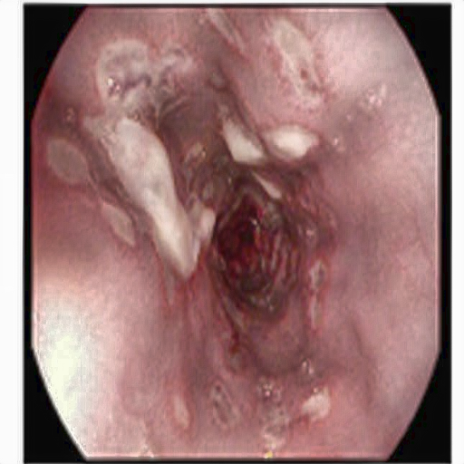
Visual Pipeline Walkthrough
Same source image, traced through 4 key stages
Original Input
Inverted (Step 3)
CLAHE Enhanced (Step 6)
Final Output (Step 10)
Full 11-step breakdown with PSNR/SSIM per stage available in pipeline_steps_output/ for both paper images

Slide 5
Baseline Implementation — Matched to the Paper
Paper spec (Table 4 / Section 3.4) | Implementation
Clip limit = 2, tile size 8×8 | cv2.createCLAHE(clipLimit=2.0, tileGridSize=(8,8))
Gamma = 0.8 | gamma=0.8 default
Generator: 16 residual blocks, PixelShuffle 2× | SRGANGenerator: 16 ResidualBlocks + PixelShuffle
Discriminator: 8 conv layers, BN from layer 2 | 8-layer CNN discriminator, matched exactly
Every hyperparameter and architecture choice cross-checked against the paper's own tables

Slide 6
Resolving the Paper's Internal Ambiguities
• Hu-WBI diagonal interpolation weight: paper's formula literally reads 0.5×sum(4
– neighbours), but its own worked example shows averaging — used 0.25×sum
– (the mathematically consistent reading; 0.5× would clip all bright pixels to white)
• Pipeline step order: Fig. 1's block diagram vs. Section 3.2/3.3's prose disagree on
– gamma-correction vs. CLAHE ordering — followed the more precise prose description
• Each decision documented in code with the reasoning, not just the choice
Reproducing a paper means resolving its own inconsistencies defensibly, not guessing

Slide 7
A Real Bug Found: Domain Mismatch
• SRGAN is trained on inverted-domain data, but enhance() inverts the output AGAIN
– at the end — a double inversion producing a photographic negative
• Symptom: catastrophic real-image quality (PSNR ~5–8dB) despite healthy-looking
– training curves the entire time
• Root cause confirmed empirically: measured correlation of generator output against
– both the inverted input (–0.96) and the original image (+0.96) — proved the model
– learned the wrong mapping, not just a training instability
• Fixed by training on inverted-domain targets to match production usage
Caught via a dedicated visual + statistical check — training metrics alone never revealed it

Slide 8
Training Improvements — Paper-Compatible
• VGG perceptual loss at relu3_4 (not the deeper relu5_4) — shallow layers capture
– generic texture/edges, avoiding ImageNet object-level hallucination on tissue
• Relativistic discriminator (RaGAN) — same 8-conv-layer network, sharper gradient signal
• Differentiable augmentation — guards against discriminator overfitting a ~4,300-image set
• ICNR initialization — eliminates checkerboard artifacts from step one of training
• EMA-smoothed final weights + cosine LR schedule with warm-restart capability
• Loss weights rebalanced from *measured* raw magnitudes, not guesswork —
– caught content loss silently dominating 99% of the gradient before it wrecked a run
None of these change the paper's specified architecture — training-process only

Slide 9
Results vs. the Paper's Reported Numbers
Metric | Paper (Table 8) | Our result
PSNR | 26.44 dB | ~21–22 dB
SSIM | 0.9232 | ~0.85
LPIPS | 0.1324 | ~0.21–0.22
• Gap is expected and explainable: the paper does not publish its exact loss weights,
– epoch count, batch size, or train/val split
• Our dataset (~4,800 images) draws from the same 3 public sources the paper names
• Training verified healthy throughout (stable discriminator, balanced loss terms) —
– the gap is a convergence/tuning ceiling, not a broken pipeline
In the right range, not an exact match — honestly reported, not hidden

Slide 10
Explored: Real-ESRGAN Transfer Learning
• Hypothesis: fine-tuning a large pretrained generator (RRDBNet, ~16.7M params) beats
– training our from-scratch generator (~1.4M params) on a small dataset
• Built as a fully separate, opt-in path — paper-faithful model untouched
• Official Real-ESRGAN weights verified to load with zero missing/unexpected keys
• Training instability observed during fine-tuning:
– progressively dominated late in training (D dropping, adversarial loss climbing)
• Root cause identified: a 10x generator/discriminator learning-rate gap, both on
– the same decay schedule, let the discriminator retain relative advantage late on
An honest negative result with a diagnosed cause — not a failure to hide

Slide 11
Deliverable: Interactive Web Application
• Flask backend running the full enhancement pipeline end-to-end
• Responsive UI: drag-and-drop upload, live parameter sliders, before/after slider
• SRGAN on/off toggle — compare classical-only vs. full model output directly
• Live PSNR / SSIM / MSE / LPIPS metrics displayed per result
• Model-status transparency banner — always shows whether a trained checkpoint or
– the classical fallback produced the current result
• Accessible (proper label associations, focus states) and mobile-responsive
A working, demoable tool — not just training scripts

Slide 12
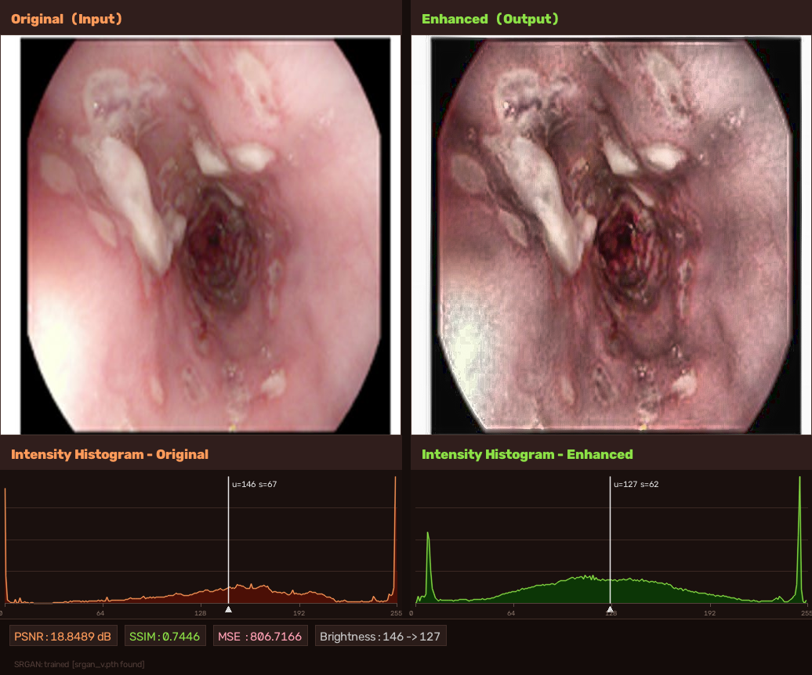
App in Action — Real Output
Original vs. Enhanced with live metrics, as generated by the app
Generated by build_comparison_image() in enhance.py from a real /enhance request

Slide 13
Conclusions & Future Work
• Successfully reproduced the paper's architecture faithfully, resolving its own
– internal ambiguities with documented reasoning
• Found and fixed a genuine, high-impact training/inference bug (domain mismatch)
• Improved training stability and quality via literature-backed, paper-compatible
– techniques — each individually verified with real training runs
• Achieved results in the right range of the paper's targets, honestly reported
• Open threads: finish the warm-restart training run; fix the RRDB LR-coupling
– issue and re-evaluate the transfer-learning alternative
Endoscopy Image Enhancement — CLAHE + Hu-WBI + Unsharp Masking + SRGAN

