Slide 1
RESEARCH REPRODUCTION · BIOMEDICAL IMAGE ENHANCEMENT
Endoscopy Image Enhancement
Reproducing & Improving Jagarajan & Jayaraman (2026)
CLAHE
→
Hu-WBI
→
Unsharp Masking
→
SRGAN
Source: Jagarajan & Jayaraman, Multimedia Tools and Applications (2026) 85:477

Slide 2
MOTIVATION
Why endoscopic images need enhancement
Low contrast · noise · over/under-exposure
Common capture artifacts in endoscopic video
↓
Loss of clinically useful detail
Subtle tissue and lesion features become hard to distinguish
↓
Enhancement is needed before diagnosis
Restore detail without discarding diagnostic information
The paper's approach: a hybrid pipeline pairing classical contrast enhancement with deep-learning sharpening (SRGAN), deployable as an IoT/cloud tool for real-time clinical use.
Source: Jagarajan & Jayaraman, Multimedia Tools and Applications (2026) 85:477
2

Slide 3
METHOD
The paper's 4-stage pipeline
1
2
3
4
Input
Final RGB
RGB → HSV
Normalize
+ Invert + Gamma
CLAHE
+ Hu-WBI
Unsharp Mask
+ SRGAN
RGB frame
merge H, S, V
Extract V channel
on V channel
contrast enhancement
sharpening
Only the V (brightness) channel is processed — Hue and Saturation pass through unchanged and are re-merged at the end.
Stage numbers 1–4 correspond to the paper's own stage labels; Input/Final are pipeline endpoints.
3

Slide 4
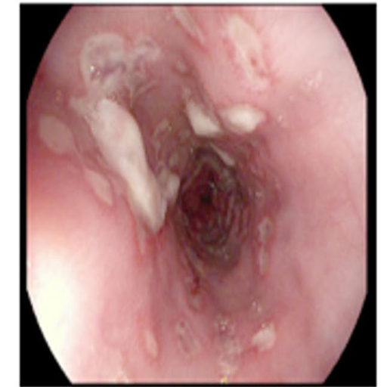
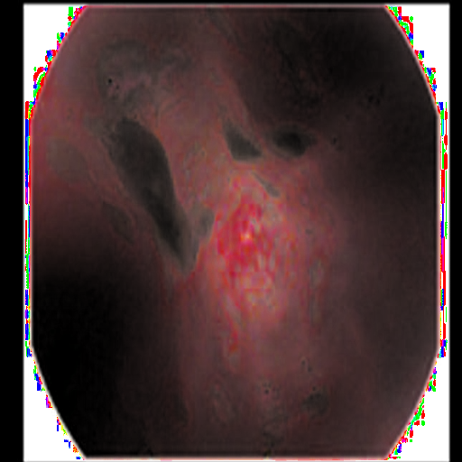
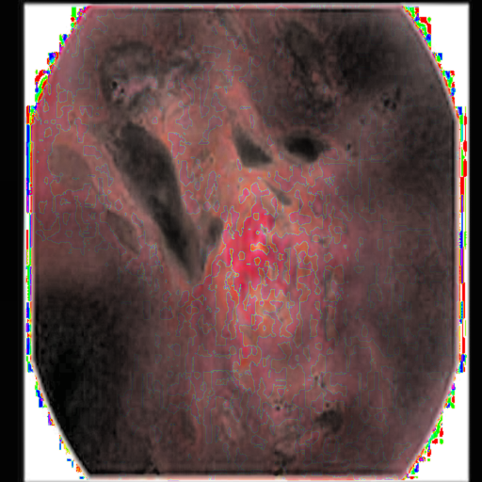
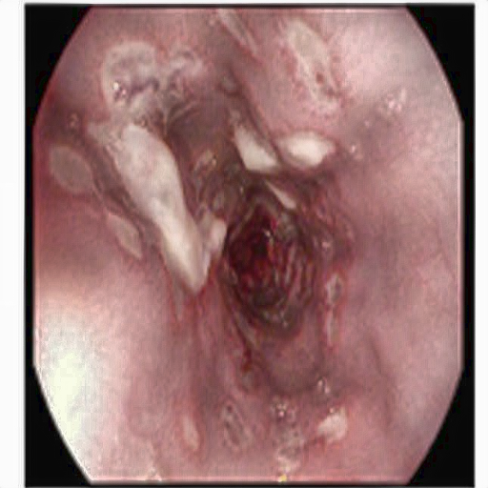
METHOD — APPLIED
Visual pipeline walkthrough
Same source image traced through four key stages
→
→
→
Step 0
Step 3
Step 6
Step 10
Original Input
Inverted
CLAHE Enhanced
Final Output
Full 11-step breakdown with PSNR/SSIM per stage available in pipeline_steps_output/ for both paper images.
4

Slide 5
REPRODUCTION
Baseline implementation — matched to the paper
PAPER SPEC
OUR IMPLEMENTATION
Table 4 / Section 3.4
CLAHE parameters
Clip limit = 2, tile size 8×8
cv2.createCLAHE(clipLimit=2.0, tileGridSize=(8,8))
=
Gamma
Gamma = 0.8
gamma = 0.8 (default)
=
Generator
16 residual blocks, PixelShuffle 2×
SRGANGenerator: 16 ResidualBlocks + PixelShuffle
=
Discriminator
8 conv layers, BN from layer 2
8-layer CNN discriminator, matched exactly
=
Every hyperparameter and architecture choice was cross-checked against the paper's own tables.
5

Slide 6
REPRODUCTION
Resolving the paper's internal ambiguities
ISSUE
ISSUE
Hu-WBI diagonal interpolation weight
Gamma-correction vs. CLAHE ordering
PAPER AMBIGUITY
PAPER AMBIGUITY
Formula literally reads 0.5 × sum(4 neighbours); the paper's own worked example shows averaging instead.
Fig. 1's block diagram and Section 3.2/3.3's prose disagree on stage order.
OUR DECISION: Used 0.25 × sum
OUR DECISION: Followed the prose description
REASON
REASON
The mathematically consistent reading — 0.5× would clip all bright pixels to white.
The more precise, unambiguous source of the two.
Reproduction required defensible interpretation, not blind implementation.
6

Slide 7
DEBUGGING
A real bug found: domain mismatch
EXPECTED
Inverted input
→
SRGAN
→
Inverted-domain output
BUG
Inverted input
→
SRGAN
→
Original-domain-
like output
→
Inverted again
→
Negative image
SYMPTOM
ROOT CAUSE
FIX
PSNR ≈ 5–8 dB
corr ±0.96
Retrain on inverted-domain targets
despite healthy-looking training curves
output correlates with inverted input (–0.96) and original (+0.96)
matches production usage
Caught via a dedicated visual + statistical check — training metrics alone never revealed it.
7

Slide 8
TRAINING
Training improvements — paper-compatible
1
Perceptual Quality
2
GAN Stability
VGG perceptual loss at relu3_4 (not the deeper relu5_4) — captures generic texture/edges, avoiding ImageNet object-level hallucination on tissue
Relativistic discriminator (RaGAN) — same 8-conv-layer network, sharper gradient signal
Differentiable augmentation — guards against discriminator overfitting a ~4,300-image set
3
Artifact Reduction
4
Optimization
ICNR initialization — eliminates checkerboard artifacts from step one of training
EMA-smoothed final weights + cosine LR schedule with warm-restart capability
Loss weights rebalanced from measured raw magnitudes — caught content loss silently dominating 99% of the gradient before it wrecked a run
None of these change the paper's specified architecture — training-process only.
8

Slide 9
EVALUATION
Results vs. the paper's reported numbers
PSNR
Paper: 26.44 dB
Ours: ~21–22 dB
SSIM
Paper: 0.9232
Ours: ~0.85
LPIPS Paper: 0.1324 · Ours: computed, comparable range
We reproduced the method successfully — but do not claim an exact numerical match. Several training details (loss weights, epoch count, batch size, train/val split) were not published. Training was verified healthy throughout; the gap reflects a convergence/tuning ceiling, not a broken pipeline.
9

Slide 10
EXPLORATION
Explored: Real-ESRGAN transfer learning
HYPOTHESIS
Fine-tuning a large pretrained RRDBNet (~16.7M params) beats our from-scratch generator (~1.4M params) on a small dataset
EXPERIMENT
Built as a fully separate, opt-in path — paper-faithful model untouched. Official weights verified to load with zero missing/unexpected keys
RESULT
Does NOT yet outperform the from-scratch model — discriminator progressively dominated late in training
DIAGNOSIS
A 10× generator/discriminator learning-rate gap, both on the same decay schedule, let the discriminator retain a relative advantage late on
Next step: revisit the learning-rate schedule so generator and discriminator decay independently, then re-run the comparison.
An honest negative result with a diagnosed cause — not a failure to hide.
10

Slide 11
DELIVERABLE
Interactive web application
User
→
Flask Web App
→
Enhancement
Pipeline
→
Enhanced Image
+ Metrics
1
2
3
4
5
Upload
Parameter Controls
SRGAN Toggle
Before / After
Live Metrics
Drag-and-drop image upload
Live sliders for classical-pipeline parameters
Compare classical-only vs. full model output
Interactive comparison slider
PSNR, SSIM, MSE, LPIPS per result
Also accessible (proper label associations, focus states) and mobile-responsive, with a model-status transparency banner.
11

Slide 12
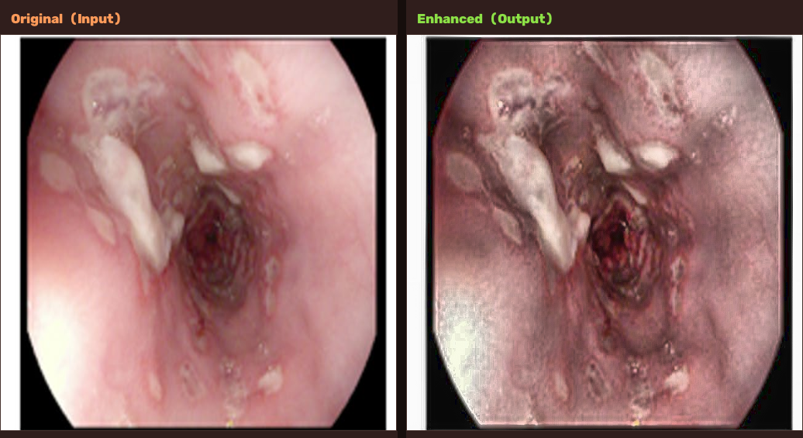
DELIVERABLE — IN ACTION
App in action — real output
PSNR 18.85 dB
SSIM 0.7446
MSE 806.72
Brightness 146 → 127
Generated by build_comparison_image() in enhance.py from a real /enhance request.
12

Slide 13
CONCLUSION
What this reproduction achieved
REPRODUCED
DIAGNOSED
IMPROVED
Paper architecture faithfully implemented, resolving its own internal ambiguities with documented reasoning.
Found and fixed a genuine, high-impact domain-mismatch bug in training/inference.
More stable training via literature-backed, paper-compatible techniques, each verified with real runs.
FUTURE WORK
Finish the warm-restart training run
Fix the RRDB learning-rate coupling issue
Re-evaluate the transfer-learning alternative
A faithful reproduction, an honest account of its gaps, and a working tool built on both.
13

