Slide 1
TRAINING TRACK
Implementation corrections and experimental extensions to the SRGAN stage
Training the paper's SRGAN component end-to-end -- not just implementing its architecture -- surfaced issues only visible once real data moved through the training loop. This section documents what was found, corrected and verified, alongside two further extensions that remain open experiments.
1
Corrections -- verified
2
Experimental extensions -- open
Domain alignment, loss-term rebalancing, the LR warm-restart schedule, the VGG perceptual-loss layer, and CLAHE clip-limit tuning. Each backed by measured before/after numbers.
RRDB/Real-ESRGAN transfer learning and a YIQ colour-space variant. Both tested on a real image; neither yet outperforms the paper-faithful baseline.

Slide 2
TRAINING TRACK · CORRECTION 1
Aligning the training and inference domains
The generator's high-resolution training target was built from the raw brightness channel, while the pipeline itself operates entirely in an inverted, gamma-corrected domain and only un-inverts once, at the very end. Left mismatched, the generator learns to undo the inversion as part of super-resolution -- so inference then inverts a second time, producing near-negative output.
BEFORE (mismatched)
AFTER (aligned)
HR target = raw V channel
LR input = pre_srgan_v(downsample(V))
→ domains mismatched
HR target = pre_srgan_v(V)
LR input = pre_srgan_v(downsample(V))
→ same domain on both sides
Measured impact (real image)
~5–8 dB mismatched
→ ~21–24 dB aligned

Slide 3
TRAINING TRACK · CORRECTION 2
Rebalancing the composite loss function
Raw per-term loss magnitudes were logged during training rather than assumed. Content loss was found to dominate the total weighted loss almost completely:
Loss term
Weight before → after
Contribution before
Pixel (L1)
0.01 → 1.0
0.1%
Content (VGG)
1.0 → 0.05
98.8%
Adversarial (RaGAN)
0.001 → 0.03
0.8%
High-pass (HPF)
0.1 → 1.0
0.25%
After rebalancing (measured via smoke-test logging), all four terms fall within a 13–39% contribution band — no single term dominates.

Slide 4
TRAINING TRACK · CORRECTION 3
Stabilizing adversarial training
Four standard GAN-training techniques were added to keep the discriminator and generator in balance on a small (~4,300 image) dataset:
1
2
3
4
RaGAN loss
Differentiable augmentation
ICNR initialization
EMA of generator weights
Discriminator judges “more realistic than the other,” not absolute real/fake — smoother gradients than plain BCE.
Brightness/contrast/translation/cutout applied before the discriminator sees a batch — guards against overfitting.
PixelShuffle upsampling initialized to avoid checkerboard artifacts from the start of training.
Final checkpoint uses an exponential moving average, smoothing out late-training noise.
Learning-rate warm-restart correction
Before: LR stayed flat at 1e-6 across the resumed run. After: correctly restarts to 5.05e-5, then decays to eta_min again.

Slide 5
TRAINING TRACK · CORRECTION 4
Choosing a shallower VGG perceptual-loss layer
The content-loss term compares generator output and target through a pretrained VGG network's features rather than raw pixels. Deeper layers (relu5_4) encode ImageNet object-level semantics -- dog ears, car wheels -- which is a real hallucination risk when applied to endoscopy images, a domain VGG was never trained on. Shallower layers (relu3_4) encode generic texture and edge structure instead, which transfers far more safely to an out-of-domain image type.
relu5_4 (before)
relu3_4 (after)
Deep, object-level features (features[:36]) -- risks hallucinating ImageNet-style objects onto tissue texture.
Shallower, generic texture/edge features (features[:18]) -- matches structure without imposing semantic priors.

Slide 6
TRAINING TRACK · CORRECTION 5
Tuning the classical CLAHE clip_limit
Real-image output initially didn't visually match the paper's published figures, which looked like a training problem at first. It wasn't: the mismatch traced back to the classical pre-SRGAN stage -- CLAHE's clip_limit -- not the generator. Once isolated with the step-by-step pipeline-debug tool (pipeline_debug.py), the fix was a classical-parameter tune, with no retraining required.
Why this mattered
Separates two independent failure modes that look identical in a final image: a badly-trained generator vs. a mis-tuned classical stage feeding it a bad input.

Slide 7
TRAINING TRACK · EXTENSION 1
Extension: Real-ESRGAN / RRDBNet transfer learning
An explicit, opt-in alternative to training the paper's SRGAN generator from scratch: fine-tune a pretrained Real-ESRGAN generator (RRDBNet, dense residual blocks, no BatchNorm) on the same endoscopy data instead. Official RealESRGAN_x2plus.pth weights load with zero missing/unexpected keys.
From scratch (train_srgan.py)
Transfer learning (train_rrdb.py)
SRGANGenerator, 16 residual blocks -- 1,378,899 parameters -- matches the paper's Table 4 exactly.
RRDBGeneratorV, 23 RRDB blocks -- ~16.7M parameters -- ESRGAN architecture, ImageNet-pretrained prior.
Status: training instability observed -- discriminator dominating late in fine-tuning, likely from a 10x learning-rate gap between G and D on the same decay schedule. Not yet fixed or re-validated.

Slide 8
TRAINING TRACK · EXTENSION 2
Extension: YIQ colour-space variant
Tests whether Y (perceptually-weighted luma, 0.299R+0.587G+0.114B) gives a more “honest” brightness signal for gamma/CLAHE to work on than HSV's V (=max(R,G,B), dominated by whichever channel is brightest) -- at a cost HSV never has: YIQ→RGB is a linear transform, so an independently-modified Y can push RGB out of gamut, requiring clipping.
HSV (paper-faithful)
YIQ (this extension)
V = max(R,G,B). HSV→RGB never needs clipping, by construction -- no gamut risk.
Y = 0.299R+0.587G+0.114B. Verified near-lossless round-trip (max abs diff 1.0) -- no visible clipping artifacts found in practice.
Status: mixed results on both the paper's test images and the 3-way comparison (next slide) -- not a clear improvement over HSV. Only smoke-tested on CPU; full-dataset GPU training not yet run.

Slide 9
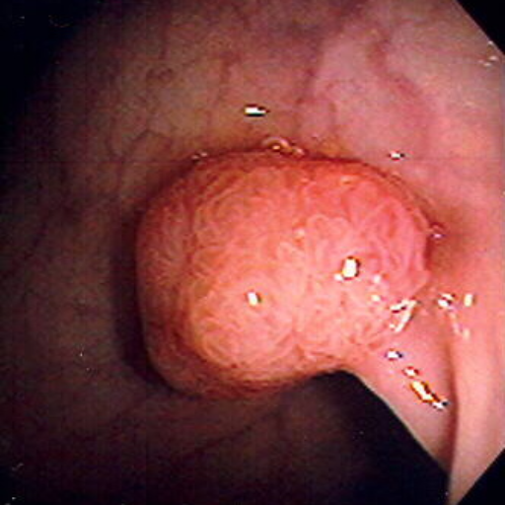
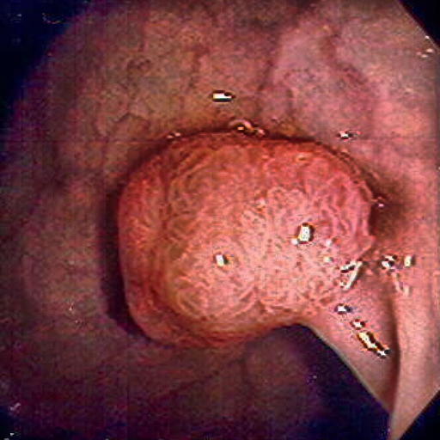
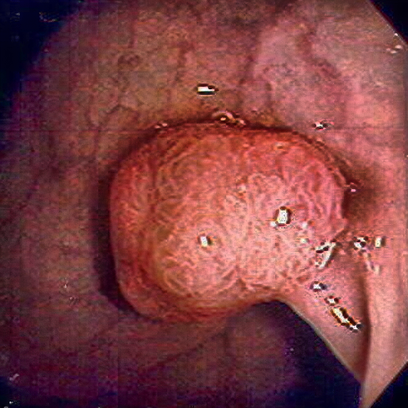
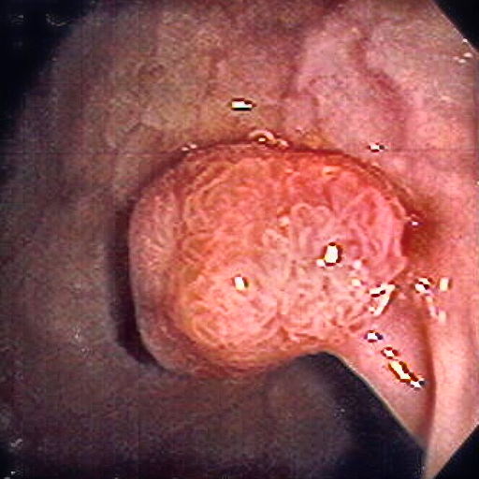
TRAINING TRACK · EVALUATION 1 OF 2
Comparative evaluation: three super-resolution strategies -test image 1
Original
1 — SRGAN (paper-faithful)
2 — RRDB transfer
3 — YIQ variant
Method
PSNR
SSIM
MSE
LPIPS
1-HSV + srgan_v_transfer.pth (RRDB)
20.62
0.785
444.4
0.269
2-YIQ + srgan_yiq.pth
19.94
0.755
657.9
0.217

Slide 10
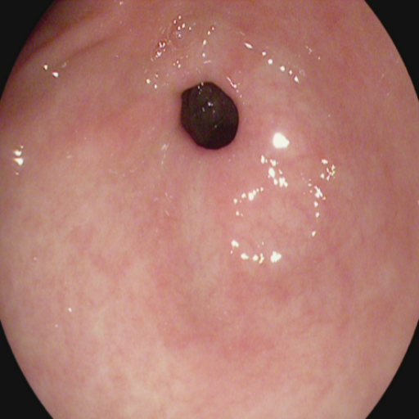
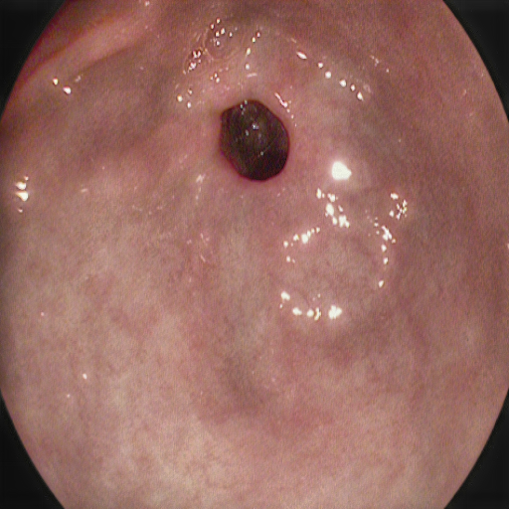
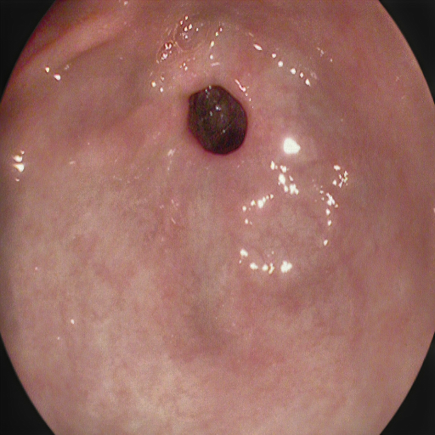
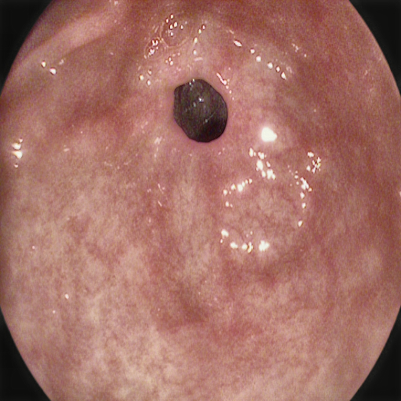
TRAINING TRACK · EVALUATION 2 OF 2
Comparative evaluation: three super-resolution strategies - test image 2
Original
1 — SRGAN (paper-faithful)
2 — RRDB transfer
3 — YIQ variant
Method
PSNR
SSIM
MSE
LPIPS
1 -HSV + srgan_v.pth (paper-faithful)
21.75
0.874
420.6
0.190
2 -HSV + srgan_v_transfer.pth (RRDB)
22.70
0.867
339.1
0.201
3 -YIQ + srgan_yiq.pth
22.85
0.826
337.6
0.239

