Slide 1

Quiz Mangement System
Abhishek 009
Avishkar 041
Piyush 044
Kunal 095
Pranav 133
Rahul 146

Slide 2
Introduction
Project Description:
Web-based application for streamlining quizzes and assessments.
Utilizes Spring Boot (backend) and ReactJS (frontend).
Objectives:
Enhance quiz process efficiency.
Provide user-friendly platform for creators and participants.
Key Features:
Spring Boot: Scalable backend with authentication, quiz creation, result tracking.
ReactJS: Dynamic frontend ensuring engagement

Slide 3
Introduction
Functionality:
User registration/authentication.
Quiz creation/management.
Detailed result tracking.
Development Process:
Requirement analysis, system design, implementation, testing, deployment.
Benefits:
Scalability, maintainability, and performance.
Seamless frontend-backend communication with RESTful APIs.

Slide 4
Functional Requirement
User Registration: The system should allow users to register by providing necessary information such as username, email, and password
Quiz Creation and Management
Multiple Quiz Creation: Allow quiz creators to create multiple quizzes, each with a unique set of questions and settings
Quiz Details: Enable quiz creators to specify details such as title, description, duration, and passing criteria for each quiz

Slide 5
Functional Requirement
Participant Registration and Management
Participant Registration: Participants should be able to register by providing essential information
Profile Management: Participants should have the ability to manage their profiles, including updating personal information and changing password
Quiz Participation: Participants should be able to browse and select quizzes they want to participate in

Slide 6
Non-Functional Requirement
The system should support concurrent quiz creation and participation by multiple users without significant performance degradation
Response time for user interactions, such as creating quizzes, submitting answers, and viewing results, should be minimal to provide a seamless user experience
Scalability: The system should be designed to scale horizontally to handle an increasing number of users, quizzes, and concurrent quiz sessions

Slide 7
Non-Functional Requirement
Reliability: The system should have high availability to ensure users can access and use the platform reliably
Security: User authentication and authorization mechanisms should be robust to ensure secure access to the system
Usability: The user interface should be intuitive and user-friendly, promoting easy navigation and efficient quiz creation

Slide 8
Hardware Requirement (User)
Personal Computer or Laptop with minimum system requirements to support web browsing and online transactions
Reliable internet connection to ensure smooth website access and uninterrupted online shopping experience

Slide 9
Software Requirement (User)
Web Browser with the latest version installed to access and interact with website
Operating System compatible with the chosen web browser for seamless website navigation and functionality
Integrated Development Environment such as Spring Tool Suite
Backend
Java Development Kit 11
Build Tool: Apache Maven

Slide 10
Hardware And Software Requirement (Developer)
Integrated Development Environment (IDE) such as Spring Tool Suite
Backend (Spring Boot):
Java Development Kit (JDK) 11
Build Tool: Apache Maven
Frontend (ReactJS):
Node.js and npm (Node Package Manager).
Code Editor: Visual Studio Code, Sublime Text, or Atom.
Database Management System (DBMS): MySQL
Version Control: Git for version control.
API Documentation: Swagger
Deployment: Choose a hosting service (VERCEL) to deploy website and configure the necessary server configurations.

Slide 11
Methodology

Slide 12
Spring Boot
Backend Development: Spring Boot is utilized to create a robust and scalable backend for the Quiz Management System. It facilitates the development of RESTful APIs, handles business logic, and connects with the database.
Spring MVC: Manages the web layer, handling HTTP requests and responses.
Spring Data JPA: Simplifies database operations by providing an abstraction layer over the data access layer.
RESTful API: Creates APIs to handle communication between the frontend and backend.

Slide 13
ReactJS
Frontend Development: ReactJS is employed to build a dynamic and interactive user interface for quiz creation, participation, and result display.
Component-Based Architecture: Facilitates modular development and maintenance.
React Router: Manages navigation within the application.
State Management: Utilizes local component state and Redux for managing global state.

Slide 14
MySQL
Database Management: MySQL is chosen as the relational database system to store and manage quiz data, user profiles, and results.
Database Schema: Defines tables for quizzes, questions, users, and results.

Slide 15
Redux
State Management: Redux is implemented for managing the global state of the application, especially for complex state interactions.
Store: Holds the global state of the application.
Actions: Defines events that trigger state changes.
Reducers: Handles the state changes based on dispatched actions.

Slide 16
BootStrap
Frontend Styling: Bootstrap is employed for frontend styling, providing a responsive and consistent design across different devices and browsers.
Responsive Design: Ensures the application is accessible on various devices.
Bootstrap Components: Utilizes pre-built UI components for buttons, forms, navigation bars, etc., saving development time.
Grid System: Supports responsive layouts, aiding in the creation of a visually appealing and user-friendly interface.

Slide 17
Git
Version Control: Git is employed for source code versioning, enabling collaboration, tracking changes, and maintaining a history of the project.
Branching and Merging: Supports parallel development and integration of features.
Pull Requests: Facilitates code review before merging changes.
Commit Messages: Provides a clear history of changes and their purposes.

Slide 18
System Design

Slide 19
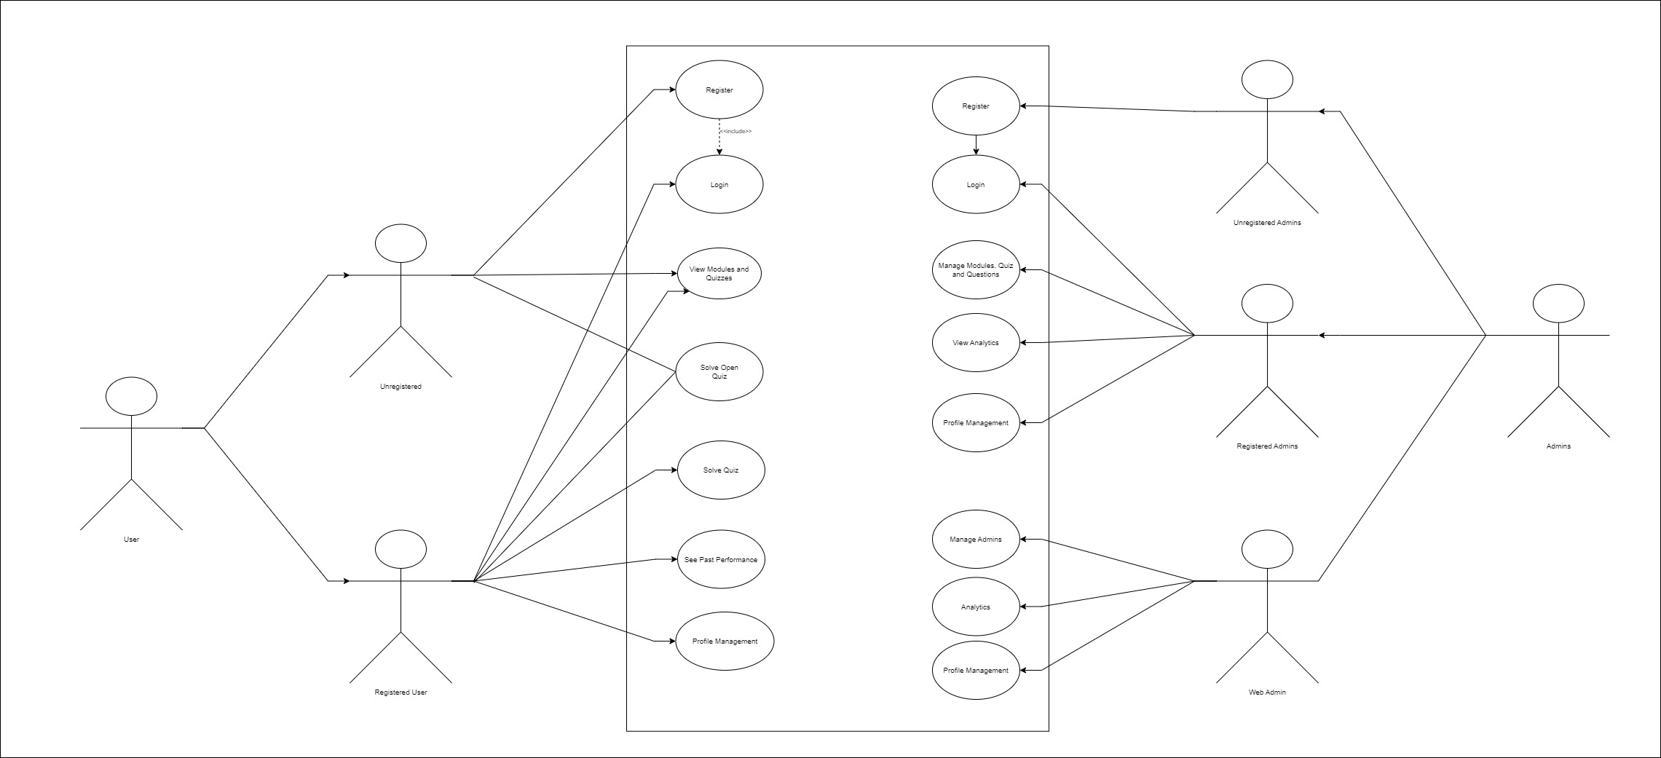
Use Case Diagram

Slide 20
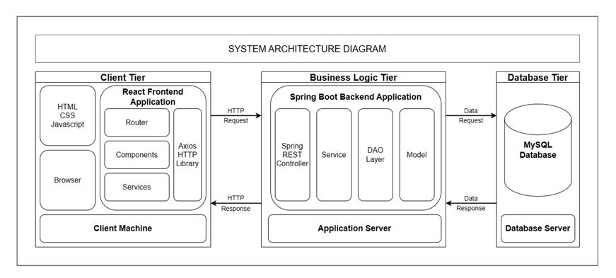
System Architecture

Slide 21
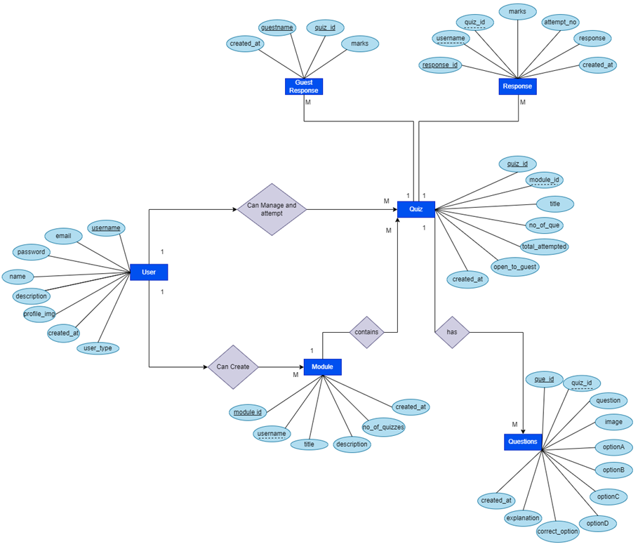
Entity Relationship Diagram

Slide 22
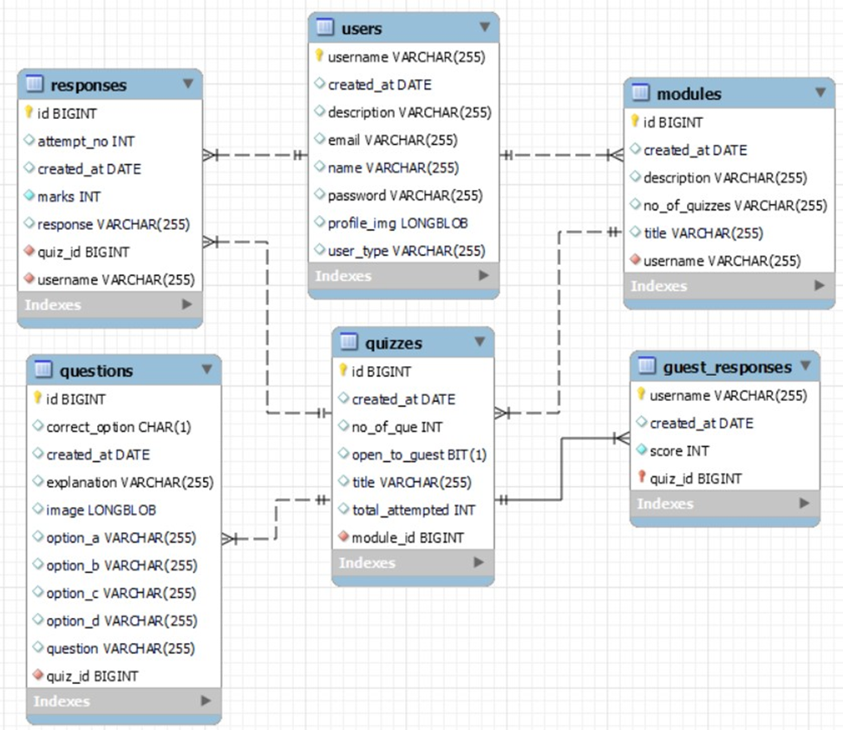
Database Design

Slide 23
Implementation

Slide 24
Setting Up the Development Environment
Backend (Spring Boot):
Installed Java Development Kit (JDK) and an Integrated Development Environment (IDE) such as STS or Eclipse.
Created a new Spring Boot project using Spring Initializer.
Added necessary dependencies such as Spring Web, Spring Data JPA.
Set up a MySQL database and configured the application.properties file with database connection details.

Slide 25
Setting Up the Development Environment
Frontend (ReactJS):
Installed Node.js and npm for managing frontend dependencies.
Created a new React application using create-react-app.
Installed additional libraries such as Redux for state management and Bootstrap for styling.
Set up a folder structure for organizing React components, actions, reducers, and other files.

Slide 26
Backend Development:
User Authentication:
Implemented user registration and login endpoints.
Quiz Creation:
Created RESTful API endpoints for quiz creation, question addition, and option inclusion.
Implemented data validation to ensure the integrity of quiz-related information.

Slide 27
Backend Development:
Quiz Participation:
Developed API endpoints for fetching quiz details and submitting user responses.
Evaluated user responses, calculated scores, and stored results in the database.
Result Retrieval:
Implemented API endpoints to retrieve user-specific or quiz-specific result data
Ensure proper authorization to access result information.

Slide 28
Frontend Development:
User Authentication:
Designed login and registration forms.
Implemented React components for user authentication, integrating with backend authentication endpoints.
Quiz Creation:
Created React components for creating quizzes, adding questions, and managing options.
Implemented Redux actions and reducers to manage quiz-related state.

Slide 29
Frontend Development:
Quiz Participation:
Designed React components for viewing available quizzes and participating in them.
Integrated Redux to manage the state of quiz participation, including user responses.
Result Display:
Developed React components to display quiz results.

Slide 30
API Communication
Utilized Axios or another HTTP client in the ReactJS frontend to make requests to the Spring Boot backend.
Implemented Redux actions to dispatch API requests and manage asynchronous behavior.
Ensured proper handling of API responses and errors in the frontend components.

Slide 31
Integration
Integrated the ReactJS frontend with the Spring Boot backend by configuring CORS (Cross-Origin Resource Sharing) settings.
Tested the end-to-end communication between frontend and backend components.

Slide 32
Project Management

Slide 33
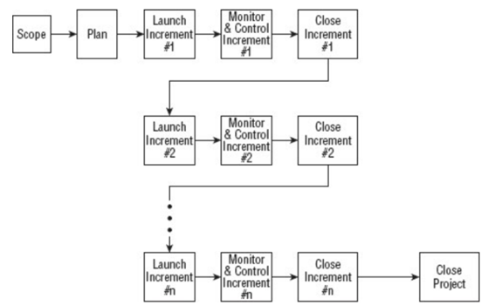
Incremental Project Management Life Cycle

Slide 34
Incremental Project Management Life Cycle
This model can be used when the requirements of the complete system are clearly defined and understood
This model is much better equipped to handle change. Each incremental functionality is verified by the customer and hence the relative risk in managing large and complex projects is substantially reduced.
Advantages:
Generates working software quickly and early during the software life cycle.
This model is more flexible and less costly to change scope and requirements.
It is easier to test and debug during a smaller iteration.
In this model customer can respond to each built.

Slide 35
Github
Advantages:
Collaboration: Easy teamwork on coding projects.
Version Control: Keeps track of changes in code.
Community: Access to a large community of developers and projects.
Integration: Works well with other development tools.
Documentation: Helps in maintaining project documentation alongside code.
Disadvantages:
Learning Curve: Can be tough for beginners.
Privacy Concerns: Public repositories might expose sensitive data.
Dependency on Internet: Needs internet for access.
Security Risks: Potential for unauthorized access or breaches.
Over-reliance: Might limit options for alternative platforms.

Slide 36
Result

Slide 37
Result
Login:
Authenticate users securely with username and password for personalized access to the Quiz Management System.
Signup:
Register new quiz creators, capturing essential information and ensuring a smooth onboarding process.
Homepage:
Present a personalized dashboard highlighting quizzes created, ongoing modules, and recent results for multiple quiz creators.
Module List:
Display a comprehensive list of quiz modules, facilitating easy navigation for quiz creators in managing and editing modules.

Slide 38
Result
Quiz Page:
Enable quiz creators to design and customize quizzes, specifying details like time limits and question types effortlessly.
Quiz Questions:
Allow quiz creators to add, edit, and organize questions with options, ensuring flexibility and creativity in quiz content creation.
Result:
Present individual results, empowering quiz creators to assess participant performance and make data-driven improvements.
Profile Management:
Empower quiz creators to personalize their profiles, manage account settings, and track their contribution history within the Quiz Management System.

Slide 39
Result
Manage Content:
Modules: Create, edit, and organize learning modules seamlessly, allowing quiz creators to structure content logically.
Quizzes:
Efficiently manage quizzes, enabling quiz creators to set parameters, schedule, and monitor participation details.
Questions:
Streamline question management, offering quiz creators the ability to add, edit, and categorize questions for diverse quiz content.

Slide 40
Future Work

Slide 41
Future Work
Enhanced User Analytics: Implement advanced analytics features to provide detailed insights into user performance, popular quiz topics, and participation trends.
Gamification Elements: Incorporate gamification elements, such as badges, leaderboards, and achievements, to motivate users and enhance user engagement.
Real-Time Collaboration: Implement real-time collaboration features, allowing multiple users to collaboratively create quizzes or participate in quizzes simultaneously.
Integration with Learning Management Systems (LMS): Integrate the Quiz Management System with popular Learning Management Systems for seamless incorporation into educational environments.
Mobile Application Development: Develop a dedicated mobile application to expand accessibility and provide users with a more convenient way to engage with quizzes on the go.

Slide 42
Thank You!
Abhishek 009
Avishkar 041
Piyush 044
Kunal 095
Pranav 133
Rahul 146

