Slide 1
Quarterly Review: Q3 2026
Example Widgets Inc.
Example Widgets Inc. | Internal review draft
Notes:
Welcome everyone.
Keep the opening under two minutes.

Slide 2

Agenda
Results
Revenue bridge
Outlook
Example Widgets Inc. | Internal review draft

Slide 3
Revenue bridge
Net revenue up 12% YoY
  Driven by enterprise renewals
    Renewal rate reached 94%
Services revenue flat
  Hardware margin improved
Example Widgets Inc. | Internal review draft
Notes:
Emphasize that churn is flat.
Renewals carried the quarter.

Slide 4
Research spend
R&D <50% of operating expense
Revenue grew
in Q3 as planned
Example Widgets Inc. | Internal review draft

Slide 5
Regional results
Region | Q2 | Q3
NA | 41 | 46
EMEA | 30 | 33
Total | all regions |  | 79
Example Widgets Inc. | Internal review draft

Slide 6
Revenue by quarter
Example Widgets Inc. | Internal review draft

Slide 7
Two teams
Devices team: cut unit cost by 8%
Platform team: shipped the billing rewrite
Example Widgets Inc. | Internal review draft

Slide 8
Backup: raw survey data
Not for presentation
Example Widgets Inc. | Internal review draft

Slide 9
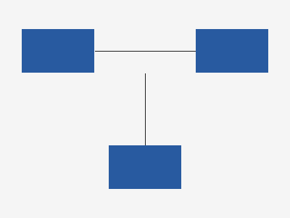
Architecture
Example Widgets Inc. | Internal review draft
Notes:
Walk through the three services left to right.

Slide 10
Questions welcome at any point
Example Widgets Inc. | Internal review draft

Slide 11
Release process
Plan
Build
Verify
Ship
Example Widgets Inc. | Internal review draft

Slide 12
Next steps
Hire two support engineers
Close the Q4 books by January 15
Owner: finance team
Example Widgets Inc. | Internal review draft
Notes:
Ask for volunteers.

