Slide 1


The New Stethoscope: LLMs, Multimodal Models, and the Future of Clinical AI
A Gentle Introduction to LLMs and Their Role in Medicine
IMPACT-MED 2025: FROM IMAGE TO IMPACT

Slide 2


Presenters:
Noushin Jafarpisheh
Ernest Namdar
PhD in Electrical and Computer Engineering, Concordia University, Montreal
Postdoctoral researcher at the University of Toronto.
Current research focuses on deep learning, medical image analysis, and generative AI.
PhD in Medical Science, University of Toronto
NVIDIA Healthcare Ambassador. Instructor and course designer for NVIDIA Deep Learning Institute.
Translational medicine postdoctoral researcher with a focus on AI and statistics.

Slide 3
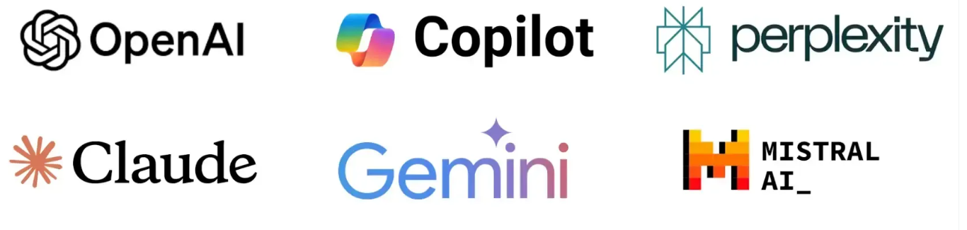
What Are Large Language Models (LLMs)?
LLMs are AI systems trained on vast text data to understand and generate language.
Built using the Transformer architecture → self-attention helps the model focus on relevant words.
Learn the statistical patterns of language by predicting the next word.
Examples: ChatGPT (OpenAI), Google Gemini, Claude, etc.
Notes:
Large Language Models (LLMs) are advanced AI systems built on deep neural networks designed to process, understand and generate human-like text. By using massive datasets and billions of parameters, LLMs have transformed the way humans interact with technology. It learns patterns, grammar and context from text and can answer questions, write content, translate languages and many more. Mordern LLMs include ChatGPT (OpenAI), Google Gemini, Anthropic Claude, etc

Slide 4
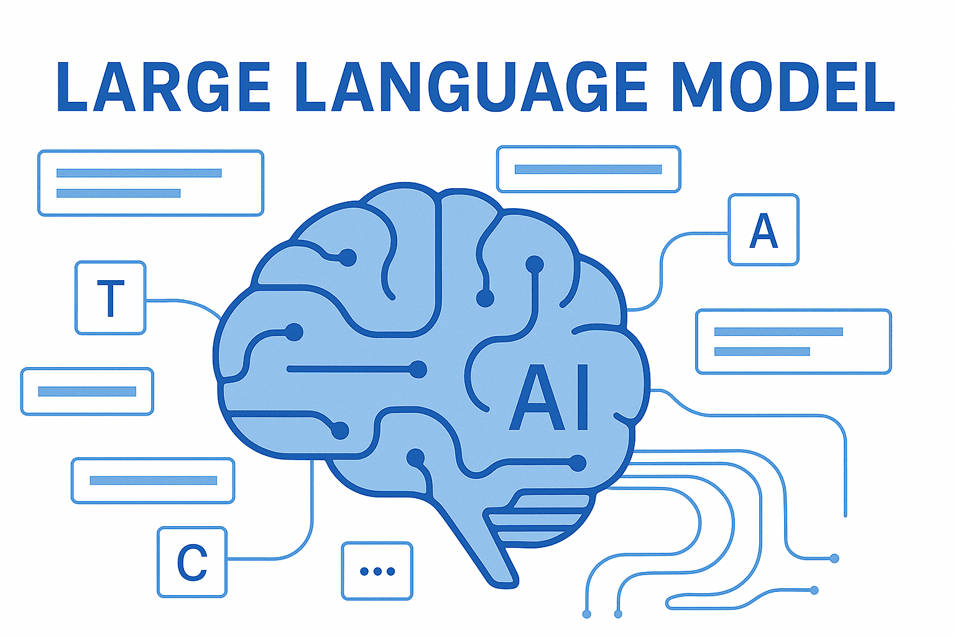
How Does LMM work?
Encoder
Attention Mechanism
Decoder
Input Text
Tokenizer
Output Text
Embedding
LLMs are like digital chefs: They take your words as ingredients, chop them into tokens, mix them with attention and context, and serve up a perfectly seasoned sentence!”
Notes:
Large Language Models function through a complex and systematic process. LLMs are primarily based on the transformers architecture which enables them to learn long-range dependencies and contextual meaning in text. The key components are:
Input Text. Raw text data serves as the foundation for LLMs. It represents the initial information provided for processing.
Tokenizer. The input text undergoes tokenization, where it is broken down into smaller units such as words, phrases, or characters. Tokenization structures the text for the model’s comprehension.
Embedding. Tokens are converted into numerical vectors through embedding. They capture the semantic and syntactic meanings of the text. Embeddings transform textual data into a format understandable by the neural network.
Encoder. The embedded tokens are processed by the encoder. It’s a fundamental component that extracts relevant information from the input sequence. The encoder’s role is crucial in understanding the context and relationships between words.
Attention Mechanism. This element allows the model to focus on specific parts of the input text. It assigns varying levels of importance to different tokens. Thus, it enhances the model’s ability to weigh the significance of words and improve context understanding.
Decoder. Utilizing the encoded information, the decoder generates the output sequence. This component translates the processed data back into human-readable text. It also ensures the response is coherent and contextually relevant.
Output Text. The final generated text is the result of the LLM’s intricate processing. It is based on the input and the model’s learned patterns and relationships.

Slide 5
Why LLMs Matter in Medicine
Medicine is language-heavy — reports, notes, guidelines, and research papers.
LLMs can:
  Summarize patient records.
  Generate structured reports from free text.
  Explain findings in plain language for patients.
They turn unstructured medical data into usable insight.

Slide 6



Medical Applications of LLMs
Clinical Practice
Medical Question Answering
Medical Education
Personalized Learning
Medical Research
Assistance with Academic Writing
Administrative Tasks
Clinical Decision-Making
Educational Material Generation
Virtual Patients
Language Translation
Data Analysis

Slide 7
The Lifecycle of Large Language Models
Learns everything from the ground up using massive datasets and huge compute.
Builds a general foundation model (e.g., GPT).
Starts from a pretrained model → adapts to a specific task.
Uses smaller, curated datasets and updates only parts of the model.
Produces specialized, high-performance models.
Handles new tasks without retraining (zero-shot).
Can use a few examples to guide responses (few-shot).
Enables fast experimentation and prototyping.
Training
(Learning from Scratch)
Fine-Tuning (Becoming a Specialist)
Zero-/Few
-Shot
Inference (Applying Knowledge)
Notes:
Training (Learning from Scratch)
Model learns everything from the ground up.
Requires massive datasets and huge compute.
Example: GPT pretraining on billions of text and image samples.
Produces a general foundation model, but not task-specialized.
Fine-Tuning (Becoming a Specialist)
Start from a pretrained model → adapt to a specific task.
Use a smaller, curated dataset (e.g., 10,000 labeled X-rays).
Only update parts of the model (PEFT, LoRA, adapters).
Produces specialized, high-performance models (e.g., pneumonia classifier).
Zero-Shot and Few-Shot Inference
Zero-shot: Model handles a task it wasn’t trained on, using its general knowledge.
Example: “Is this X-ray normal?” → model answers without retraining.
Few-shot: Give a few examples in the prompt to guide the response.
Enables fast experimentation when no training data is available.
Useful for prototyping medical AI tasks.

Slide 8
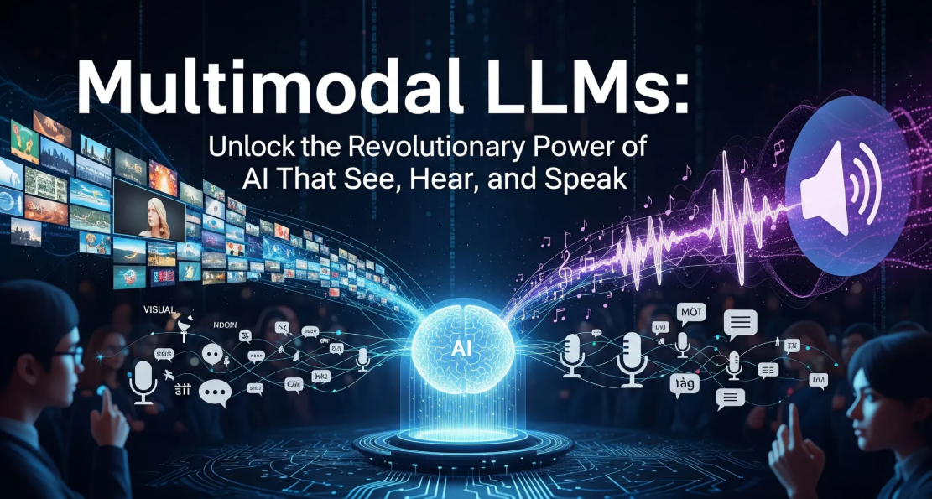
Notes:
What They Are
Traditional LLMs process only text.
Multimodal LLMs (MLLMs) integrate text, images, audio, video, and structured data.
They aim to mimic how humans combine multiple information sources for reasoning.
Consider your thinking process. When you are presented with a picture by someone who is telling you about something, you do not simply read what they are saying or simply observe the picture. Your brain skillfully integrates the two inputs to form an understanding. This is precisely what multimodal LLMs do, i.e. they are capable of processing multiple data types at once.
In contrast to the traditional AI models, which were restricted to one type of data, multimodal LLMs can deal with:
Text (code, natural language, documents)
Photos (pictures, diagrams, charts)
Audio (sounding, music, background sounds)
Video (moving images and sound).

Slide 9
The Real Magic: Multimodal (MLLMs) AI In Practice.
Encoding Phase
Fusion Phase
Processing Phase
Alignment Phase
Notes:
The Real Magic: Multimodal AI In Practice.
It is at this point that it becomes interesting. Multimodal LLMs do not simply load various AI systems on top of each other. They involve complex encoding, alignment and fusion algorithms:
Encoding Phase: The processing of each type of data is handled by special encoders. Images are processed by convolutional neural networks, texts by transformer networks and audio by spectral analysis.
Alignment Phase: It is the most important stage, during which various types of data are aligned into a common representation space. It is as though we are teaching the AI the language of all the inputs.
Fusion Phase: It is the combined data produced through the attention mechanisms, or concatenation techniques, that form a single understanding.
Processing Phase: The merged data is fed through the language model backbone, which allows cross-modal reasoning and generation.

Slide 10
MLLMs in Healthcare
Why They Matter
Healthcare uses many data types — text, images, sounds, and labs.
Key Benefits
Boost diagnostic accuracy and clinical efficiency
MLLMs unify these for smarter, context-aware analysis and decision support.
Cut administrative workload through automation
Enable multilingual & multimodal communication
Improve data integration across systems
Privacy & regulation concerns with medical data
Need for transparency & fairness
Complex integration of multimodal inputs
Require rigorous clinical validation
Challenges
Notes:
Why They Matter
Healthcare is naturally multimodal — combining clinical notes, scans, lab data, sounds, and visuals.
MLLMs can unify these data types, offering more accurate insights and decision support.
Enable context-aware analysis (e.g., linking a radiology image to its report).
Key Benefits
Improve diagnostic accuracy and clinical efficiency.
Reduce administrative burden through automation.
Support multilingual and multimodal communication between clinicians and patients.
Enhance data integration across fragmented healthcare systems.
Challenges
Data privacy & regulation — sensitive medical data needs secure handling.
Bias and transparency — models must be explainable and fair.
Integration complexity — combining multimodal data is technically demanding.
Clinical validation is essential before deployment.
Takeaway
MLLMs could redefine medical AI, moving from single-modality tools to holistic, context-aware assistants.
Understanding these models helps clinicians become informed adopters, not just passive users.
Multimodal LLMs excel in analyzing medical images and reports, aiding healthcare professionals in accurate diagnosis and treatment planning. The integration of textual patient history with visual data enhances the overall diagnostic accuracy.

Slide 11
MedGemma: A Multimodal Medical Foundation Model
MedGemma officially announced at Google I/O 2025, featuring:
MedGemma 4B: 4B-parameter multimodal model (images + text).
MedGemma 27B Text-Only: 27B-parameter model for medical text comprehension and clinical reasoning.
Release of MedGemma 27B Multimodal (instruction-tuned), flagship model integrating image, text, and EHR data, completing the initial MedGemma lineup.
Early 2025
May 20–22, 2025
July 7, 2025
July 9, 2025
Google released the open-source Gemma models, providing the architectural foundation for MedGemma — built on research from the Gemini family.
“MedGemma Technical Report” submitted to arXiv, detailing architecture, training, and performance.
Notes:
Key Milestones
Early 2025: Google released the general-purpose, open-source Gemma models. These models provided the architectural foundation for MedGemma. They were built on research from the Gemini models.
May 20–22, 2025: MedGemma was officially announced and first released at the Google I/O event. The initial release included:
MedGemma 4B: A 4 billion parameter multimodal model capable of processing images (like X-rays and dermatology photos) and text.
MedGemma 27B Text-Only: A 27 billion parameter model optimized exclusively for medical text comprehension and clinical reasoning tasks.
July 7, 2025: The initial "MedGemma Technical Report" was submitted to arXiv. The report detailed the models' architecture, training, and performance benchmarks.
July 9, 2025: Google released the flagship MedGemma 27B multimodal instruction-tuned model, completing the initial collection. This version integrates image, text, and electronic health record (EHR) data capabilities, offering the most comprehensive feature set in the family

Slide 12




Key Features of MedGemma
Medical Image Analysis
Understands and interprets X-rays, MRIs, and CT scans
Medical Question Answering
Answers health-related questions and queries
Open-Source Flexibility
Customizable and adaptable to local healthcare needs
Text Summarization
Summarizes patient records and clinical documents
Notes:
Medical Image Analysis
MedGemma 4B can interpret medical scans like X-rays, MRIs, and CT images. It helps radiologists generate detailed reports and identify key findings.
Text Summarization
MedGemma 27B can take long clinical documents and turn them into concise, easy-to-read summaries. This saves time for doctors who need quick information.
Medical Question Answering
Both versions can answer questions like “What are the symptoms of heart failure?” or “How is asthma treated?” This helps doctors, students, and even patients.
Open-Source and Flexible
Being open-source means you can fine-tune MedGemma with your own medical data to make it even more accurate for your specific needs.

Slide 13
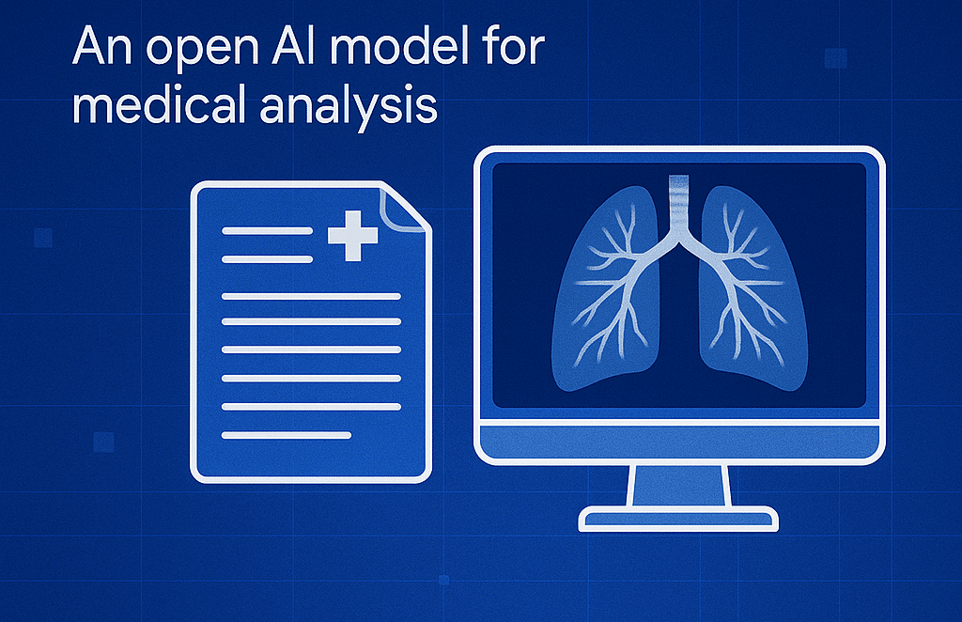
MedGemma Real World Application
Clinical Summaries
Medical Education
Healthcare Apps
Radiology Reports
Notes:
MedGemma has many potential uses in healthcare. Here are some ways it can help:
Radiology Reports
MedGemma 4B can generate detailed reports from medical images, helping radiologists save time and focus on critical cases.
Clinical Summaries
MedGemma 27B can process long patient records and create summaries, making it easier for doctors to get key information fast.
Medical Education
MedGemma’s question-answering features make it a helpful tool for teaching students and training new healthcare professionals.
Healthcare Apps
Developers can build apps that integrate MedGemma’s features, supporting telehealth, patient monitoring, and decision support systems.

Slide 14
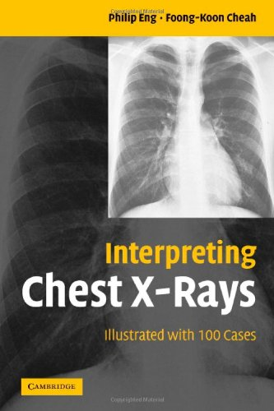
Reference Dataset for Evaluating MedGemma
Contains 100 clinical cases with questions, chest X-rays, and expert radiologic impressions.
Use the book’s expert explanations as a reference to evaluate MedGemma’s X-ray outputs for accuracy and completeness.
Compare model interpretations with the book’s findings to determine clinical correctness and areas for improvement.

Slide 15

Anastasia Oikonomou, MD PhD FRCPC
Professor of Radiology, University of Toronto
Staff Cardiothoracic Radiologist and Cardiothoracic Imaging Division Head, Department of Medical Imaging, Sunnybrook Health Sciences Centre
Affiliated Scientist, Sunnybrook Research Institute
Medical School, Radiology residency & PhD - Aristotel University of Thessaloniki, Greece
Clinical & Research fellowships
  Royal Brompton Hospital London, UK, University of Ottawa, CA and University of British Columbia, CA
Research interests
  classification and prognostication of lung malignancies using artificial intelligence with CT, PETCT and lung MRI, interstitial lung diseases and lung infections

Slide 16

Let’s Move to the Coding Part!

