Slide 1


SENTINEL
Real-Time Prompt Injection Firewall
AI Trust, Safety & Governance | Exasol AI + Data Challenge 2026s
Presented By : 404ever

Slide 2

AI SYSTEMS ARE BEING TRICKED
AND NOBODY'S WATCHING
Prompt injection is ranked the #1 risk on OWASP's Top 10 for LLM Applications
Real incidents: a car dealership chatbot manipulated into agreeing to sell a vehicle for $1; AI browser agents hijacked by hidden instructions on webpages
As AI agents get access to tools, data, and real actions, the attack surface grows fast
Most teams have zero visibility into whether their AI is even being attacked
Evolution of Attack
90%

Slide 3
COMPLETE
WEBSITE SECURITY
Trust & Governance is the Missing Layer
The AI stack needs a trust and governance layer.
Growing Need for AI Security
No Simple Defense Layer
Every company using LLM chatbots or agents faces these risks.
Regulations increasingly demand audit trails and risk controls. Security teams need visibility into AI traffic.
Most teams still lack a simple, drop-in defense layer for AI systems.
The AI stack needs a trust and governance layer.

Slide 4
OUR AMAZING
Smart AI Traffic Protection
Monitors every interaction between users and AI models.
SENTINEL: A FIREWALL + AUDIT TRAIL FOR AI CONVERSATIONS
Sits between the user and any LLM — a transparent proxy layer
Scores every prompt in real time using two detection layers:
Fast regex/keyword heuristics
Embedding similarity against a known attack fingerprint database
Intelligent Threat Detection
Combines pattern analysis and AI-powered similarity checks to identify suspicious prompts.
Decision: ALLOW / FLAG / BLOCK — before the prompt ever reaches the model
Every decision is logged for full forensic replay
Real-Time Security Decisions
Allows, flags, or blocks risky prompts.

Slide 5

SENTINEL ARCHITECTURE
1. Ingress Proxy
Receives user prompts and responses
|
2. Feature Extraction
Extracts patterns and embeddings
|
3. Exasol Core
Compares prompts with attack fingerprints
|
4. Decision Engine
Allows, flags, or blocks prompts
|
5. Immutable Audit Log
Records every decision for replay
|
6. Live Dashboard
Displays threats, scores, and activity

Slide 6

WHY EXASOL
EXASOL ISN'T BOLTED ON — IT'S THE CORE OF SENTINEL
Detection and governance work together on one data platform.
Fingerprint Store
Immutable Audit Log
Analytics Engine
Fast attack pattern matching
Records every AI decision
Delivers instant security insights

Slide 7
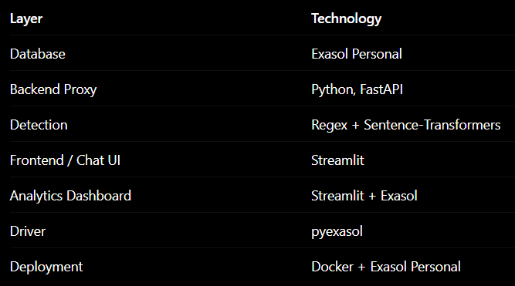
TECH
STACK
Open & Accessible Tools
  Built with open-source technologies.
  Fast and intelligent AI threat detection.
  Scalable and flexible architecture.
  Easy deployment using Docker.
  Real-time monitoring and analytics.

Slide 8
BENEFITS & FEASIBILITY
WHY THIS WORKS, AND WHY IT'S REALISTIC
Benefits
Model-agnostic — works with any LLM/chatbot behind the proxy
Extensible — new attack patterns added with a single CSV + reseed
Transparent — every decision is explainable and auditable, not a black box
Feasibility
No proprietary infrastructure required — runs on a laptop via Exasol Personal
Lightweight embedding model (~90MB) — no GPU needed
Clear path to production: containerize the proxy, point at a shared Exasol instance

Slide 9

LIMITATIONS & WHAT'S NEXT
CURRENT LIMITATIONS
Roadmap
  Move similarity matching into an Exasol
  Python UDF — scoring runs inside the database itself
  Expand fingerprint library with community-sourced jailbreak datasets
  Add LLM-as-judge as a third detection layer for ambiguous cases
  Multi-tenant support for enterprise deployment
Fixed fingerprint library (~25 patterns) — not exhaustive against novel attacks
Similarity scoring runs in the app layer, not yet inside Exasol itself
No production-grade auth/rate-limiting on the proxy yet

Slide 10
THANK YOU !
Sentinel — AI Trust & Safety, built on Exasol
GitHub: github.com/knandhini2208/sentinel-prompt-firewall
TEAM :
  KRITHIHA S
krithihasathish@gmail.com
63692 06535
  2. NANDHINI K
knandhini2369@gmail.com
9344483410
  3. NETHRA K
nethrakannan07@gmail.com
7010911305

