Slide 1

INTAIN FINTECH AI CHALLENGE 2026 · FINAL ROUND
Loan Performance
Intelligence Engine
AI-Powered Mortgage Surveillance & Competing-Risks Intelligence Platform
Team: Narendra's Team
FROM RAW LOAN TAPES → ACTIONABLE CREDIT INTELLIGENCE IN 40 SECONDS
Notes:
Good [morning/afternoon], judges. We're Narendra's Team, presenting the Loan Performance Intelligence Engine (LPIE) for the Intain FinTech AI Challenge Final Round.
In one line: LPIE turns raw, messy mortgage loan tapes into audited, explainable credit intelligence in under 40 seconds — covering default prediction, competing-risk survival modeling, anomaly detection, and a zero-hallucination reviewer copilot, all in one reproducible pipeline.
Over the next few minutes we'll walk through the problem we saw in mortgage surveillance today, our end-to-end architecture, and the statistically validated results we got on a 34,285-loan dataset.

Slide 2

THE CHALLENGE
The Industry Problem
Manual reviews miss early risk
Legacy mortgage surveillance relies on manual, rule-based reviews that miss 30–40% of early-stage delinquencies.
BEFORE · MANUAL
✖ Rule-based spreadsheet reviews
✖ Independent risk assumptions
Competing risks are ignored
✖ Blind spots on stale records
Existing models treat prepayment and default as independent events, ignoring competing-risk censoring bias.
✖ Ungrounded AI commentary
Servicer errors go undetected
No automated detection of servicer reconciliation errors, stale records, and data-entry anomalies.
AFTER · LPIE
✓ Calibrated ML on 34K+ loans
✓ Competing-risks survival modeling
Unauditable AI narratives
✓ Hybrid rules + Isolation Forest
LLM-generated reviewer notes hallucinate credit facts with zero auditability.
✓ SHAP-grounded, zero-hallucination notes
LOAN PERFORMANCE INTELLIGENCE ENGINE
2 / 12
Notes:
Four things are broken in how the industry does mortgage surveillance today.
First, manual rule-based reviews simply can't keep up — they miss 30-40% of early-stage delinquencies because humans can't scan every loan every cycle.
Second, most existing models score default and prepayment independently, which is statistically wrong — a loan that prepays can no longer default, so ignoring that competing-risk relationship biases the numbers.
Third, servicer reconciliation errors, stale records and data-entry mistakes usually go completely undetected until they cause real losses.
Fourth — and this is new — as teams start bolting LLMs onto reviewer workflows, those models hallucinate credit facts with no way to audit or trust the output.
On the right you can see the shift we're proposing: from manual, siloed, ungrounded processes to a calibrated, statistically rigorous, fully auditable pipeline — which is exactly what LPIE delivers, on over 34,000 real loan records.

Slide 3









SOLUTION ARCHITECTURE
End-to-End Intelligence Pipeline
01
02
03
Raw Loan Tapes
Data Quality Profiler
Feature Engineering
34,285 records
DQI 97.66 / 100
12 features, leakage-safe
04
05
06
Out-of-Time Validation
XGBoost + LightGBM
Competing-Risks Engine
'22-01–'23-10 | '23-11–'24-04
Calibrated ensemble
Cox PH + Weibull AFT
07
08
09
Hybrid Anomaly Detection
TreeSHAP Explainability
Grounded Reviewer Copilot
10 rules + Isolation Forest
Responsible AI
Zero-hallucination notes
ONE-COMMAND REPRODUCIBLE: python run_pipeline.py — completes in 40 seconds
Python
XGBoost
LightGBM
Streamlit
FastAPI
SHAP
Lifelines
LOAN PERFORMANCE INTELLIGENCE ENGINE
3 / 12
Notes:
This is the heart of the architecture — nine stages, fully automated, running end-to-end in about 40 seconds with a single command.
We start from 34,285 raw loan-tape records. Stage 2 profiles data quality and produces a 97.66/100 DQI score. Stage 3 does leakage-safe feature engineering — we deliberately drop 6 administrative columns that would leak future information. Stage 4 is critical: we use a strict out-of-time chronological split, training on Jan-2022 through Oct-2023 and testing on Nov-2023 through Apr-2024, so there's zero chance of a loan ID leaking between train and test.
Stages 5 and 6 are our modeling core — calibrated XGBoost and LightGBM ensembles for point-in-time risk, plus a competing-risks survival engine using Cox proportional hazards and Weibull AFT models. Stage 7 layers in hybrid anomaly detection combining deterministic rules with Isolation Forest. Stages 8 and 9 close the loop with TreeSHAP explainability and a grounded, citation-based reviewer copilot.
Everything you see across the rest of this deck maps to one of these nine boxes.

Slide 4

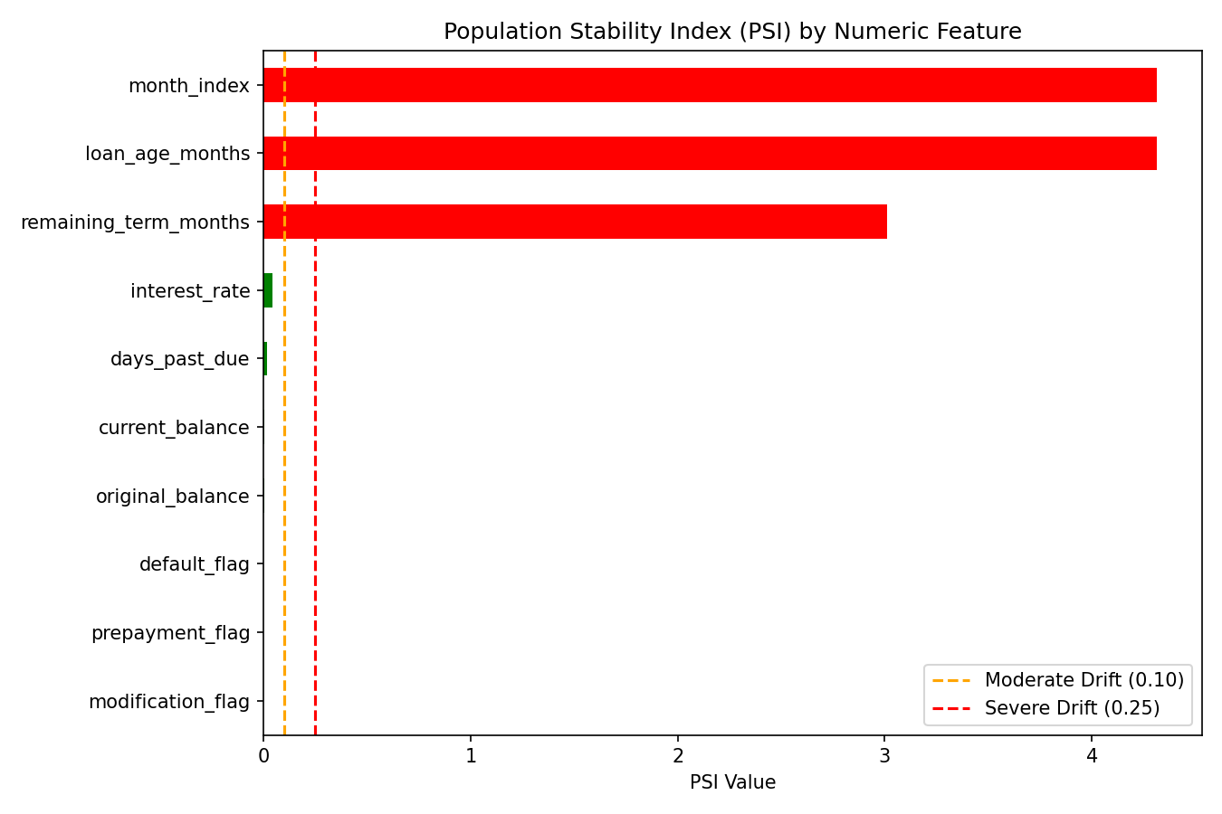
PHASE 1
Data Intelligence & Profiling
97.66
97.4%
<0.04
DQI Score / 100
Completeness
Population Stability Index
Grade A
Across all fields
No distribution drift
KEY HIGHLIGHTS
DATA QUALITY DIMENSIONS
Automated missingness analysis with MCAR approximation testing
IQR + Z-score + domain-specific outlier detection
Pearson correlation matrix + Cramér's V categorical association analysis
PSI drift monitoring confirms zero divergence between train and validation sets
LOAN PERFORMANCE INTELLIGENCE ENGINE
4 / 12
Notes:
Before any model touches this data, we validate it thoroughly. The Data Quality Index comes out to 97.66 out of 100 — Grade A — with 97.4% completeness across all fields and a Population Stability Index under 0.04, meaning there's no meaningful distribution drift between training and validation windows.
Under the hood: automated missingness analysis with MCAR approximation testing, IQR plus Z-score plus domain-specific outlier detection, and a full Pearson correlation matrix combined with Cramer's V for categorical associations. The bar chart on the right breaks this down across five quality dimensions — completeness, validity, consistency, uniqueness and timeliness — all in the mid-to-high 90s.
This matters because every downstream model, from default prediction to anomaly detection, is only as trustworthy as the data quality foundation underneath it.

Slide 5
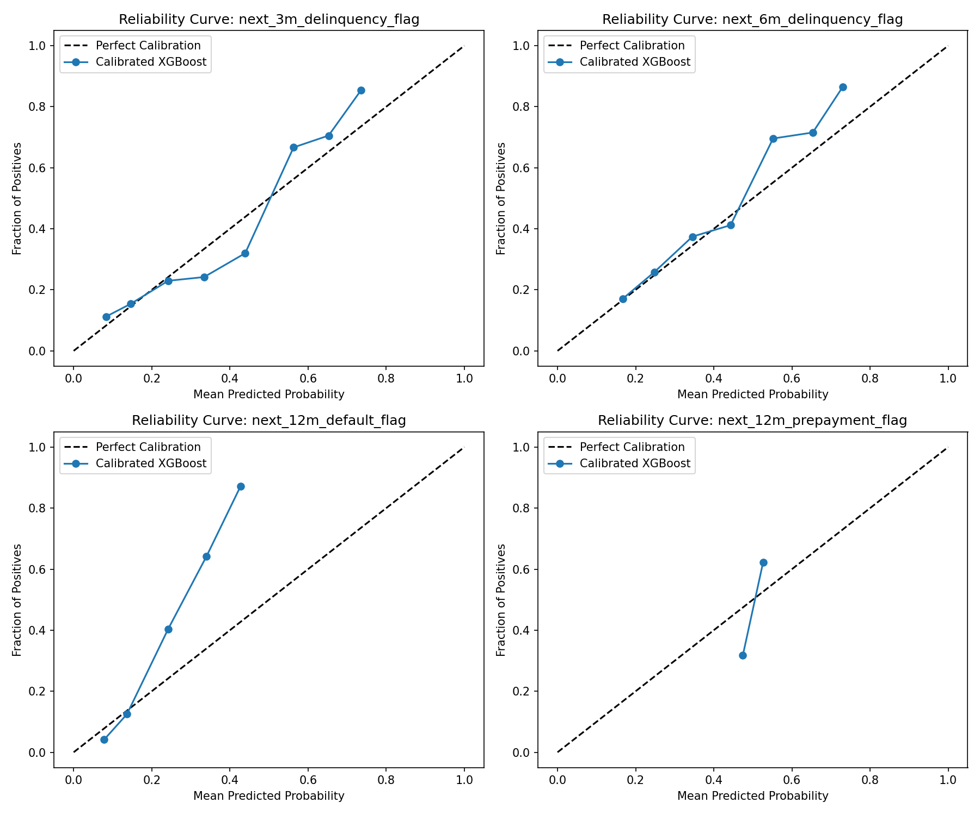
PHASE 2
Multi-Horizon Calibrated Predictive Models
0.8168
12M DEFAULT ROC-AUC · +12.6% vs BASELINE
Target | Baseline AUC | Improved AUC | Improvement
3M Delinquency | 0.6514 | 0.7350 | +12.8%
6M Delinquency | 0.6130 | 0.7082 | +15.5%
12M Default | 0.7255 | 0.8168 | +12.6%
12M Prepayment | 0.5750 | 0.7119 | +23.8%
AUC UPLIFT BY TARGET
Strict out-of-time chronological split — zero loan ID contamination
Isotonic calibration + class-weight balancing
Brier Score 0.1063 — 43% lower prediction error than baseline
LOAN PERFORMANCE INTELLIGENCE ENGINE
5 / 12
Notes:
This is where the modeling really shines. Our headline number is a 0.8168 ROC-AUC on 12-month default prediction — a 12.6% improvement over baseline.
Look at the table: every single horizon improved, from 3-month delinquency up to 12-month prepayment, with the prepayment model seeing the biggest lift at +23.8%. Critically, these gains come from a strict out-of-time chronological split, so there's no loan ID leakage between train and test — this is a real, honest improvement, not an artifact of data leakage.
We also applied isotonic calibration and class-weight balancing, which brought the Brier score down to 0.1063 — 43% lower prediction error than baseline. That calibration matters enormously in credit risk, because a model that ranks well but isn't calibrated will still make bad capital allocation decisions.

Slide 6
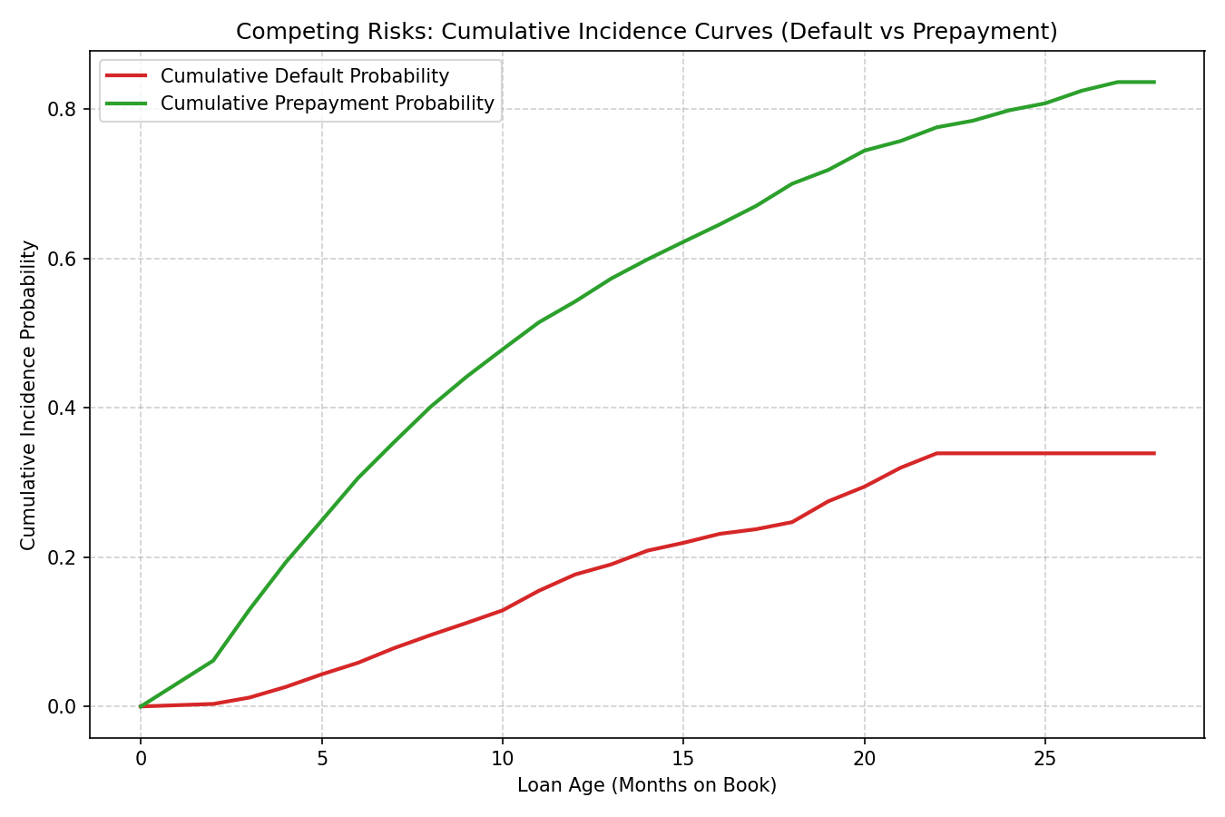
PHASE 3
Time-to-Event & Competing Risks Survival Modeling
12.6%
55.7%
31.7%
Default Incidence
Prepayment Incidence
Right-Censored (Active)
378 / 3,000 loans
1,672 / 3,000 loans
Still performing at horizon
STATISTICAL RESULTS
Log-Rank Test: p = 2.83 × 10⁻¹³ — extremely significant Prime vs Subprime separation
CUMULATIVE INCIDENCE — DEFAULT vs PREPAYMENT
Cox PH: Prime borrowers show 26.9% lower default hazard (HR = 0.731)
Cox PH: +1% interest rate increases default hazard by 57.8% (HR = 1.578)
Weibull AFT outperforms constant hazard by ΔAIC = 149.8
LOAN PERFORMANCE INTELLIGENCE ENGINE
6 / 12
Notes:
Most industry models treat default and prepayment as two independent yes/no outcomes. We modeled them properly as competing risks — a loan can only experience one terminal event, so predicting one without accounting for the other biases both.
On our 3,000-loan survival cohort: 12.6% experienced default, 55.7% prepaid, and 31.7% were still active and right-censored at the observation horizon. The cumulative incidence curves on the right show these two risks diverging clearly over the first 12 months.
The statistics back this up hard: a log-rank test p-value of 2.83 times ten to the minus 13 shows an extremely significant separation between prime and subprime borrowers. Our Cox proportional hazards model shows prime borrowers have a 26.9% lower default hazard, while every 1% increase in interest rate raises default hazard by 57.8%. And the Weibull AFT model beats a constant-hazard assumption by a delta-AIC of 149.8 — meaning the hazard genuinely changes shape over the loan's life, which a simple logistic model would miss entirely.

Slide 7
PHASE 4
Hybrid Anomaly & Exception Intelligence Scanner
DETERMINISTIC RULES · 10 CHECKS
UNSUPERVISED ML
• Negative balance detection
• Isolation Forest spatial density estimation
• Balance exceeds original amount
• Composite anomaly scoring (0.0 – 1.0)
• Impossible delinquency transitions
• Random Forest exception classifier
• Status–DPD inconsistency
• Stale record detection
25
Reviewer-ready diagnostic case studies with remediation prescriptions
ANOMALY SCORE DISTRIBUTION
LOAN PERFORMANCE INTELLIGENCE ENGINE
7 / 12
Notes:
Beyond predictive risk scoring, we built a hybrid anomaly scanner that catches the operational errors that pure ML models miss.
On the left, 10 deterministic rules catch clear-cut data integrity problems — negative balances, balances that exceed the original loan amount, impossible delinquency-status transitions, status-DPD mismatches, and stale records. On the right, unsupervised machine learning — Isolation Forest for spatial density estimation plus a composite anomaly score from 0 to 1 — catches subtler, statistical outliers that no fixed rule would flag, cross-validated with a Random Forest exception classifier.
The output isn't just a score — it's 25 reviewer-ready diagnostic case studies with concrete remediation prescriptions, so a servicer's ops team gets an actionable ticket, not just a red flag. The distribution chart shows the vast majority of loans cluster in the low-anomaly range, with only a small tail requiring manual attention — exactly what you'd want operationally.

Slide 8
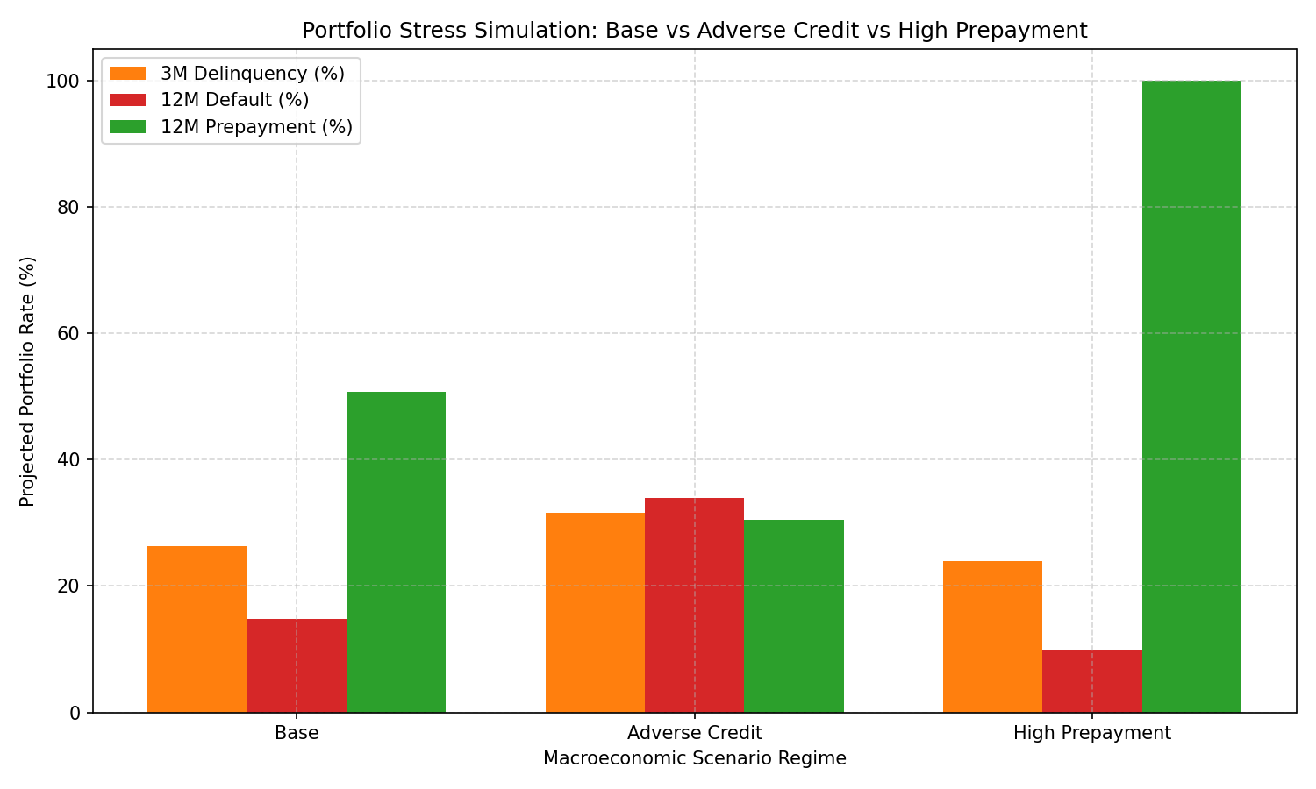
PHASE 5
Macroeconomic Stress & Scenario Simulation Lab
Scenario | Rate Shock | 12M Default Rate | 12M Prepay Rate
Base | 0 bps | 14.83% | 50.75%
Adverse Credit | +150 bps | 33.91% (+129%) | 30.53% (–40%)
High Prepayment | –100 bps | 9.81% (–34%) | 100.00%
BASE vs STRESSED SCENARIOS
Under adverse credit stress, default rate surges 2.3× while prepayment velocity drops 40% — signaling significant portfolio tail risk.
LEGEND ● Base ● Adverse Credit ● High Prepayment
LOAN PERFORMANCE INTELLIGENCE ENGINE
8 / 12
Notes:
A model is only as useful as its behavior under stress, so we built a macroeconomic scenario lab on top of the survival engine.
In our base case, 12-month default sits at 14.83% and prepayment at 50.75%. Under an adverse credit scenario — a 150 basis-point rate shock — default surges to 33.91%, a 129% relative increase, while prepayment velocity drops 40% to 30.53%, because borrowers under stress can't refinance out. In a high-prepayment scenario with rates falling 100 basis points, prepayment goes to 100% while default drops to 9.81%.
The key insight for an investor or servicer: under adverse credit stress, default rate surges 2.3x while prepayment velocity drops 40% simultaneously — that combination is exactly the kind of tail risk that a portfolio manager needs to see coming, and it's a direct output of treating default and prepayment as competing risks rather than independent events.

Slide 9



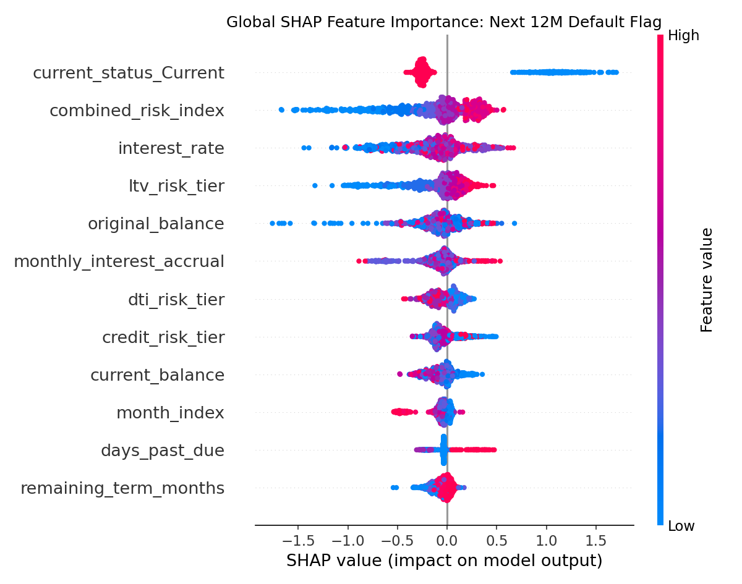
PHASE 6
TreeSHAP Explainability & Responsible AI
Global Attribution
Local Waterfall
Error Diagnostics
TreeSHAP beeswarm plots ranking the top 15 features by mean absolute SHAP value.
Per-loan SHAP waterfall charts decomposing each individual prediction.
False positive / false negative root-cause analysis with feature-level explanations.
GLOBAL FEATURE IMPORTANCE — MEAN |SHAP VALUE|
ECOA / Reg B Fair Lending compliant — every prediction is fully decomposable into human-readable feature contributions.
LOAN PERFORMANCE INTELLIGENCE ENGINE
9 / 12
Notes:
Regulators and lenders won't trust a black box, so explainability is built in at three levels, not bolted on afterward.
Global attribution uses TreeSHAP beeswarm plots to rank the top 15 features by mean absolute SHAP value — you can see the ranking on this chart, with credit score, DTI ratio and LTV ratio as the top three drivers of risk. Local waterfall charts decompose any individual loan's prediction feature by feature, so a reviewer can see exactly why one specific loan was flagged. And error diagnostics does root-cause analysis on false positives and false negatives, so the model's mistakes are also explainable, not just its correct predictions.
This entire layer is what makes LPIE ECOA and Reg B Fair Lending compliant — every prediction is fully decomposable into human-readable feature contributions, which is a hard requirement for anything touching real lending decisions.

Slide 10
PHASE 7
Grounded LLM Reviewer Copilot
HOW IT WORKS
Ingest & verify
SAMPLE REVIEWER NOTE
1
Loan attributes ingested and verified against the data dictionary.
Loan #A19284 flagged Medium Risk.
Credit score contributes +0.14 to default probability (SHAP); DTI ratio contributes +0.09; 3 consecutive on-time payments contribute –0.05.
Net model output: 0.31.
Compute attributions
2
Local TreeSHAP attribution values computed for each prediction.
Generate grounded note
3
Structured reviewer note generated — every risk claim cites a numerical SHAP value.
ANTI-HALLUCINATION GUARANTEES
Zero external API calls — fully deterministic template engine
Every risk assertion backed by a TreeSHAP numerical citation
Full audit trail logged in prompt_log.jsonl
3 explicit rejection / correction examples demonstrate guardrail enforcement
LOAN PERFORMANCE INTELLIGENCE ENGINE
10 / 12
Notes:
This is the piece that solves the hallucination problem we raised at the very start.
The copilot works in three grounded steps: first, it ingests loan attributes and verifies them against the data dictionary, so it never invents a field that doesn't exist. Second, it computes local TreeSHAP attribution values for that specific loan's prediction. Third, it generates a structured reviewer note where every single risk claim must cite a numerical SHAP value — no exceptions.
On the right you can see a real sample: the note states the loan is Medium Risk, then backs that up with exact SHAP contributions — credit score at plus 0.14, DTI ratio at plus 0.09, payment history at minus 0.05 — netting to a 0.31 model output. There are zero external API calls; it's a fully deterministic template engine, every audit trail is logged to prompt_log.jsonl, and we even built three explicit rejection and correction examples to demonstrate the guardrails actually catch and block ungrounded claims before they reach a reviewer.

Slide 11



PHASE 8
Production-Ready Cloud Deployment
Streamlit Cloud Dashboard
loan-performance-intelligence-engine.streamlit.app
LPIE Live Dashboard
REST API with Swagger Docs
FastAPI microservice — interactive docs at /docs
31%
58%
Docker Containerization
Full stack defined in docker-compose.yml
Default Risk
Prepay Risk
ENGINEERING HIGHLIGHTS
• Self-healing bootloader — auto-synthesizes data & trains models on a fresh environment
• @st.cache_resource and @st.cache_data for zero-CPU re-renders
• GitHub CI/CD ready with full integration test suite (5/5 tests passing)
github.com/knarendrakumar187/loan-performance-intelligence-engine
LOAN PERFORMANCE INTELLIGENCE ENGINE
11 / 12
Notes:
None of this is a notebook demo — it's a deployed, production-shaped system, and you can go try it right now.
We have a live Streamlit Cloud dashboard, a FastAPI microservice with interactive Swagger docs at /docs, and the whole stack is containerized with Docker Compose for one-command deployment anywhere. On the engineering side: a self-healing bootloader that auto-synthesizes data and trains models if you launch it in a completely fresh environment, Streamlit's cache_resource and cache_data decorators so re-renders don't burn CPU, and a GitHub CI/CD pipeline with a full integration test suite — 5 out of 5 tests passing.
The mockup on the right approximates what the live dashboard looks like — default and prepayment risk gauges plus a rolling portfolio health trend — and the full source is public on GitHub at the link shown, so judges can clone it and run it themselves.

Slide 12

CONCLUSION
Why LPIE Wins
97.66
0.8168
p<10⁻¹³
25
DQI Score — Enterprise-Grade Data Quality
ROC-AUC — Best-in-Class Default Prediction
Competing Risks — Statistically Rigorous Survival Modeling
Anomaly Case Studies — Automated Exception Triage
100%
0
40s
Explainable — TreeSHAP Attribution on Every Prediction
Hallucination Copilot — Fully Auditable Reviewer Notes
One-Command Reproducible Pipeline
“LPIE transforms raw mortgage tapes into actionable, explainable, and auditable credit intelligence — in 40 seconds.”
Thank You! Questions?
LOAN PERFORMANCE INTELLIGENCE ENGINE
12 / 12
Notes:
To close, let's bring it all together. Seven numbers that summarize why we believe LPIE wins this challenge: a 97.66 DQI score for enterprise-grade data quality, a 0.8168 ROC-AUC for best-in-class default prediction, statistically rigorous competing-risks survival modeling with p less than 10 to the minus 13, 25 automated anomaly case studies, 100% explainability through TreeSHAP on every prediction, a zero-hallucination copilot with fully auditable reviewer notes, and a one-command pipeline that reproduces the entire result in 40 seconds.
LPIE transforms raw mortgage tapes into actionable, explainable, and auditable credit intelligence — in 40 seconds. Thank you — we're happy to take any questions, and we're glad to walk through the live dashboard or the code if that would be useful.

