Slide 1

Accelerating SIVIA (Set Inversion via Interval Analysis). An Interval Set Membership Technique to explain Neural Classifier Decisions.
Nasiotis Konstantinos

Slide 2
Contents

Slide 3
Contents
Introduction
Background
Implementation
Results
Conclusion
Acknowledgements

Slide 4
Introduction

Slide 5
Interval Analysis
What is Interval Analysis?
Interval Analysis is a field of mathematics which was created by R. E. Moore in 1962 with the purpose of integrating errors in engineering computational problems
What are some common applications of IA?
Basically, any engineering problem can benefit from Interval Analysis.
Applications range from path planning and global optimization to neural networks
What is SIVIA?
Set Inversion Via Interval Analysis is a technique utilizing interval analysis that can estimate the input space of non-linear functions
R. E. Moore, Interval arithmetic and automatic error analysis in digital computing. PhD thesis, Department of Mathematics, Stanford University, 1962.
R. E. Moore, Interval analysis, vol. 4. Prentice-Hall Englewood Cliffs, 1966.
L. Jaulin and E. Walter, Set inversion via interval analysis for nonlinear bounded-error estimation, Automatica, vol. 29, no. 4, pp. 1053–1064, 1993.

Slide 6
SIVIA Applications
Parameter Estimation
I. Braems, F. Berthier, L. Jaulin, M. Kieffer, and E. Walter, Guaranteed estimation of electrochemical parameters by set inversion using interval analysis, Journal of Electroanalytical Chemistry, vol. 495, no. 1, pp. 1–9, 2000.
Combinatorial & Global Optimization problems
E. Hansen and G. W. Walster, Global optimization using interval analysis: revised and expanded, vol. 264. CRC Press, 2003.
Path Planning
A. Pruski and S. Rohmer, Robust path planning for non-holonomic robots, Journal of Intelligent and Robotic Systems, vol. 18, pp. 329–350, 1997.
L. Jaulin, “Path planning using intervals and graphs,” Reliable computing, vol. 7, no. 1, pp. 1–15, 2001.
Neural Networks
Vladik Kreinovich and Andrew Bernat. Parallel algorithms for interval computations: An introduction. Interval Computations, 1994, 01 1994.
S. P. Adam, D. A. Karras, G. D. Magoulas, and M. N. Vrahatis, Reliable estimation of a neural network’s domain of validity through interval analysis-based inversion, in 2015 International Joint Conference on Neural Networks (ĲCNN), pp. 1–8, 2015.
S. P. Adam, A. C. Likas, and M. N. Vrahatis, Evaluating generalization through interval-based neural network inversion, Neural Computing and Applications, vol. 31, no. 12, pp. 9241–9260, 2019.

Slide 7
Interval Analysis
What are the challenges of SIVIA?
SIVIA works by exhaustively expanding the search space, increasing computational demand exponentially
Why acceleration?
Parallelization can reduce computational intensity by distributing work to other processing units, in this case, GPU devices
R. E. Moore, Interval arithmetic and automatic error analysis in digital computing. PhD thesis, Department of Mathematics, Stanford University, 1962.
R. E. Moore, Interval analysis, vol. 4. Prentice-Hall Englewood Cliffs, 1966.
L. Jaulin and E. Walter, Set inversion via interval analysis for nonlinear bounded-error estimation, Automatica, vol. 29, no. 4, pp. 1053–1064, 1993.

Slide 8
Background

Slide 9
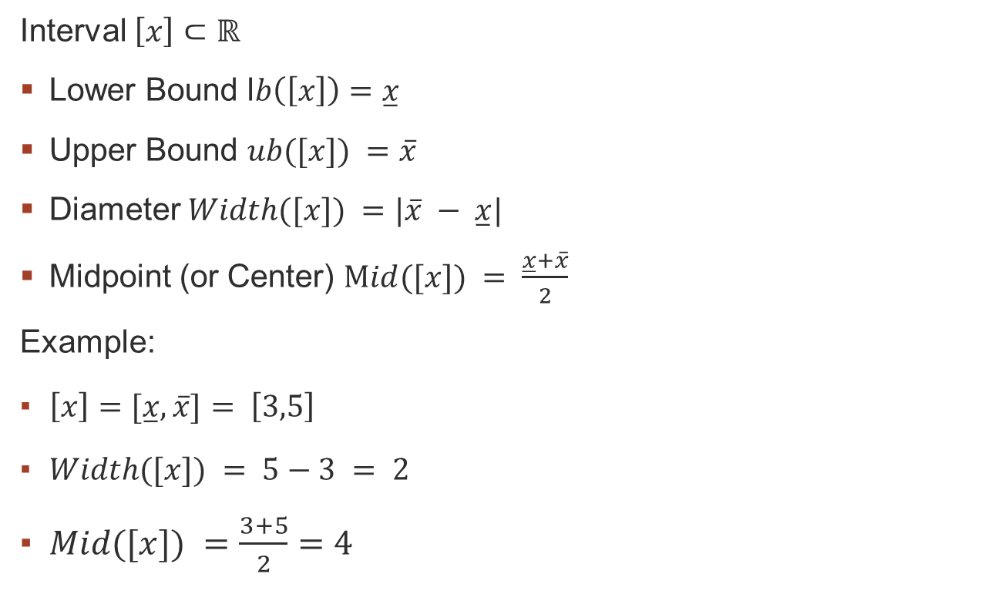
Interval Definitions
Interval $\left[x\right]⊂ℝ$
Lower Bound l$b\left(\left[x\right]\right)=\overset{̲}{x}$
Upper Bound $ub([x]) =\overline{x}$
Diameter $Width([x]) =|\overline{x} − \overset{̲}{x}|$
Midpoint (or Center) $Mid([x]) = \frac{\overset{̲}{x}+\overline{x}}{2}$
Example:
$\left[x\right]=[\overset{̲}{x},\overline{x}]= \left[3,5\right]$
$Width([x]) = 5−3 = 2$
$Mid([x]) =\frac{3+5}{2}=4$

Slide 10
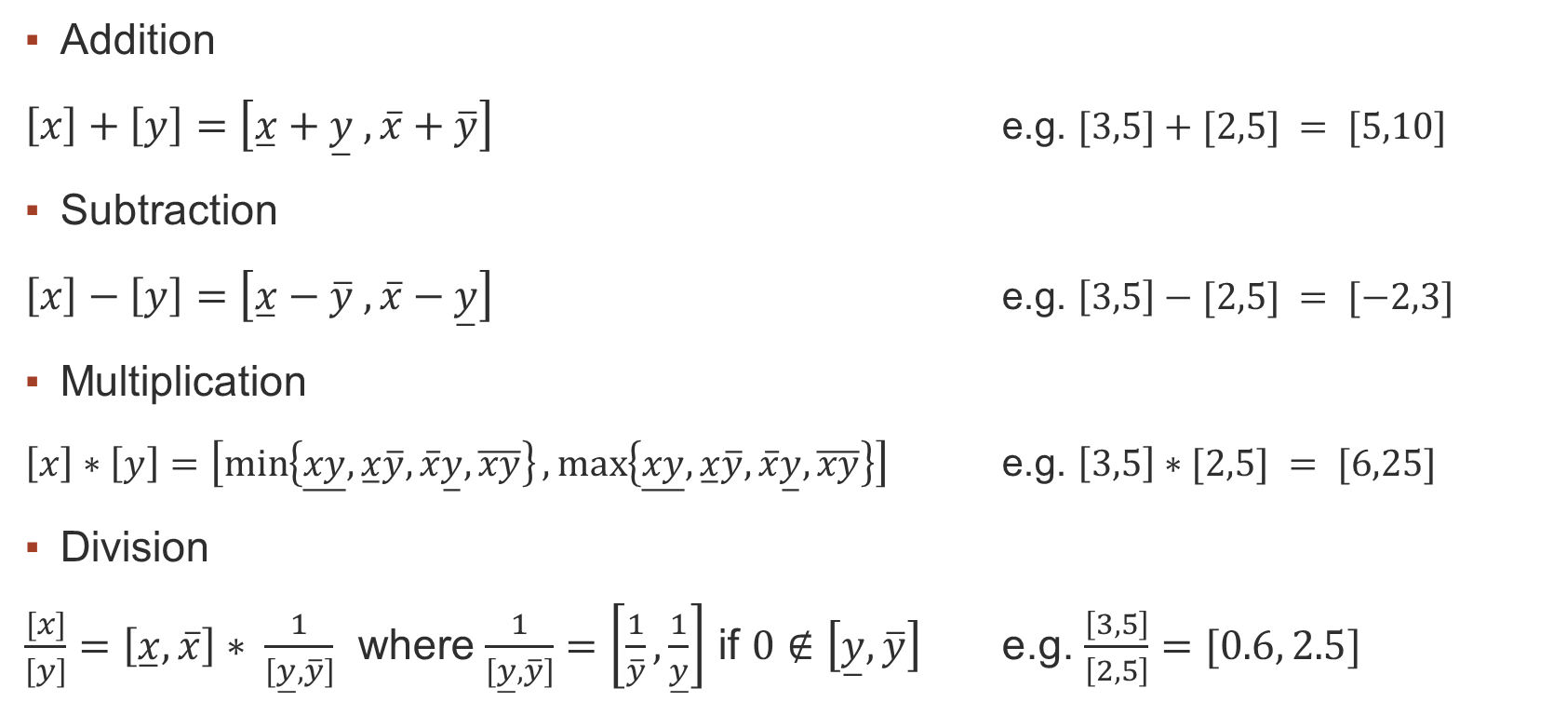
Interval Basic Operations
Addition
$\left[x\right]+\left[y\right]=\left[\overset{̲}{x}+\overset{̲}{y} , \overline{x}+\overline{y}\right]$ e.g. $[3,5]+[2,5] = [5,10]$
Subtraction
$\left[x\right]−\left[y\right]=\left[\overset{̲}{x}−\overline{y} , \overline{x}−\overset{̲}{y}\right]$ e.g. $\left[3,5\right]−[2,5] = [−2,3]$
Multiplication
$\left[x\right]∗\left[y\right]=\left[\min\left\{\overset{̲}{xy},\overset{̲}{x}\overline{y}, \overline{x}\overset{̲}{y}, \overline{xy}\right\},\max\left\{\overset{̲}{xy},\overset{̲}{x}\overline{y}, \overline{x}\overset{̲}{y}, \overline{xy}\right\}\right]$ e.g. $\left[3,5\right]∗[2,5] = [6,25]$
Division
$\frac{[x]}{[y]}=\left[\overset{̲}{x},\overline{x}\right]∗ \frac{1}{[\overset{̲}{y}, \overline{y}]}$ where $\frac{1}{[\overset{̲}{y}, \overline{y}]}=\left[\frac{1}{\overline{y}},\frac{1}{\overset{̲}{y}}\right]$ if $0∉\left[\overset{̲}{y},\overline{y}\right]$ e.g. $\frac{\left[3,5\right]}{\left[2,5\right]}=[0.6, 2.5]$

Slide 11

Interval Set Operations
Set-Membership Operations
isSubset
$\left[x\right]⊆\left[y\right]=\overset{̲}{y}≤\overset{̲}{x} AND \overline{y}≥\overline{x}$
Intersects
$\left[x\right]∩\left[y\right]= (\overset{̲}{x}≤\overline{y} AND \overline{x}≥\overset{̲}{y} )$

Slide 12

Interval Trigonometric Operations
Non-linear Elementary & Trigonometric functions are also supported!
${\left[x\right]}^{2}$
$\sqrt{[x]}$
$e^{\left[x\right]}$
$log⁡([x])$
$sin([x])$
$cos⁡([x])$
$tan⁡([x])$

Slide 13

Interval Boxes
Multidimensional Intervals or Interval Vectors
$[X] = [[x_{1}],[x_{2}], …, [x_{n}]]$
Interval Matrices also supported!!

Slide 14

Interval Functions
Interval Inclusion Functions
Given $f$ from $ℝ^{n}$ to $ℝ^{m}$, $[f]$ (from $𝕀ℝ^{n}$ to $𝕀ℝ^{m}$) is an inclusion function if
$$∀\left[x\right]∈𝕀ℝ^{n} f\left(\left[x\right]\right)⊂[f]([x])$$
Input Set Image Set

Slide 15
SIVIA Algorithm

Slide 16


SIVIA Algorithm
Input: $X_{0}$ Box, incl. function $[f](x),$image Y
Begin with an initial $X_{0}$ box.
Repeat:
Send Box to an Inclusion Function [f]([x])
Evaluation phase -$\text{[}\text{f}\text{]([}\text{x}\text{])}⊆Y$
Accept - [f]([x]).isSubset(Y) (Box is part of the solution)
Reject - ! [f]([x]).intersects(Y)
Bisect - $X_{0}$ $→X_{1}, X_{2}$
Also reject width(box) $≤$ $ε$ (Box is too small to process)
Until all boxes have been evaluated.
Output: $X_{n}$ Boxes with their categorization labels (accepted, rejected, epsilon)
Branch and Bound Technique!!
Jaulin L., Kieffer M., Didrit O., Walter E. (2001). Applied interval analysis. Springer.
L. Jaulin and E. Walter, Set inversion via interval analysis for nonlinear bounded-error estimation, Automatica, vol. 29, no. 4, pp. 1053–1064, 1993.

Slide 17
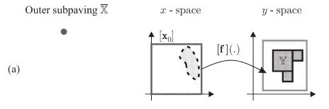
SIVIA Algorithm
Jaulin L., Kieffer M., Didrit O., Walter E. (2001). Applied interval analysis. Springer.
L. Jaulin and E. Walter, Set inversion via interval analysis for nonlinear bounded-error estimation, Automatica, vol. 29, no. 4, pp. 1053–1064, 1993.

Slide 18
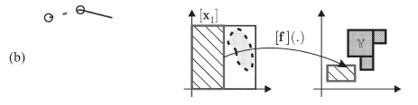
SIVIA Algorithm
Jaulin L., Kieffer M., Didrit O., Walter E. (2001). Applied interval analysis. Springer.
L. Jaulin and E. Walter, Set inversion via interval analysis for nonlinear bounded-error estimation, Automatica, vol. 29, no. 4, pp. 1053–1064, 1993.

Slide 19
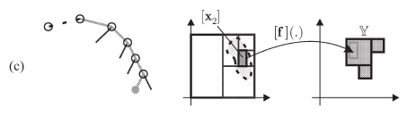
SIVIA Algorithm
Jaulin L., Kieffer M., Didrit O., Walter E. (2001). Applied interval analysis. Springer.
L. Jaulin and E. Walter, Set inversion via interval analysis for nonlinear bounded-error estimation, Automatica, vol. 29, no. 4, pp. 1053–1064, 1993.

Slide 20
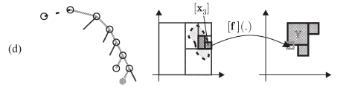
SIVIA Algorithm
Jaulin L., Kieffer M., Didrit O., Walter E. (2001). Applied interval analysis. Springer.
L. Jaulin and E. Walter, Set inversion via interval analysis for nonlinear bounded-error estimation, Automatica, vol. 29, no. 4, pp. 1053–1064, 1993.

Slide 21
SIVIA and Neural Networks

Slide 22
SIVIA & Neural Networks
SIVIA enables the estimation of non-linear spaces
Consequently, combining it with a Neural Network enables the estimation of its input space even without knowledge of training data
Allows the extraction of useful information such as the volume of a recognized input area
McCulloch, Warren S., and Walter Pitts. A logical calculus of the ideas immanent in nervous activity. The bulletin of mathematical biophysics 5 (1943): 115-133.
S. Haykin, Neural Networks and Learning Machines. Pearson India, 2008.
S. P. Adam, A. C. Likas, and M. N. Vrahatis, “Evaluating generalization through interval-based neural network inversion,” Neural Computing and Applications, vol. 31, no. 12, pp. 9241–9260, 2019.

Slide 23
GPU Parallelism

Slide 24
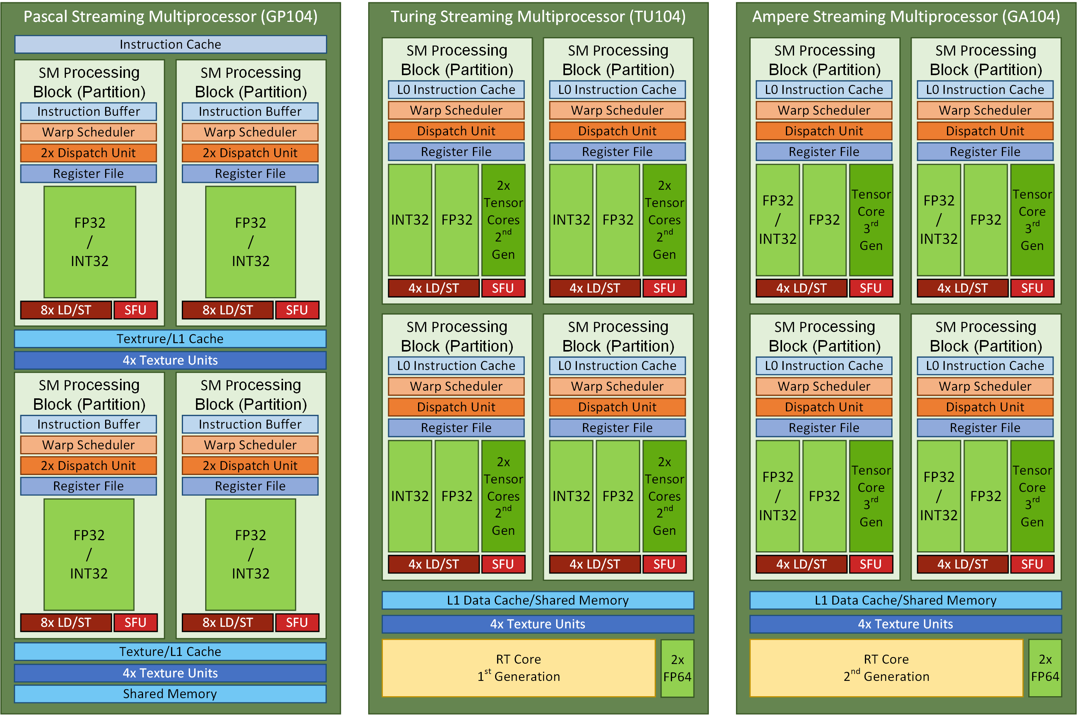
GPU Parallelism
SIMD/SIMT: many low performance cores solving the same task in parallel
Originally developed for computer graphics
Primary focus on NVIDIA GPUs due to high market share
Lorenz Gillner, Ekaterina Auer., Interval Methods for the GPU, SWIM, 2023.
P. Pacheco and M. Malensek, An introduction to parallel programming. Morgan Kaufmann, 2021
https://docs.nvidia.com/cuda/cuda-c-programming-guide/

Slide 25
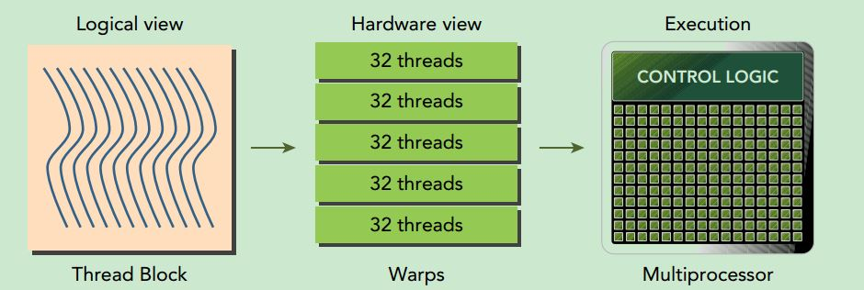
CUDA Programming Model
Defined by Blocks, Threads, Warps
Blocks are programmable
Warps are groups of 32 Threads
A thread is a processing (CUDA) core (max 1024 per block)
Lorenz Gillner, Ekaterina Auer., Interval Methods for the GPU, SWIM, 2023.
P. Pacheco and M. Malensek, An introduction to parallel programming. Morgan Kaufmann, 2021
https://docs.nvidia.com/cuda/cuda-c-programming-guide/

Slide 26
CUDA Memory Hierarchy
Constant, Global, Shared, Registers
Global Memory is the slowest but largest in size – also known as VRAM
Registers are the fastest but very small in size
Shared Memory is on-chip slower than registers but of larger size
Cache reduces the cost of accessing the Global Memory
Lorenz Gillner, Ekaterina Auer., Interval Methods for the GPU, SWIM, 2023.
P. Pacheco and M. Malensek, An introduction to parallel programming. Morgan Kaufmann, 2021
https://docs.nvidia.com/cuda/cuda-c-programming-guide/

Slide 27
Implementation

Slide 28
CUDA Design Principles
Find ways to parallelize sequential code.
Minimize data transfers between the host and the device.
Adjust kernel launch configuration to maximize device utilization.
Ensure global memory accesses are coalesced.
Minimize redundant accesses to global memory whenever possible.
Avoid long sequences of diverged execution by threads within the same warp.
https://docs.nvidia.com/cuda/cuda-c-programming-guide/
https://docs.nvidia.com/cuda/ampere-tuning-guide/index.html
https://docs.nvidia.com/cuda/cuda-c-best-practices-guide/

Slide 29
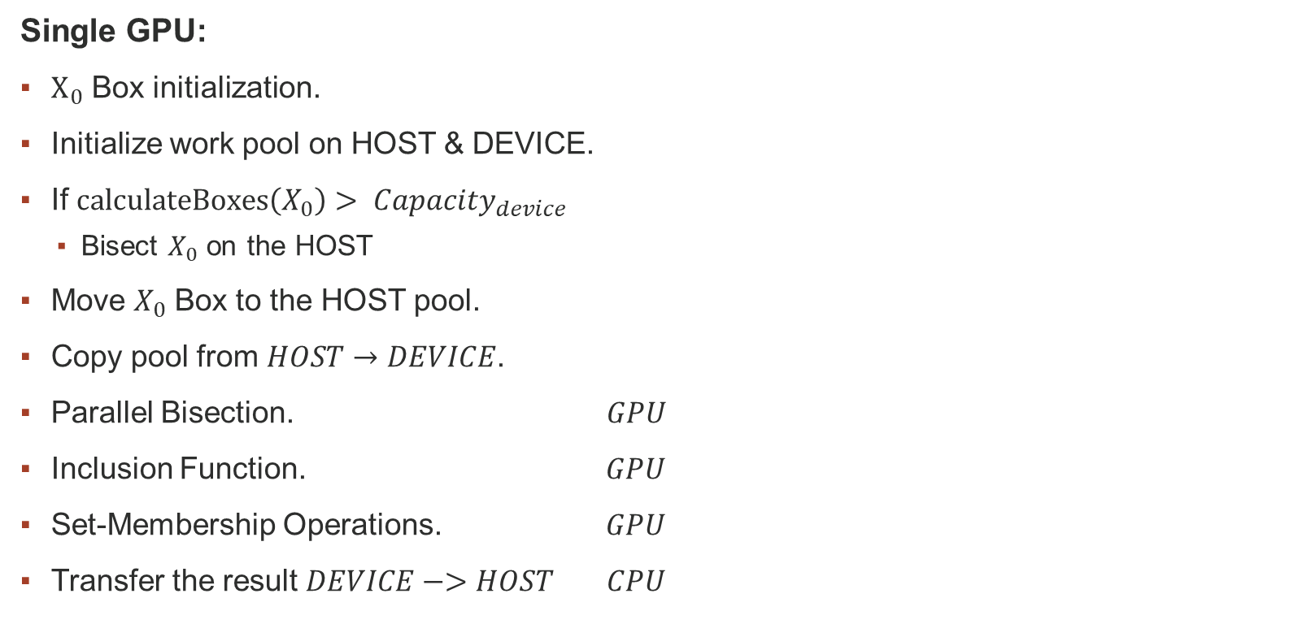
Implementation
Single GPU:
$Χ_{0}$ Box initialization.
Initialize work pool on HOST & DEVICE.
If $calculateBoxes\left(X_{0}\right)> Capacity_{device}$
Bisect $X_{0}$ on the HOST
Move $X_{0}$ Box to the HOST pool.
Copy pool from $HOST→DEVICE$.
Parallel Bisection. $GPU$
Inclusion Function. $GPU$
Set-Membership Operations. $GPU$
Transfer the result $DEVICE−>HOST$ $CPU$

Slide 30
Implementation
Single GPU:
$Χ_{0}$ Box initialization.
Initialize work pool on HOST & DEVICE.
If $calculateBoxes\left(X_{0}\right)> Capacity_{device}$
Bisect $X_{0}$ on the HOST
Move $X_{0}$ Box to the HOST pool.
Copy pool from $HOST→DEVICE$.
Parallel Bisection. $GPU$
Inclusion Function. $GPU$
Set-Membership Operations. $GPU$
Transfer the result $DEVICE−>HOST$ $CPU$
SSP Strategy!!
B. Gendron and T. G. Crainic, Parallel branch-and-branch algorithms: Survey and synthesis, Operations research, vol. 42, no. 6, pp. 1042–1066, 1994.
K. Nasiotis, D. López, S. Adam, and L. Casado, Set inversion via interval analysis a study on parallel processing implementation, SWIM 2019.

Slide 31
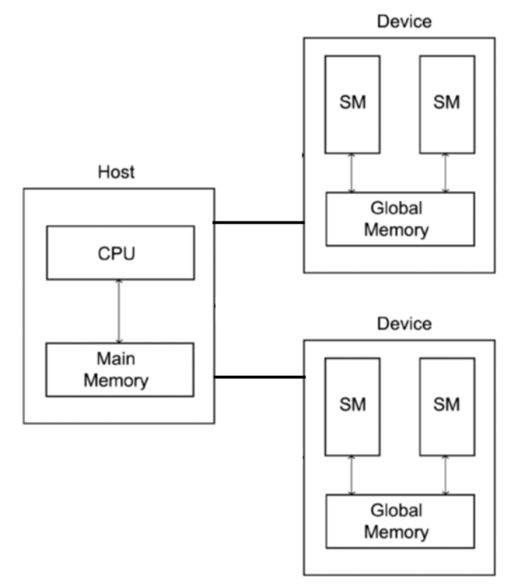
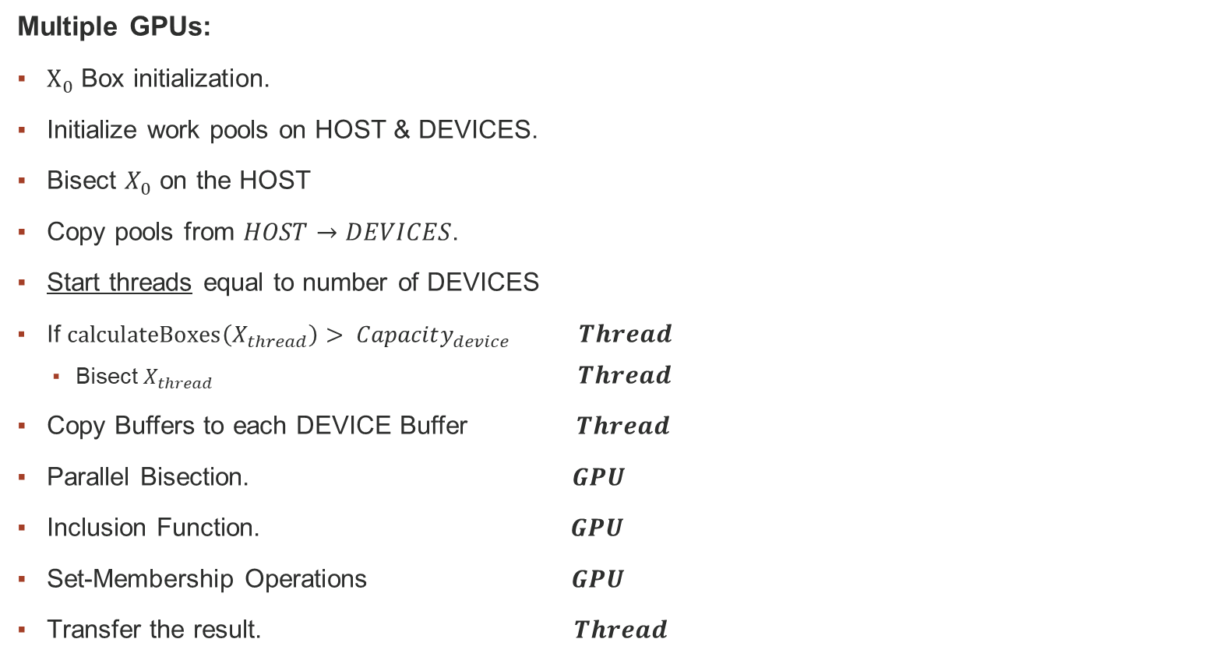
Implementation
Multiple GPUs:
$Χ_{0}$ Box initialization.
Initialize work pools on HOST & DEVICES.
Bisect $X_{0}$ on the HOST
Copy pools from $HOST→DEVICES$.
Start threads equal to number of DEVICES
If $calculateBoxes\left(X_{thread}\right)> Capacity_{device}$ $Thread$
Bisect $X_{thread} Thread$
Copy Buffers to each DEVICE Buffer $Thread$
Parallel Bisection. $GPU$
Inclusion Function. $GPU$
Set-Membership Operations $GPU$
Transfer the result. $Thread$
AMP/SSP Hybrid Strategy!!
B. Gendron and T. G. Crainic, Parallel branch-and-branch algorithms: Survey and synthesis, Operations research, vol. 42, no. 6, pp. 1042–1066, 1994.
K. Nasiotis, D. López, S. Adam, and L. Casado, Set inversion via interval analysis a study on parallel processing implementation, SWIM 2019.

Slide 32
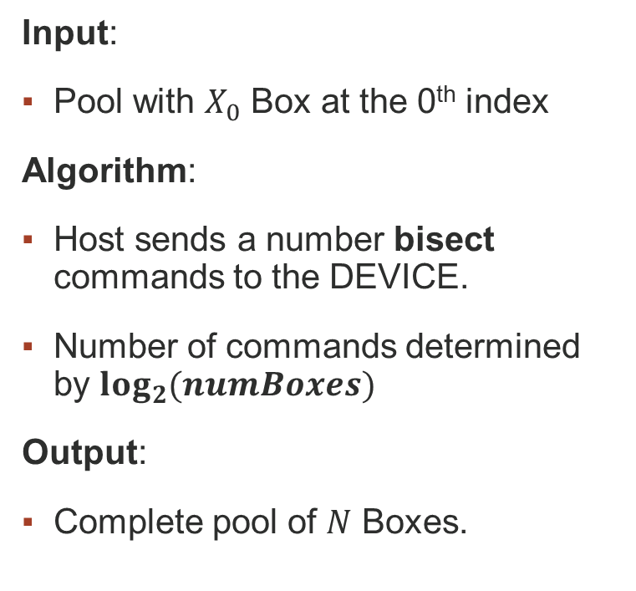
Parallel Bisection
Input:
Pool with $X_{0}$ Box at the 0th index
Algorithm:
Host sends a number bisect commands to the DEVICE.
Number of commands determined by $\log_{2}{(numBoxes)}$
Output:
Complete pool of $N$ Boxes.

Slide 33
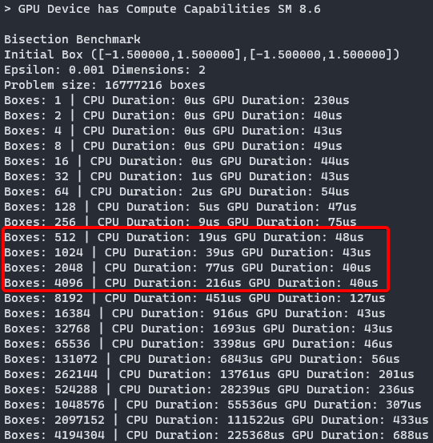
Parallel Bisection
Pros:
Faster Execution
Trivial memory transfer costs
Scalable
Cons:
Wasted GPU Resources in initial executions

Slide 34





Parallel Bisection
Equal Bisection $−>$ Full expansion of the problem tree
$$e = 0.1$$
$$e = 0.01$$
$$e = 0.4$$
$$e = 0.2$$

Slide 35
Inference & Set Estimation
Input:
Vector of Boxes – Work Pool
Empty Label Vector - Problems 1&2
Algorithm:
Coarse-grained approach
Each Box processed independently. ( [f]([x]) and set-membership operations)
Optimized to avoid Warp Divergence. (replaces “if” clauses with Boolean operations)
Parallel Reduction – Problem 3
Output:
Label Buffer filled with evaluation labels (included, discarded, epsilon) – Problems 1&2
Volume of domain of validity – Problem 3

Slide 36
Parallel Reduction
Without Warp Divergence
Sequential Addressing (cache friendly)
M. Harris et al., Optimizing parallel reduction in cuda, Nvidia developer technology, vol. 2, no. 4, p. 70, 2007.
https://github.com/NVIDIA/cuda-samples - Reduction #3

Slide 37
Results

Slide 38
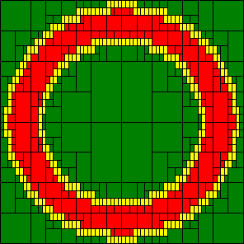
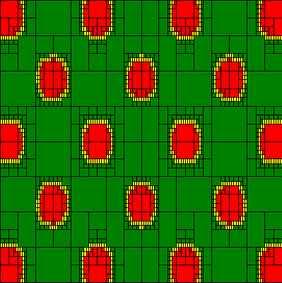


Problems 1 & 2
Problem 1: 2D Torus
Problem 2: 2D Griewank
$\left[f\right]\left(\left[x\right]\right)={[x]}^{2}+{[y]}^{2}$ ${\left[x\right]}_{0}=\left[−1.5,1.5\right],\left[−1.5,1.5\right]$
$$\left[y\right]=\left[1,2\right]$$
$$\left[x_{0}\right]={\left[−10,10\right]}^{2}$$
$$\left[y\right]=\left[1.5,3\right]$$
$$[f]\left([x]\right)=Σ_{i=1}^{2} \frac{{[x]}_{i}^{2}}{4000} −Π_{i=1}^{2}cos\left(\frac{{[x]}_{i}}{\sqrt{i}}\right)+1$$
Problem Requirement: The whole input space

Slide 39
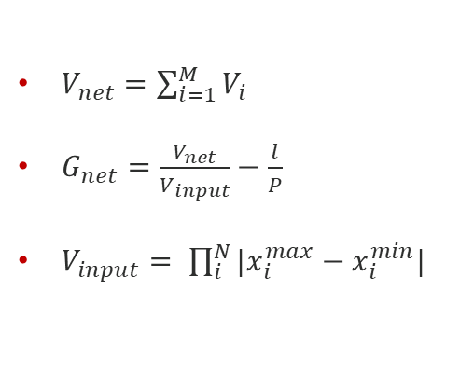
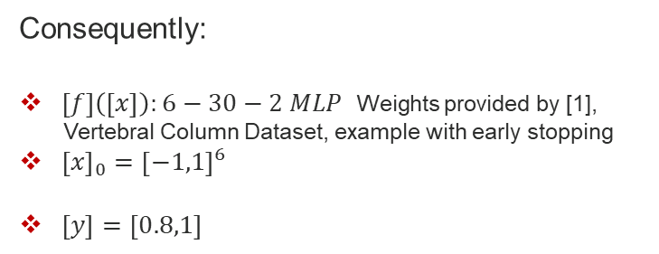
Problem 3
Evaluating Generalization Performance of Neural Classifiers
$V_{net}=\sum_{i=1}^{M}{V_{i}}$
$G_{net}=\frac{V_{net}}{V_{input}}−\frac{l}{P}$
$V_{input}= \prod_{i}^{N}{|x_{i}^{max}−x_{i}^{min}|}$
Consequently:
$\left[f\right]\left(\left[x\right]\right):6−30−2 MLP$ Weights provided by [1],
Vertebral Column Dataset, example with early stopping
${\left[x\right]}_{0}={\left[−1,1\right]}^{6}$
$\left[y\right]=\left[0.8,1\right]$
Problem Requirement: A single value
Undertraining
Sample data
“Proper” fit
Overtraining (overfitting)
[1] S. P. Adam, A. C. Likas, and M. N. Vrahatis, “Evaluating generalization through interval-based neural network inversion,” Neural Computing and Applications, vol. 31, no. 12, pp. 9241–9260, 2019.
S. P. Adam, D. A. Karras, G. D. Magoulas, and M. N. Vrahatis, Reliable estimation of a neural network’s domain of validity through interval analysis-based inversion, in 2015 International Joint Conference on Neural Networks (ĲCNN), pp. 1–8, 2015.

Slide 40
Test Configurations
Home Setup
GPU: Nvidia RTX 3060 Ti 8GB
OS: WSL2 Ubuntu 22.04.2 LTS
Microlab DaVinci of NTUA:
GPU: Nvidia Tesla V100 32GB
OS: Ubuntu 20.04.2 LTS
Google Collab:
GPU 1: Nvidia A100 40GB
GPU 2: Nvidia Tesla V100 16GB
CEID of UPATRAS:
GPU: 8x Nvidia A100 32GB
OS: Ubuntu 22.04.3 LTS

Slide 41
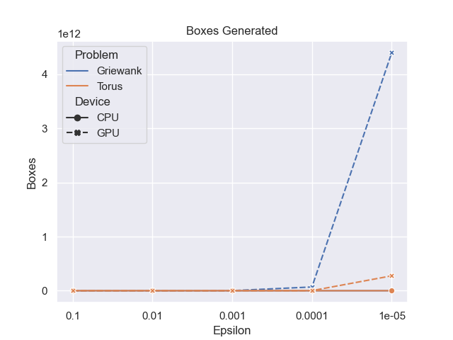
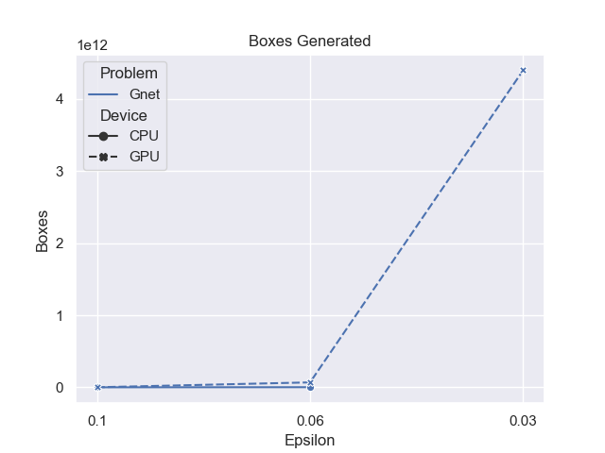
Problem Size
Parallel implementation computes a larger number of boxes
Missing value on problem 3 due to long execution time required to exit execution
Problems 1&2 Problem 3

Slide 42
Results: Problem 1

Slide 43
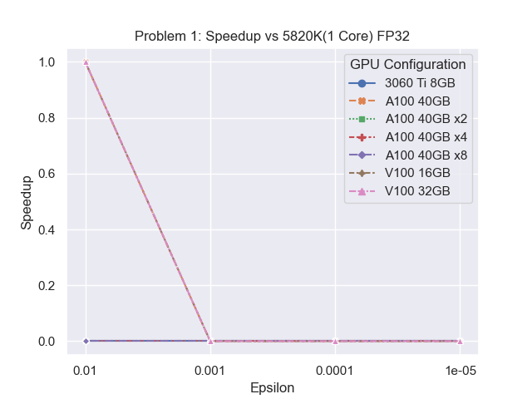

Speedup
Comparison to sequential SIVIA using an i7 5820k @ 4.3Ghz
Slowdowns due to intensive memory transfers between host and device

Slide 44
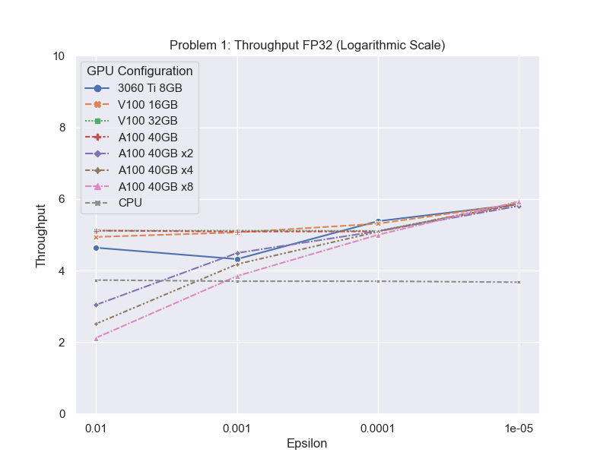
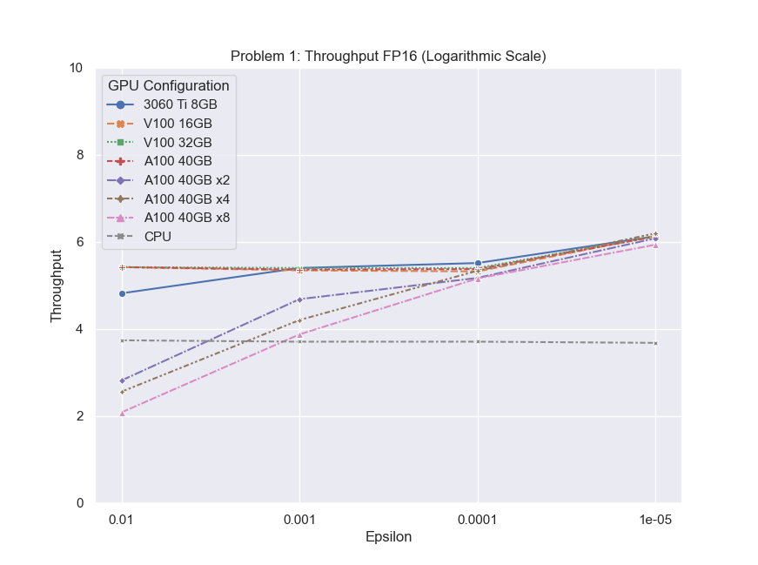
Throughput
CPU has way smaller throughput
Half variables increase throughput
Slight depiction due to logarithmical scaling

Slide 45
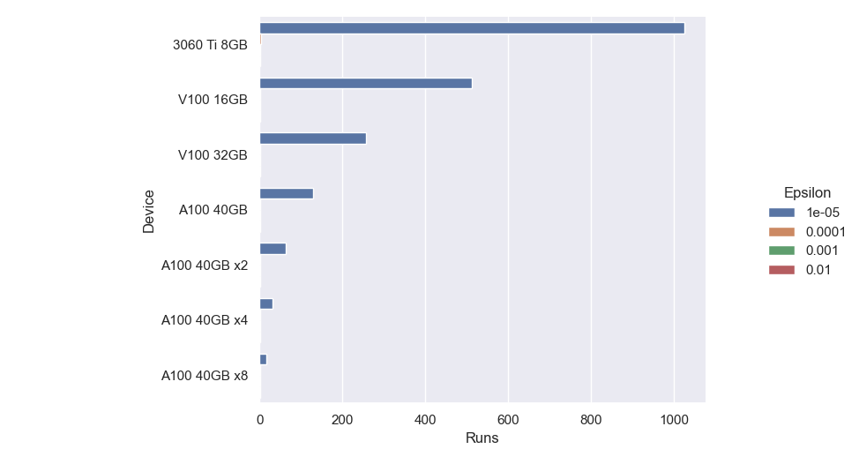
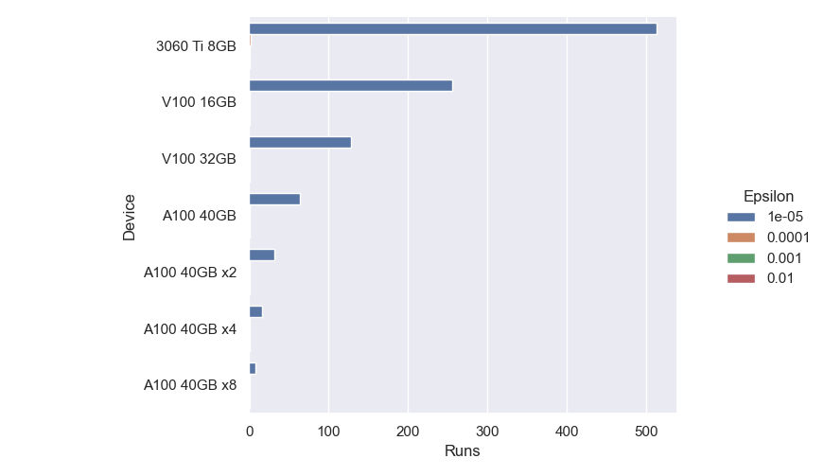
Kernel Runs
Problem 1
More VRAM -> More Boxes fit -> less GPU executions
FP32
FP16

Slide 46
Results: Problem 2

Slide 47
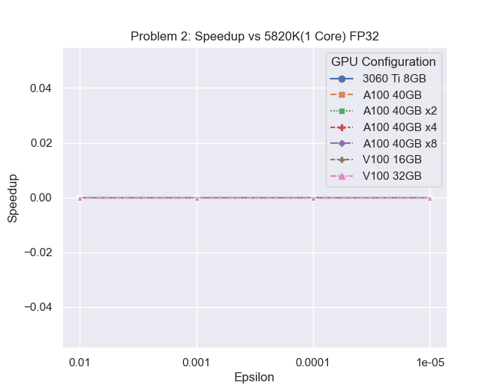
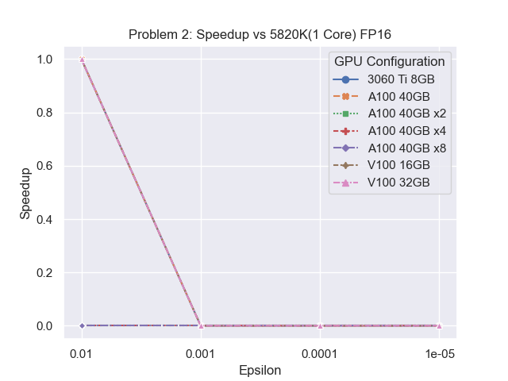
Speedup
Similar findings as with Problem 1

Slide 48
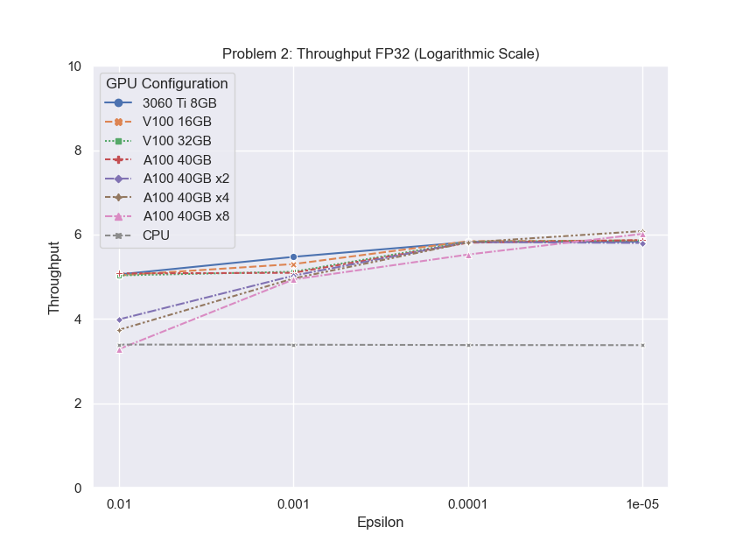
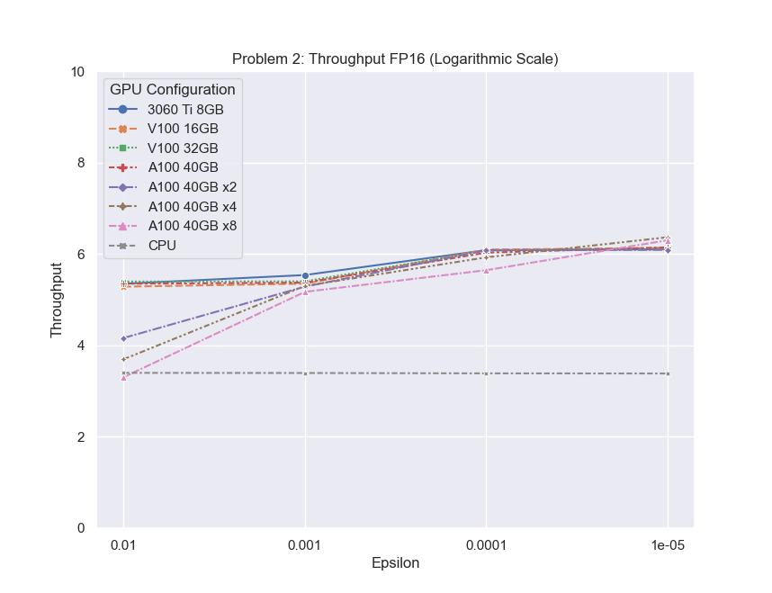
Throughput
Throughput findings of Problem 1 also extend to Problem 2
Half variables increase throughput

Slide 49
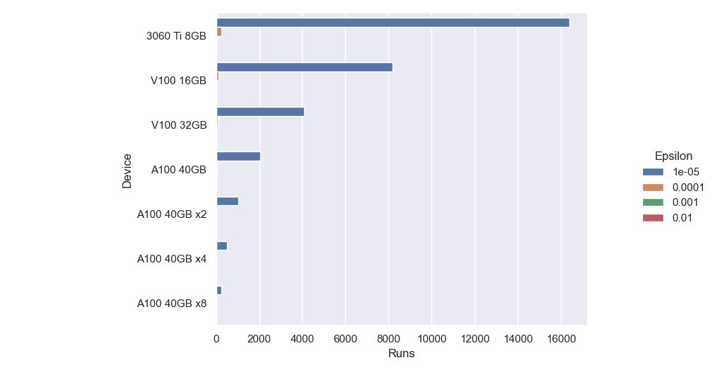

Kernel Runs
Problem 2
Similar behavior to Problem 1, more VRAM mean less GPU executions
FP32
FP16

Slide 50
Problem 3

Slide 51
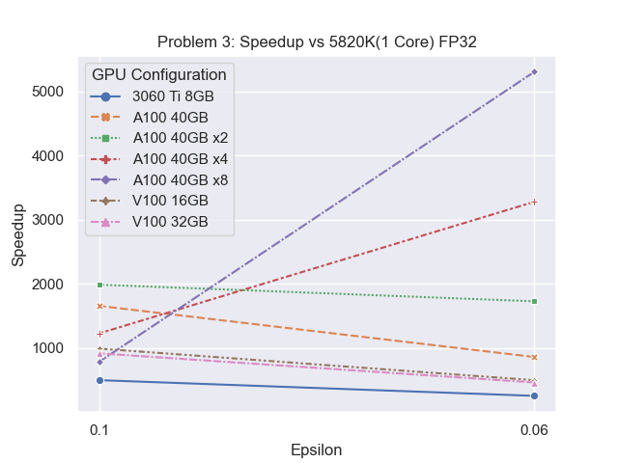

Speedup
Key result: 5000+ speedup when using 8x A100 GPUs
8000 with FP16 variables

Slide 52
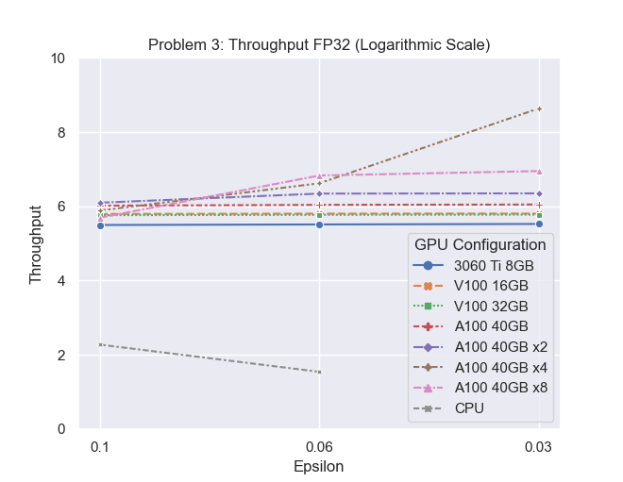
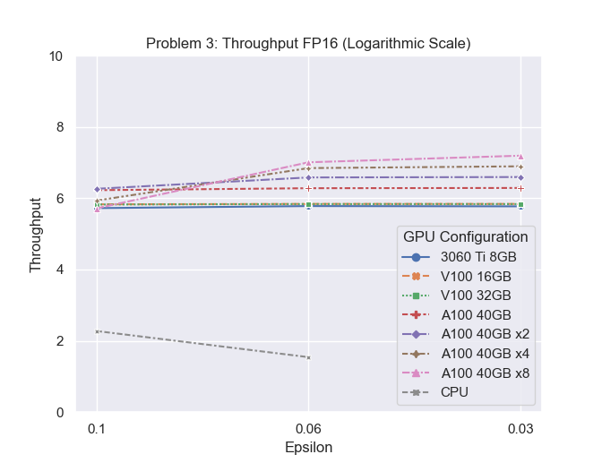
Throughput
Speedup findings align with the throughput
CPU throughput shrinks with increasing problem size

Slide 53
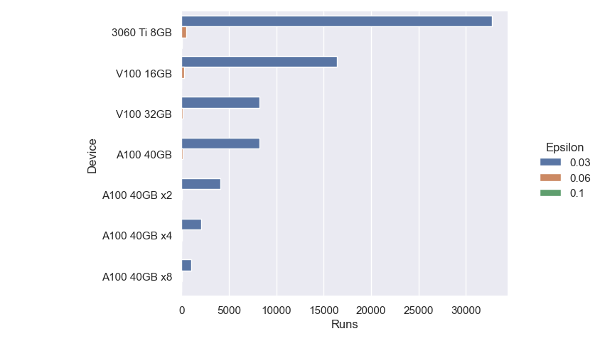

Kernel Runs
Problem 3
Like problems 1&2, less VRAM = More executions
FP32
FP16

Slide 54
Profiling

Slide 55
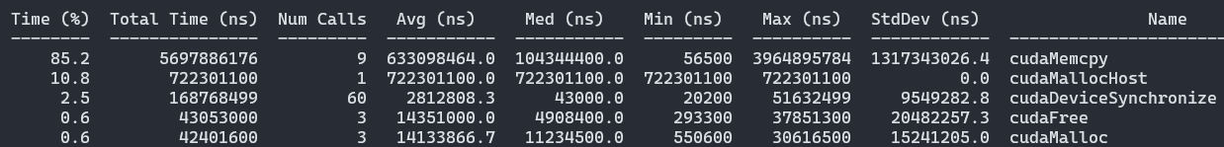
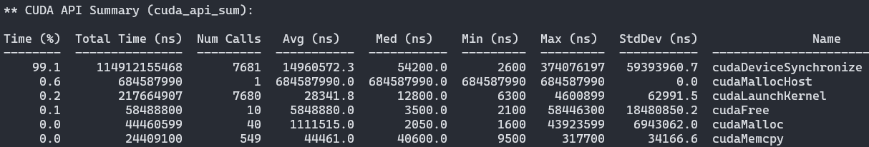
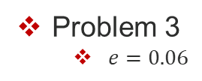

Profiling
Nvidia profiler validates assumptions of previous results
Problem 2
$e=0.001$
Problem 3
$e=0.06$

Slide 56
Conclusion

Slide 57
Conclusion
GPU parallelization is very compatible with SIVIA when intensive memory transfers are not a requirement
Mathematical Techniques should accompany parallelization efforts
E.g. Optimization problems have their search space reduced by calculating the hull of an iteration’s best Boxes
Proposed implementation not a one-size-fits-all technique
Scales very well with multiple GPUs

Slide 58
Future Work
Expansion of GPU Interval Ecosystem
Better Fine-tuning and resource allocation
Test algorithm with optimization problems
Experiment with in-GPU synchronization strategies
Test and compare modern parallel interval environments[1][2]
[1]Lorenz Gillner, Ekaterina Auer., Interval Methods for the GPU, SWIM, 2023.
[2]https://github.com/JuliaIntervals/IntervalArithmetic.jl

Slide 59
Acknowledgements

Slide 60
Thank you for your time!

Slide 61
Flynn’s Taxonomy
SISD – Single Instruction Single Data
MISD – Multiple Instructions Multiple Data
SIMD – Single Instruction Multiple Data
MIMD – Multiple Instructions Multiple Data
Lorenz Gillner, Ekaterina Auer., Interval Methods for the GPU, SWIM, 2023.
P. Pacheco and M. Malensek, An introduction to parallel programming. Morgan Kaufmann, 2021

Slide 62
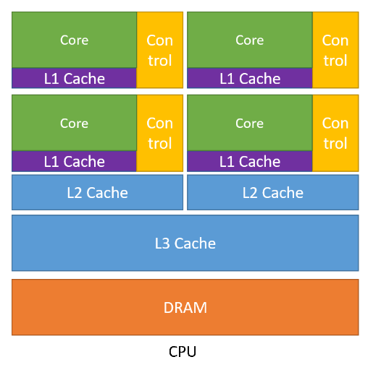
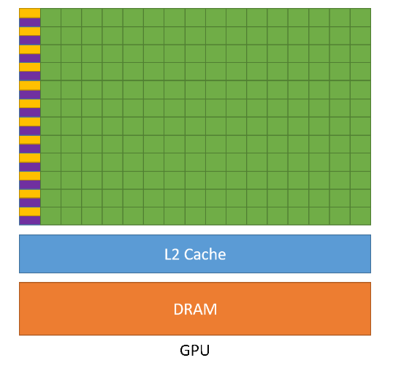
Parallel Computing
Task Parallelism
Data Parallelism
Fine-Grained
Coarse-Grained
Lorenz Gillner, Ekaterina Auer., Interval Methods for the GPU, SWIM, 2023.
P. Pacheco and M. Malensek, An introduction to parallel programming. Morgan Kaufmann, 2021

