Slide 1

Accelerating SIVIA (Set Inversion via Interval Analysis). An Interval Set Membership Technique to explain Neural Classifier Decisions.
Nasiotis Konstantinos

Slide 2
Contents

Slide 3
Contents
Background
Implementation
Results
Discussion & Conclusion
Acknowledgements

Slide 4
Background

Slide 5
Interval Analysis
R. E. Moore, Interval arithmetic and automatic error analysis in digital computing. PhD thesis, Department of Mathematics, Stanford University, 1962.
R. E. Moore, Interval analysis, vol. 4. Prentice-Hall Englewood Cliffs, 1966.
L. Jaulin and E. Walter, Set inversion via interval analysis for nonlinear bounded-error estimation, Automatica, vol. 29, no. 4, pp. 1053–1064, 1993.

Slide 6
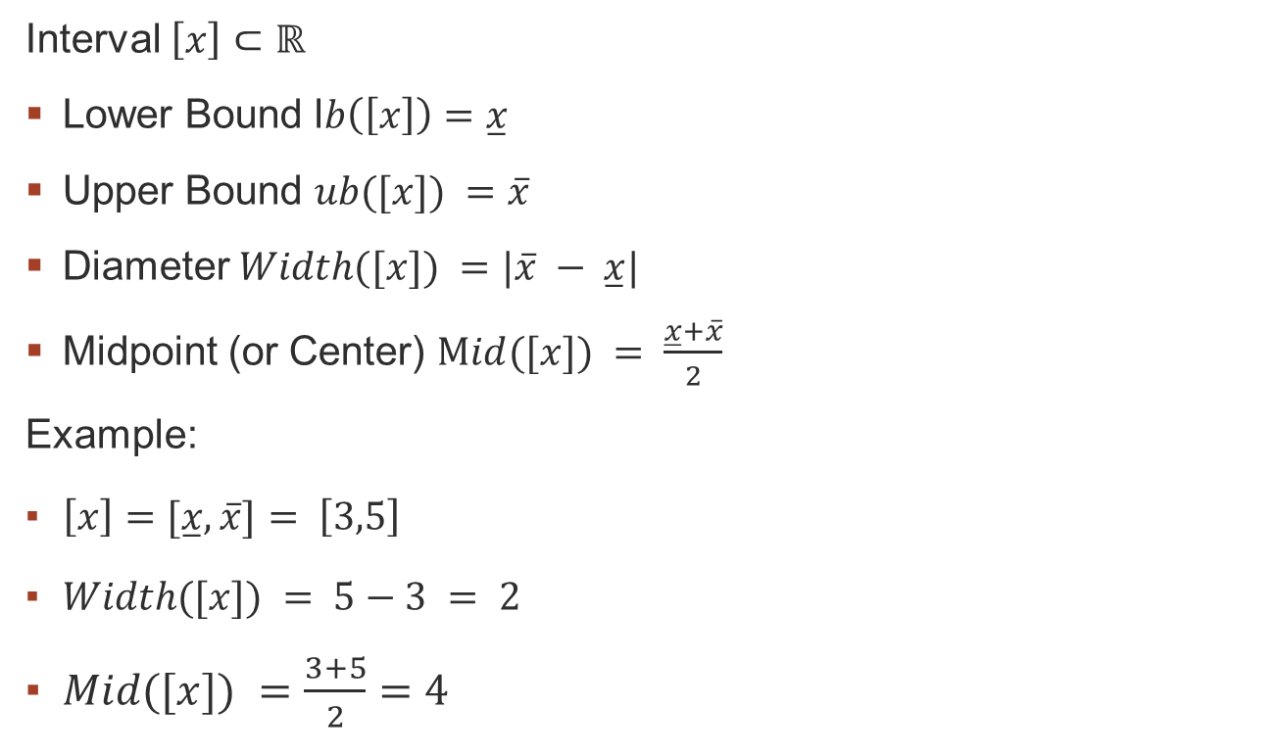
Interval Analysis
Interval $\left[x\right]⊂ℝ$
Lower Bound l$b\left(\left[x\right]\right)=\overset{̲}{x}$
Upper Bound $ub([x]) =\overline{x}$
Diameter $Width([x]) =|\overline{x} − \overset{̲}{x}|$
Midpoint (or Center) $Mid([x]) = \frac{\overset{̲}{x}+\overline{x}}{2}$
Example:
$\left[x\right]=[\overset{̲}{x},\overline{x}]= \left[3,5\right]$
$Width([x]) = 5−3 = 2$
$Mid([x]) =\frac{3+5}{2}=4$

Slide 7
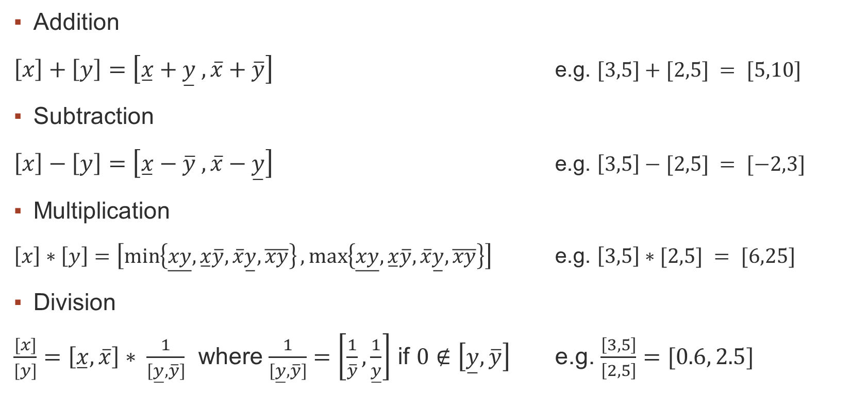
Interval Analysis
Addition
$\left[x\right]+\left[y\right]=\left[\overset{̲}{x}+\overset{̲}{y} , \overline{x}+\overline{y}\right]$ e.g. $[3,5]+[2,5] = [5,10]$
Subtraction
$\left[x\right]−\left[y\right]=\left[\overset{̲}{x}−\overline{y} , \overline{x}−\overset{̲}{y}\right]$ e.g. $\left[3,5\right]−[2,5] = [−2,3]$
Multiplication
$\left[x\right]∗\left[y\right]=\left[\min\left\{\overset{̲}{xy},\overset{̲}{x}\overline{y}, \overline{x}\overset{̲}{y}, \overline{xy}\right\},\max\left\{\overset{̲}{xy},\overset{̲}{x}\overline{y}, \overline{x}\overset{̲}{y}, \overline{xy}\right\}\right]$ e.g. $\left[3,5\right]∗[2,5] = [6,25]$
Division
$\frac{[x]}{[y]}=\left[\overset{̲}{x},\overline{x}\right]∗ \frac{1}{[\overset{̲}{y}, \overline{y}]}$ where $\frac{1}{[\overset{̲}{y}, \overline{y}]}=\left[\frac{1}{\overline{y}},\frac{1}{\overset{̲}{y}}\right]$ if $0∉\left[\overset{̲}{y},\overline{y}\right]$ e.g. $\frac{\left[3,5\right]}{\left[2,5\right]}=[0.6, 2.5]$

Slide 8

Interval Analysis
Set-Membership Operations
isSubset
$\left[x\right]⊆\left[y\right]=\overset{̲}{y}≤\overset{̲}{x} AND \overline{y}≥\overline{x}$
Intersects
$\left[x\right]∩\left[y\right]= (\overset{̲}{x}≤\overline{y} AND \overline{x}≥\overset{̲}{y} )$

Slide 9

Interval Analysis
Non-linear Elementary & Trigonometric functions are also supported!
${\left[x\right]}^{2}$
$\sqrt{[x]}$
$e^{\left[x\right]}$
$log⁡([x])$
$sin([x])$
$cos⁡([x])$
$tan⁡([x])$

Slide 10

Interval Analysis
Multidimensional Intervals or Interval Vectors
$[X] = [[x_{1}],[x_{2}], …, [x_{n}]]$
Interval Matrices also supported!!

Slide 11

Interval Analysis
Interval Inclusion Functions
Given $f$ from $ℝ^{n}$ to $ℝ^{m}$, $[f]$ (from $𝕀ℝ^{n}$ to $𝕀ℝ^{m}$) is an inclusion function if
$$∀\left[x\right]∈𝕀ℝ^{n} f\left(\left[x\right]\right)⊂[f]([x])$$
Input Set Image Set

Slide 12

Set Inversion via Interval Analysis
Begin with an initial $X_{0}$ box.
Repeat:
Send Box to an Inclusion Function [f]([x])
Evaluation phase -$\text{[}\text{f}\text{]([}\text{x}\text{])}⊆Y$
Accept - [f]([x]).isSubset(Y) (Box is part of the solution)
Reject - ! [f]([x]).intersects(Y)
Bisect - $X_{0}$ $→X_{1}, X_{2}$
Also reject width(box) $≤$ $ε$ (Box is too small to process)
Until all boxes have been evaluated.
Branch and Bound Technique!!
Jaulin L., Kieffer M., Didrit O., Walter E. (2001). Applied interval analysis. Springer.
L. Jaulin and E. Walter, Set inversion via interval analysis for nonlinear bounded-error estimation, Automatica, vol. 29, no. 4, pp. 1053–1064, 1993.

Slide 13
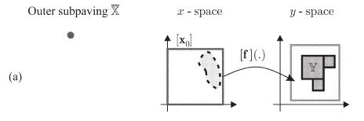
Set Inversion via Interval Analysis
Jaulin L., Kieffer M., Didrit O., Walter E. (2001). Applied interval analysis. Springer.
L. Jaulin and E. Walter, Set inversion via interval analysis for nonlinear bounded-error estimation, Automatica, vol. 29, no. 4, pp. 1053–1064, 1993.

Slide 14
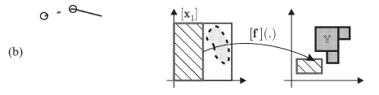
Set Inversion via Interval Analysis
Jaulin L., Kieffer M., Didrit O., Walter E. (2001). Applied interval analysis. Springer.
L. Jaulin and E. Walter, Set inversion via interval analysis for nonlinear bounded-error estimation, Automatica, vol. 29, no. 4, pp. 1053–1064, 1993.

Slide 15
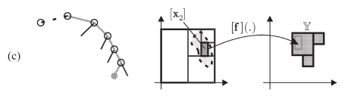
Set Inversion via Interval Analysis
Jaulin L., Kieffer M., Didrit O., Walter E. (2001). Applied interval analysis. Springer.
L. Jaulin and E. Walter, Set inversion via interval analysis for nonlinear bounded-error estimation, Automatica, vol. 29, no. 4, pp. 1053–1064, 1993.

Slide 16
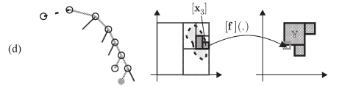
Set Inversion via Interval Analysis
Jaulin L., Kieffer M., Didrit O., Walter E. (2001). Applied interval analysis. Springer.
L. Jaulin and E. Walter, Set inversion via interval analysis for nonlinear bounded-error estimation, Automatica, vol. 29, no. 4, pp. 1053–1064, 1993.

Slide 17
SIVIA Applications
Parameter Estimation
I. Braems, F. Berthier, L. Jaulin, M. Kieffer, and E. Walter, Guaranteed estimation of electrochemical parameters by set inversion using interval analysis, Journal of Electroanalytical Chemistry, vol. 495, no. 1, pp. 1–9, 2000.
Combinatorial & Global Optimization problems
E. Hansen and G. W. Walster, Global optimization using interval analysis: revised and expanded, vol. 264. CRC Press, 2003.
Path Planning
A. Pruski and S. Rohmer, Robust path planning for non-holonomic robots, Journal of Intelligent and Robotic Systems, vol. 18, pp. 329–350, 1997.
L. Jaulin, “Path planning using intervals and graphs,” Reliable computing, vol. 7, no. 1, pp. 1–15, 2001.
Neural Networks
Vladik Kreinovich and Andrew Bernat. Parallel algorithms for interval computations: An introduction. Interval Computations, 1994, 01 1994.
S. P. Adam, D. A. Karras, G. D. Magoulas, and M. N. Vrahatis, Reliable estimation of a neural network’s domain of validity through interval analysis-based inversion, in 2015 International Joint Conference on Neural Networks (ĲCNN), pp. 1–8, 2015.
S. P. Adam, A. C. Likas, and M. N. Vrahatis, Evaluating generalization through interval-based neural network inversion, Neural Computing and Applications, vol. 31, no. 12, pp. 9241–9260, 2019.

Slide 18
Neural Networks
Initially probabilistic models of information storage and organization in the brain
Forward-Backward Step
Forward step requires Multiplications, Additions & Trigonometric operations
Neuron
Multilayer Perceptron – Feedforward Network
Sigmoid Activation Function
Frank Rosenblatt. The Perceptron, a perceiving and recognizing automaton. Cornell Aeronotical Laboratory, inc., 1957
McCulloch, Warren S., and Walter Pitts. A logical calculus of the ideas immanent in nervous activity. The bulletin of mathematical biophysics 5 (1943): 115-133.
S. Haykin, Neural Networks and Learning Machines. Pearson India, 2008.

Slide 19
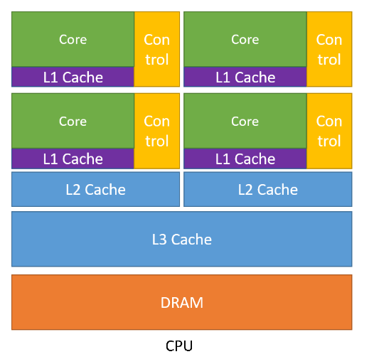
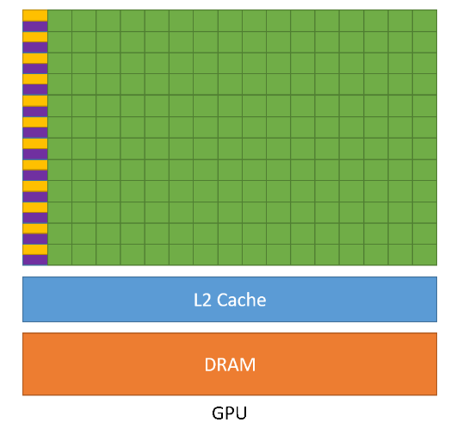
Parallel Computing
Task Parallelism
Data Parallelism
Fine-Grained
Coarse-Grained
Lorenz Gillner, Ekaterina Auer., Interval Methods for the GPU, SWIM, 2023.
P. Pacheco and M. Malensek, An introduction to parallel programming. Morgan Kaufmann, 2021

Slide 20
Flynn’s Taxonomy
SISD – Single Instruction Single Data
MISD – Multiple Instructions Multiple Data
SIMD – Single Instruction Multiple Data
MIMD – Multiple Instructions Multiple Data
Lorenz Gillner, Ekaterina Auer., Interval Methods for the GPU, SWIM, 2023.
P. Pacheco and M. Malensek, An introduction to parallel programming. Morgan Kaufmann, 2021

Slide 21
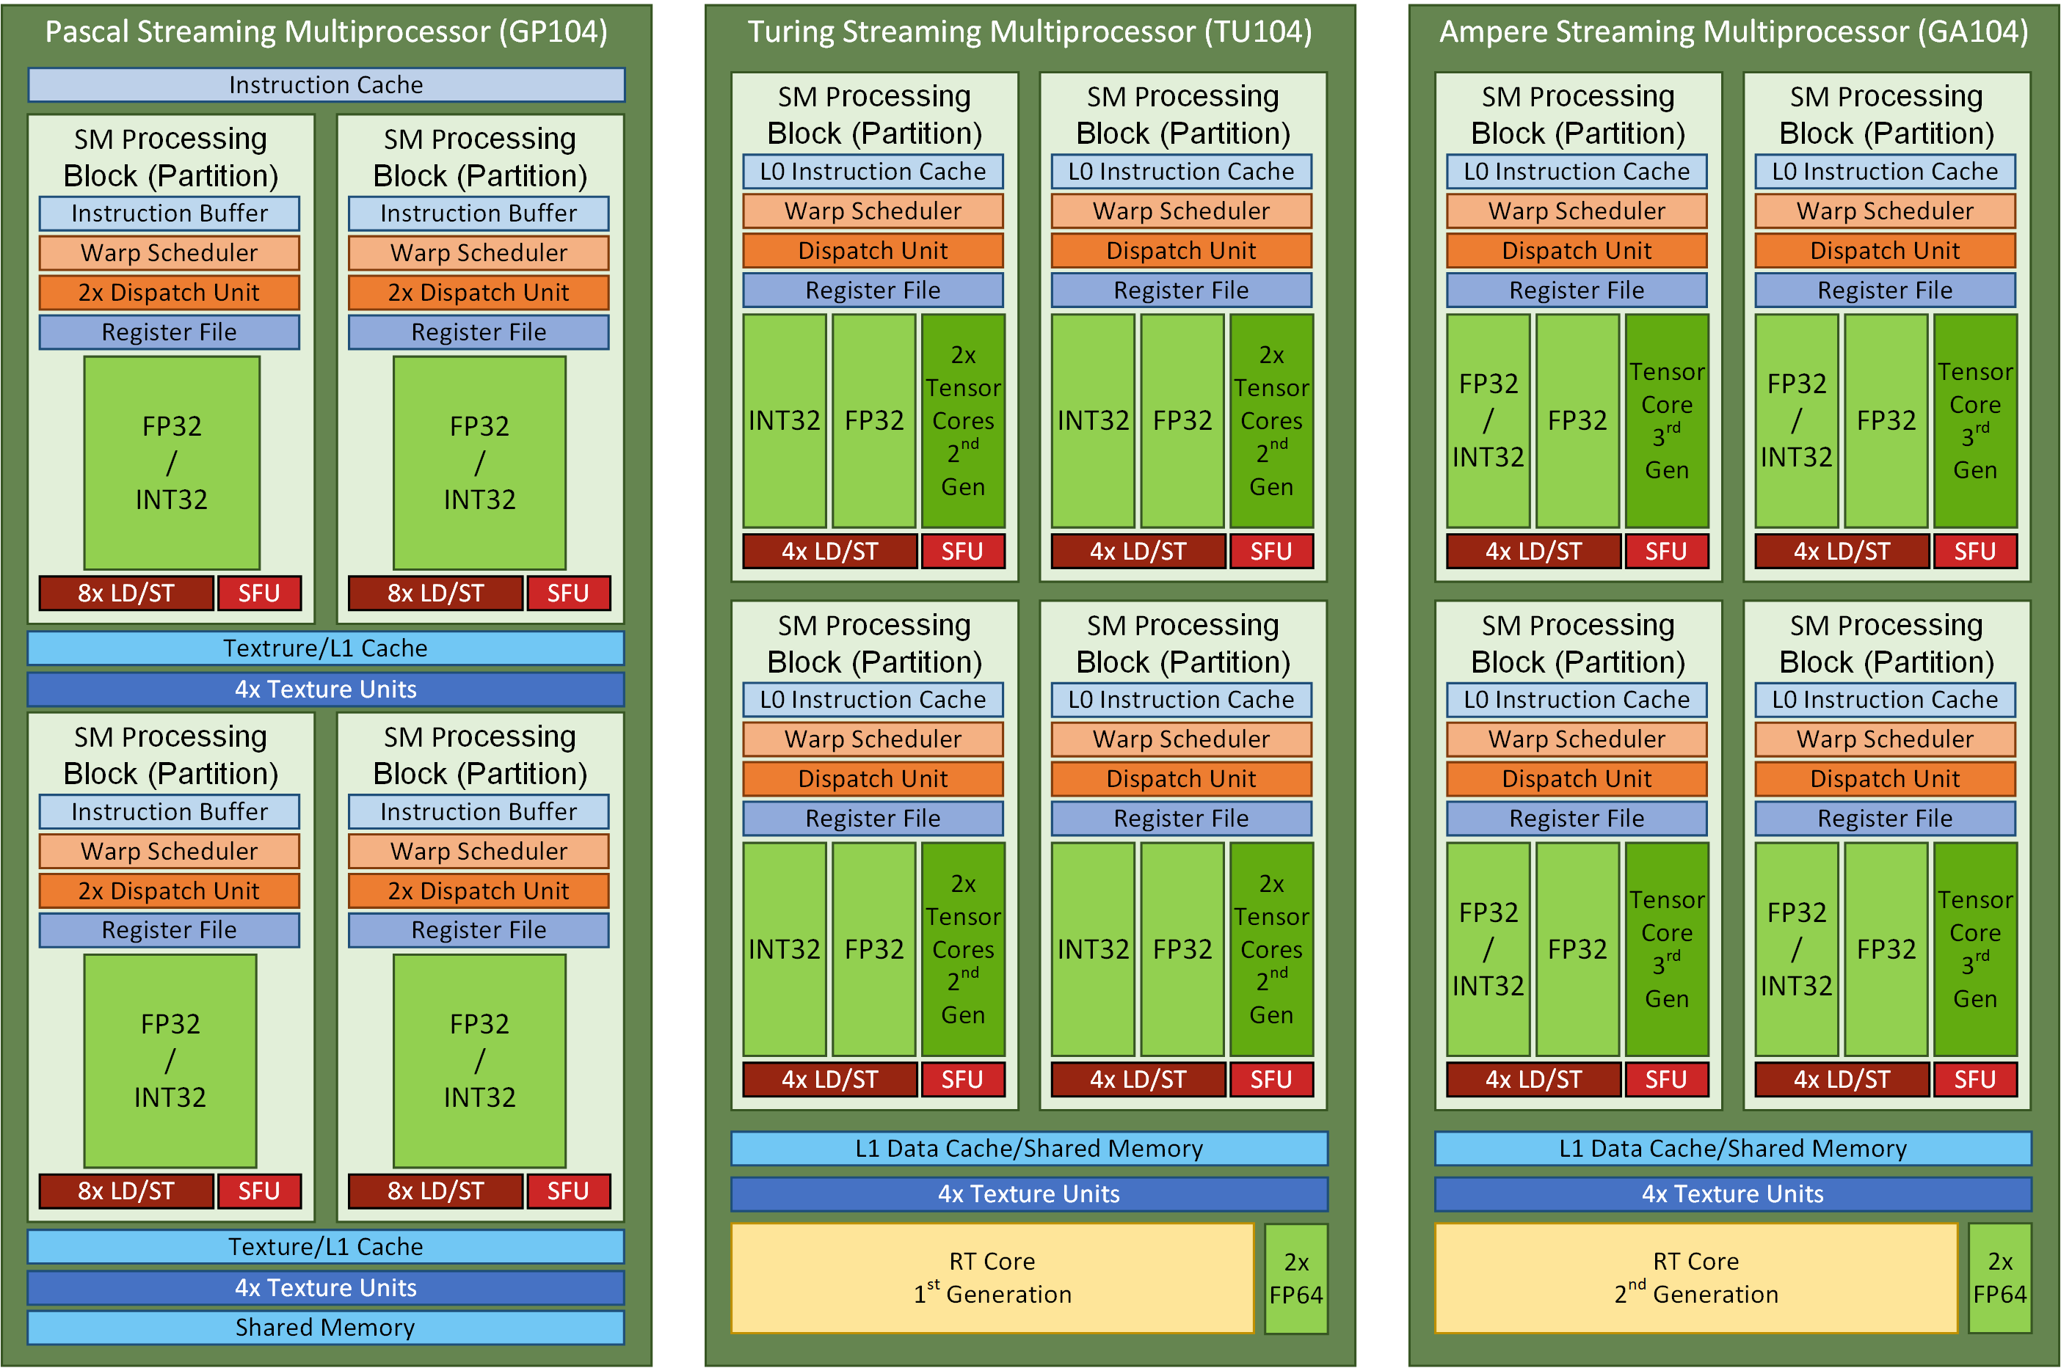
GPU Parallelism
SIMD/SIMT: many low performance cores solving the same task in parallel
Originally developed for computer graphics
Primary focus on NVIDIA GPUs due to high market share
Lorenz Gillner, Ekaterina Auer., Interval Methods for the GPU, SWIM, 2023.
P. Pacheco and M. Malensek, An introduction to parallel programming. Morgan Kaufmann, 2021
https://docs.nvidia.com/cuda/cuda-c-programming-guide/

Slide 22
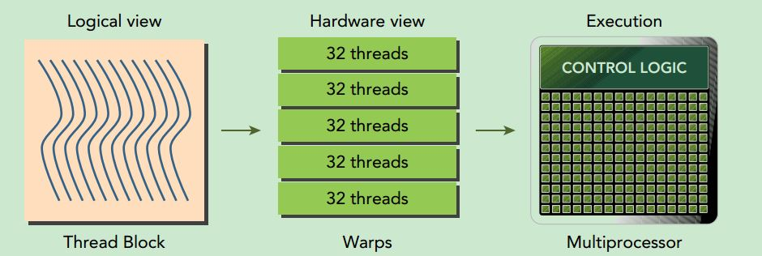
CUDA Programming Model
Defined by Blocks, Threads, Warps
Blocks are programmable
Warps are groups of 32 Threads
A thread is a processing (CUDA) Core (max 1024 per block)
Lorenz Gillner, Ekaterina Auer., Interval Methods for the GPU, SWIM, 2023.
P. Pacheco and M. Malensek, An introduction to parallel programming. Morgan Kaufmann, 2021
https://docs.nvidia.com/cuda/cuda-c-programming-guide/

Slide 23
CUDA Memory Hierarchy
Constant, Global, Shared, Registers
Global Memory is the slowest but largest in size – also known as VRAM
Registers are the fastest but very small in size
Shared Memory is on-chip slower than registers but of larger size
Cache reduces the cost of accessing the Global Memory
Lorenz Gillner, Ekaterina Auer., Interval Methods for the GPU, SWIM, 2023.
P. Pacheco and M. Malensek, An introduction to parallel programming. Morgan Kaufmann, 2021
https://docs.nvidia.com/cuda/cuda-c-programming-guide/

Slide 24
CUDA Best Practices
Find ways to parallelize sequential code.
Minimize data transfers between the host and the device.
Adjust kernel launch configuration to maximize device utilization.
Ensure global memory accesses are coalesced.
Minimize redundant accesses to global memory whenever possible.
Avoid long sequences of diverged execution by threads within the same warp.
https://docs.nvidia.com/cuda/cuda-c-programming-guide/
https://docs.nvidia.com/cuda/ampere-tuning-guide/index.html
https://docs.nvidia.com/cuda/cuda-c-best-practices-guide/

Slide 25
Implementation

Slide 26
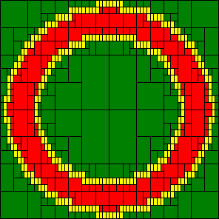
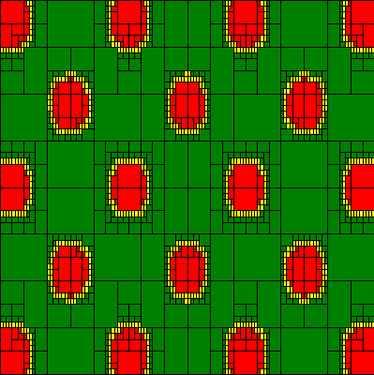


Problems
Problem 1: 2D Torus
Problem 2: 2D Griewank
$\left[f\right]\left(\left[x\right]\right)={[x]}^{2}+{[y]}^{2}$ ${\left[x\right]}_{0}=\left[−1.5,1.5\right],\left[−1.5,1.5\right]$
$$\left[y\right]=\left[1,2\right]$$
$$\left[x_{0}\right]={\left[−10,10\right]}^{2}$$
$$\left[y\right]=\left[1.5,3\right]$$
$$[f]\left([x]\right)=Σ_{i=1}^{2} \frac{{[x]}_{i}^{2}}{4000} −Π_{i=1}^{2}cos\left(\frac{{[x]}_{i}}{\sqrt{i}}\right)+1$$

Slide 27
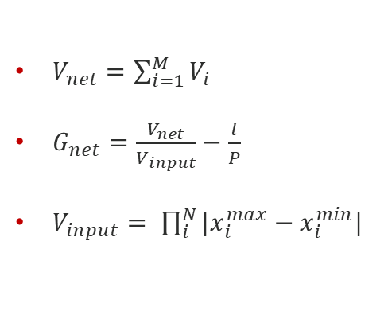
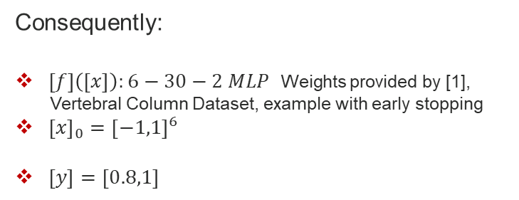
Problems
Problem 3: Evaluating Generalization Performance of Neural Classifiers
$V_{net}=\sum_{i=1}^{M}{V_{i}}$
$G_{net}=\frac{V_{net}}{V_{input}}−\frac{l}{P}$
$V_{input}= \prod_{i}^{N}{|x_{i}^{max}−x_{i}^{min}|}$
Consequently:
$\left[f\right]\left(\left[x\right]\right):6−30−2 MLP$ Weights provided by [1],
Vertebral Column Dataset, example with early stopping
${\left[x\right]}_{0}={\left[−1,1\right]}^{6}$
$\left[y\right]=\left[0.8,1\right]$
Undertraining
Sample data
“Proper” fit
Overtraining (overfitting)
[1] S. P. Adam, A. C. Likas, and M. N. Vrahatis, “Evaluating generalization through interval-based neural network inversion,” Neural Computing and Applications, vol. 31, no. 12, pp. 9241–9260, 2019.
S. P. Adam, D. A. Karras, G. D. Magoulas, and M. N. Vrahatis, Reliable estimation of a neural network’s domain of validity through interval analysis-based inversion, in 2015 International Joint Conference on Neural Networks (ĲCNN), pp. 1–8, 2015.

Slide 28
Background & Related work
Classification of Branch & Bound Algorithms:
SSP – Synchronous Single Pool
Not commonly found in a parallel context, mainly Master-Slave implementations on message-passing architectures.
SMP – Synchronous Multiple Pool
Not commonly found, processes request a synchronization phase after their work is empty
ASP – Asynchronous Single Pool
Found in Shared-Memory Systems and Message-Passing architectures. Not very scalable.
AMP – Asynchronous Multiple Pool
Work is shared with a “best-first” strategy, efficient with CPU systems with high core count.
B. Gendron and T. G. Crainic, Parallel branch-and-branch algorithms: Survey and synthesis, Operations research, vol. 42, no. 6, pp. 1042–1066, 1994.

Slide 29
Background & Related work
ASP & AMP: L. G. Casado, J. Martinez, I. Garcνa, and E. M. Hendrix, Branch-and-bound interval global optimization on shared memory multiprocessors, Optimization Methods & Software, vol.23, no. 5, pp. 689–701, 2008.
AMP: K. Nasiotis, D. López, S. Adam, and L. Casado, Set inversion via interval analysis a study on parallel processing implementation, SWIM 2019.
ASP/SSP: M. B. Eriksen and S. Rasmussen, Gpu accelerated parameter estimation by global optimization using interval analysis, 2013

Slide 30
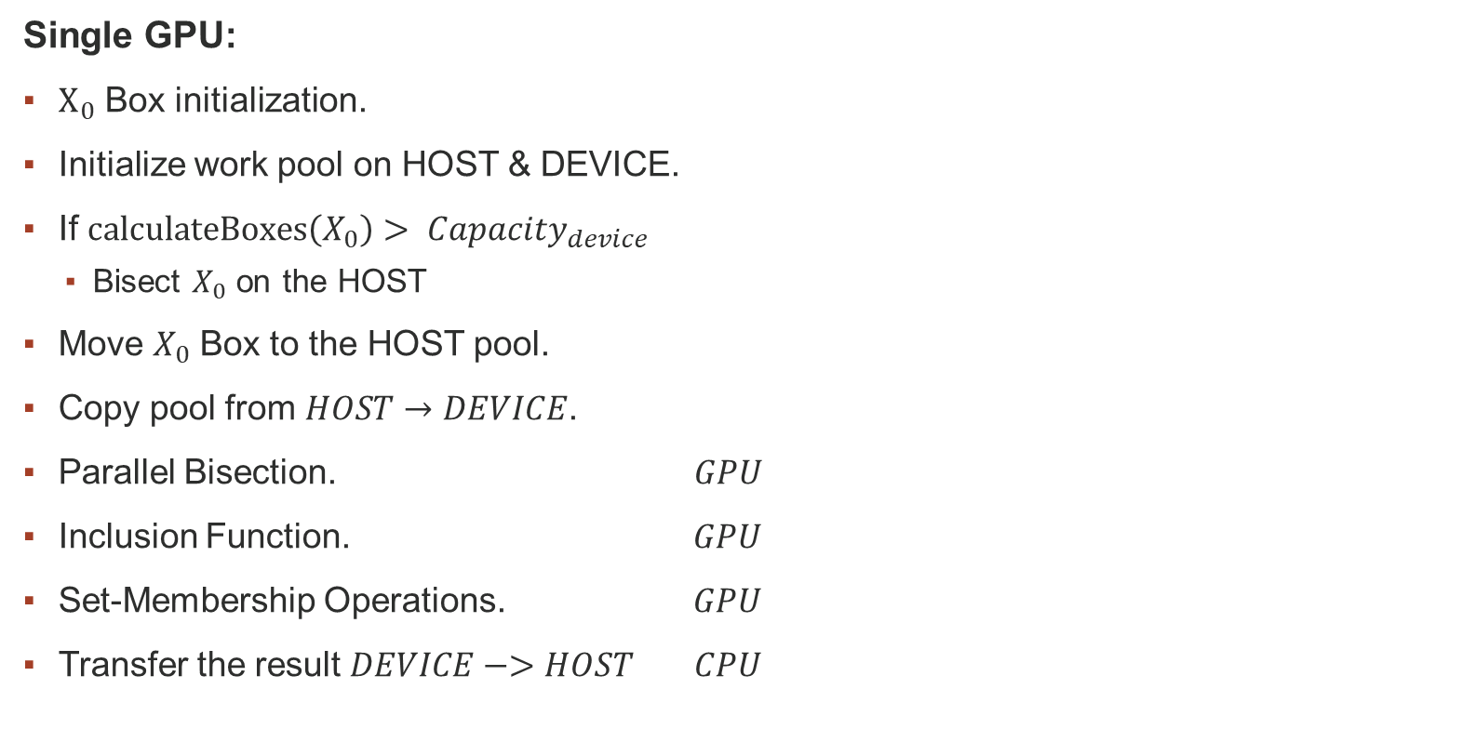
Implementation
Single GPU:
$Χ_{0}$ Box initialization.
Initialize work pool on HOST & DEVICE.
If $calculateBoxes\left(X_{0}\right)> Capacity_{device}$
Bisect $X_{0}$ on the HOST
Move $X_{0}$ Box to the HOST pool.
Copy pool from $HOST→DEVICE$.
Parallel Bisection. $GPU$
Inclusion Function. $GPU$
Set-Membership Operations. $GPU$
Transfer the result $DEVICE−>HOST$ $CPU$

Slide 31
Implementation
Single GPU:
$Χ_{0}$ Box initialization.
Initialize work pool on HOST & DEVICE.
If $calculateBoxes\left(X_{0}\right)> Capacity_{device}$
Bisect $X_{0}$ on the HOST
Move $X_{0}$ Box to the HOST pool.
Copy pool from $HOST→DEVICE$.
Parallel Bisection. $GPU$
Inclusion Function. $GPU$
Set-Membership Operations. $GPU$
Transfer the result $DEVICE−>HOST$ $CPU$
SSP Strategy!!

Slide 32
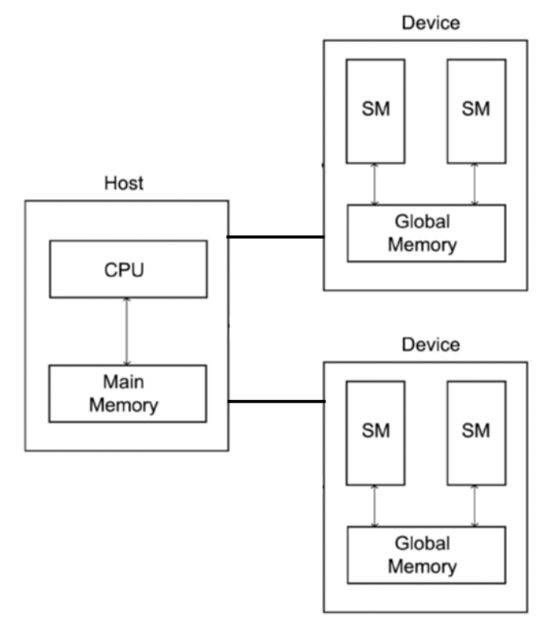
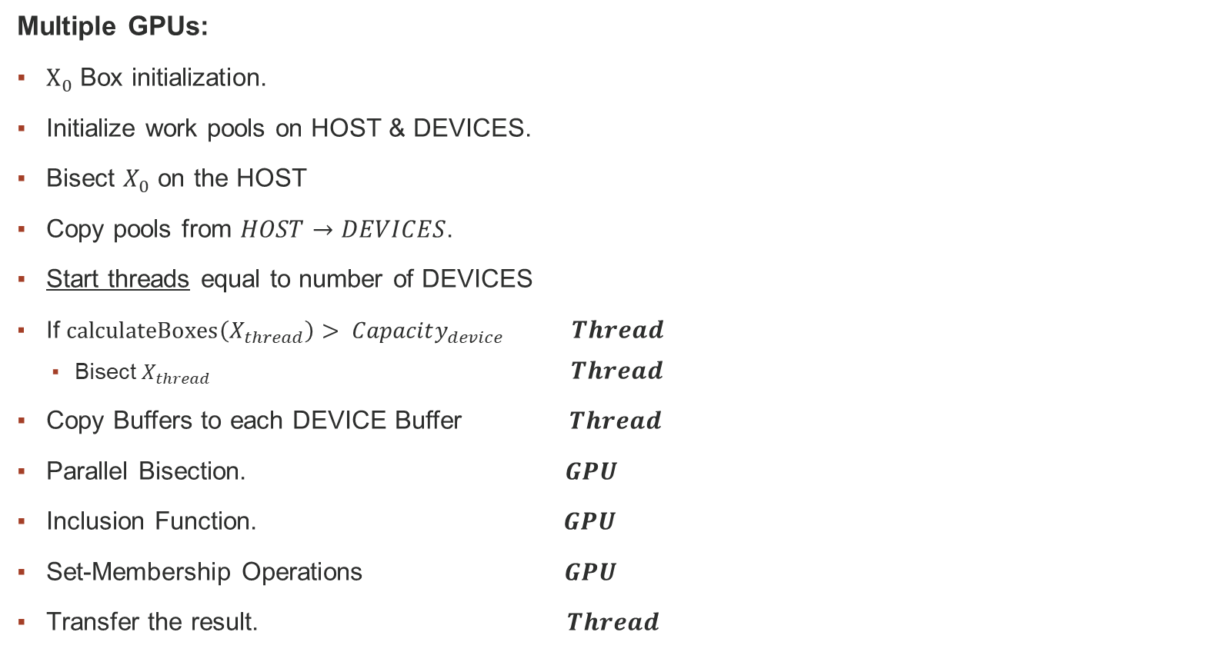
Implementation
Multiple GPUs:
$Χ_{0}$ Box initialization.
Initialize work pools on HOST & DEVICES.
Bisect $X_{0}$ on the HOST
Copy pools from $HOST→DEVICES$.
Start threads equal to number of DEVICES
If $calculateBoxes\left(X_{thread}\right)> Capacity_{device}$ $Thread$
Bisect $X_{thread} Thread$
Copy Buffers to each DEVICE Buffer $Thread$
Parallel Bisection. $GPU$
Inclusion Function. $GPU$
Set-Membership Operations $GPU$
Transfer the result. $Thread$
AMP/SSP Hybrid Strategy!!

Slide 33
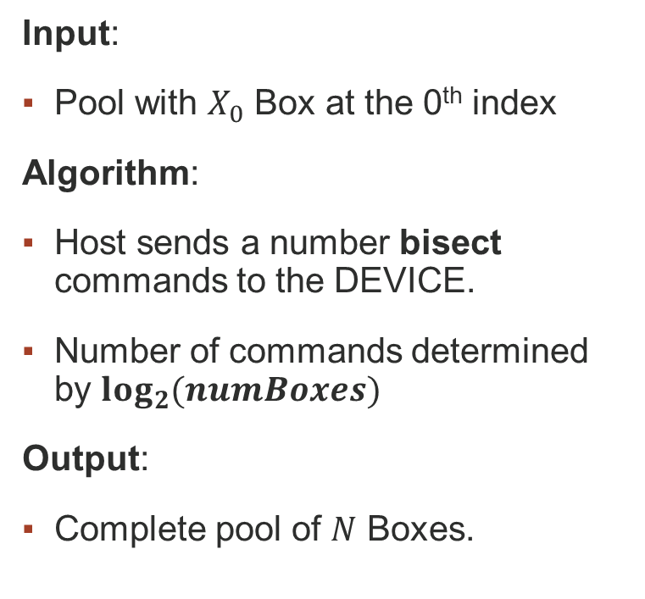
Parallel Bisection
Input:
Pool with $X_{0}$ Box at the 0th index
Algorithm:
Host sends a number bisect commands to the DEVICE.
Number of commands determined by $\log_{2}{(numBoxes)}$
Output:
Complete pool of $N$ Boxes.

Slide 34
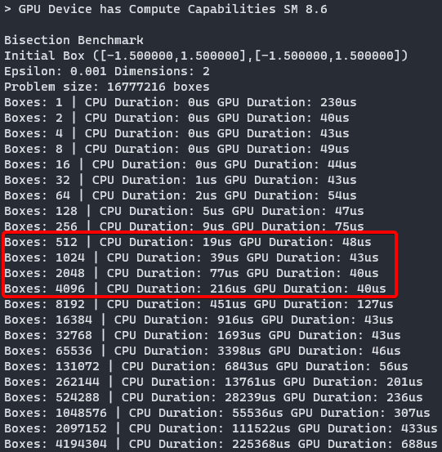
Parallel Bisection
Pros:
Faster Execution
Doesn’t have memory transfer costs
Scalable
Cons:
Wasted GPU Resources in initial executions

Slide 35





Parallel Bisection
Equal Bisection $−>$ Full expansion of the problem tree
$$e = 0.1$$
$$e = 0.01$$
$$e = 0.4$$
$$e = 0.2$$

Slide 36
Parallel Inference & Set Estimation
Input:
Vector of Boxes – Work Pool
Empty Label Vector - Problems 1&2
Algorithm:
Coarse-grained approach
Each Box processed independently. ( [f]([x]) and set-membership operations)
Optimized to avoid Warp Divergence. (replaces “if” clauses with Boolean operations)
Parallel Reduction – Problem 3
Output:
Label Buffer filled with evaluation labels (included, discarded, epsilon) – Problems 1&2
Volume of domain of validity – Problem 3

Slide 37
Parallel Reduction
Without Warp Divergence
Sequential Addressing (cache friendly)
M. Harris et al., Optimizing parallel reduction in cuda, Nvidia developer technology, vol. 2, no. 4, p. 70, 2007.
https://github.com/NVIDIA/cuda-samples - Reduction #3

Slide 38
Results

Slide 39
Test Configurations
Home Setup
GPU: Nvidia RTX 3060 Ti 8GB
OS: WSL2 Ubuntu 22.04.2 LTS
Microlab DaVinci of NTUA:
GPU: Nvidia Tesla V100 32GB
OS: Ubuntu 20.04.2 LTS
Google Collab:
GPU 1: Nvidia A100 40GB
GPU 2: Nvidia Tesla V100 16GB
CEID of UPATRAS:
GPU: 8x Nvidia A100 32GB
OS: Ubuntu 22.04.3 LTS

Slide 40
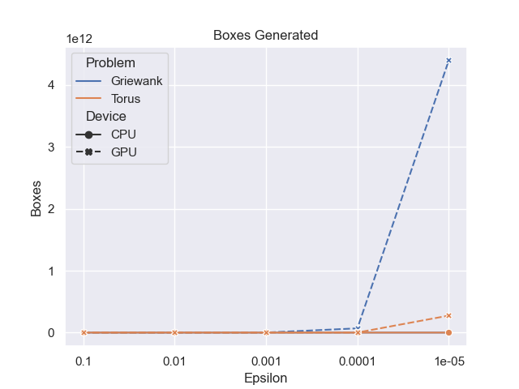
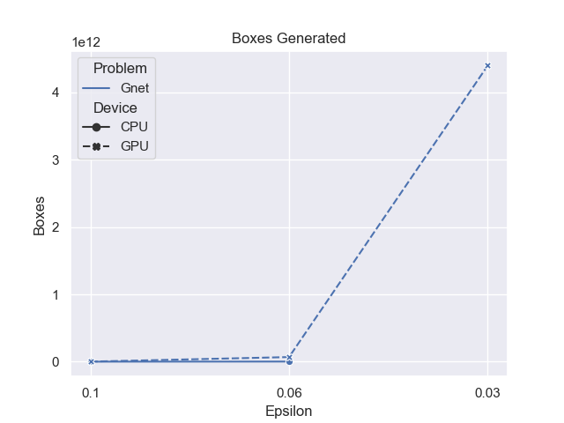
Problem Size

Slide 41
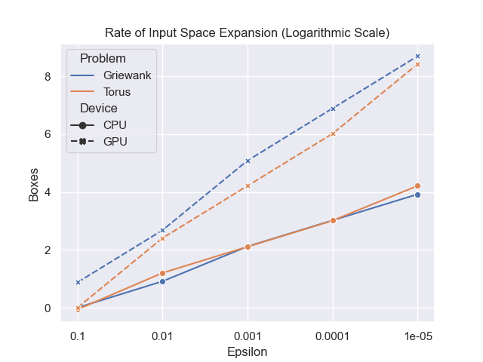
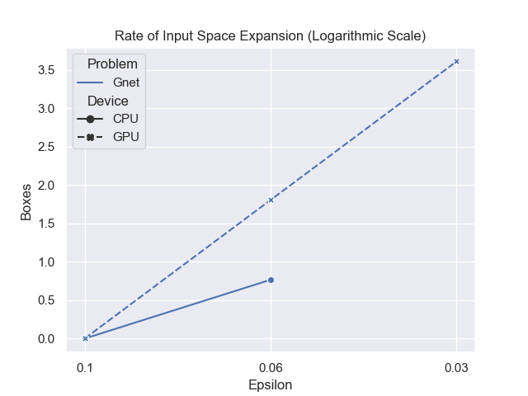
Problem Size

Slide 42
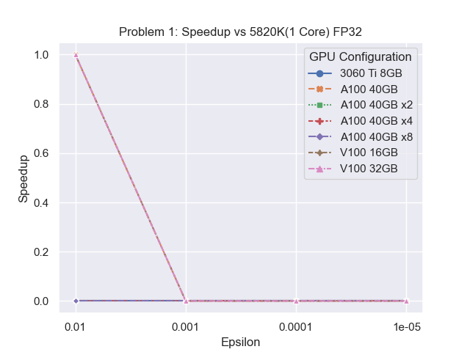

Speedup

Slide 43
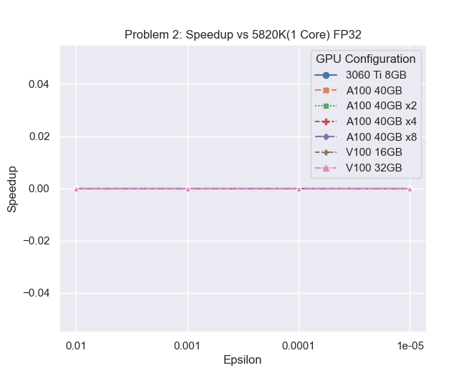
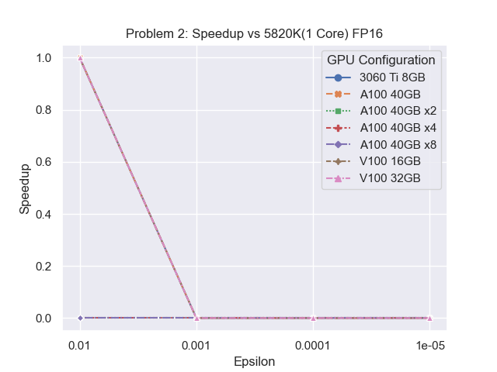
Speedup

Slide 44
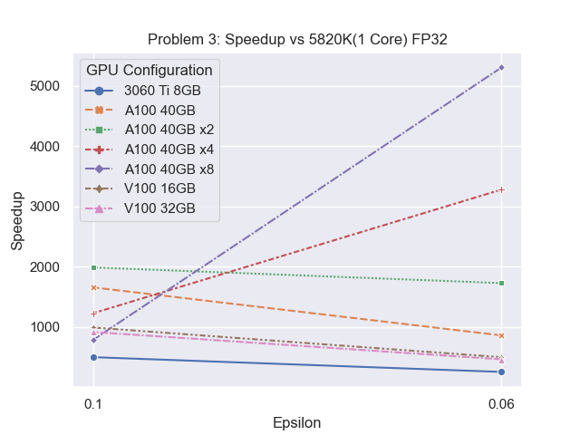

Speedup

Slide 45
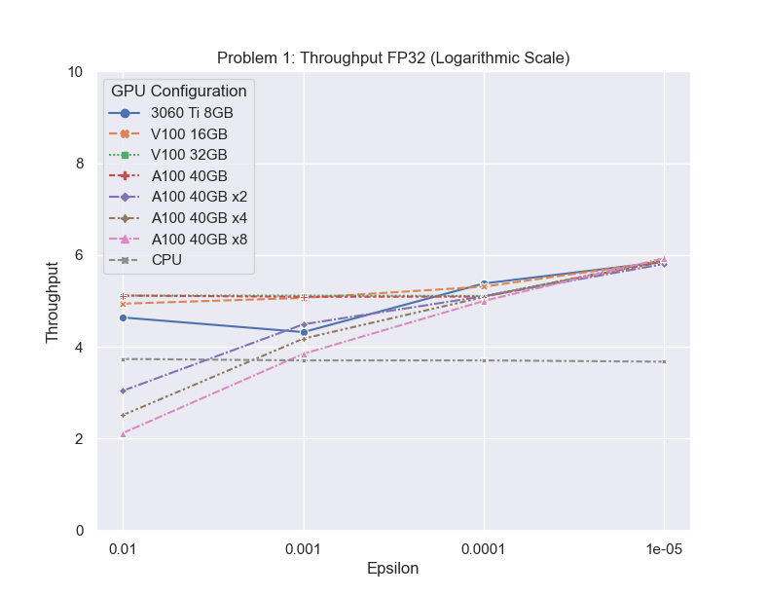
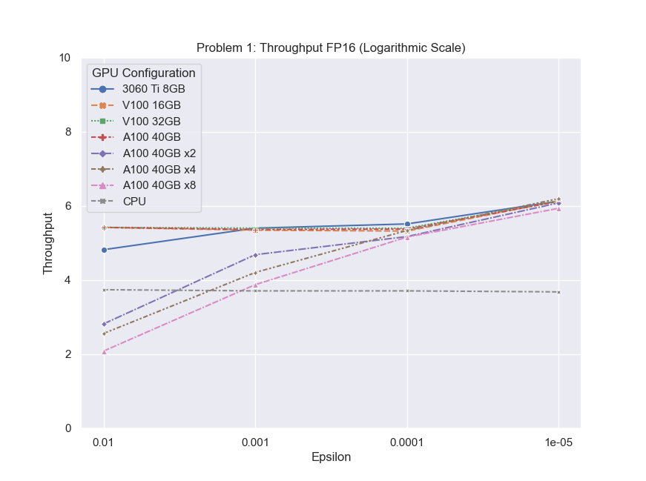
Throughput

Slide 46
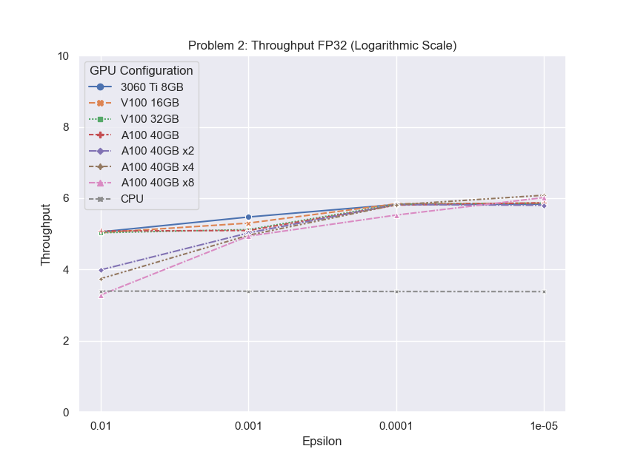
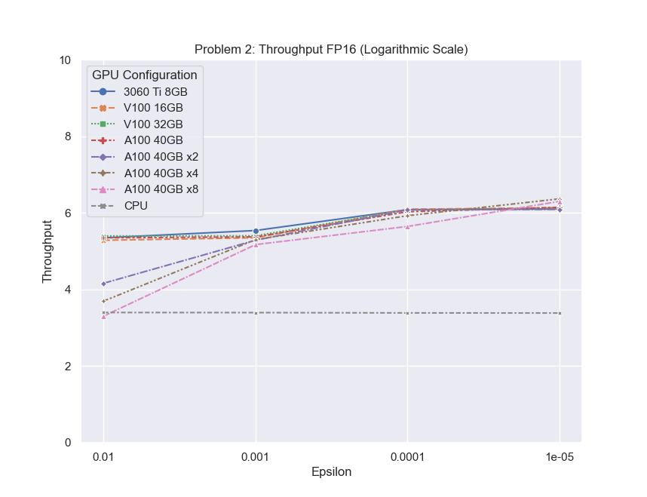
Throughput

Slide 47
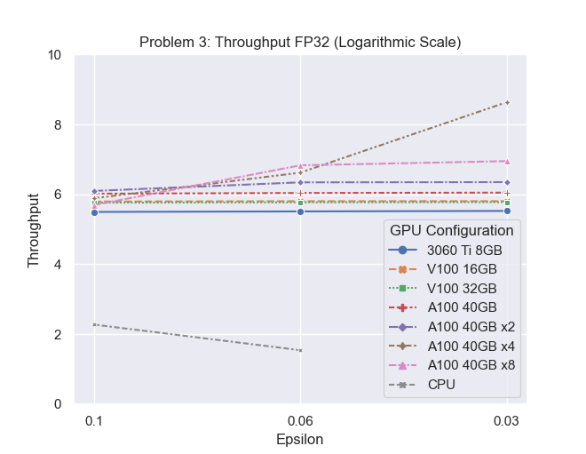
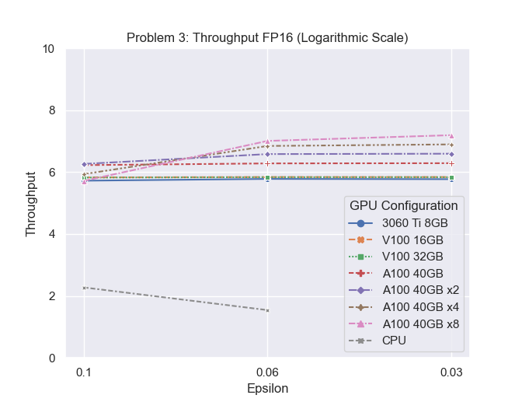
Throughput

Slide 48
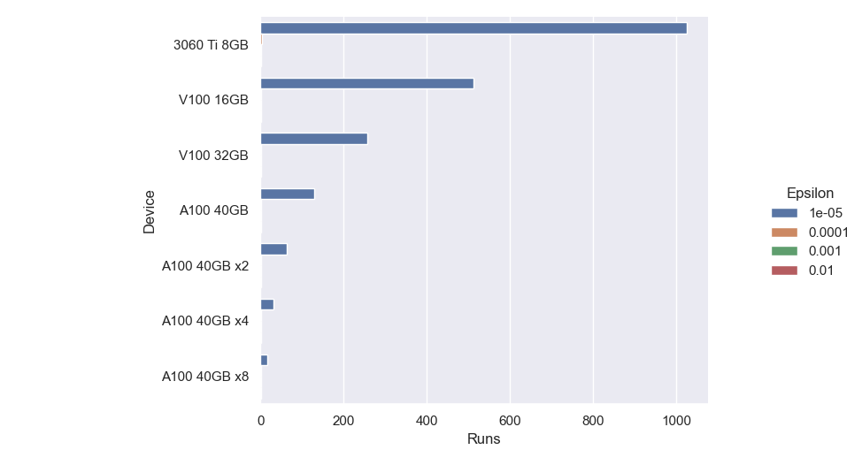
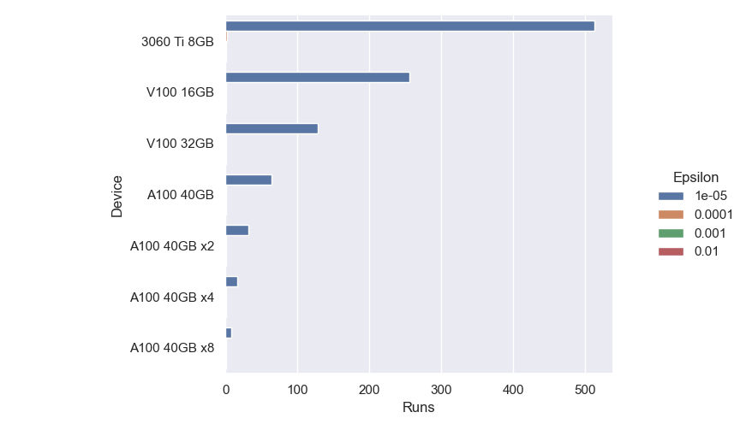
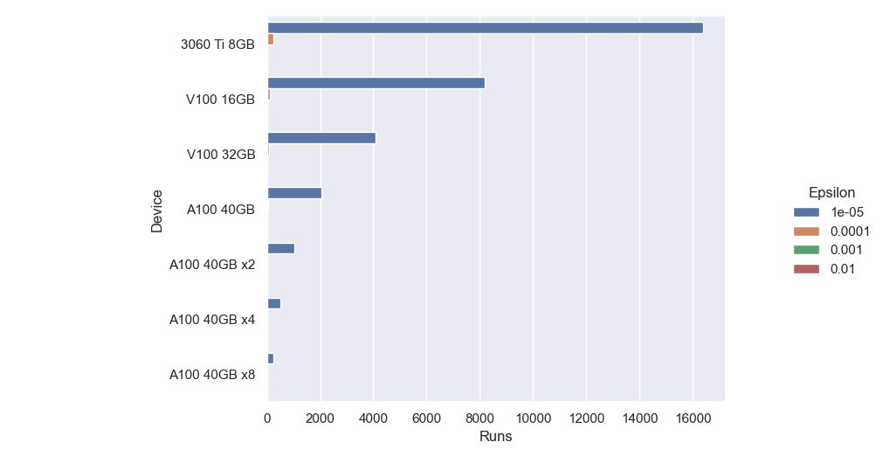
Kernel Runs
FP32
FP16
Problem 1
Problem 2

Slide 49
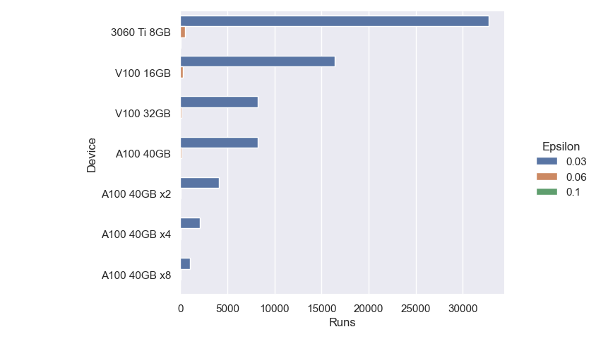

Kernel Runs
FP32
FP16
Problem 3

Slide 50
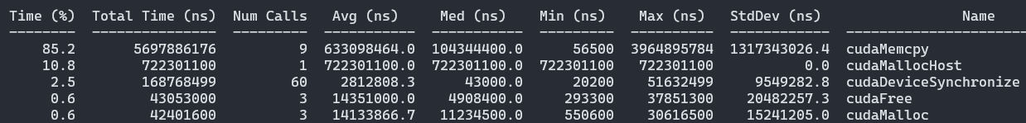
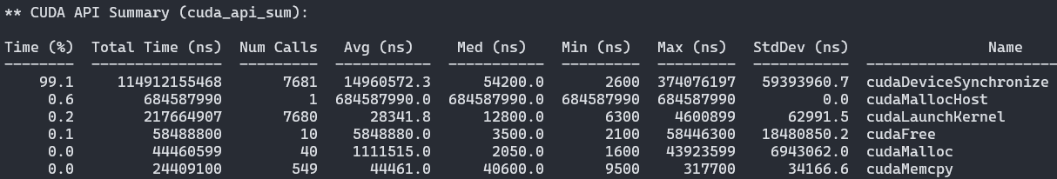


Profiling
Problem 2
$e=0.001$
Problem 3
$e=0.06$

Slide 51
Discussion & Conclusion

Slide 52
Discussion
In-line with CUDA best practices, memory transfers are too costly
Without them the algorithm is highly scalable
Global Memory is underutilized
Compatible with multiple GPU configurations
Use of FP16 (Half) variables do not result in less accuracy
Execution time correlates with DEVICE executions
Expensive GPU setups with large amounts of VRAM required for more accurate approximations & higher speedups

Slide 53
Conclusion
GPU parallelization is very compatible with SIVIA
Efficient Synchronization Techniques could help reduce the search space
Mathematical Techniques should accompany parallelization efforts
E.g. Optimization problems have their search space reduced by calculating the hull of an iteration’s best Boxes
Proposed implementation not a one-size-fits-all technique
When it fits, it scales very well with multiple GPUs

Slide 54
Future Work
Expansion of GPU Interval Ecosystem
Better Fine-tuning and resource allocation
Test algorithm with optimization problems
Experiment with in-GPU mixed strategies
Test and compare modern parallel interval environments[1][2]
[1]Lorenz Gillner, Ekaterina Auer., Interval Methods for the GPU, SWIM, 2023.
[2]https://github.com/JuliaIntervals/IntervalArithmetic.jl

Slide 55
Acknowledgements

Slide 56
Thank you for your time!

