Slide 1
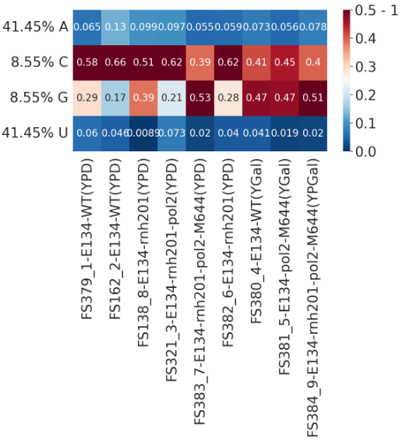
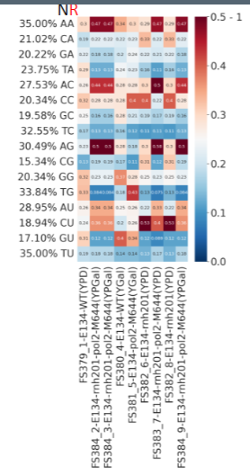
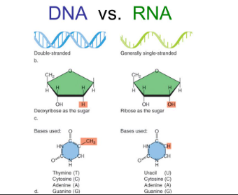
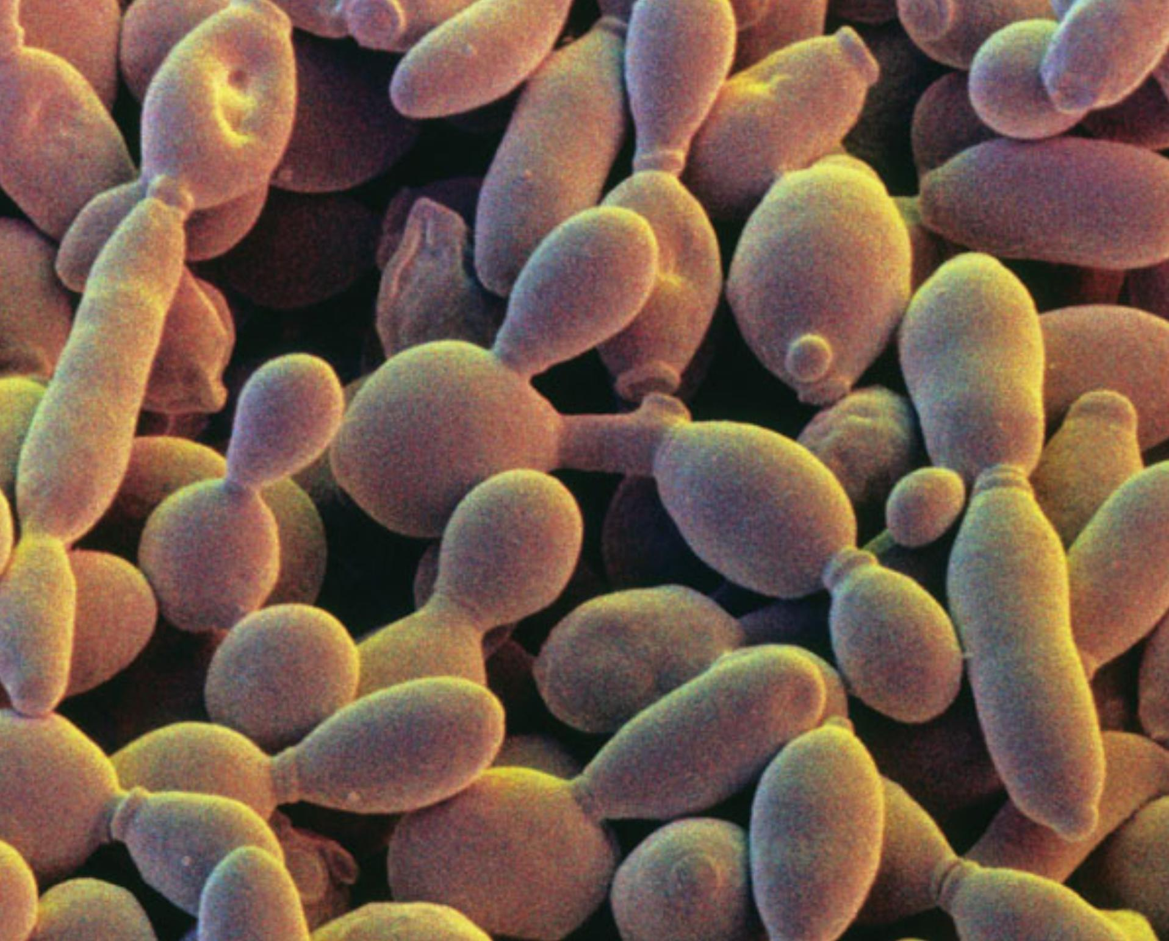
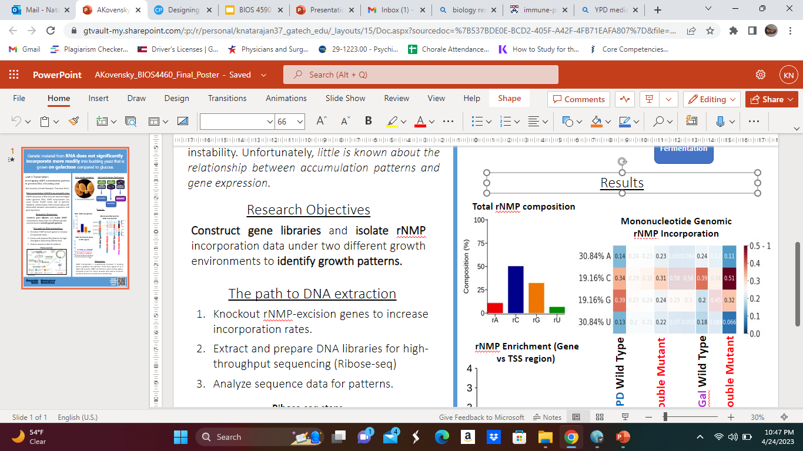
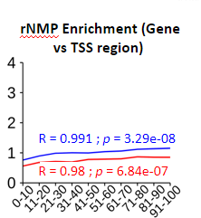
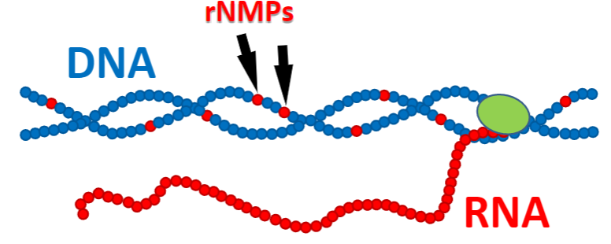
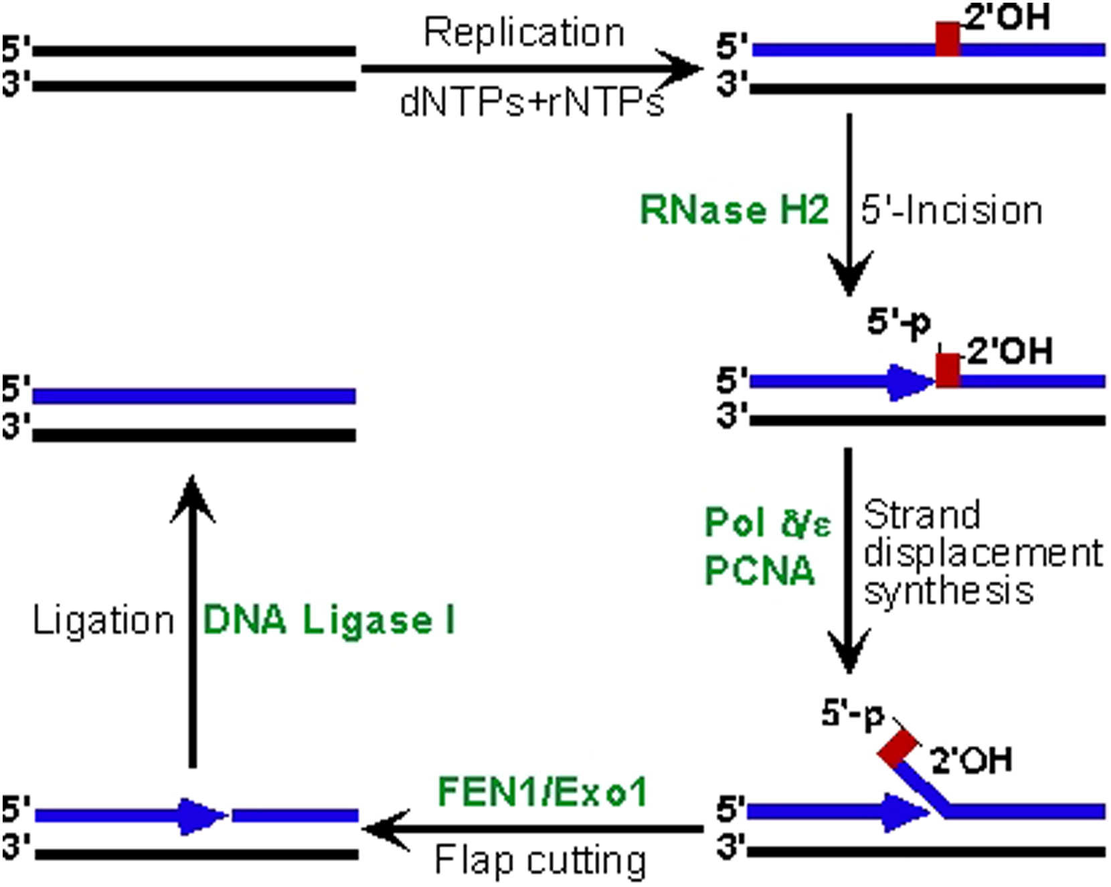
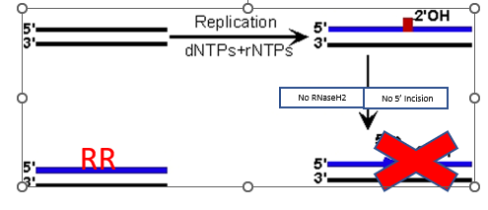

Examining rNMP incorporation patterns into genomic DNA of Budding Yeast
Kamala Natarajan, Biological Sciences, Georgia Tech
Introduction
rNMPs in DNA are the most common form of DNA mutation (Wallace and Williams, 2014).
Found as DNA synthesis primers and are usually replaced by enzyme RNAseH2.
Problematic if not replaced with deoxyribonucleotides.
Genetic Diseases- Cancer, Aicardi-Goutieres syndrome, etc.
Conclusions
The results of the experiment do in fact indicate that carbon sources, glucose and galactose, profoundly impact the rNMP incorporation rates in budding yeast cells.
The wild-type yeast have lower rNMP enrichment.
Higher rNMP rates are seen in RNaseH2 mutants grown in galactose.
The reasons behind this observation are still not understood.
Future scientists interested in this study should verify our observations and research the mechanisms involved in rNMP incorporation rates.
Big Question
Can different carbon sources affect the rate of rNMP incorporation in yeast cells?
If yes, can the results be applied to future research to address DNA damage-related disorders?
Results
Figure 1: Heatmap Comparison between Mono-nucleotide and Dinucleotide rNMP incorporation rates across different treatment conditions. Cooler colors represent lower rNMP uptake levels while warmer colors represent higher rNMP uptake levels.
Figure 2: Graph showcasing the relative rNMP levels for the RNAse H2 mutant in YPD medium. Higher bars indicate higher composition with respect to other rNMPs.
Figure 3: Graph representing rNMP enrichment region in the gene coding region, depicted in blue versus the TSS region, depicted in red.
Figure 1: Monocleotide vs Dinucleotide rNMP Incorporation Rates Between Treatment Groups
Model
Budding Yeast is used as a model eukaryote.
Microarray experiments show different gene expressions for yeast grown in glucose vs. galactose (Lashkari. et al. 1997).
Little is known about the distribution of rNMPs in DNA being altered by the environment in which the yeast cells grow.
Figure 2: Total rNMP composition levels as a percentage for RnaseH2 knockouts
Figure 3: rnMP Enrichment region for gene coding vs TSS region
Methods
Wild-Type cells have normal functioning RNAseH2.
These cells will be used as control and grown under glucose and galactose conditions separately.
RNaseH2 mutants are created by knocking out the rnh201 gene. These mutants are grown under glucose and galactose conditions.
The DNA is extracted and prepared for RNA-sequencing. The data generated will be analyzed

