Slide 1
BloodHound: Use and Abuse
Active Directory Security & Analysis
Notes:
Notes for LPD/Course Developer(s):
This is the title slide. It should match the official course title and course number exactly.

Slide 2
sh #> whoami
Ellis Springe
@ RSM US LLP
Penetration Testing Consultant
OSCP
Tool Dev
Connoisseur of dogs
Twitter == @knavesec
Notes:
Notes for Course Developer(s)/Instructor:
Replace the text above with your information – OPTIONAL. These slides will not appear in the Participant Guide – only in the live webcast slide deck. If there are multiple instructors, please use the next slide.
Leader Instructional Notes
Tell participants a little about yourself.

Slide 3
Objectives
Designed for both Red & Blue teams as an intro->intermediate dive into BloodHound AD, by the end of this talk you will be able to:
Understand BloodHound basics & use cases with AD security
Utilize open-source tooling for analysis & operations
Understand Cypher query language at a beginner level
Continue learning on your own
An Active Directory requires an Active Defense – someone, probably
Notes:
Notes for LPD/Course Developer(s):
This should match what is listed in My Learning exactly (NASBA requirement).

Slide 4
Credits & Plugs
Creators of BloodHound - Will Schroeder (@harmjoy), Rohan Vazarkar (@cptjesus), Andy Robbins (@_wald0)
Great write-ups/cheat-sheets - @Haus3c
BloodHound Slack Channel - bloodhoundhq.slack.com
https://bloodhoundgang.herokuapp.com/ (invite)
https://github.com/BloodHoundAD/BloodHound

Slide 5
Agenda
Active Directory Essentials
BloodHound Basics
Data Collection Methods
Open Source Tooling
Cypher Basics

Slide 6
Active Directory Essentials
Just enough, but not too much

Slide 7
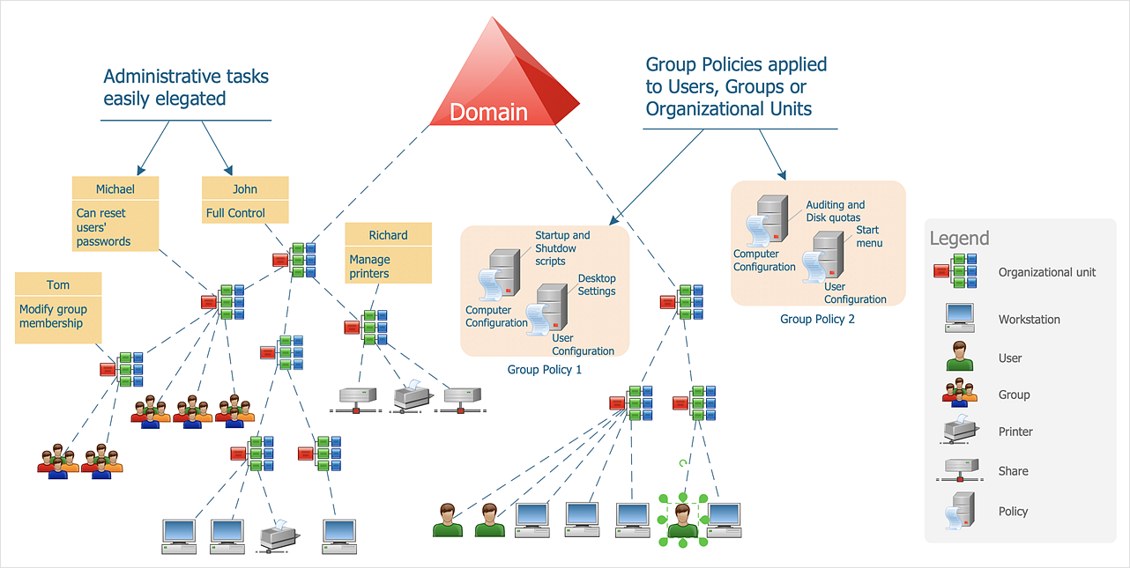
Overview

Slide 8
AD Objects
User, Computer
One user, one computer object
Group
An entity that contains objects, any privs granted to this group is also granted to all objects contained
OU (Organizational Unit)
A subdivision of AD that can contains users, groups, etc, in order to mirror the organizations structure
Domain
Area of the network organized by a single authorization database

Slide 9
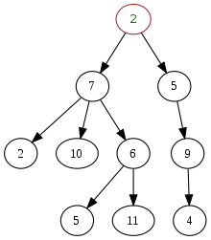
AD Structure
AD is a “Hierarchical directory” made up of objects, groups, trees & forests
Split into categories of “Containers” and “Leaves” (just like in CS)
Leaves – An object that is stored - User, Computer obj
Container – Something that contains other objs – Groups, Ous
Remember how objects are related to each other

Slide 10
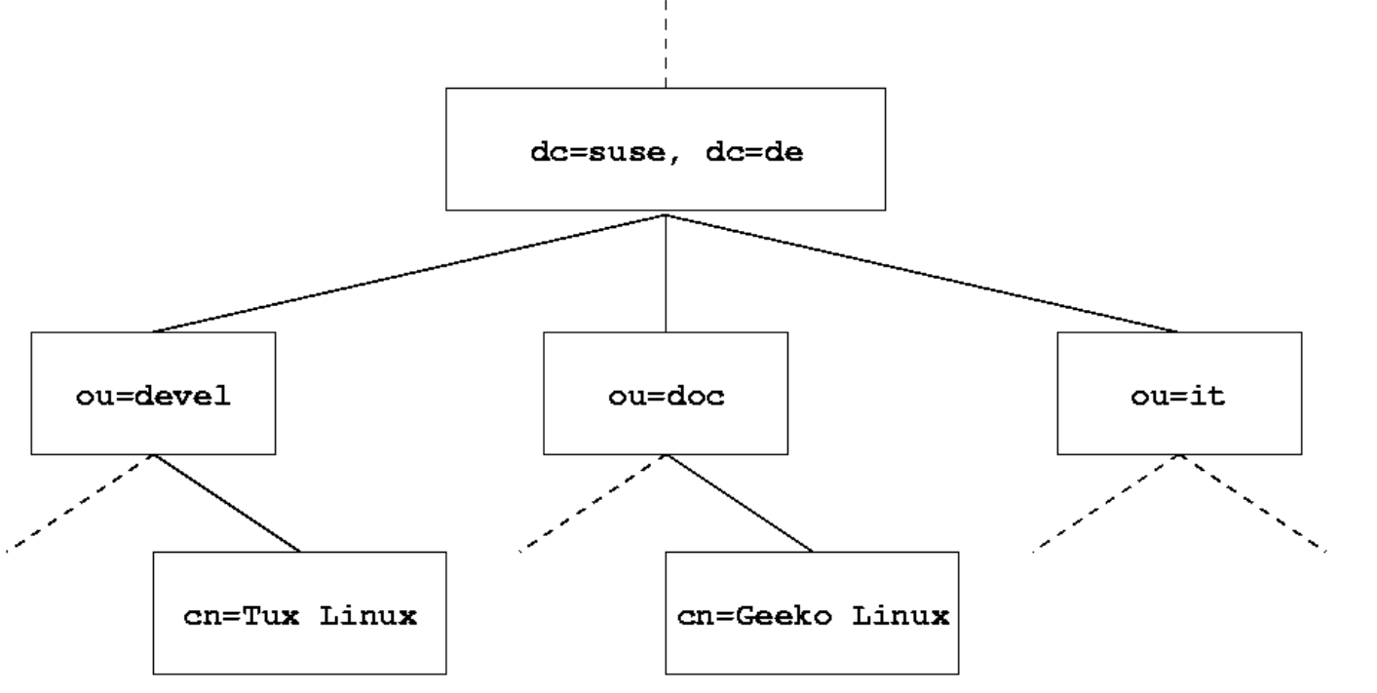
AD Structure
Client Root Domain
OU - Finance
OU – R&D
OU – HR
Member Group
Member User

Slide 11
BloodHound Basics
Notes:
Notes for Course Developer(s):
This slide is meant for breaks; please copy and paste where you need it throughout the presentation.

Slide 12

BloodHound - whois
Active Directory Analysis tool
Created by Andy Robbins, Rohan Vazarkar, Will Schroeder
https://github.com/BloodHoundAD/BloodHound
Graphical AD analysis, works by tying AD objects, properties, etc and shows potential paths to escalation
Utilizes Neo4j as a database to access relationships

Slide 13
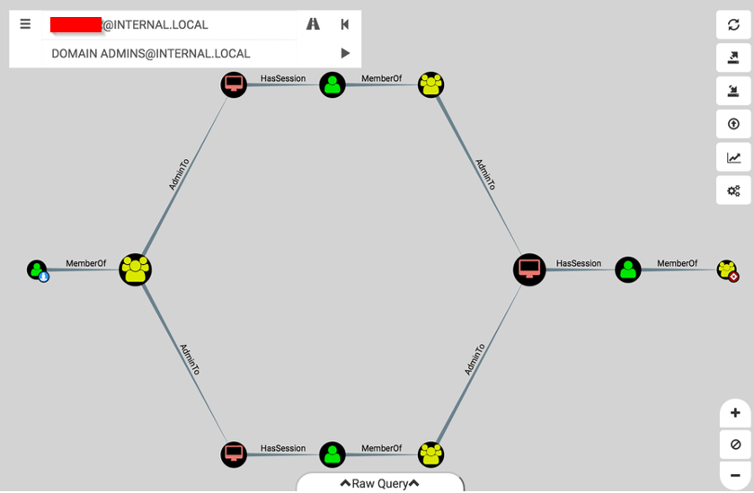
Attackers Think in Graphs

Slide 14
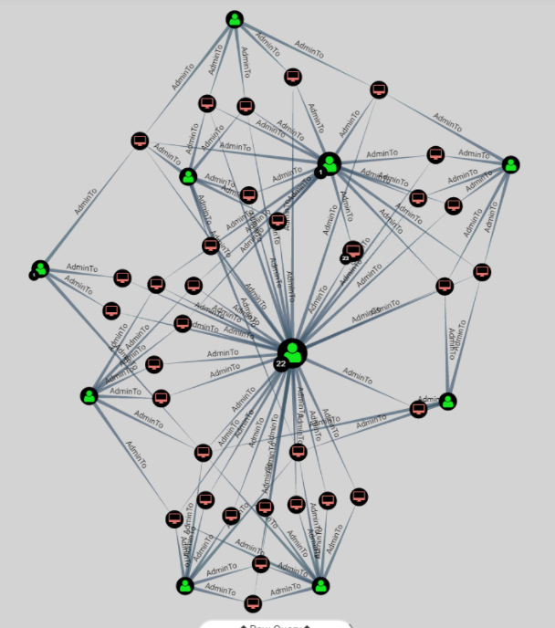

Attackers Think in Graphs

Slide 15
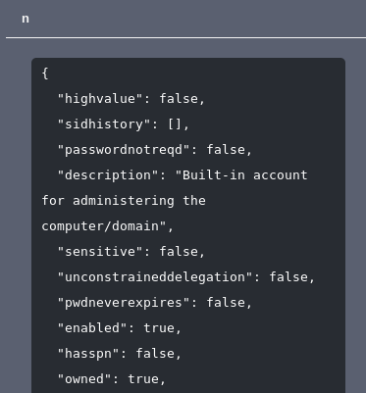
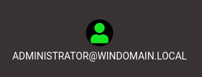
Basics – Terms
Nodes – AD objects of a specific type
Types: User, Group, Computer, Domain, OU, GPO, etc
Attributes – pieces of information about each node
Attributes: name, displayname, objectid, owned, highvalue, etc

Slide 16

Edges
Edges – Link between two nodes, creating a relationship
Edges: HasSession, AdminTo, MemberOf, CanRDP, etc
Displayed within brackets [:Edge]
Based on: Permissions, ACLs, GPOs, Group Memberships, etc (Only exploitable relationships)

Slide 17
Visual
Edge type
Computer Node
User node
Node ‘name’ attribute

Slide 18
Data Collection Methods
Notes:
Notes for Course Developer(s):
This slide is meant for breaks; please copy and paste where you need it throughout the presentation.

Slide 19
Collection Basics
Ingests data, then formats it to be imported into BH client
Two main ways to collect data:
LDAP queries
Queries DC for users, computers, groups, ACLs, delegation, SPNs, everything...
Querying computers
Asks all domain computers about session data, local users/groups/admins/RDP rights

Slide 20
Collection Methods
SharpHound
Windows Ingestor (exe & ps1)
Made by creators of BloodHound
BloodHound.py
Linux Ingestor (python)
Made by Fox-IT (security firm, primarily Dirk-Jan Mollema)
Won’t go over this tool much

Slide 21
SharpHound – Collection Methods
All – collects everything, hits everything
DCOnly – only hits the DC, collects ACLs, Users, Groups, etc. Does not collect non-group delegated admin rights, sessions
ComputerOnly – Doesn’t hit the DC, but hits every computer. Collects local computer properties like admin rights, RDP rights, and sessions. Won’t collect DC only properties
Others: RDP, LocalAdmin, Session, PSRemote, ACL, ObjectProps, etc…

Slide 22
SharpHound – Evasion
--ExcludeDC – instructs tool not to touch domain controllers
--Stealth – employs “stealth” techniques, very vague
ExcludeDC will evade Microsoft ATA
Combination of Stealth & Exclude DC will typically evade detection, unless specifically looking for “one-to-many” computer system relationships

Slide 23
SharpHound - Detections
Detections
One-to-many connections/logins (specific events)
Large amounts of traffic to the DC, trend analysis (ATA)
List of enumeration RPC calls to watch
https://twitter.com/infosecn1nja/status/1379411524842758144

Slide 24
Demo

Slide 25
Open Source Tooling
Notes:
Notes for Course Developer(s):
This slide is meant for breaks; please copy and paste where you need it throughout the presentation.

Slide 26
Tools
Testing
BadBlood
Vulnerable-AD
Analysis
Plumhound/cypheroth
WatchDog
Operations
Powershell – CypherDog
Linux – Max
https://github.com/chryzsh/awesome-bloodhound

Slide 27
Testing
BadBlood
Populates a test AD with tons of fake data
https://github.com/davidprowe/BadBlood
Vulnerable-AD
Populates a test AD instance with known vulnerabilities
https://github.com/WazeHell/vulnerable-AD

Slide 28
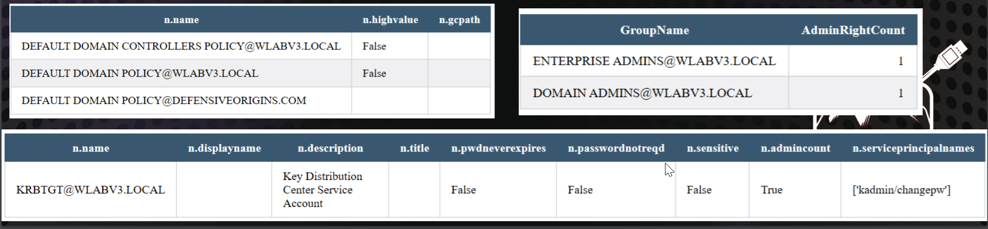
Analysis – PlumHound / Cypheroth
Python / Bash respectively
Runs a battery of predefined commands through the BloodHound data, and extracts relevant info
PlumHound outputs to an HTML file, Cypheroth outputs to an Excel doc
https://github.com/DefensiveOrigins/PlumHound
https://github.com/seajaysec/cypheroth

Slide 29
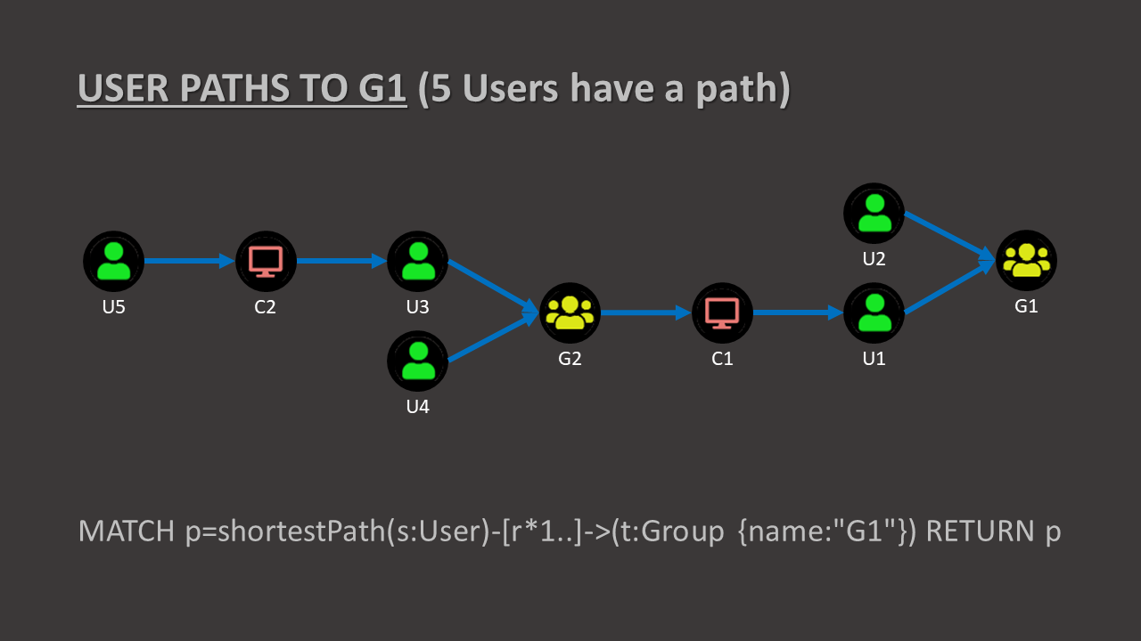
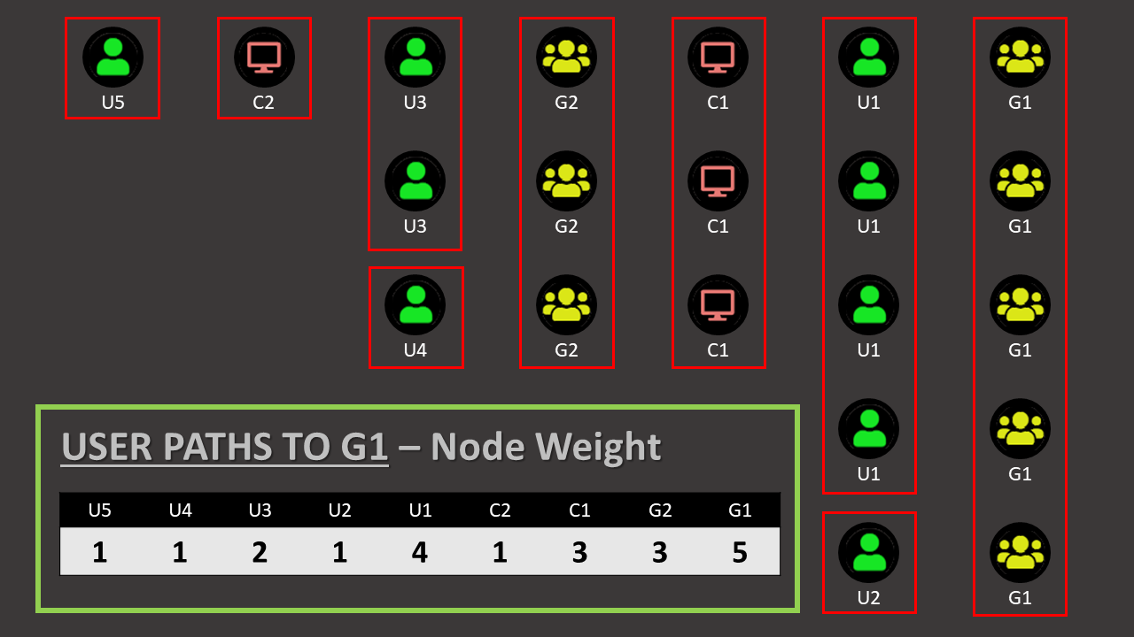
Analysis - WatchDog
Powershell script designed to “weight” nodes based on their impact on AD escalation
Provides the ability to target AD objects that are susceptible to compromise/pivoting through
https://github.com/SadProcessor/WatchDog

Slide 30
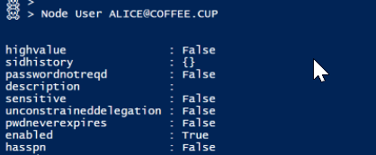
Operations – CypherDog
Powershell cmdlets for interacting with the BloodHound database
Cypher is required for some advanced use, but overall simple and user-friendly
https://github.com/SadProcessor/CypherDog

Slide 31
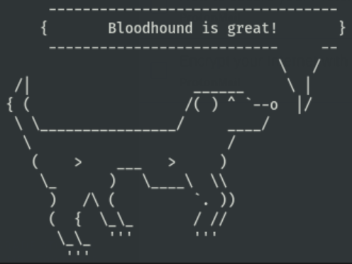
Operations – Max
Python script for extracting information from a database, importing owned assets, analysis, etc
Perks:
Domain Password Audit Tool, cracked user permission analysis
Easy data extraction & manipulation
Bulk import of Owned objects
New attack primitives
Sweet ASCII Art
https://github.com/knavesec/Max

Slide 32
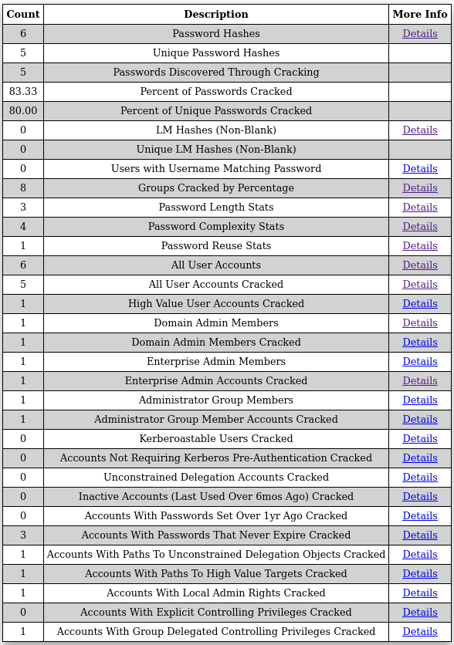
Analysis – Max
BloodHound Domain Password Audit Tool, cracked user permission analysis
Export NTDS.dit, perform password cracking, run analysis
https://github.com/knavesec/Max/blob/master/wiki/dpat.md

Slide 33
Cypher Queries
Notes:
Notes for Course Developer(s):
This slide is meant for breaks; please copy and paste where you need it throughout the presentation.

Slide 34
Quick Note
Cypher is the backend Neo4j database query language
This is where the magic happens
Cypher is capitalization independent (KEYWORD = kEyWoRd), with one exception (noted later)

Slide 35
Basics – Cypher
Nodes
Displayed as (node:Type) where “node” is the name of a reference variable, and “Type” is the type of node (“Type” is not required)
(n:User) – node “n” of type “User”
(n:User {name:“USER01@DOM.LOCAL”}) – node “n” of type “User” who has the name USER01@DOM.LOCAL (case sensitive exception!)
Can call this same node later using (n), since “n” is the name of the reference variable

Slide 36
Basics – Cypher
MATCH, WHERE, RETURN
RETURN
Returns information to the GUI/Browser
MATCH
Query for a specific node or relationship
MATCH (n:User) RETURN n
WHERE
Comparator, used with MATCH statement to specify node information
Comparators are tricky, the username in BH must match UNAME@DOMAIN.LOCAL, *case sensitive*
MATCH (n:User) WHERE n.name=“UNAME@DOMAIN.LOCAL” RETURN n
Can also use a regex for wildcards & other regex matching
MATCH (n:User) WHERE n.name=~”UNAME.*|SQL.*” RETURN n

Slide 37
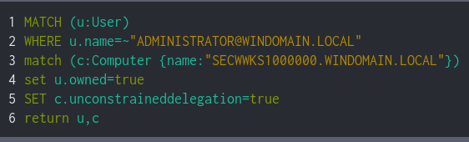
Dissecting a Custom Query v1
Full Query

Slide 38
Basics – Relationships & Pathfinding
Relationships
One-way, indications that two objects are related by a specific edge type (see edges slide for types)
A bi-directional relationship is just 2 one-way relationships
Nodes = ( ), relationship edge = [ ]
Full relationship ()-[]-() or ()-[]->()
First is direction independent, second is directed

Slide 39
Basics – Relationships & Pathfinding
Sample Relationships
()-[]-()
Relationship from any node to any node with via any edge
(u:User)-[]-(c:Computer)
Relationship between any user & any computer via any edge
(u:User)-[r:AdminTo]->(c:Computer)
Relationship where any user has admin rights over a computer (one-way)
()-[r:AdminTo|Owns]->(g:Group {name:”NAME”})
Relationships where any node has admin rights/ownership over a target group
All of these will return multiple relationships, unless it is specific to one instance

Slide 40
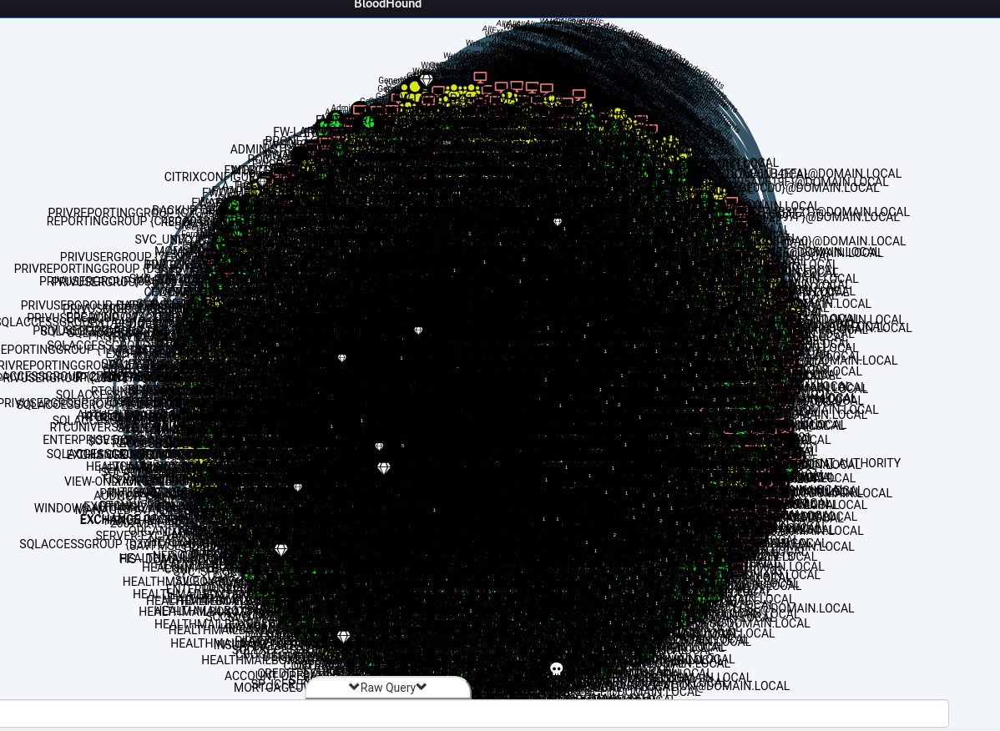
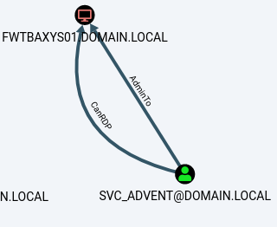
Basics – Relationships & Pathfinding
MATCH p=()-[]-() RETURN p
Return all relationships between all nodes
This seems useful
MATCH (n:User), (m:Computer) MATCH p=(n)-[r:CanRDP|AdminTo]->(m) RETURN p
Find relationship where a user has RDP or Admin rights to a computer

Slide 41
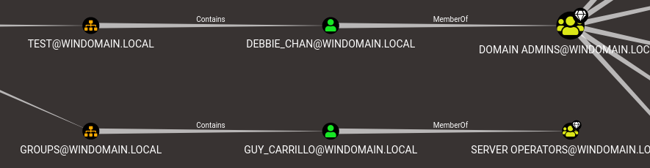
Basics – Pathfinding
Pathfinding is just multiple linked relationships
A relationship is simply a path with only 1 level of depth
Node1 – edge -> node2 – edge -> node3 -> ……

Slide 42
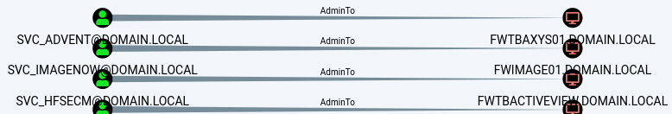
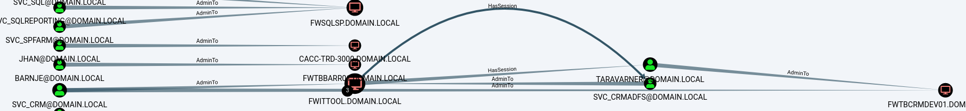
Basics – Pathfinding
Specifying depth
MATCH p=(n)-[r:AdminTo|HasSession]->(m) RETURN p
One hop
MATCH p=(n)-[r:AdminTo|HasSession*1..3]->(m) RETURN p
One to three hops
MATCH p=(n)-[r:AdminTo|HasSession*1..]->(m) RETURN p
All hops necessary

Slide 43
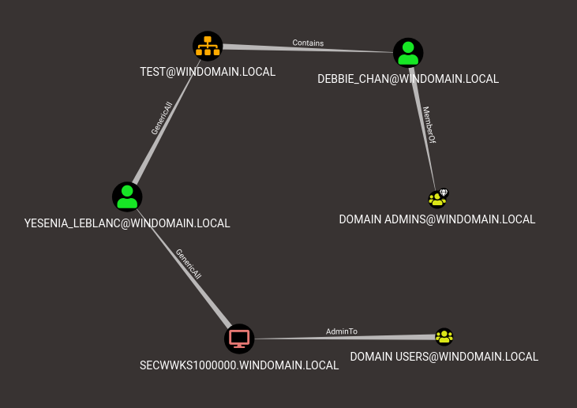
Basics – Functions
shortestPath(relationship)
Returns only the shortest path, standard search functionality
allShortestPaths(relationship)
Returns all of the shortest paths (shocking)

Slide 44
Examples
List all owned objects
MATCH (n) WHERE n.owned=True RETURN n
List all high value targets
MATCH (n) WHERE n.highvalue=true RETURN n
List all groups with ADMIN in the name
MATCH (n:Groups) WHERE n.name=~".*ADMIN.*" RETURN n
Shortest path from username to unconstrained delegation system
MATCH (n) WHERE n.name='username' MATCH (m) WHERE m.unconstraineddelegation=True MATCH p=allShortestPaths((n)-[r*1..]->(m)) RETURN p
Shortest path from any owned user to unconstrained delegation system
MATCH (n {owned: true}),(m {unconstraineddelegation: true}),p=shortestPath((n)-[r*1..]->(m)) RETURN p

Slide 45

Example
For each user, return how many computers they have admin rights to
lets build on it

Slide 46
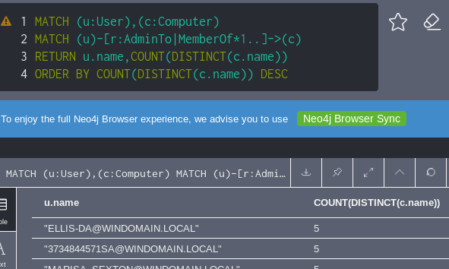
Example
Now order it

Slide 47
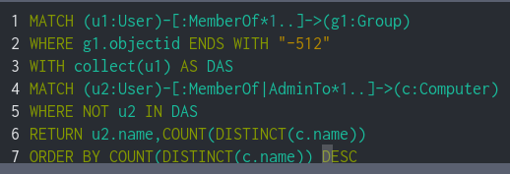
Example
Now remove domain administrators

Slide 48
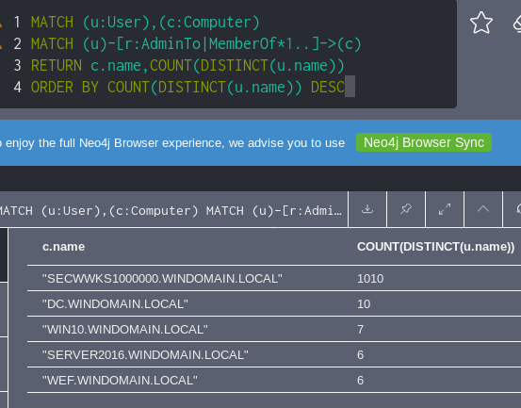
Example

Slide 49
Cypher!
Super powerful!
Steep learning curve!
Able to leap tall buildings in a single bound!

Slide 50
Conclusion
Over this presentation I hope that you’ve learned how BloodHound AD can improve your AD security, and found some tools & tricks can maximize your use
There are tons of other resources out there for BloodHound, those are how I learned, and you can too
Find me on the BloodHound slack! @knavesec

Slide 51
Thanks
Thanks to you all for listening!
Thanks to RMISC!

