Slide 1
User Enumeration Via Correlated Response Analysis Against Office365 Ellis Springe Adversary Simulation, IBM X-Force Red

Slide 2

Who am I?
Agenda
Current Role
Adversary Simulation, IBM X-Force Red
Personal
Dogs/Climbing/Occasionally Security
That’s pretty much it
Intro
Request Breakdown
Process
Demo

Slide 3
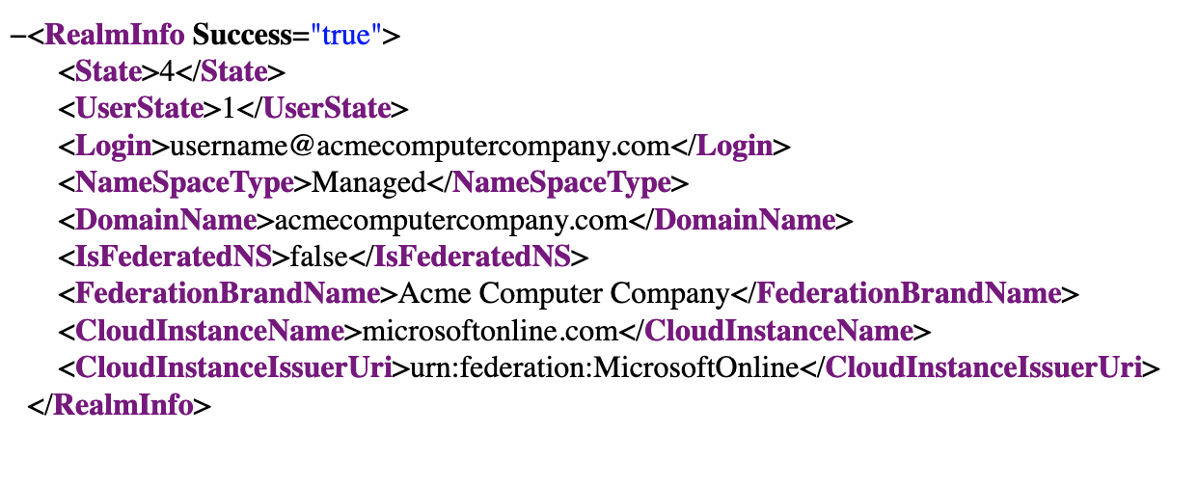
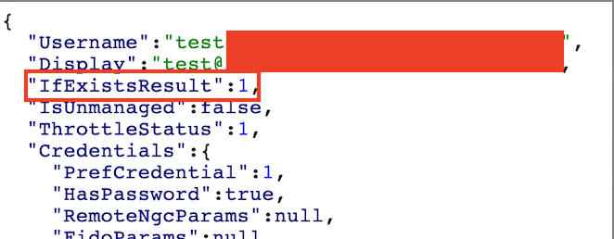
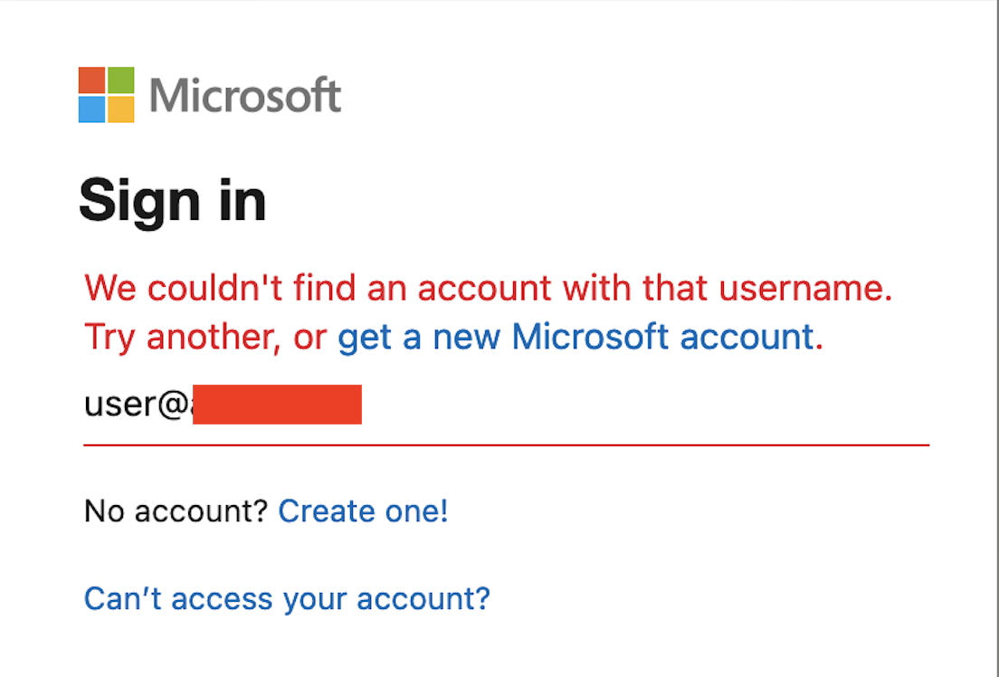
Yet Another User Enum Tool
There are many tools for Office365 user enumeration
Primarily target organizations in a Managed environment, rather than a Federated system
Examples:
https://github.com/dafthack/MSOLSpray
https://github.com/BarrelTit0r/o365enum
https://github.com/Raikia/UhOh365
But, for Federated environments, this is more difficult and inconsistent

Slide 4
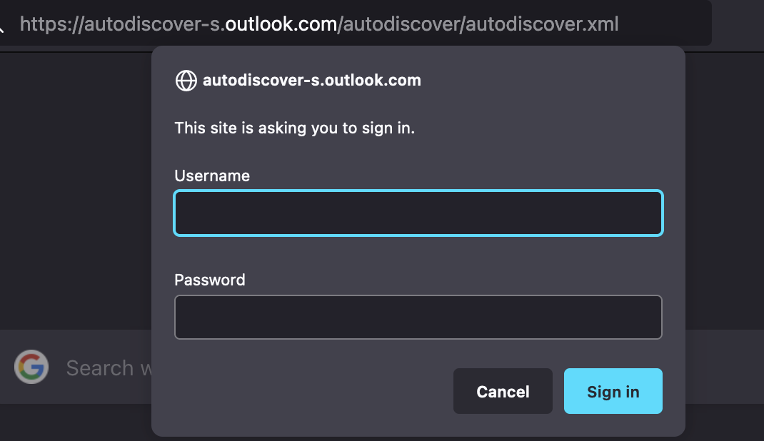
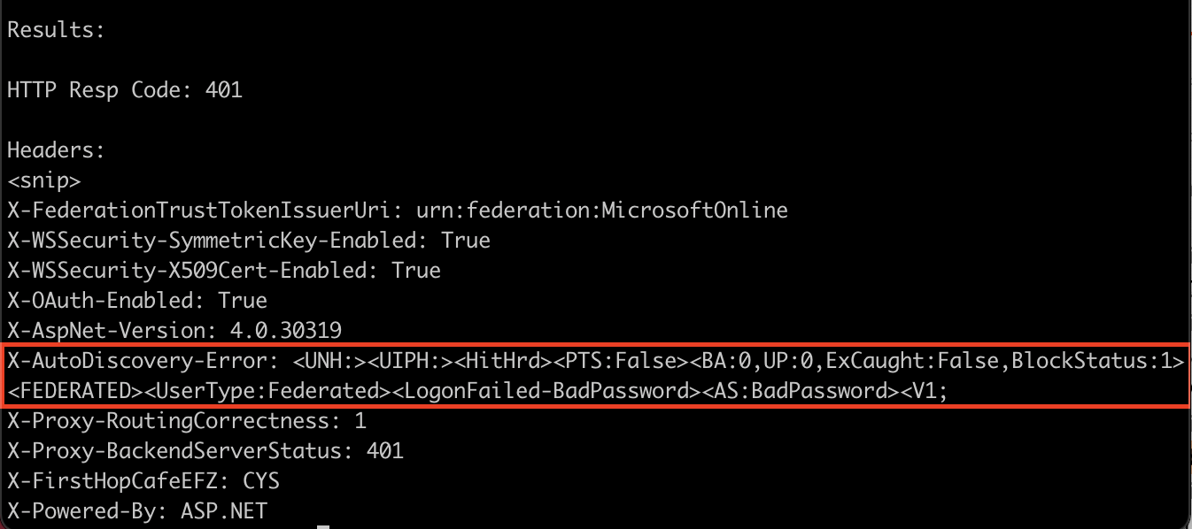
Initial Request
Found https://autodiscover-s.outlook.com/autodiscover/autodiscover.xml from byt3bl33d3r’s SprayingToolkit
Request was normal, but contained a header that looked like a debugging info
“X-AutoDiscovery-Error”

Slide 5
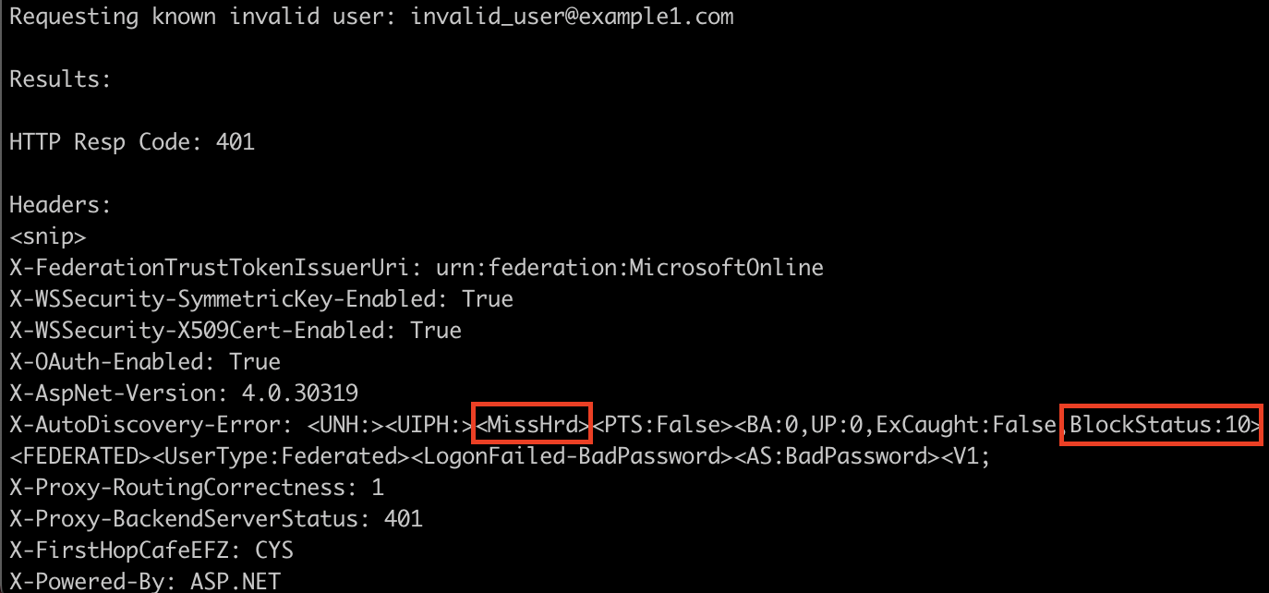
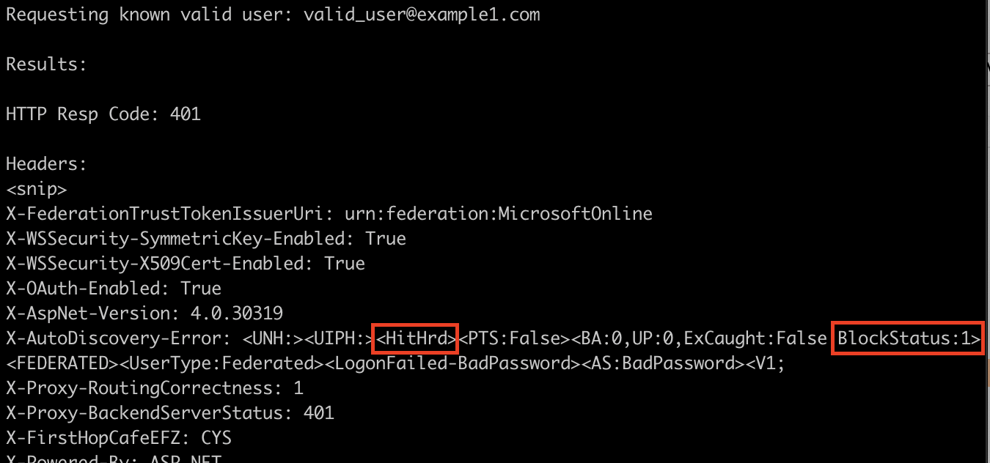
Example 1
Invalid user: BlockStatus:10 & MissHrd
Valid user: BlockStatus:1 & HitHrd
Simple? Check for those differences

Slide 6
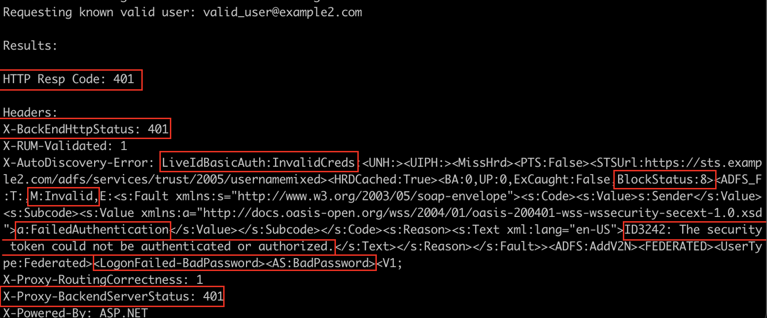
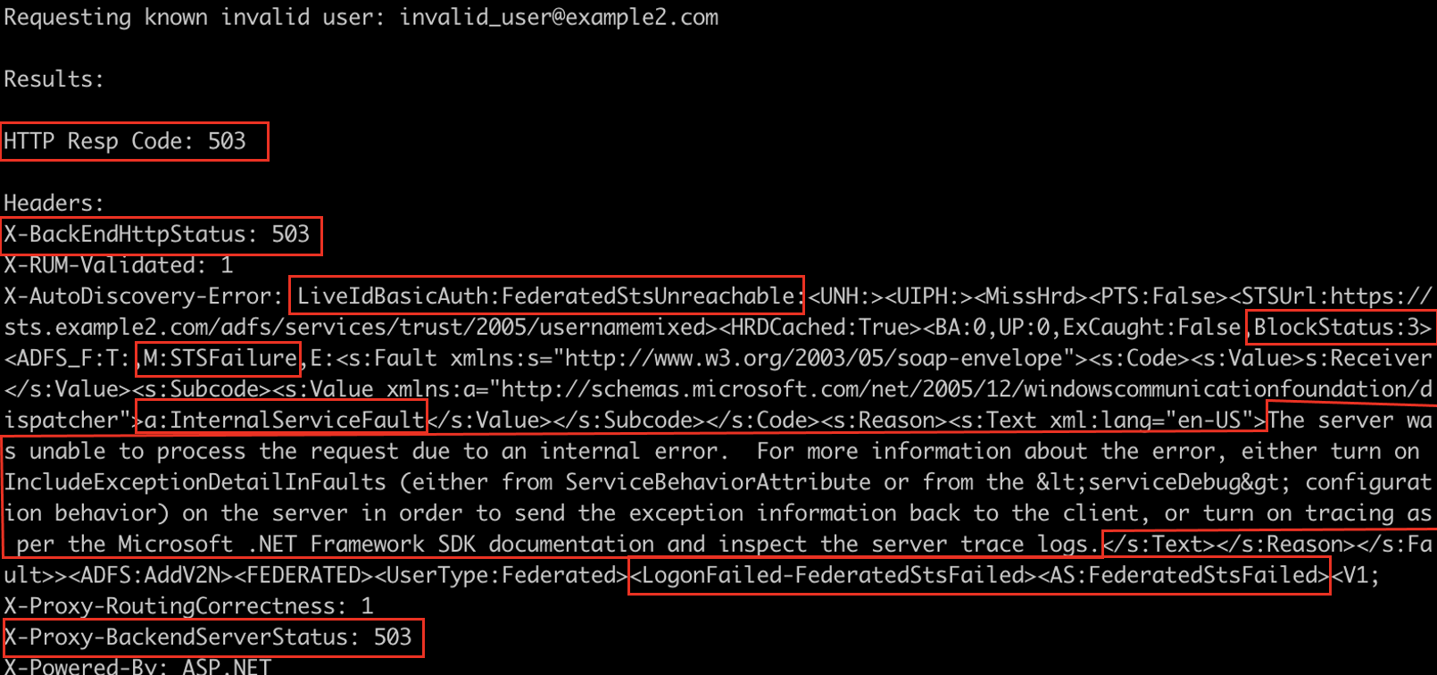
Example 2
BlockStatus different, MissHrd for both
BUT
Different Response code
Unique keywords
Strings of debugging text
Different differences
Repeated across a number of clients, all different
How to make this consistent?

Slide 7
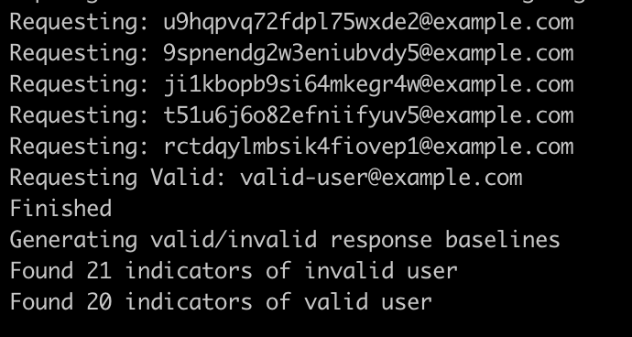
Flow
Make 5 invalid user requests (RNG)
Make 1 known valid user request
Correlate the requests, identify unique characteristics for each type
Remove insignificant items from the baseline
Make additional requests
~ Magic ~

Slide 8
Demo

Slide 9
Conclusion
Isolated case, but the technique is consistent to identify user enumeration vulnerabilities
Tool: github.com/knavesec/o365fedenum
Note: this was reported to Microsoft, “Won’t Fix”

Slide 10
Thanks for listening
Notes:
Optional end slide

