Slide 1
Report It
Crystal Gomes, Meighan Rasley, and Grace Hatamyar
Mentor: Jessica Wicksnin

Slide 2
What is Report It?
A web app that helps users log incidents of bullying or sexual harassment.
Report It makes it easier to build a case by helping users gather pertinent information to recognize and demonstrate a pattern to others.

Slide 3
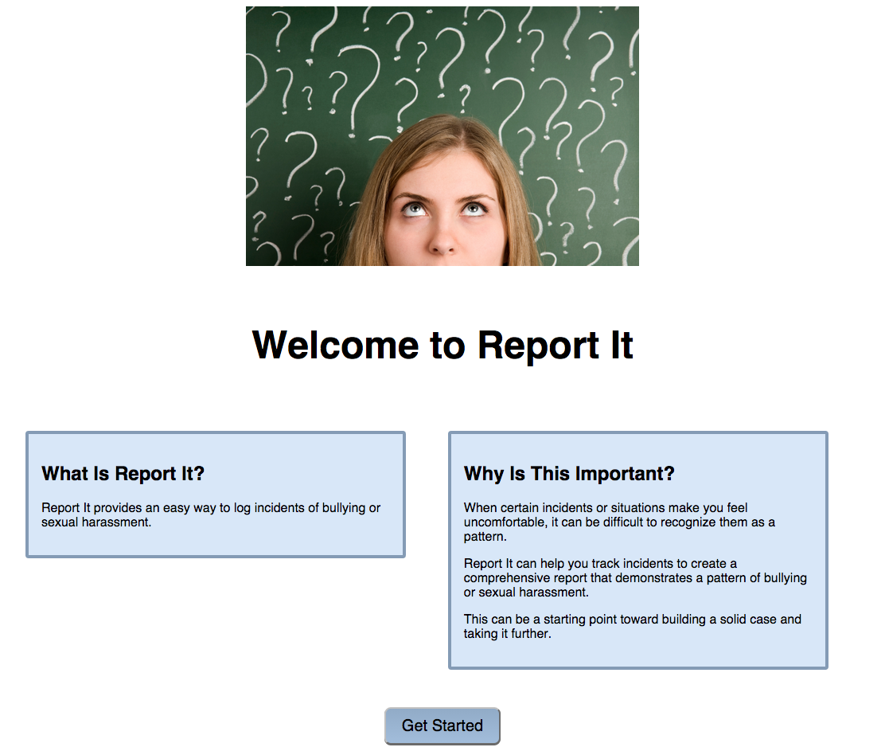
Front-end

Slide 4
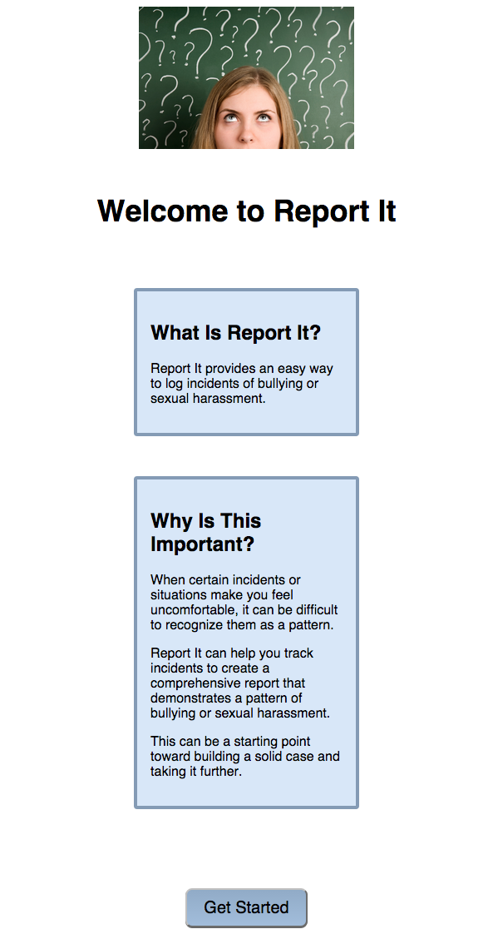
Mobile View
Responsive design
Media queries
Adjusting to using ems instead of pixels

Slide 5
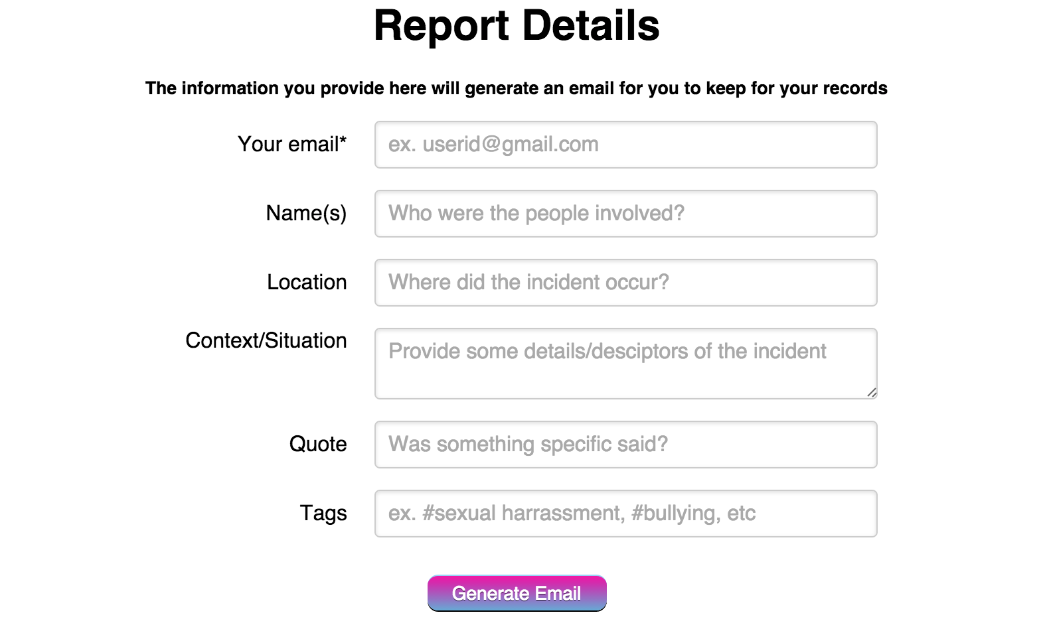
Incident Log

Slide 6
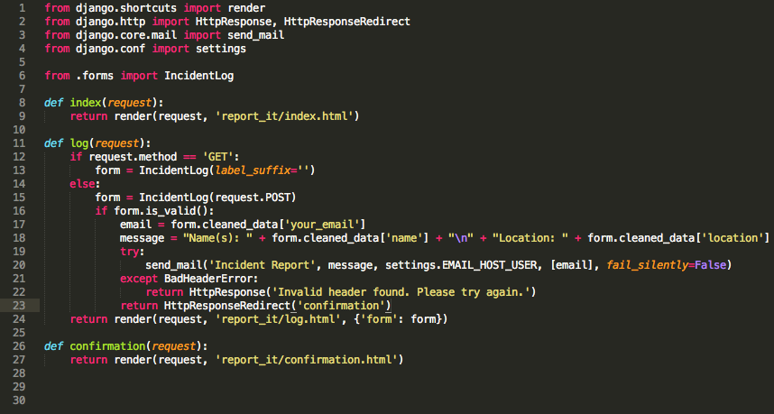
Back-end

Slide 7
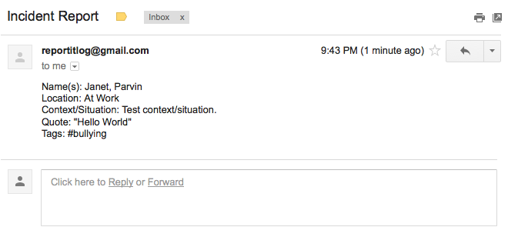
Incident Report

Slide 8
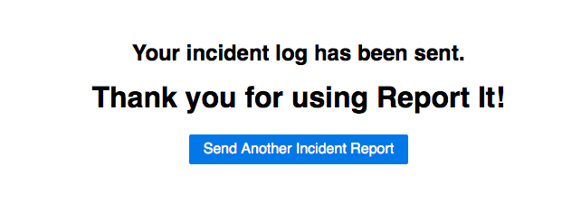

Slide 9
Challenges
All team members being able to meet, despite traveling and other circumstances.
Strange GitHub errors
Most of the group had never used Django before
Lost a team member

Slide 10
Next Steps…
Format and design incident report email.
Add a database so that Report It’s users can store their data in one location and generate various reports based on need.
Create an app for iOS and Android so that users can Report It on the go.
THANK YOU!

