Slide 1
Report It
Crystal Gomes, Meighan Rasley, and Grace Hatamyar
Mentor: Jessica Wicksnin

Slide 2
What is Report It?
A web app that helps users log incidents of bullying or sexual harassment.
Report It makes it easier to build a case by helping users gather pertinent information to recognize and demonstrate a pattern to others.

Slide 3
Front-end
Crystal – insert screen shot/text

Slide 4
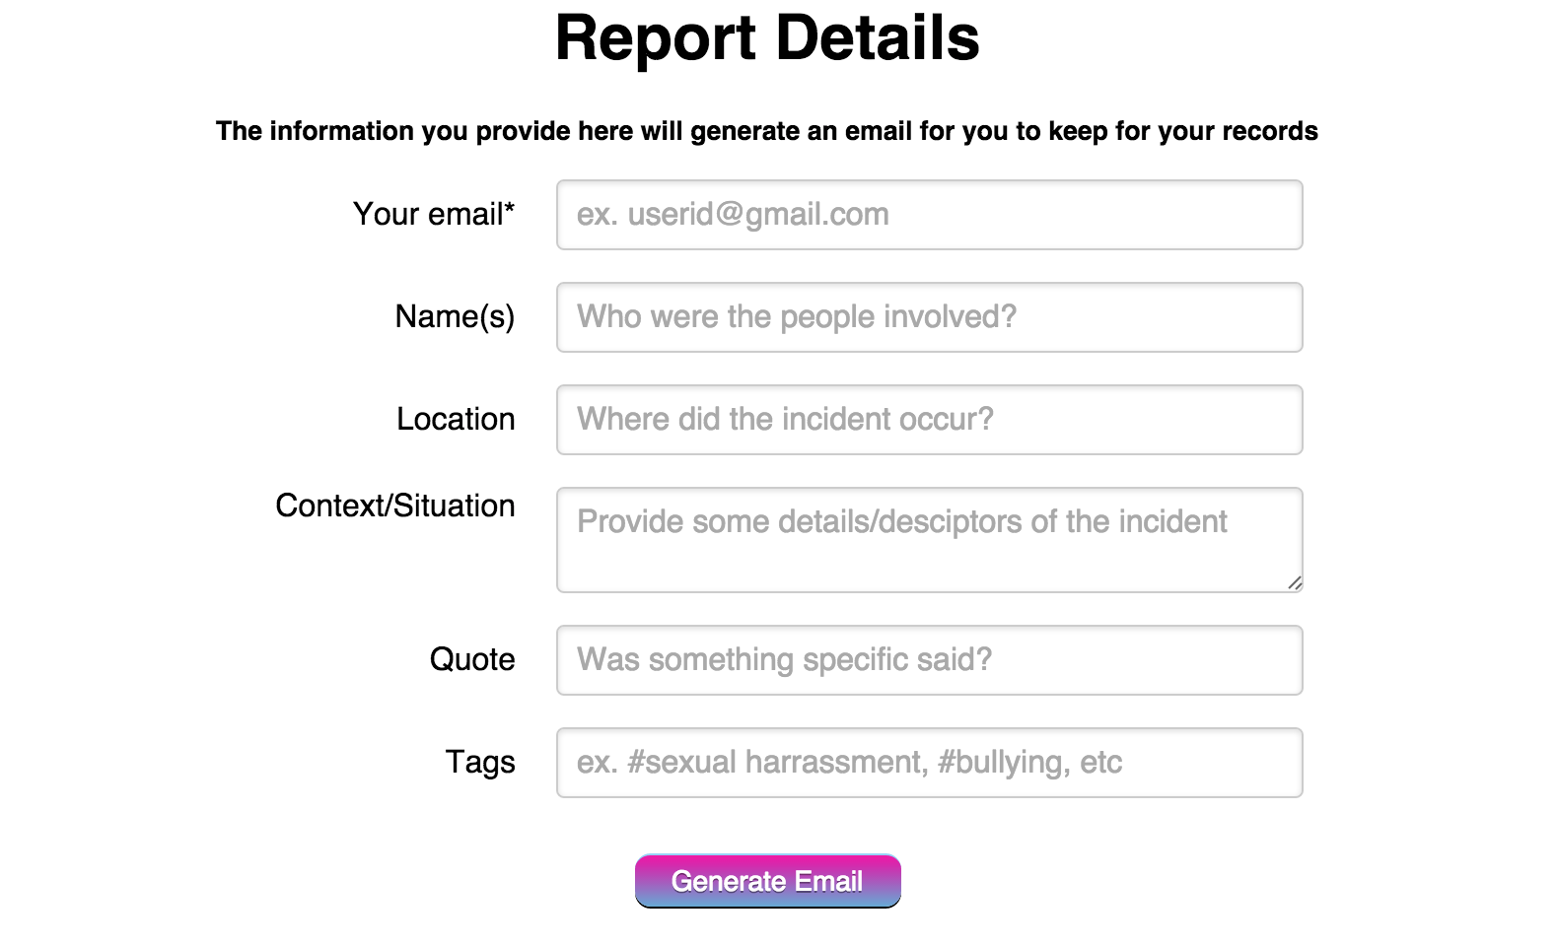
Incident log

Slide 5
Back-end
Code snippet

Slide 6
Incident Report
Possible snap shot of email. This slide might not be here.

Slide 7
Next Steps…
Format and design incident report email.
Add a database so that Report It’s users can store their data in one location and generate various reports based on need.
Create an app for iOS and Android so that users can Report It on the go.
THANK YOU!

