Slide 1

Introduction to Generative AI & ChatGPT
Generative AI is a field of artificial intelligence that focuses on creating systems capable of generating content, such as images, videos, text, and music on their own.
by Naga Chaitanya & Chandra Rekha Kosanam

Slide 2
What is ChatGPT?
1
Conversational AI
2
Natural Language Generation
3
Seamless Interaction
ChatGPT is a conversational AI model based on OpenAI's GPT (Generative Pre-trained Transformer) architecture.
It excels in natural language generation and can generate human-like text based on the provided context.
It can engage in meaningful, context-aware conversations with users, simulating human-like responses.

Slide 3
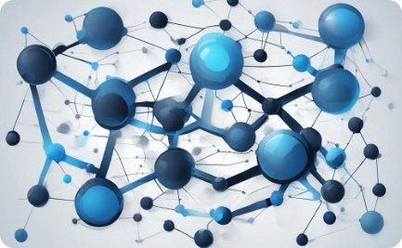
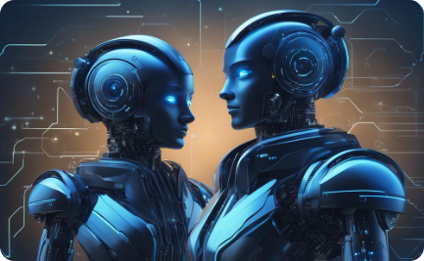

How does ChatGPT work?
Neural Networks
Large-scale Training
Continuous Learning
ChatGPT uses neural networks to process and understand input text and generate appropriate responses.
It's trained on massive amounts of data to develop an understanding of human language and context.
ChatGPT continuously learns and adapts to improve its conversational abilities over time.

Slide 4
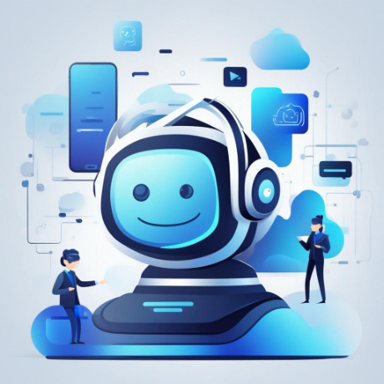
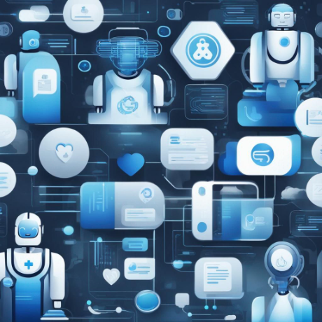
Use cases of ChatGPT in various industries
Customer Service
Healthcare
Chatbots powered by ChatGPT provide efficient and instant customer support across industries.
Assisting in patient support, appointment scheduling, and providing medical information in a conversational manner.
Content Generation
It's used for automated content creation, including news articles, product descriptions, and more.
Education
Enhancing remote learning experiences through personalized tutoring and educational content creation.

Slide 5
Benefits of using ChatGPT for college students
1
Personalized Learning
2
24/7 Support
ChatGPT can deliver personalized study resources, adaptive practice questions, and tailored educational materials for college subjects.
It provides round-the-clock access to educational assistance, answering queries and providing guidance at any time.
3
Enhanced Learning Tools
4
Improvement in Writing Skills
Integration with educational platforms to offer interactive learning exercises and language practice opportunities.
ChatGPT aids in improving writing skills by providing automated feedback and suggesting improvements in essays and assignments.

Slide 6




Potential applications of ChatGPT in education
Virtual Tutoring
Language Learning
Automated Writing Feedback
Personalized Study Resources
ChatGPT can act as a virtual tutor, offering personalized learning experiences and study guidance.
It supports language learning activities by providing conversational language practice and vocabulary building exercises.
Offers automated writing feedback, aiding in improving students' writing skills and clarity of expression.
Customizes study materials and resources to meet the specific learning needs and pace of individual students.

Slide 7
Challenges and limitations of ChatGPT
Biased Responses
Contextual Misinterpretation
Data Privacy Concerns
ChatGPT may generate biased or insensitive responses due to inherent biases in the training data.
It may misinterpret context or provide inaccurate information when faced with complex or ambiguous queries.
Issues related to data privacy and security may arise when using ChatGPT for sensitive interactions.

Slide 8




Conclusion and future prospects
Continued Advancement
ChatGPT is expected to undergo further development and refinement for more accurate and context-aware interactions.
Ethical Implementation
Addressing ethical considerations and ensuring responsible use of the technology in various domains.
Expanding Capabilities
Exploring applications in diverse fields, from entertainment to specialized professional services.

