Slide 1
1 · Addis Demand AI — Addis ride demand forecasting
1/5
Abraham Getachew · Ahmed Hussen · Natanim Masresha · Nigus Shiferaw · Tekilu Asefa
IDAE · EDI-Qiyas-CoDiST Advanced Digital Skills Program
12 zones
Addis Ababa pickups
1–14 Nov
Forecast fortnight
~85k
Train zone-hours
3 tables
Trips · weather · events
• Goal: hourly trip forecasts so ops know where drivers should be
• Integrate three messy sources: ride_demand, weather_hourly, events_calendar
• Validate by time — never random split
• Only features known at forecast time (no fare / wait / active drivers)
1 ride_demand
2 weather_hourly
3 events_calendar
Addis Demand AI · IDAE · EDI-Qiyas-CoDiST Advanced Digital Skills Program · 1/5
Notes:
Open with the ops problem (45s). Point at the four metric cards, then the three source chips. Emphasize chronological validation and no leakage features. Mention synthetic training data briefly.

Slide 2
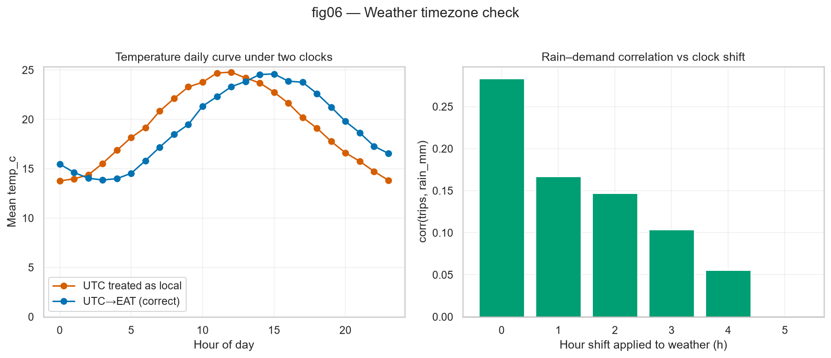
2 · Cleaning & integration — clocks and joins
2/5
• 55 zone spellings → 12 canonical labels
• Clock proof: trips are EAT (+03); weather mostly UTC (Z)
• Convert weather UTC → Africa/Addis_Ababa before join
• Weather join: many-to-one on hour — 100% match after hourly spine
• Events: interval join; football/concert ±2h; confirmed only (159)
• Sentinels fixed (rain −9999); negatives/caps logged in A1
Addis Demand AI · IDAE · EDI-Qiyas-CoDiST Advanced Digital Skills Program · 2/5
Notes:
Walk clocks then joins (60s). Stress the +3h bug — wrong clock kills the rain signal. Point at fig06: afternoon temperature peak only after conversion.

Slide 3
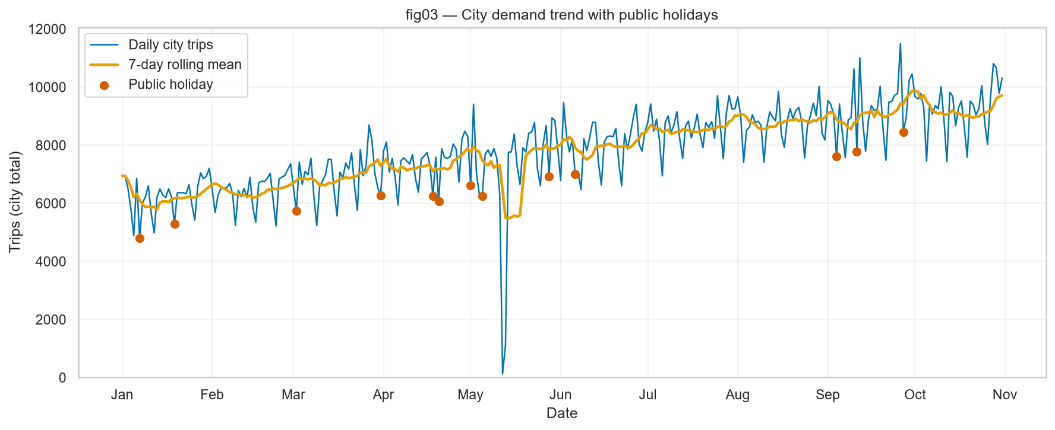
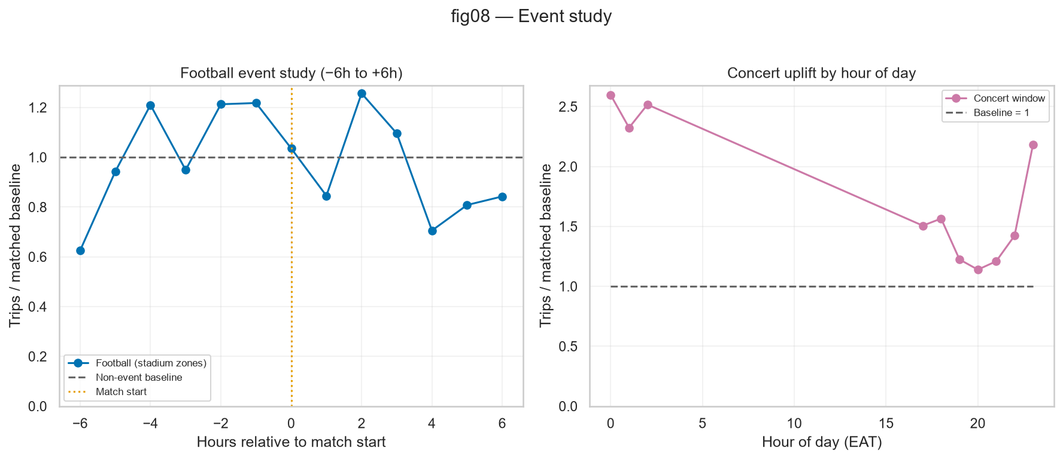
3 · What the data says — two findings
3/5
~30% growth Jan→Oct
November needs trend + lags — not seasonality alone
~2.7× pre-kickoff
Football uplift in stadium zones (supports ±2h windows)
Also: Ayat is late-launch (short history) · rain effects differ by zone type · cancelled events excluded
Addis Demand AI · IDAE · EDI-Qiyas-CoDiST Advanced Digital Skills Program · 3/5
Notes:
Two takeaways only (50s). Growth → week_index + lags. Football before-window justifies ±2h features. Figures are from Deliverable B/C.

Slide 4
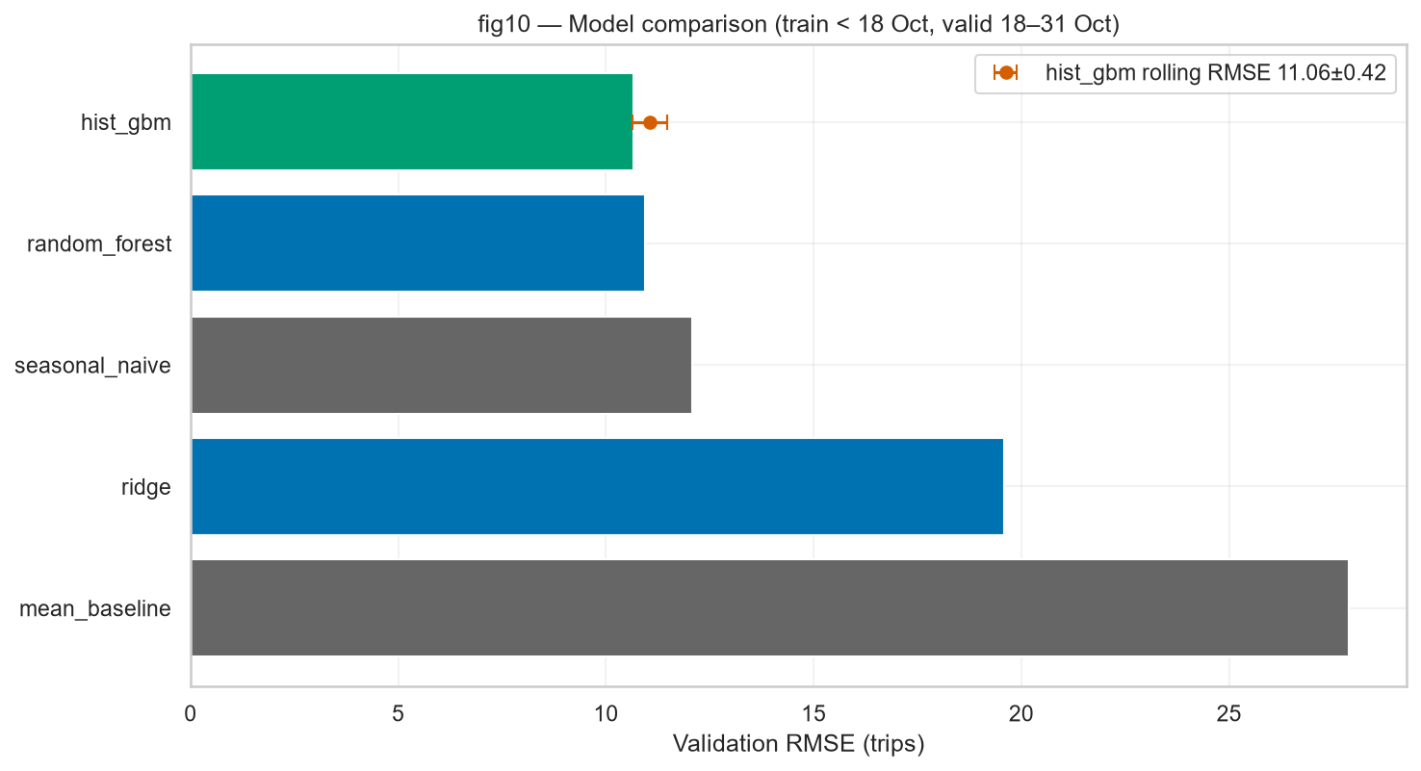
4 · Modeling — beat the seasonal baseline
4/5
10.16
Tuned HistGBM RMSE
12.08
Seasonal naive RMSE
11.06±0.42
Rolling 5-fold RMSE
No leak
Fare / wait / drivers out
• Split: train < 18 Oct · validate 18–31 Oct (time-ordered)
• Mean baseline RMSE 27.9 — seasonal naive is the real bar
• Winner: HistGBM (D6 tuned) · MAE ≈ 6.41
• Ablation: calendar 10.43 → +weather+events 10.16 (−0.27)
• Rules 5–7: weather+events in model · chronological · no ops leakage
Addis Demand AI · IDAE · EDI-Qiyas-CoDiST Advanced Digital Skills Program · 4/5
Notes:
Seasonal naive is the bar (60s). HistGBM clears it. Ablation shows joins were worth it. Mention Rule 5/6/7 briefly. Headline 10.16 is tuned; fig10 bars show family comparison.

Slide 5
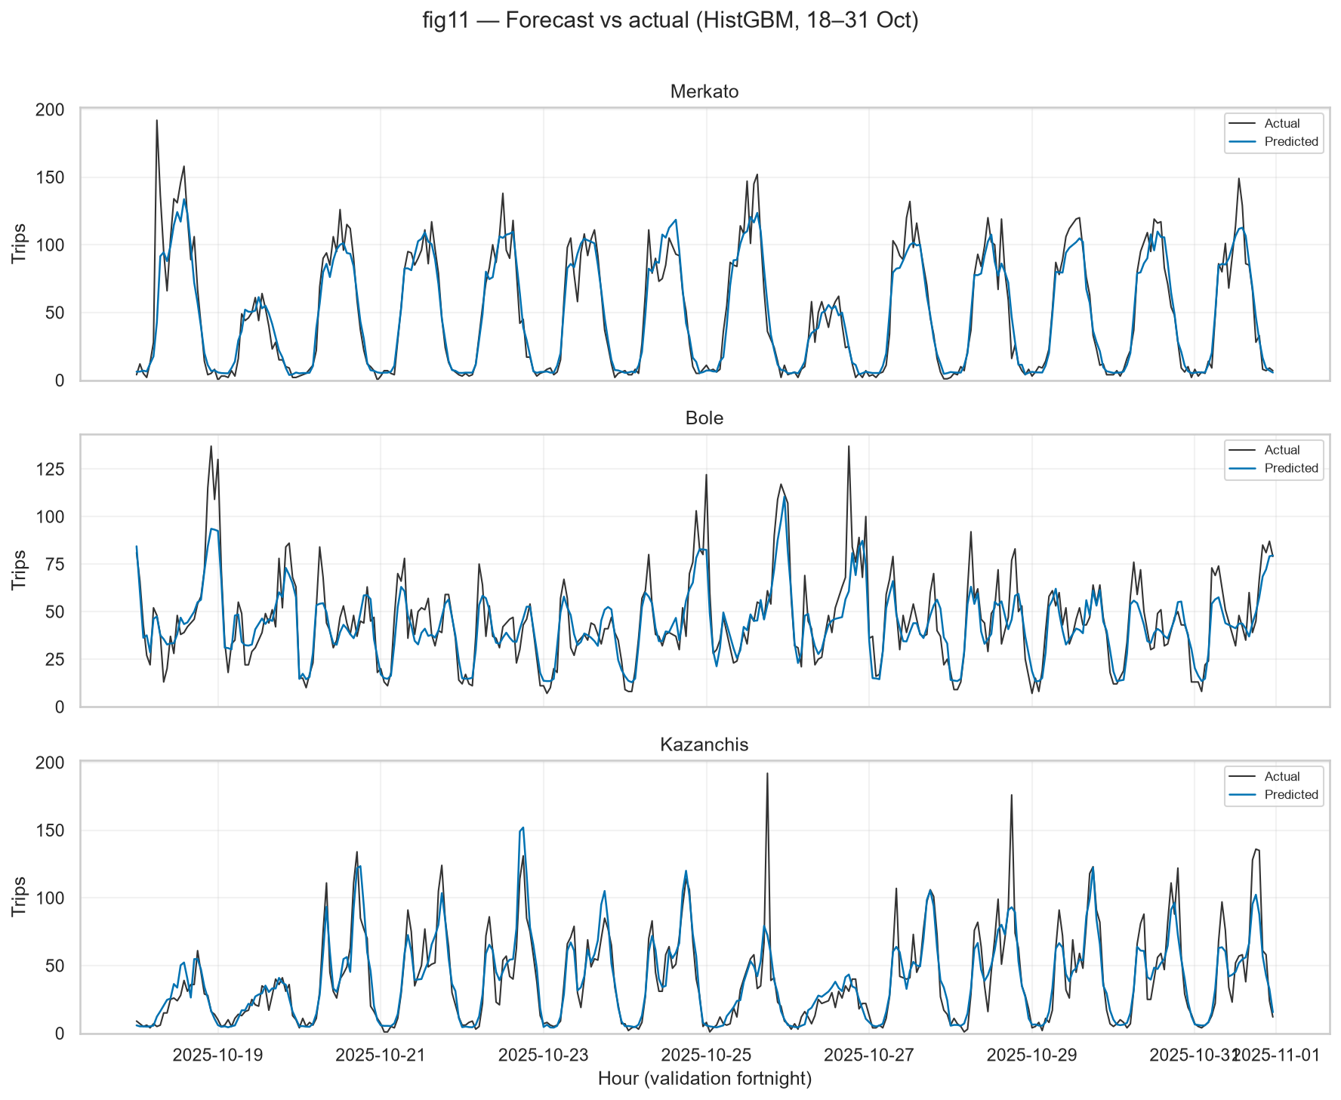
5 · Errors, score, demo — and what’s next
5/5
• Errors peak on rush hours, holidays, and unlisted event spikes
• Tried peak/rain interactions after D7 — no gain; kept simpler model
• Ops buffer: MAE ≈ 6.4 trips/h → ~±5 drivers at 1.3 trips/driver-hour
• Submission: 4,032 rows · team_addis_demand_ai_submission.csv
• Next: quantile intervals · Ayat-specific model · drift monitoring
Live demo
localhost:8501
Zone + date only · auto weather/events · Streamlit
Addis Demand AI · IDAE · EDI-Qiyas-CoDiST Advanced Digital Skills Program · 5/5
Notes:
Handoff to live demo (45s + live). Local: python -m streamlit run app/app.py → http://localhost:8501. Pick Kazanchis on a match day (e.g. 9 Nov); show weather/event lookup + drivers. Close with honest next steps. Invite judges to choose zone/date.

