Slide 1
Digital Image Processing
Resizing Image

Slide 2
Resizing Images
Zooming : Creating new pixel locations
Assigning gray-level values to these locations
Solution: Interpolation

Slide 3
Yang CS, Kao SP, Lee FB, Hung PS. 2004. Twelve Different Interpolation Methods: a Case Study of Surfer 8.0. International Society for Photogrammetry and Remote Sensing; 778–783.

Slide 4
1. The Inverse Distance to a Power Method
2. The Kriging Method
3. The Minimum Curvature Method
4. The Modified Shepard's Method
5. The Natural Neighbor Method
6. The Nearest Neighbor Method

Slide 5
x7. The Polynomial Regression Method
x8. The Radial Basis Function Interpolation Method
x9. The Triangulation with Linear Interpolation Method
10. The Moving Average Method
11. The Data Metrics Method
12. The Local Polynomial Method

Slide 6
3 main type of 2D Interpolations :
Nearest neighbor interpolation
Bilinear interpolation
Bicubic interpolation

Slide 7
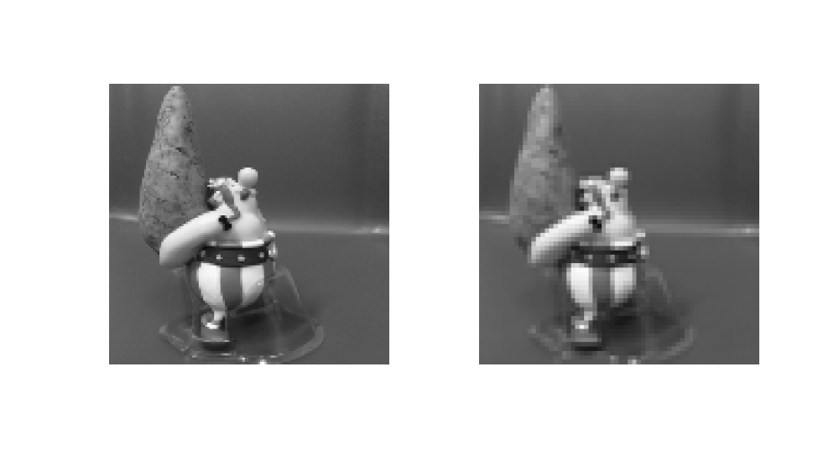
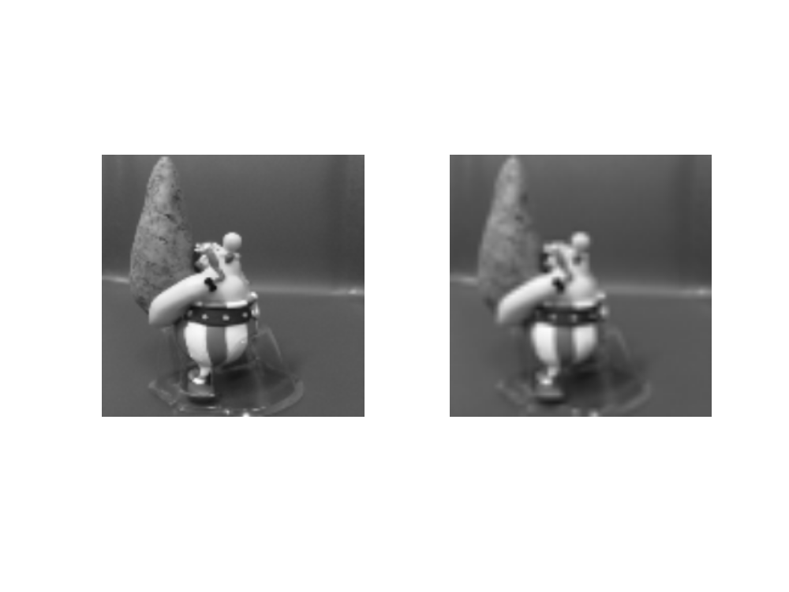

Nearest Neighbor
Bilinear
Bicubic
128 1024
64 1024

Slide 8
Summary
We have looked at:
  What is zooming/upsampling?
  What is interpolation?
  What are different types of interpolations?
Next time we will talk about aliasing
and start to talk about image enhancement

