Slide 1
Capital
The deal-flow operating system for January Capital.
Kevin Sucasa · January Capital x Lyra Hackathon · 2026.05

Slide 2
The bottleneck isn't sourcing.
10,000+
25
60+
Deals screened per year
Full-time staff
Portfolio companies

Slide 3
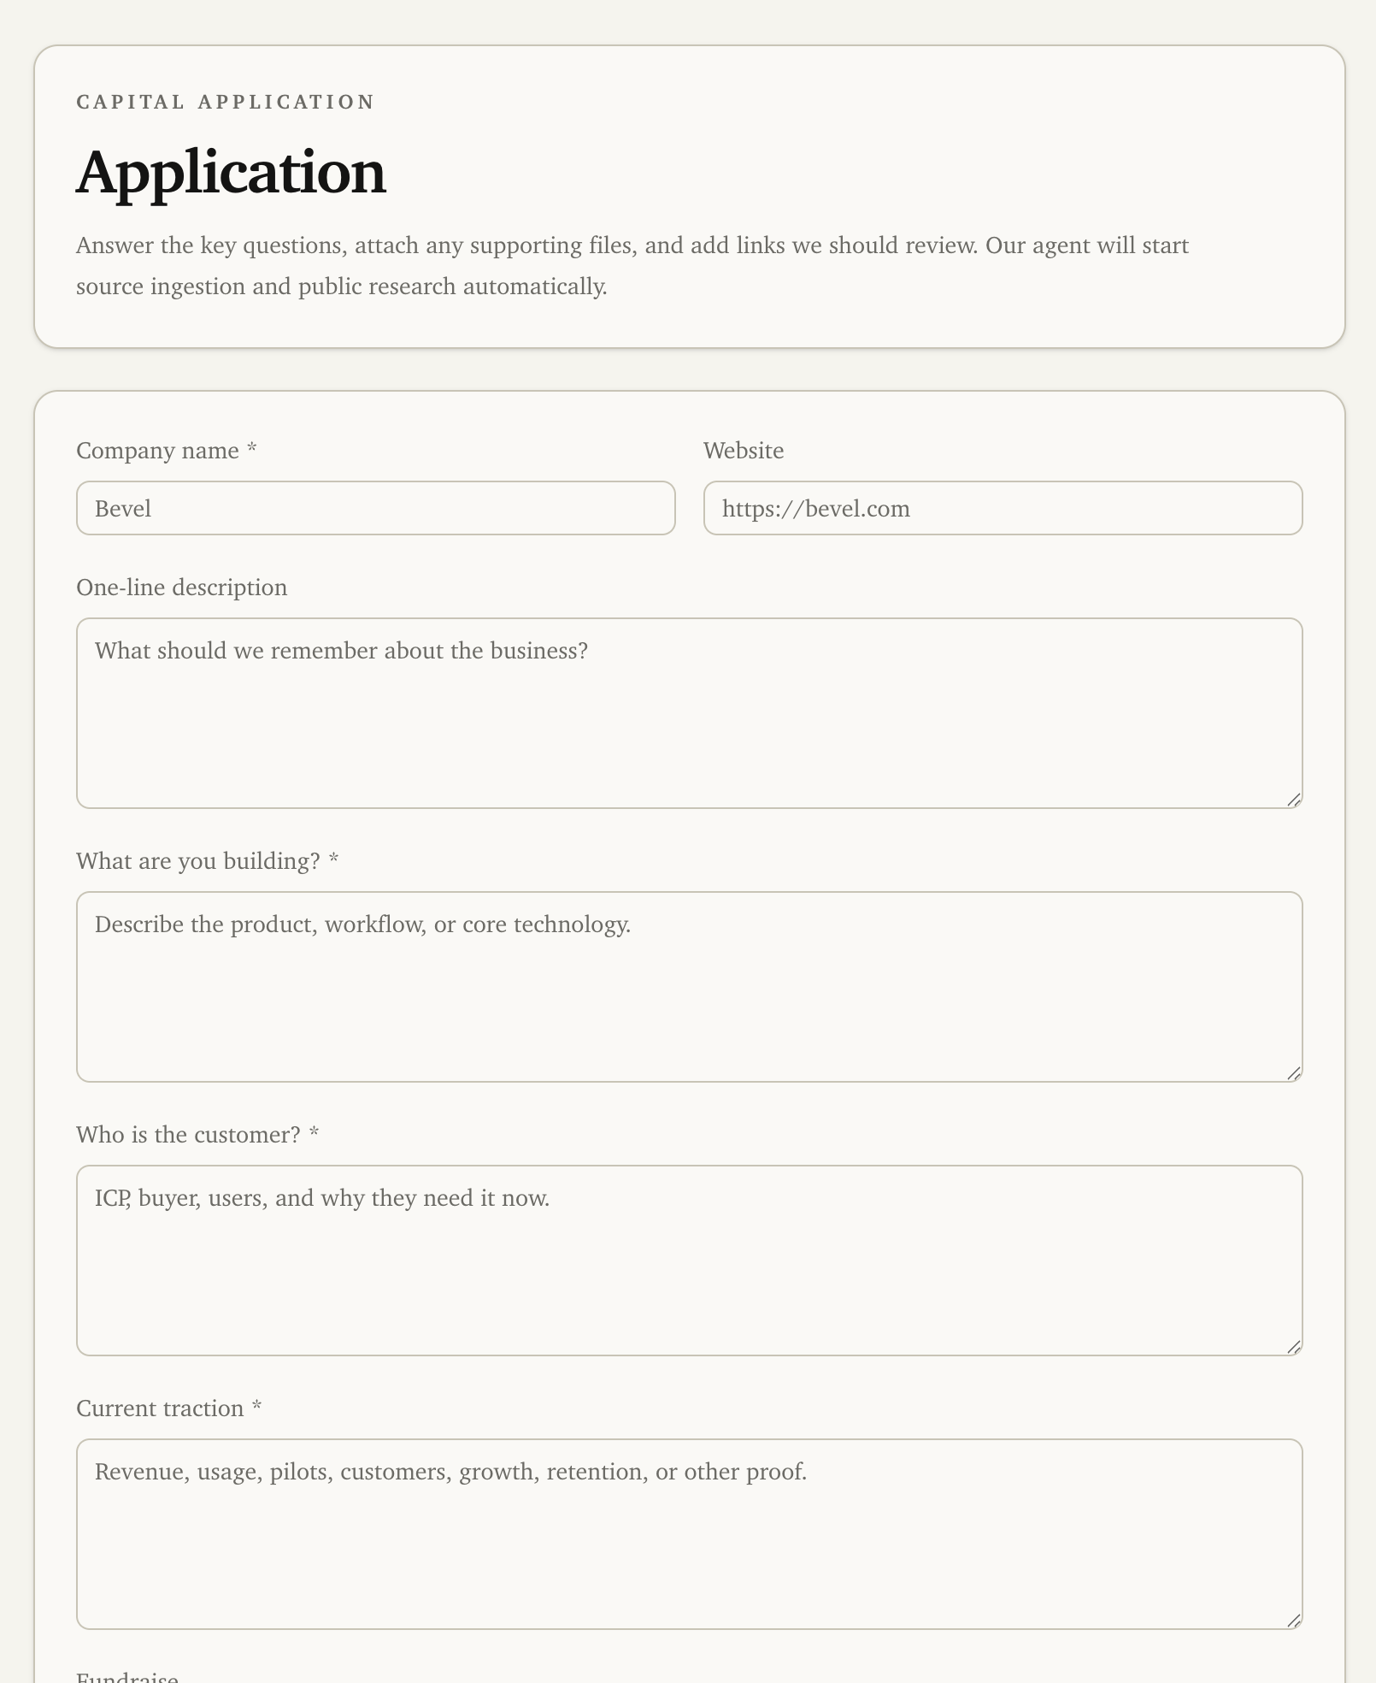
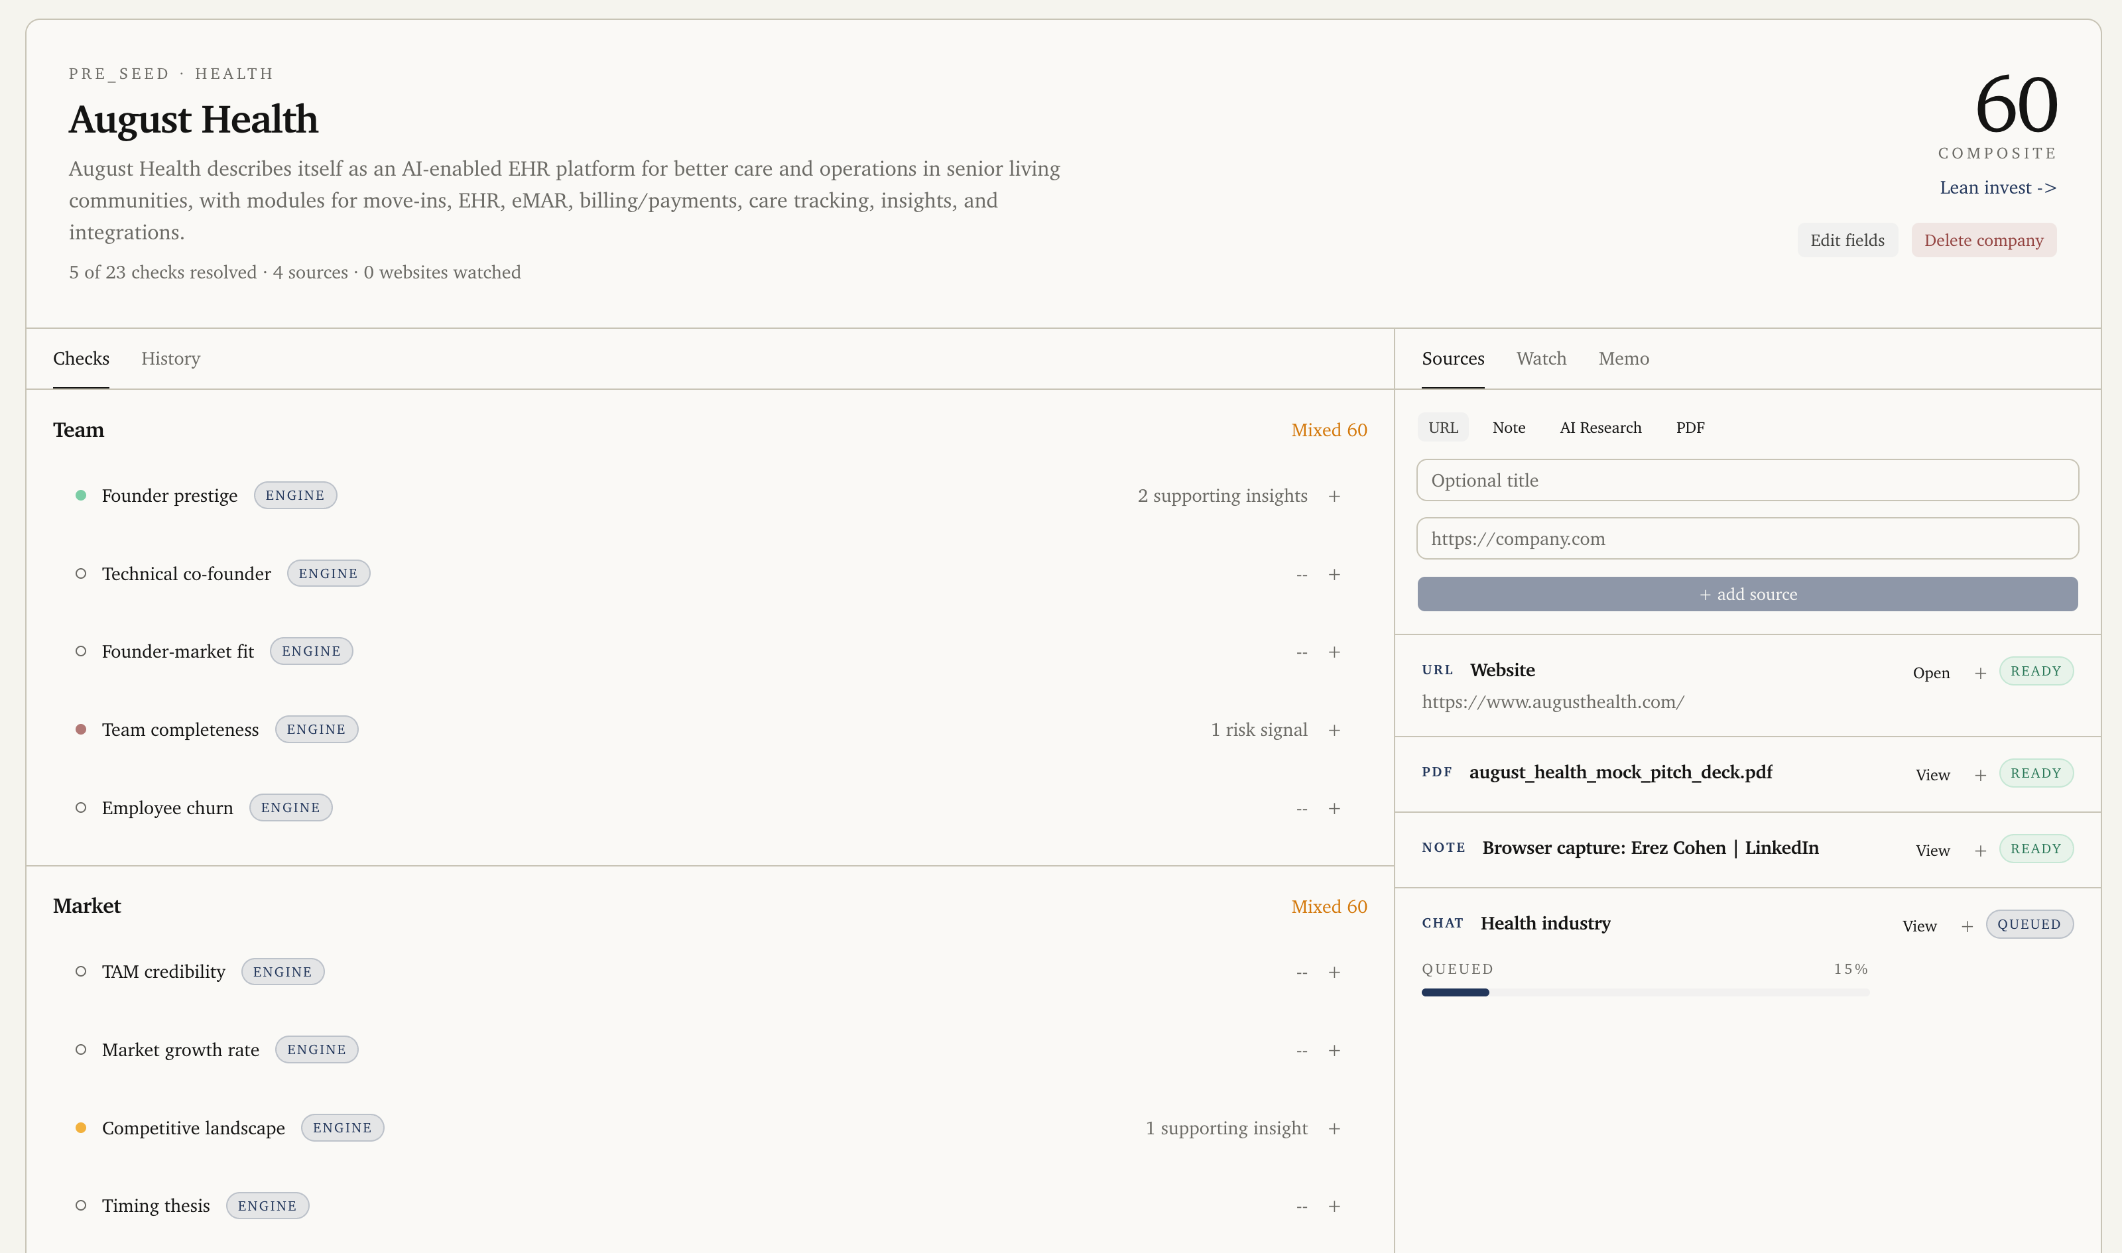
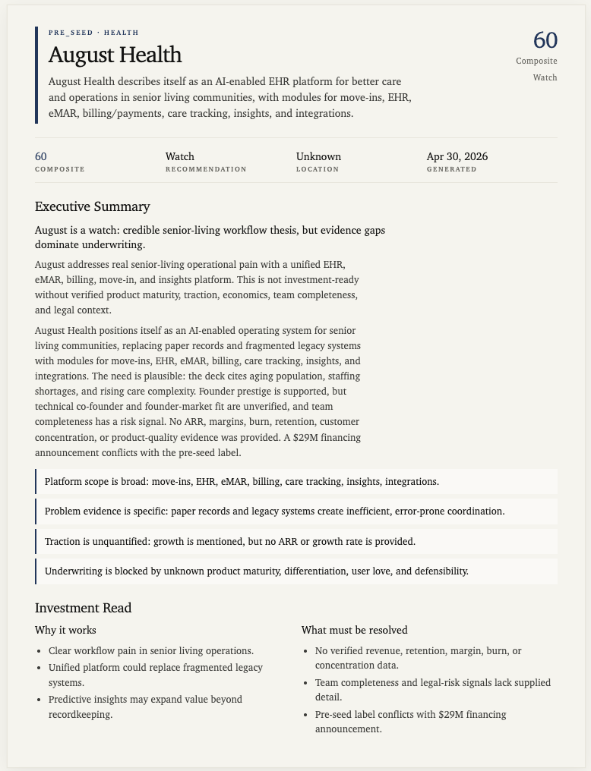
02 · PRODUCT
Application, Insight, Memo
A URL, a founder invite, or a watch target — all converge on the same scored state.
- 03

Slide 4
03 · WATCH THIS
One loop. Four steps. Live, on a real deal.
01
02
03
04
Add
Watch
Score
Memo
URL alone, or send a token-gated /apply link. Either way, market + founder research lanes spin up automatically.
Cron scans HN Launch, ProductHunt, TechCrunch, BusinessWire — plus pinned web pages and X profiles per deal.
Your diligence library runs on every signal. Pass / concern / fail, each cited to source.
Narrative + executive summary, 1-3 pages, versioned. Re-renders the moment state changes.
- 04

Slide 5
04 · TECHNICAL DEPTH
Stack
Why it holds up on real money
Effect-TS durable execution + cron, Postgres-backed
Every claim cites the exact source line
OpenAI Responses + web search + file ingest
Deterministic re-runs; engine-versioned checks
Railway deploy, fronted by Cloudflare
Apply invites are token-hashed, single-use, expiring
Adding a check is a definition file, not a retrain
- 05

Slide 6
05 · DEPLOYMENT
Replaces three tools with one loop.
Founder intake form, market intelligence subscription, IC memo template — Capital collapses all three into a single state machine your team already knows how to read. Runs at prod volumes today. Your check library imports in a day, your /apply page is brandable, watch targets are configurable per deal — pin a customer page, an X account, anything that signals truth.
- 06

Slide 7
Pilot Capital on 10 live deals from your pipeline.

