Slide 1


Machine Learning for turbulence modeling
Wilhelm Dahlin
Kenneth Huang
Francesca Zambetti

Slide 2

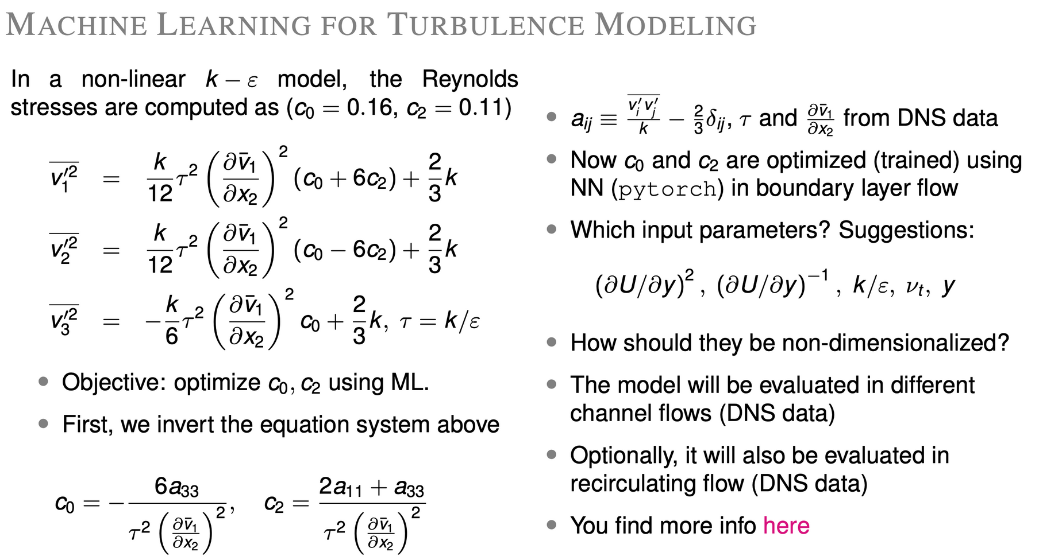

Problem description
Simulation of turbulent flows using the k-ε - model
Solves two transport equations: k and ε
k: turbulent kinetic energy
transport of kinetic energy
ε: turbulent dissipation rate
rate of lost energy from the turbulent flow
τ = k/ε describes the timescale of the turbulent eddies
Reynolds stresses are calculated using k, ε, c0 and c2
[1]. T. J Craft, B.E Launder, K.Suga, Prediction of turbulent transitional phenomena with a nonlinear eddy-viscosity model

Slide 3
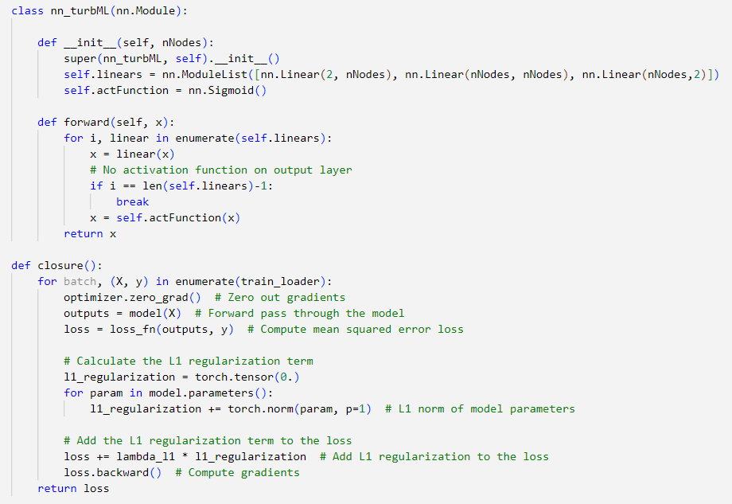
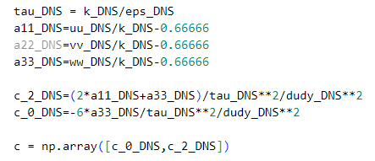
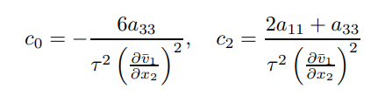
Problem description
Machine Learning will be used to improve the non-linear k− ε model of Craft et al. [1]
Data from channel flows and boundary flow simulations
[1]. T. J Craft, B.E Launder, K.Suga, Prediction of turbulent transitional phenomena with a nonlinear eddy-viscosity model

Slide 4
Assignment summary
Problem | Description | Status
1 | Train a neural network on one of the channel flows and validate on the other flows | Done
2a | Use other input parameters for the neural net | Done
2b | Use RandomForestRegressor | Done
2c | Test predictions on other types of flows | Not Done
2d | Free choice. First evaluation of symbolic regression using PySR | Done

Slide 5
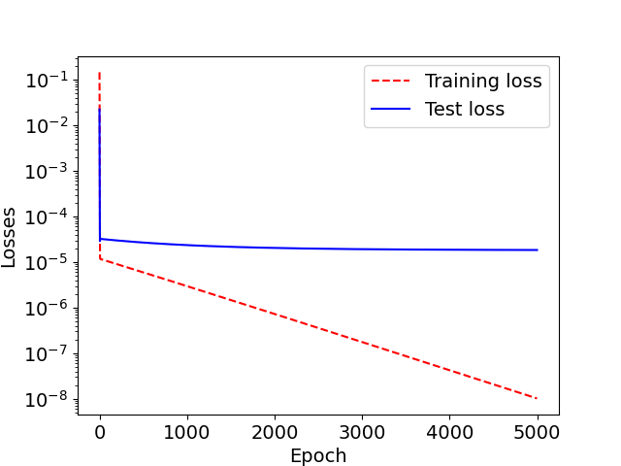
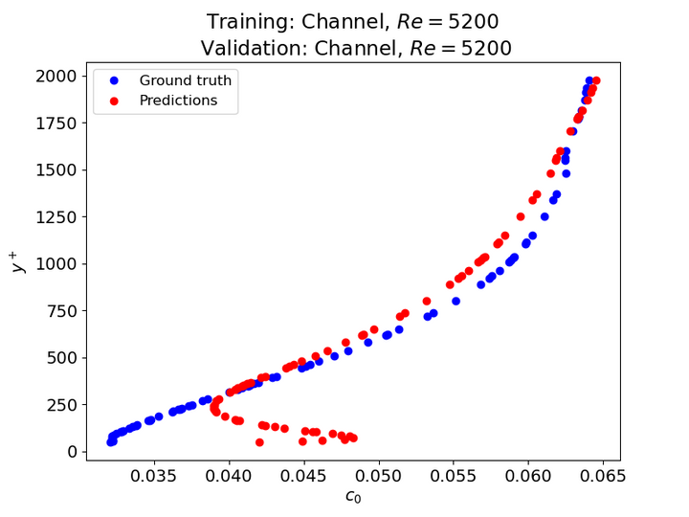
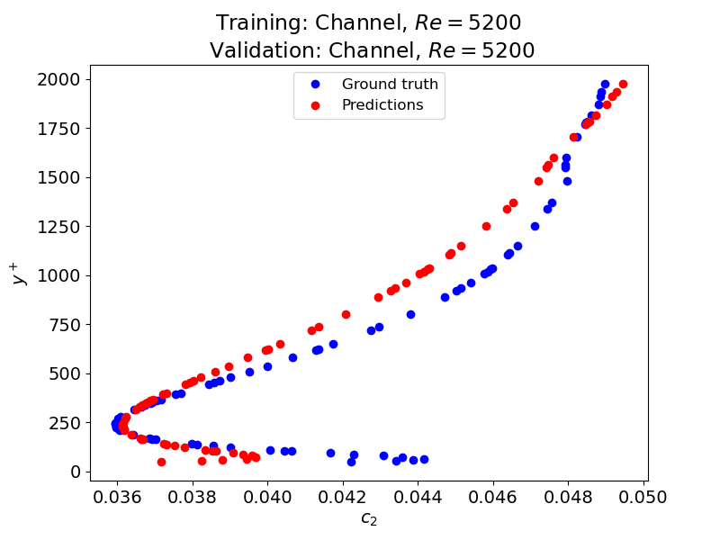
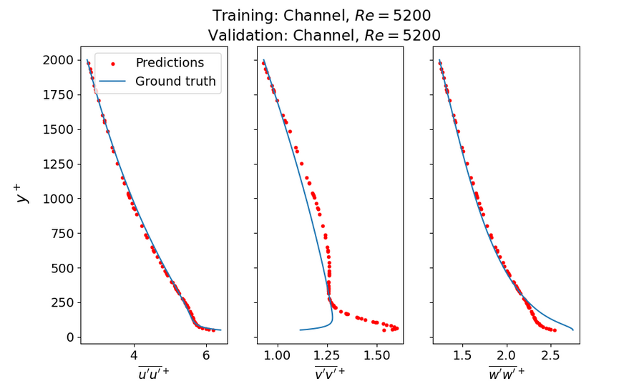
Problem 1
Training data: Channel flow, Re=5200
Test data: Channel flow, Re=550
Boundary layer flow
c0_error_std: 0.11217338712597269
c2_error_std: 0.03207818553174369
[1]. T. J Craft, B.E Launder, K.Suga, Prediction of turbulent transitional phenomena with a nonlinear eddy-viscosity model

Slide 6
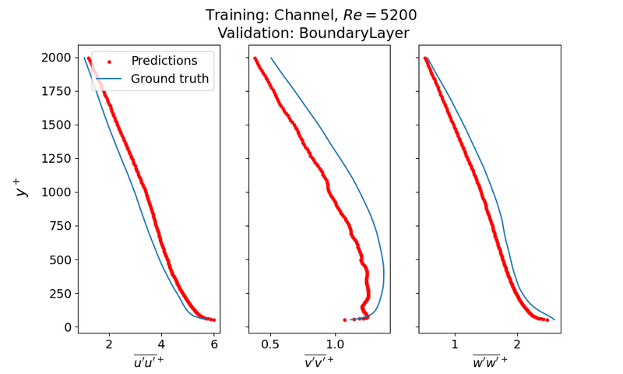
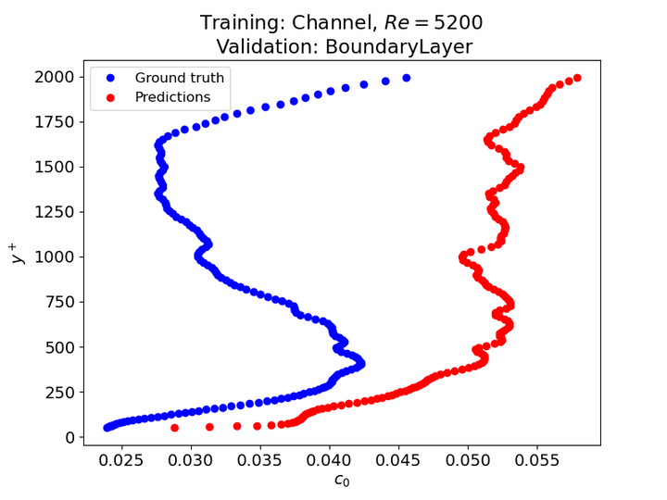
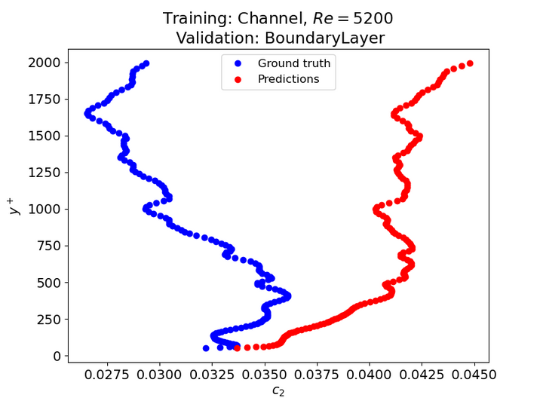
Problem 1
Training data: Channel flow, Re=5200
Test data: Channel flow, Re=550
Boundary layer flow
c0_error_std: 0.11217338712597269 c2_error_std: 0.03207818553174369
[1]. T. J Craft, B.E Launder, K.Suga, Prediction of turbulent transitional phenomena with a nonlinear eddy-viscosity model

Slide 7
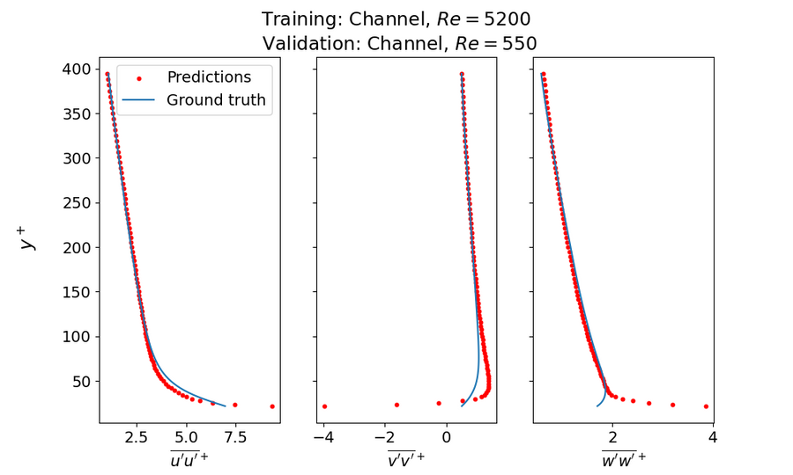
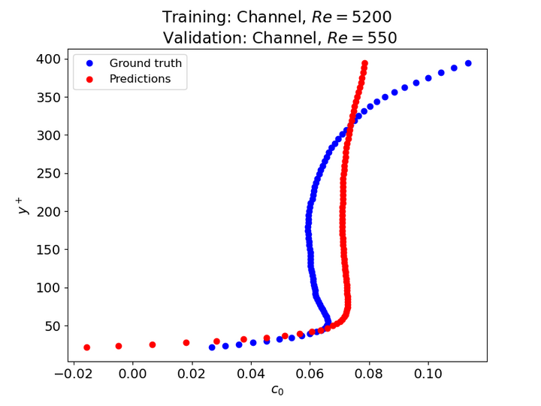
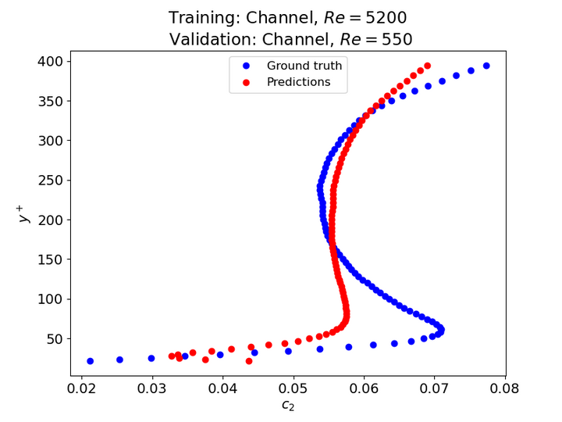
Problem 1
Training data: Channel flow, Re=5200
Test data: Channel flow, Re=550
Boundary layer flow
c0_error_std: 0.13163381867799723
c2_error_std: 0.11127585071401527
[1]. T. J Craft, B.E Launder, K.Suga, Prediction of turbulent transitional phenomena with a nonlinear eddy-viscosity model

Slide 8
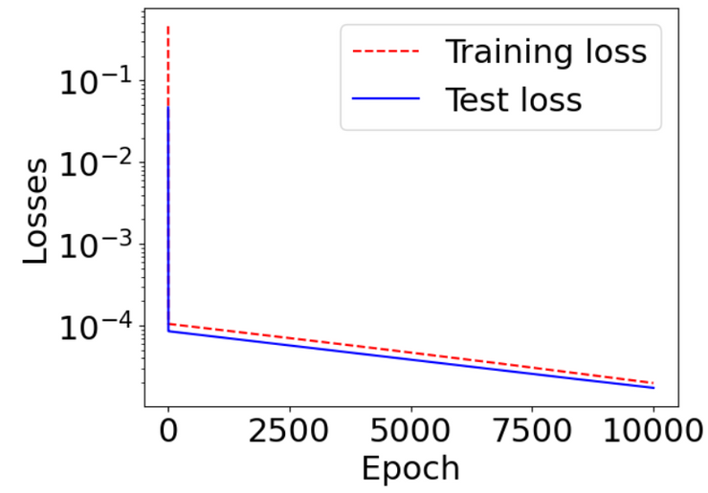
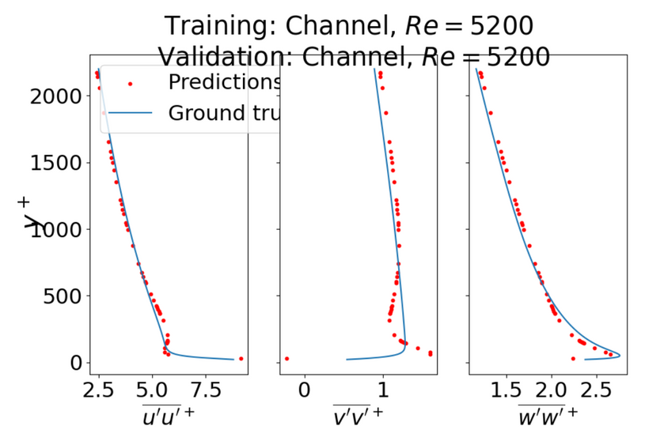
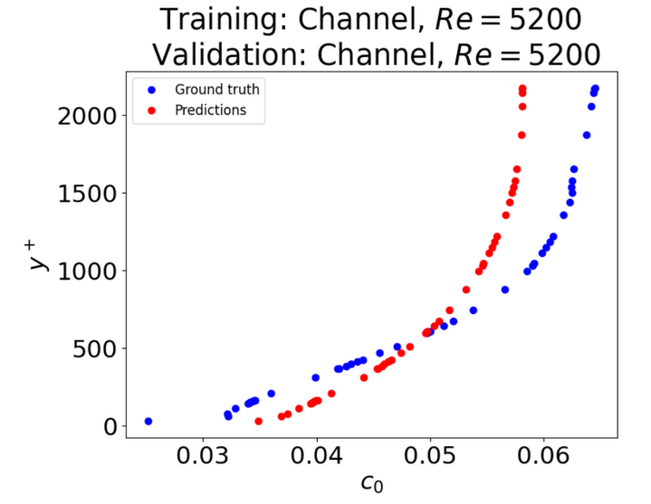
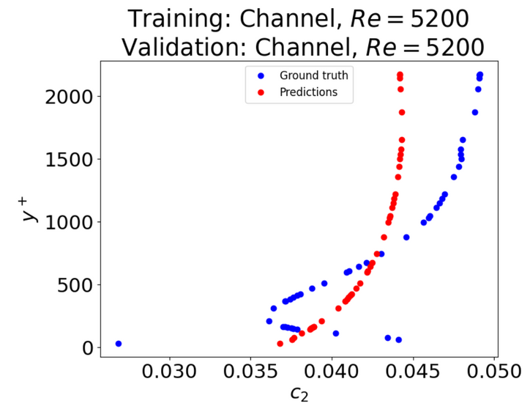
Problem 2a
Changing the input parameters
Original inputs:
(δu/δy)
(δu/δy)
New input:
ν
2
+
t
-1
Training data: Channel flow, Re=5200
c0_error_std: 0.09458814667571756 c2_error_std: 0.08363659402944848
[1]. T. J Craft, B.E Launder, K.Suga, Prediction of turbulent transitional phenomena with a nonlinear eddy-viscosity model

Slide 9
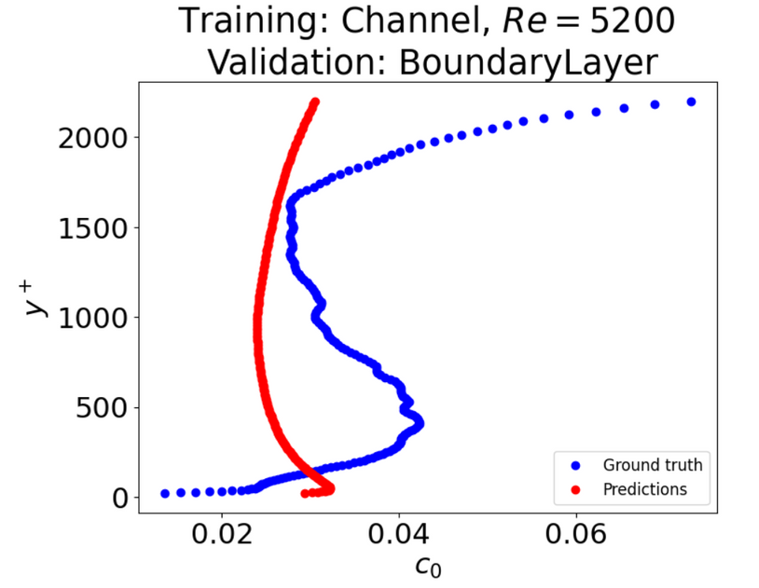
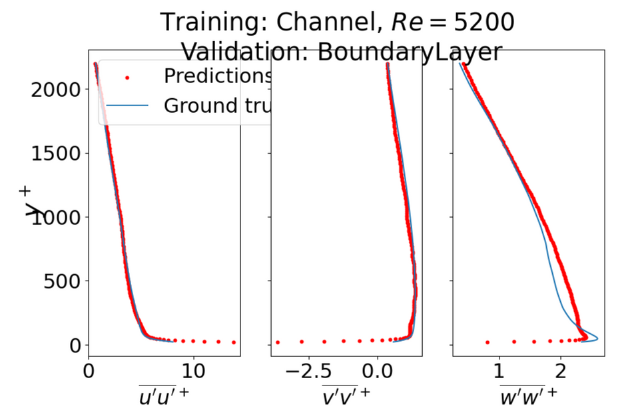
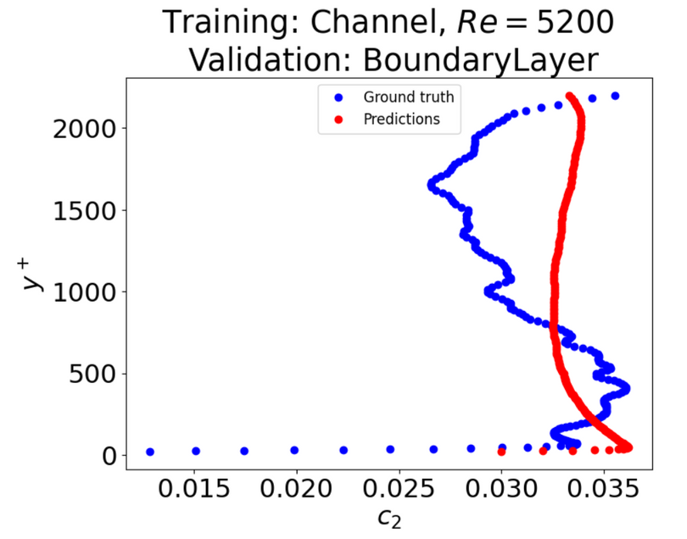
Problem 2a
Changing the input parameters
Original inputs:
(δu/δy)
(δu/δy)
New input:
ν
2
+
t
-1
Test data: Boundary layer flow
c0_error_std: 0.34764412879475376 c2_error_std: 0.1078409454966377
[1]. T. J Craft, B.E Launder, K.Suga, Prediction of turbulent transitional phenomena with a nonlinear eddy-viscosity model

Slide 10
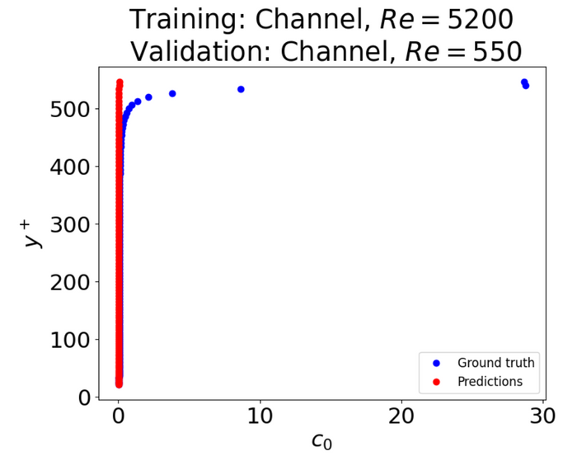
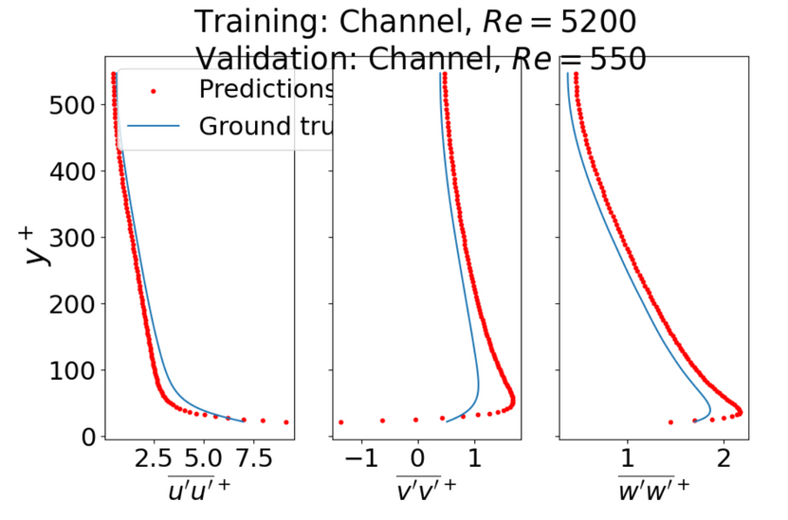
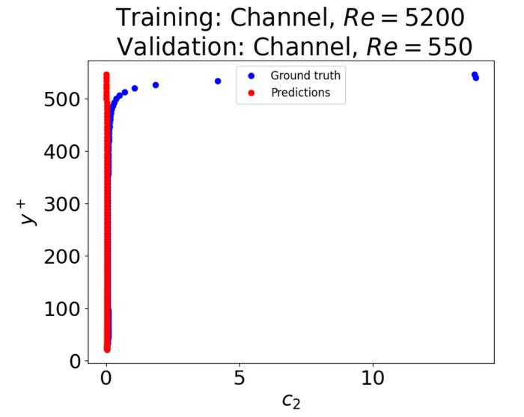
Problem 2a
Changing the input parameters
Original inputs:
(δu/δy)
(δu/δy)
New input:
ν
2
+
t
-1
Test data: Channel flow, Re=550
c0_error_std: 116.69517771821643
c2_error_std: 60.379621985309576
[1]. T. J Craft, B.E Launder, K.Suga, Prediction of turbulent transitional phenomena with a nonlinear eddy-viscosity model

Slide 11

Problem 2b
Instead of given Neural Network, Random Forest Regressor has been employed
Errors don’t decrease, but the training time has decreased significantly
PyTorch:
10 000 epochs: 7min 8sec
20 000 epochs: 13min 57sec
40 000 epochs: 28min 13sec
Random Forest Regressor
100 trees: 0.082sec (5000 times faster)
500 trees: 0.41sec (2000 times faster)
1000 trees: 0.84sec (2000 times faster)
[1]. T. J Craft, B.E Launder, K.Suga, Prediction of turbulent transitional phenomena with a nonlinear eddy-viscosity model

Slide 12
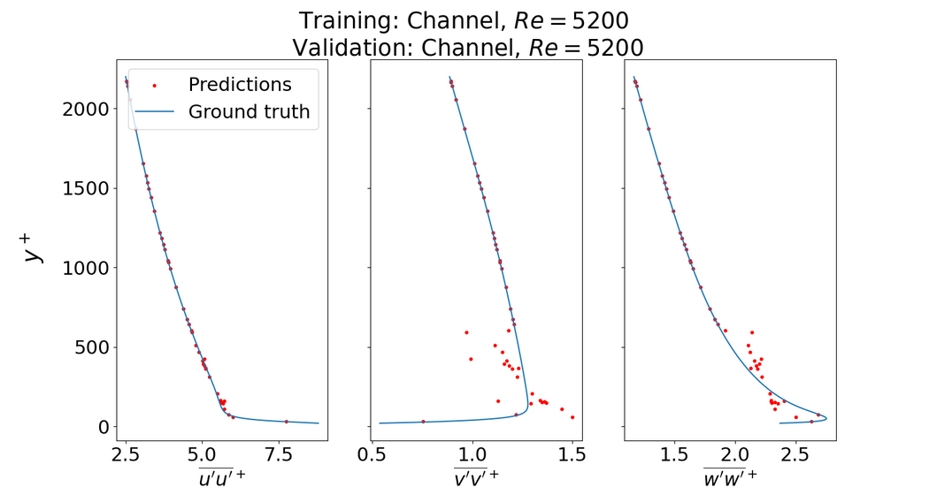
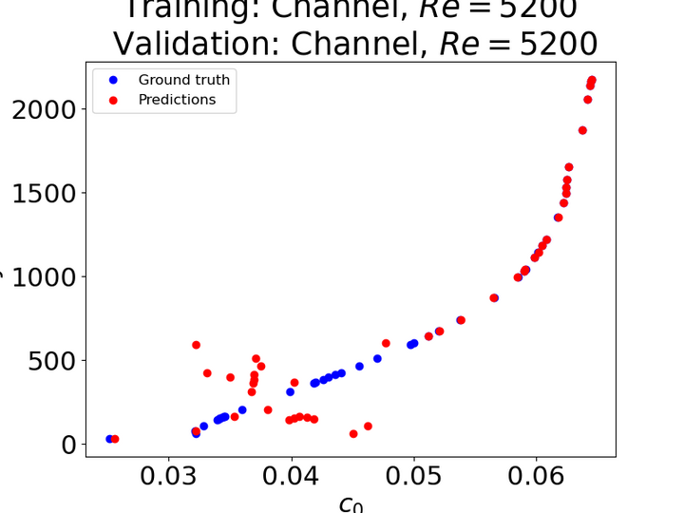
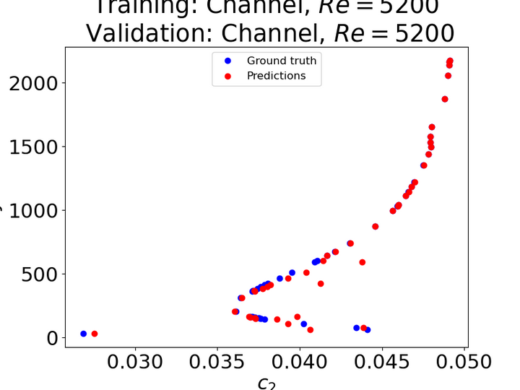
Problem 2b
Training data: Channel flow, Re=5200
Number of trees: 500
c0_error_std: 0.10845525249050589
c2_error_std: 0.02237382863626833
[1]. T. J Craft, B.E Launder, K.Suga, Prediction of turbulent transitional phenomena with a nonlinear eddy-viscosity model

Slide 13
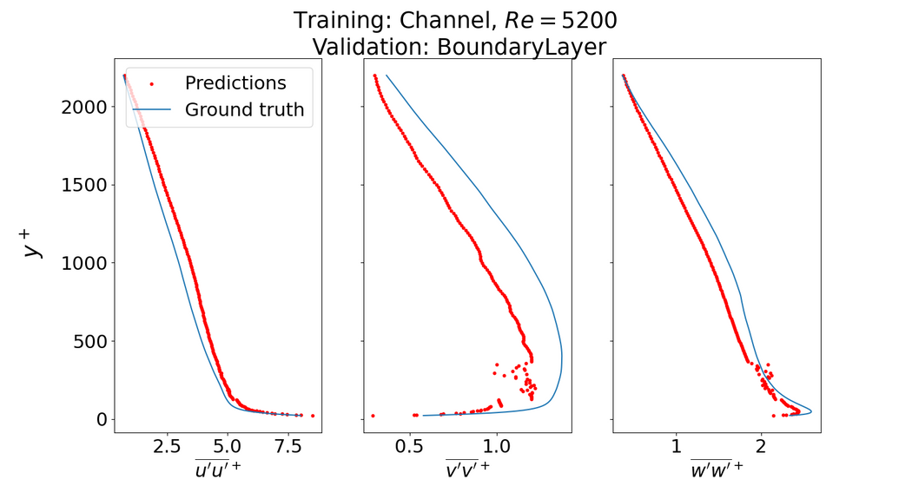
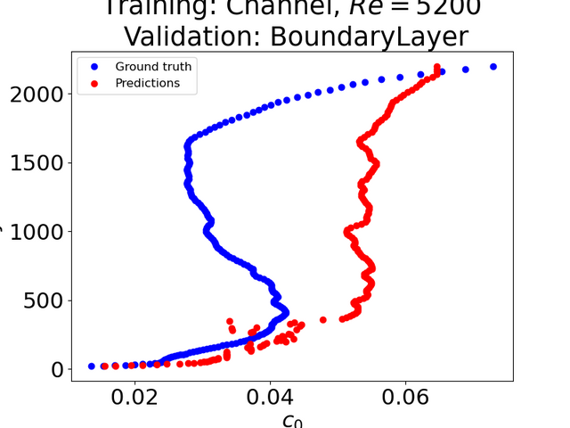
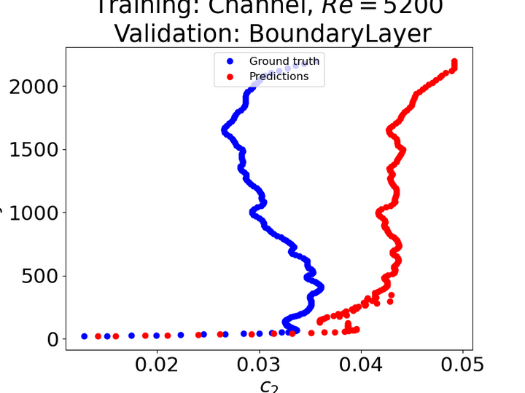
Problem 2b
Test data: Boundary layer flow
Number of trees: 500
c0_error_std: 0.18048327030472788
c2_error_std: 0.11592968646768018
[1]. T. J Craft, B.E Launder, K.Suga, Prediction of turbulent transitional phenomena with a nonlinear eddy-viscosity model

Slide 14
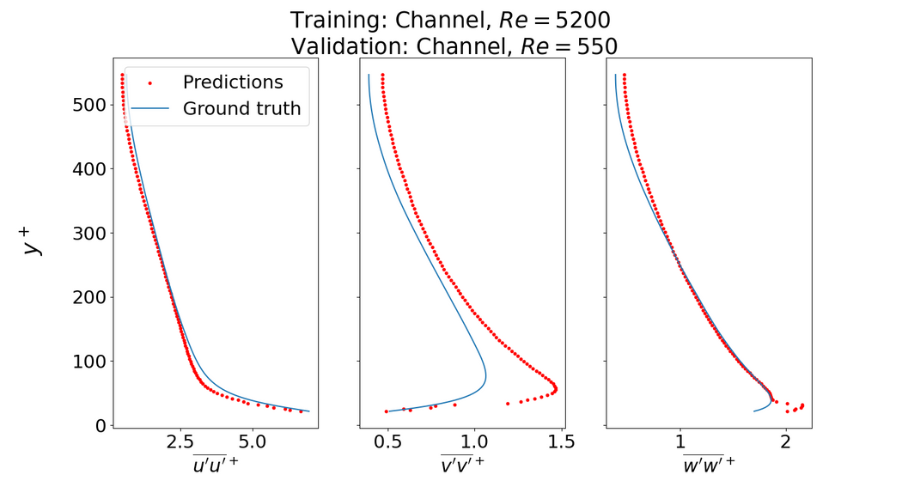
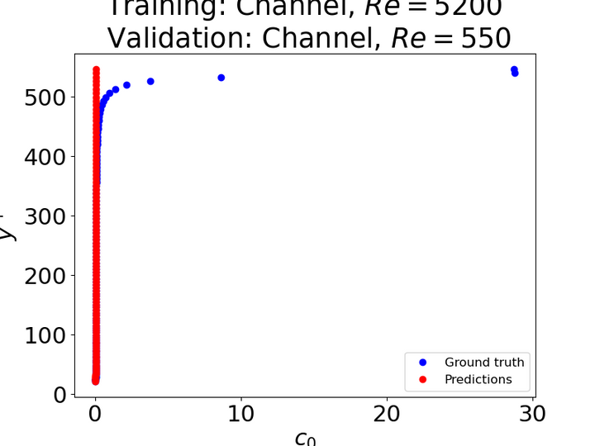
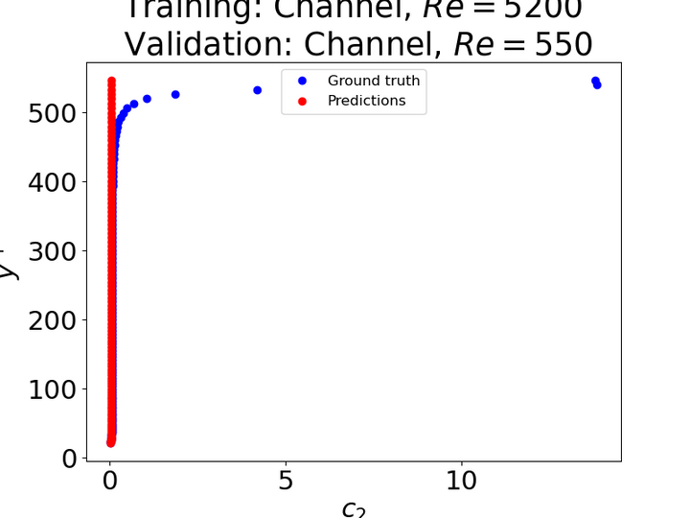
Problem 2b
Test data: Channel flow, Re=550
Number of trees: 500
c0_error_std: 63.486418365375926
c2_error_std: 39.762767953431
[1]. T. J Craft, B.E Launder, K.Suga, Prediction of turbulent transitional phenomena with a nonlinear eddy-viscosity model

Slide 15
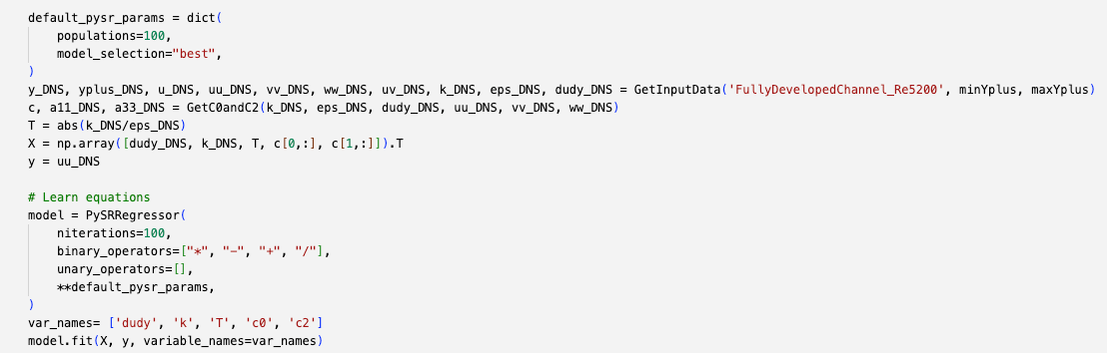
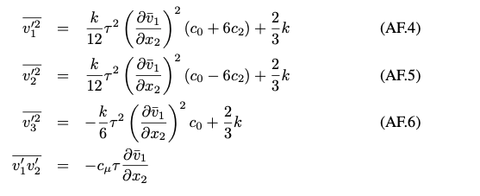
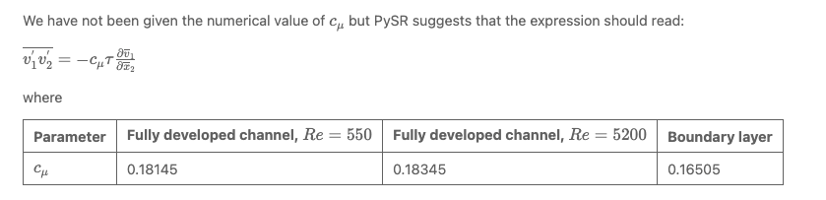
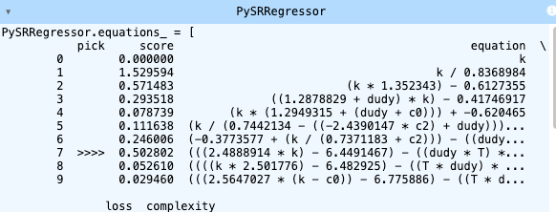
Problem 2d
First evaluation of symbolic regression using PySR. PySR is an open-source library for practical symbolic regression, a type of machine learning which aims to discover human-interpretable symbolic models. [1]
[1] Cranmer, Interpretable Machine Learning for Science
with PySR and SymbolicRegression.jl

Slide 16
Thank you for your attention!
Link to repository:
https://github.com/kne911/turbML

