Slide 1
MACHINE LEARNING · COURSE PROJECT · FINAL PRESENTATION
Why Do Lottery Tickets Need Learning-Rate Warmup?
We tested sharpness and weight correlation as explanations. Neither holds: high learning rates break the mask that pruning selects, not the training of a good mask.
SETTING
DESIGN
ResNet-20 · CIFAR-10 · iterative magnitude pruning to 6% of weights · 2 seeds
4 learning-rate conditions + a pre-registered causal test with the mask held fixed
Nitai S Koundinya · Umair Ahmed Nawaz
October 2026

Slide 2
RESEARCH QUESTION
Frankle & Carbin (2019): deep networks yield winning tickets only at a small learning rate or with warmup. Is that because high-LR training crosses the stability limit (sharpness), or because it decorrelates weights from θ₀ (Liu et al. 2021)?
H1 · Replicate
H2 · Stability ratio
Tickets win at η = 0.01 and with warmup, lose at η = 0.1
Tickets fail where S = η·λmax / (2+2β) reaches ≈ 1 early on
H3 · Warmup mechanism
H4 · Causal test
Warmup keeps S below 1 as the ticket advantage returns
Fix good masks, train at η = 0.1: does SAM or an L2 anchor to θ₀ rescue them?
S = 1 is the edge of stability for SGD with heavy-ball momentum β = 0.9 (Cohen et al. 2021; Kalra & Barkeshli 2024).
2

Slide 3
METHOD
Iterative magnitude pruning with a sharpness probe in every run
1 · Init θ₀
2 · Train θ₀⊙m
3 · Evaluate
4 · Prune 30%
5 · Reset to θ₀
saved exactly
15k steps, log λmax, S
acc, F1, AUC, R₀.₂
global magnitude
repeat ×8 → 6%
Condition | η | Warmup | Role
low | 0.01 | none | tickets expected to win
high | 0.1 | none | tickets expected to fail
warm03 | 0.03 | linear, 10k steps | Frankle's successful ResNet setting
high_warm | 0.1 | linear, 10k steps | same peak rate as high, with warmup
Baselines at every mask: random reinit and shuffled θ₀ (same layer-wise weights). Ticket advantage = ticket − best trained baseline. Winning ticket = advantage > 0 (2 seeds: > 2 SE) and accuracy within 0.5 pp of dense.
Sharpness: λmax by 10-step Lanczos on 2,048 images, 15 points per run; H2 uses max S over steps 25–3,000. Correlation: R₀.₂ = overlap of the top-20% weights of θ₀ and θ_T (chance ≈ 0.2).
ResNet-20 (0.27 M params) · SGD momentum 0.9 · batch 128 · LR ×0.1 at 10k and 12.5k · one T4 GPU, 3 runs in parallel under MPS.
3

Slide 4
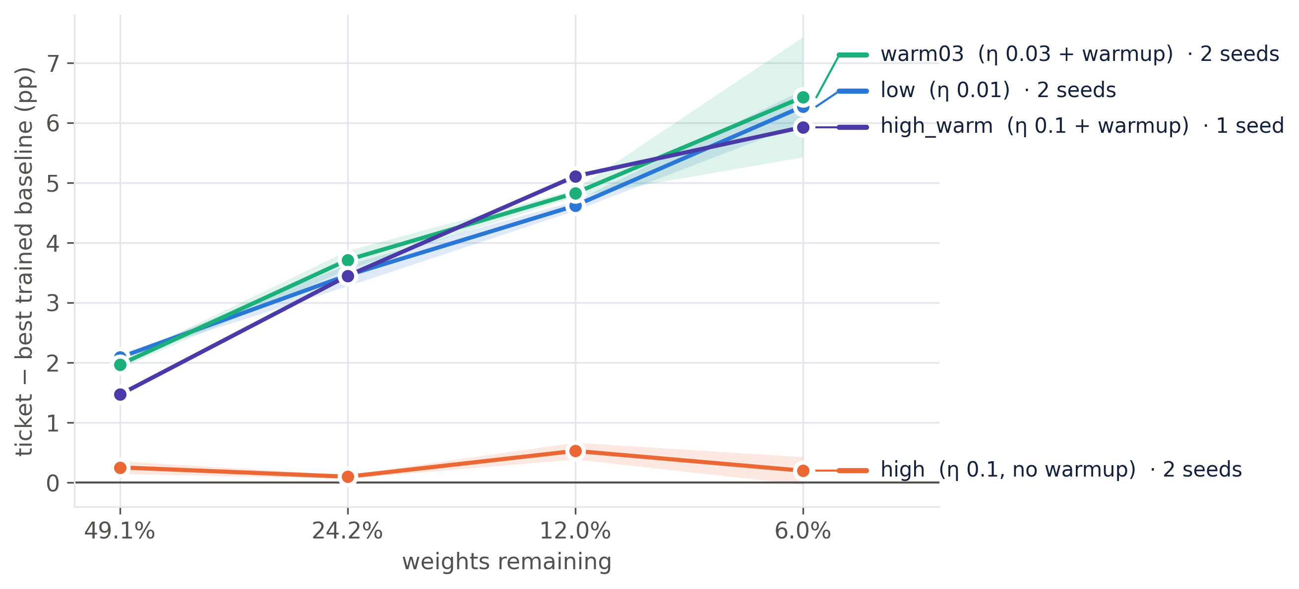
H1 · REPLICATION — SUPPORTED
Tickets win everywhere except at η = 0.1 without warmup
Two seeds agree
low: +2.1 → +6.3 pp
warm03: +2.0 → +6.4 pp
high: ≤ +0.5 pp, tickets 0.8–7.2 pp below dense: 0/4 winning
Warmup restores it
Same peak η = 0.1 with warmup (high_warm): +1.5 → +5.9 pp, 3/4 winning.
Dense high is the most accurate network (89.7%), so this is not a weak baseline.
Advantage = ticket − best trained baseline at the same mask. Bands: ± 1 SE over seeds. Gate A passed on both seeds.
4

Slide 5
RESULTS · TEST METRICS
Dense networks and tickets at 34.5% and 6.0% of weights
Condition | Network | Accuracy % | Precision % | Recall % | F1 % | AUC
low | dense | 86.57 ± 0.13 | 86.59 | 86.57 | 86.56 | 0.9894
 | ticket 34.5% | 88.00 ± 0.18 | 87.99 | 88.00 | 87.98 | 0.9915
 | ticket 6.0% | 86.18 ± 0.06 | 86.15 | 86.18 | 86.12 | 0.9888
high | dense | 89.69 ± 0.20 | 89.66 | 89.69 | 89.67 | 0.9933
 | ticket 34.5% | 88.23 ± 0.18 | 88.21 | 88.23 | 88.20 | 0.9918
 | ticket 6.0% | 82.54 ± 0.25 | 82.48 | 82.54 | 82.46 | 0.9830
warm03 | dense | 87.64 ± 0.23 | 87.62 | 87.64 | 87.62 | 0.9907
 | ticket 34.5% | 88.79 ± 0.37 | 88.77 | 88.79 | 88.76 | 0.9925
 | ticket 6.0% | 87.43 ± 0.60 | 87.40 | 87.43 | 87.38 | 0.9907
high_warm | dense | 89.46 | 89.49 | 89.46 | 89.46 | 0.9932
 | ticket 34.5% | 90.30 | 90.30 | 90.30 | 90.29 | 0.9943
 | ticket 6.0% | 88.35 | 88.39 | 88.35 | 88.35 | 0.9924
Test set, 10,000 images · macro precision / recall / F1 · macro one-vs-rest ROC-AUC · mean ± SD over 2 seeds (high_warm: 1 seed).
5

Slide 6
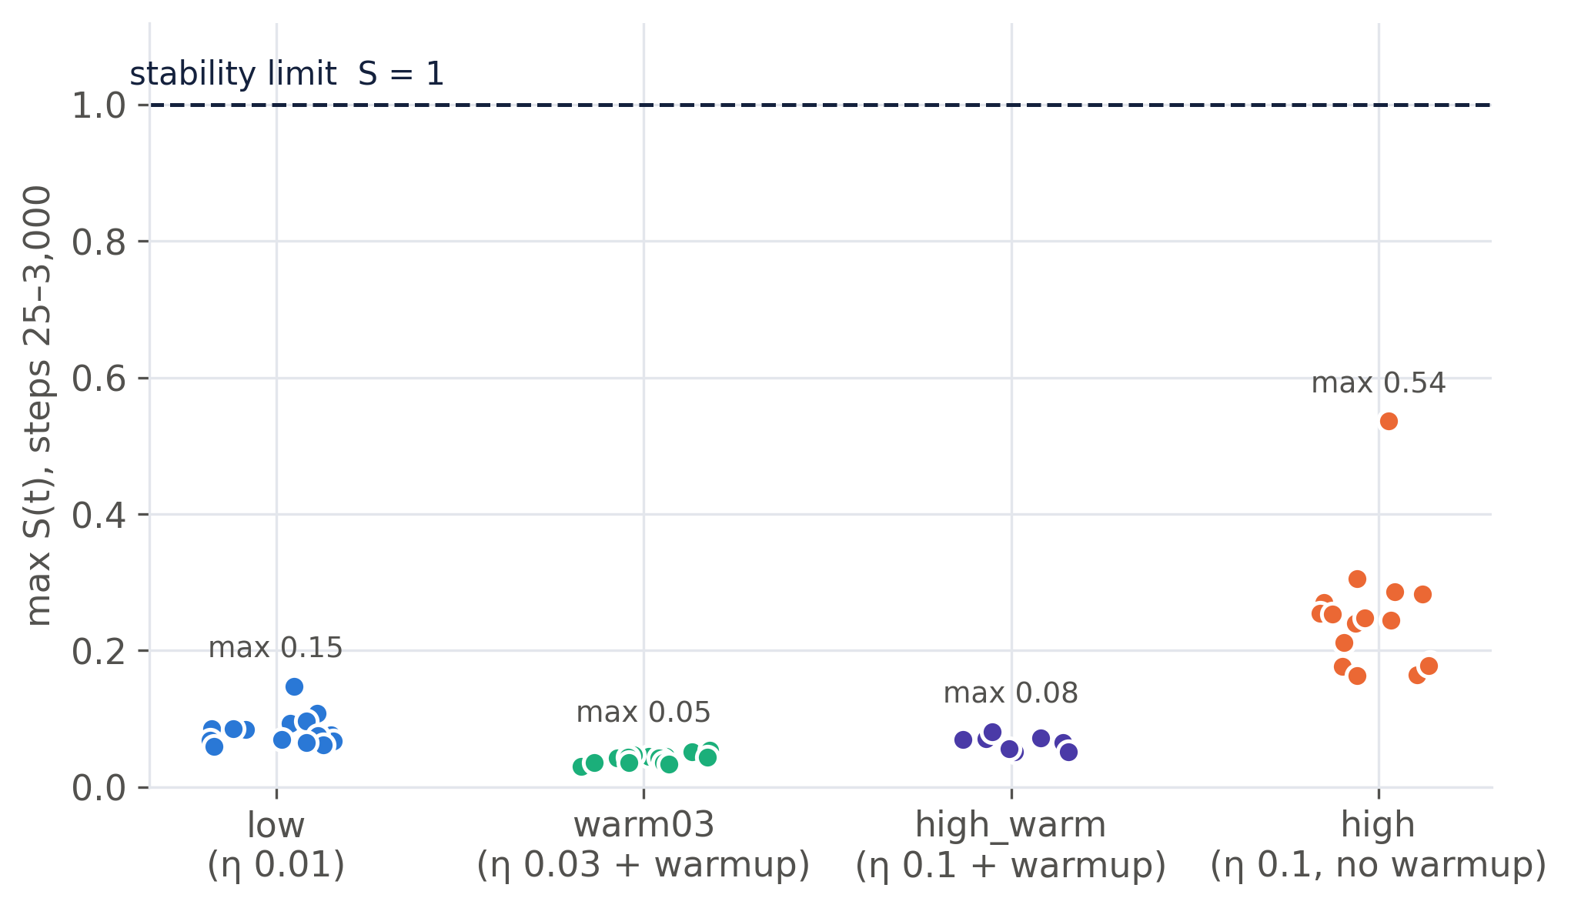
H2 · STABILITY RATIO — NOT SUPPORTED
No ticket comes near the stability limit
What fails
Max S over 105 runs is 0.54; failing tickets peak at 0.16–0.54.
Within a condition S does not order the tickets (high: ρ = +0.26).
What holds
Only the failing condition has an early spike (max at step 25 in 15/18). Correlation, not yet cause.
Caveat: with momentum the step-0 threshold is 2/λ (Kalra & Barkeshli 2024); dense high starts above it and still trains normally.
6

Slide 7
H3 · WARMUP MECHANISM — PARTLY SUPPORTED
Warmup removes the spike, but that is not what it fixes
The coincidence holds
✓
S < 1 does not discriminate
✗
Confounded
At η = 0.1, warmup brings the advantage back: 3/4 winning vs 0/4.
It removes the step-25 spike: S ≤ 0.003 vs 0.13–0.54.
high also stays below 1.
By step 9,000 both runs sit on the same plateau: λmax 1.1–1.7, S 0.03–0.04.
Warmup first lets λmax grow (25 → 53), as Kalra & Barkeshli predict.
Warmup also keeps more weight correlation (dense R₀.₂ 0.33 vs 0.25).
It halves the mean LR over the first 10k steps.
Only fixing the mask separates these. → H4
Warmup changes three things at once: the early sharpness spike, weight correlation and the mean learning rate. Phase A cannot say which one matters.
high_warm: seed 0 only.
7

Slide 8
H4 · CAUSAL TEST — DESIGN
Hold warmup's good masks fixed and change only the training
(a) plain
(b) SAM, ρ = 0.05
(c) L2 anchor to θ₀
η = 0.1, no warmup
Does a good mask still win under high-LR training?
Lowers sharpness, leaves correlation
Rescue here → sharpness story
(λ/2)·‖m⊙(θ − θ₀)‖², λ = 0.01 (chosen to match low's R₀.₂)
Rescue here → correlation story
PRE-REGISTERED RULE (committed before any H4 result)
Rescue = ticket − shuffle ≥ +2.0 pp at ≥ 2 of 3 masks, and the intervention must move its target variable vs (a).
Masks: warm03 seed 0 at 34.5%, 12.0%, 6.0%. The failing high chain never exceeds +0.7 pp, so the bar is well above failure.
Each mask trained as ticket (θ₀⊙m) and shuffle (θ₀ permuted within each layer over the mask): 18 trainings, SAM at 2× cost.
8

Slide 9
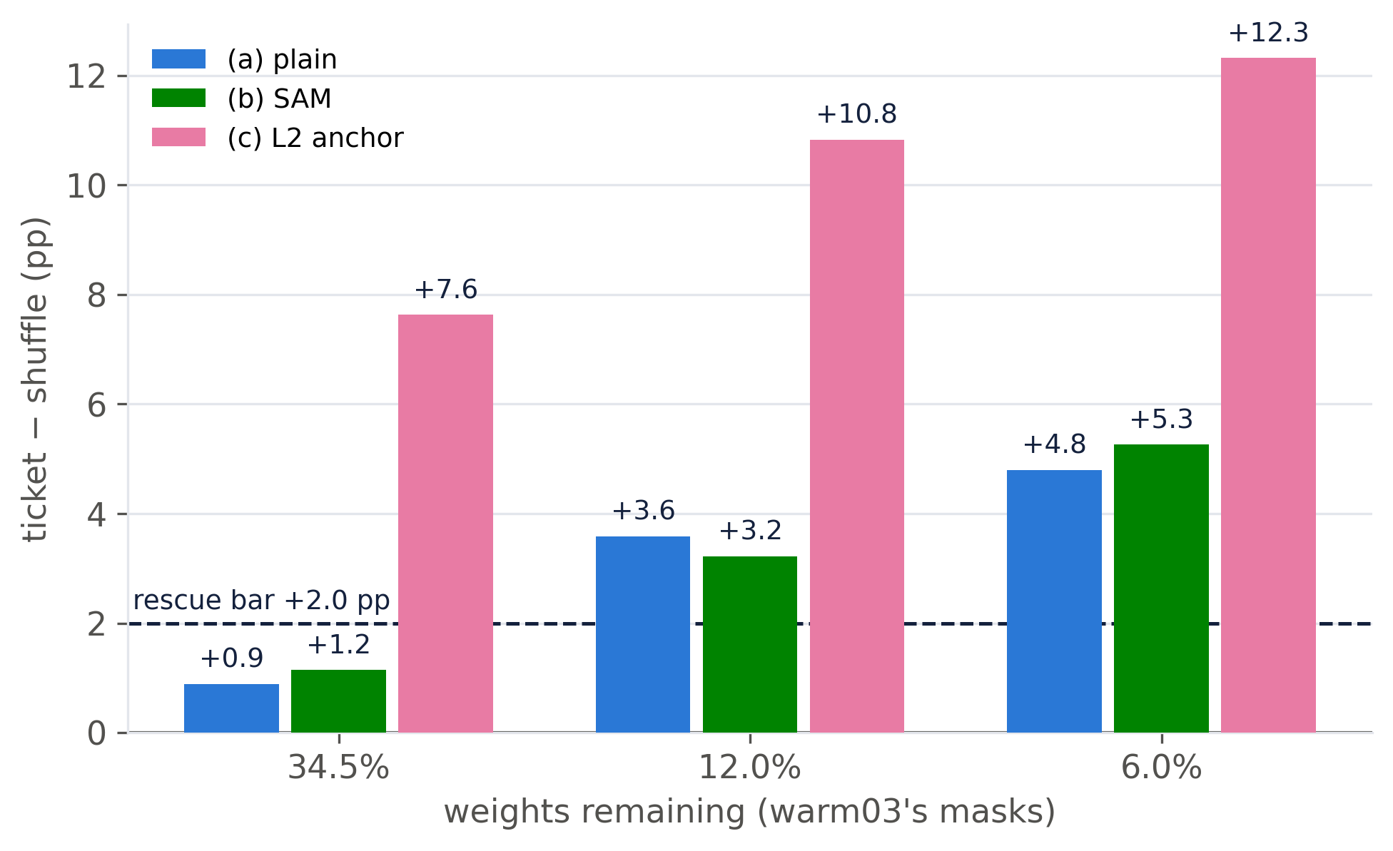
H4 · RESULT
The good masks already win at η = 0.1. There is nothing to rescue
(a) plain
WINS
+3.6 and +4.8 pp: 2/3 over the bar.
(b) SAM
NO EFFECT
S lowered at 3/3 masks; advantage moves ≤ 0.5 pp.
(c) anchor
HURTS
Ticket −3 pp, shuffle −10 pp vs (a). Not a better ticket.
Seed 0. Ticket accuracy, (a): 89.27 / 88.91 / 87.24%.
9

Slide 10
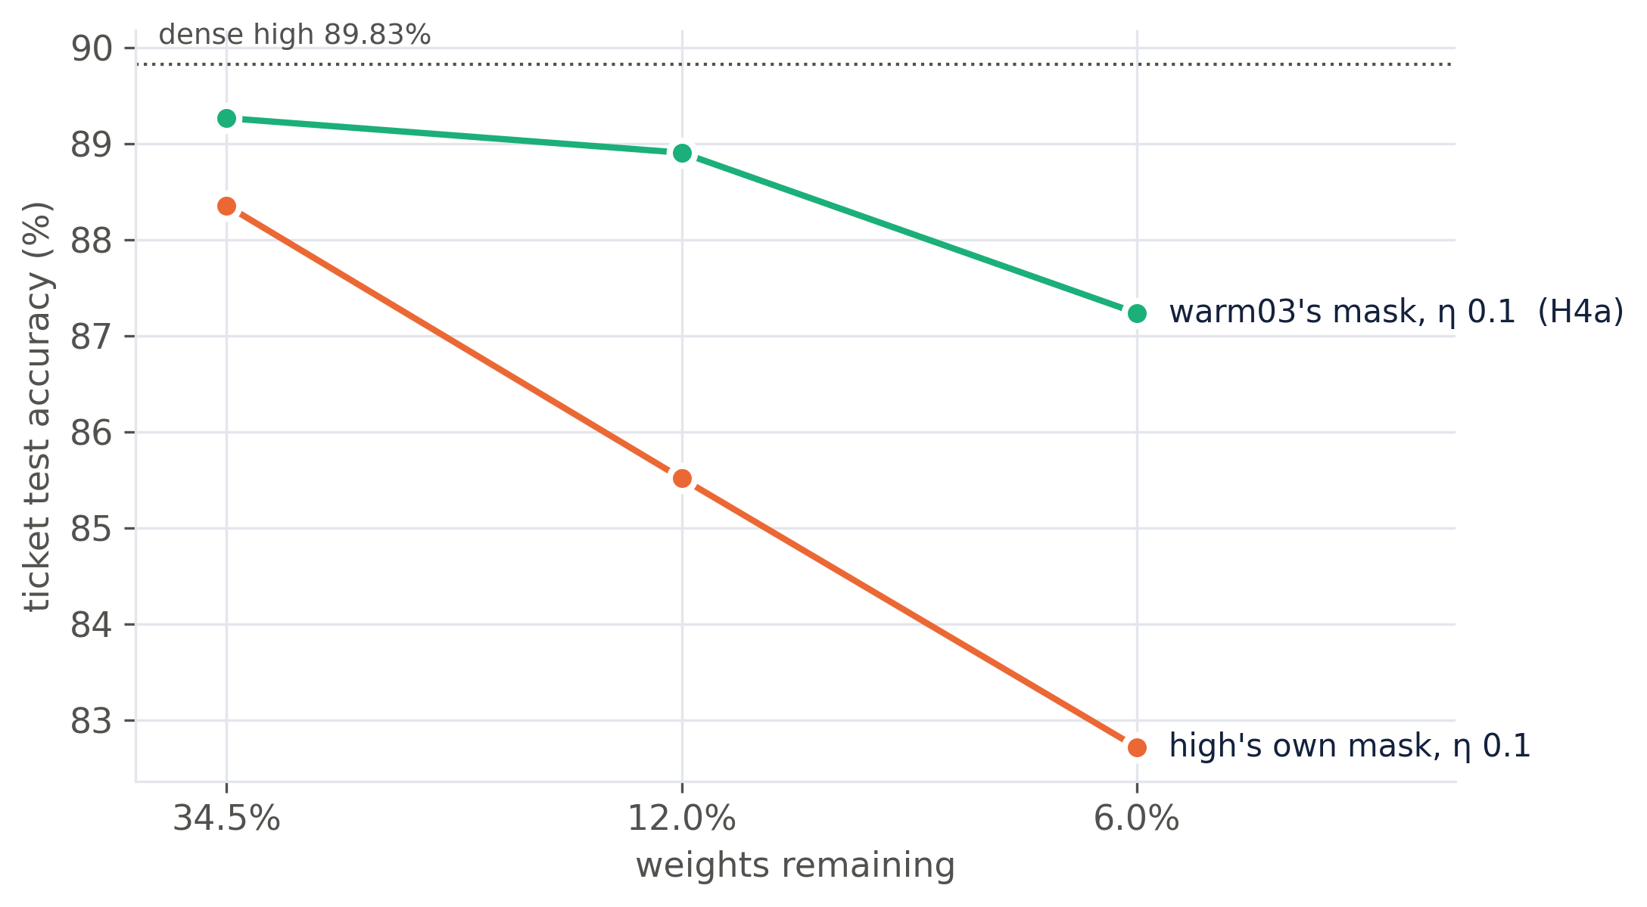
H4 · INTERPRETATION
Same training, different mask: the mask decides
Under identical training
η = 0.1, no warmup, same θ₀:
warm03's 6% mask 87.2%, high's own 6% mask 82.7%.
Shuffled controls equal (82.4 vs 82.2%).
Both stories fail
Spike present (S 0.24–0.34) and R₀.₂ at chance (0.18–0.20), yet the ticket wins.
high and warm03 seed 0 share θ₀ bit for bit: the green and orange lines differ only in the mask, the orange and violet only in warmup.
10

Slide 11
FOLLOW-UPS · PRE-REGISTERED
Does it replicate, and does warmup rescue a bad mask?
 | 34.5% | 12.0% | 6.0% | ≥ +2 pp | Verdict
(a) seed 0 · warm03 mask, η 0.1 | +0.89 | +3.59 | +4.80 | 2/3 | wins
F1 · (a) on seed 1 masks + θ₀ | pending | pending | pending | 0/0 | pending
high chain · own masks, η 0.1 | — | +0.39* | +0.57 | 0/2 | fails
F2 · high's masks + warmup | pending | pending | pending | 0/0 | pending
F1 · replication
F2 · reverse swap
Same experiment as (a) on an independent seed: warm03 seed 1's masks and θ₀.
Advantage pending / pending / pending pp → pending.
high's own masks, trained with warmup at η = 0.1 (high_warm schedule).
Ticket pending / pending / pending% vs 88.36 / 85.52 / 82.72% without warmup → pending.
Ticket − shuffle (pp). *high chain at 12.0%: vs reinit (no shuffle run there). Rule as in H4, fixed before the runs started.
11

Slide 12
VERDICTS
High learning rates break the mask, not the training
H1 · Replicate
H2 · Stability ratio
SUPPORTED
NOT SUPPORTED
2 seeds: +2 to +6.4 pp at η 0.01 / warmup; ≤ +0.5 pp at η 0.1
max S 0.54 ≪ 1; the early spike is not causal (H4)
H3 · Warmup mechanism
H4 · Causal test
PARTLY
MASK, NOT DYNAMICS
Coincidence holds; a good mask needs no warmup to train
Good masks win at η 0.1; SAM no effect; anchor hurts
Fits Paul et al. (2023): an IMP mask encodes the training run that produced it. Warmup matters while the mask is being found.
12

Slide 13
LIMITATIONS & NEXT STEPS
What this study cannot say yet
Limitations
Next steps
Seeds: 2 for the main conditions, 1 for high_warm, SAM and the anchor.
Good masks at η = 0.1 still sit 0.6–2.6 pp below dense: some LR cost survives.
Shortened protocol: 15k steps, 30% per round, no rewinding, one model and dataset.
Sharpness at 15 points per run; the minibatch stability threshold was not measured.
One strength each for SAM (ρ 0.05) and the anchor (λ 0.01).
Switch η mid-chain to find the IMP round where masks go bad.
Compare high vs warm03 masks directly: layer-wise density, overlap.
Learning-rate rewinding (Frankle et al. 2020), known to restore tickets at high η: does it work by fixing the mask?
13

Slide 14
CONCLUSION
Lottery tickets fail at high learning rates because iterative magnitude pruning picks worse masks, not because training becomes unstable or loses its correlation with θ₀.
A pre-registered causal test, with the mask held fixed, separated three explanations that the observational data could not.
Code, configs, every run and both write-ups: github.com/kneat2448/LTH-ML-final
Nitai S Koundinya · Umair Ahmed Nawaz
Thank you · questions welcome

