Slide 1
Cache effective mergesort and quicksort
Nir Zepkowitz
Based on: “Improving Memory Performance of Sorting Algorithms” by Li Xiao, Xiaodong Zhang, Stefan A. Kubricht

Slide 2
The Goal
Optimize the performance of mergesort and quicksort.
We do this by restructuring them.

Slide 3
What we saw already
The algorithms we saw tried to reduce capacity misses on direct-mapped caches.
The new algorithms will try to reduce other types of cache misses, such as conflict misses and TLB misses

Slide 4
What do we use
For the best optimization the algorithms use both tilling and padding techniques, data set repartitioning and knowledge of the processor HW (such as cache and TLB association).

Slide 5
Parameter usage
We will work with generic unit element to specify the cache capacity.
N: the size of the data set.
C: the data cache size.
L: the size of a cache line.
K: the cache associativity.
Ts: the number of entries in a TLB set.
K_{TLB}: the TLB associativity.
Ps: the size of a memory page.

Slide 6
Old mergesort – Tiled mergesort
First phase: subarrays of length C/2 (half the cache size) are sorted by the base mergesort.
Second phase: use base mergesort to complete the sorting of the entire data set.
the first phase allows the algorithm to avoid capacity misses and to fully use the data that is loaded in the cache.

Slide 7
Old mergesort - multimergesort
The first phase: like tiled mergesort
The second phase: a multiway merge method is used to merge all the sorted subarrays together in a single pass.
We do that by holding the heads of the lists (the sorted subarrays) to be merged.

Slide 8
areas for improvement
The algorithms significantly reduce capacity misses but do not sufficiently reduce the conflict misses. In cache with low associativity, mapping conflicts occur frequently among the elements in the three subarrays (the target and the two sources).
Reducing the TLB misses is not considered. TLB misses can severely damage the execution performance.

Slide 9
Tiled mergesort - the problem
In the second phase of Tiled mergesort, pairs of sorted subarrays are sorted and merged into a destination array.
At each time we are holding three elements two sources and one target element.
These three data elements can potentially be in conflicting cache blocks because they may be mapped to the same block in a direct-mapped cache and in 2-way associative cache.

Slide 10
Tiled mergesort with padding
we insert L elements (or a spacing the size of cache line) to separate every section of C elements in the data set in the second phase of the tiled mergesort.
These padding elements can significantly reduce the cache conflicts.
The extra memory is trivial when compared to the size of the data set.

Slide 11
Multimergesort – The problem
In the second phase of the multimergesort, the multiple subarrays are completely sorted in a single pass.
this is done by using a heap structure for each of the subarrays.
However, the working set is much larger than that of the base mergesort. This large working set causes TLB misses which degrade performance.

Slide 12
TLB - reminder
The TLB is a special cache that stores most recently used virtual-physical page translation for memory access.
A TLB cache miss forces the system to retrieve the missing translation from the page table in the memory, and then to replace an existing TLB entry with this translation.

Slide 13
Multimergesort with TLB padding
In the second phase of multimergesort, we insert P_{S} elements (or a page space) to separate every sorted subarray in the data set in order to reduce or eliminate the TLB cache conflict misses.
The padding changes the base address of these lists in page units to avoid potential TLB conflict misses.

Slide 14
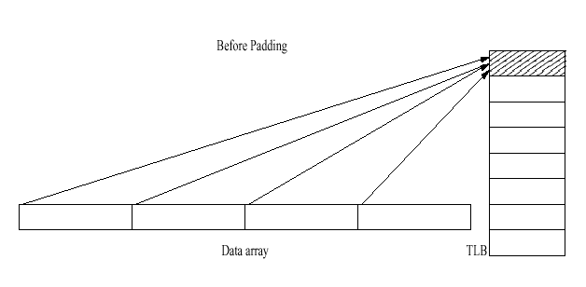

Slide 15
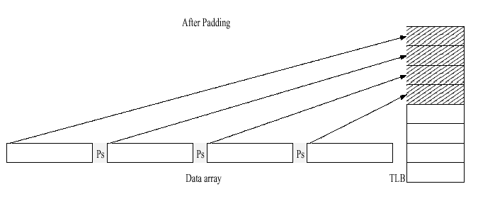

Slide 16
Trade offs
The algorithm increases the instruction count, because we need to move the elements.
This leads to additional CPU cycles.
But, Memory accesses are far more expensive than CPU cycles.

Slide 17
Measurement results
Tiled mergesort with padding is highly effective in reducing conflict misses on machines with direct-mapped caches.
Multimergesort with TLB padding performs very well on all types of architecture.

Slide 18
Old quicksort: memory-tuned quicksort
a modification of the basic quicksort.
Instead of saving small subarrays to sort in the end, the memory-tuned quicksort sorts these subarrays when they are first encountered in order to reuse the data elements in the cache.

Slide 19
Old quicksort - Multiquicksort
Divides the full data set into multiple subarrays, with the hope that each subarray will be smaller than the cache capacity.
The performance gain of these two algorithms from experiments reported is modest.

Slide 20
The challenge
In practice, the quicksort algorithms exploit cache locality well on balanced data sets.
These algorithms were not efficient in unbalanced data sets.
The challenge is to make quicksort perform well on unbalanced data sets.

Slide 21
Flash quicksort
A combination of flashsort and quicksort.

Slide 22
Flashsort
The maximum and the minimum values are first identified in the data set to identify the data range.
The data range is then evenly divided into classes to form subarrays.

Slide 23
Flashsort…
Three steps:
“classification” to determine the size of each class.
“permutation” to move each element into its class by using a single temporary variable to hold the replaced element.
“straight insertion” to sort elements in each class by using insertion sort.

Slide 24
Flashsort (cont.)
If the data set is balanced the sizes of the subarrays after the first two steps are similar and small enough to fit in the cache.
However, if the data set is unbalanced the sizes of the generated subarrays are disproportionate, causing ineffective usage of the cache, and making flashsort as slow as insertion sort in the worst case.

Slide 25
The good and bad
In comparison with the pivoting process of quicksort, the classification step of flashsort is more likely to generate balanced subarrays, which favors better cache utilization.
Quicksort outperforms insertion sort on unbalanced data sets.

Slide 26
Flash quicksort
By combining the advantages of flashsort and quicksort we make flash quicksort.
The first two stages are as in flash sort (“classification” & “permutation”).
The last step uses quicksort to sort the elements in each class.

Slide 27
Inplaced flash quicksort
An improvement to the flash quicksort.
The only change is in the second phase.
We use an additional array as a buffer to hold the permuted elements.
A cache line usually holds more than one element.
we try to reuse elements in the cache before their replacement.

Slide 28
Measurement results
On balanced data set the performance of memory-tuned quicksort, flash quicksort and implaced flash quicksort is similar with a small advantage to the memory-tuned quicksort.
On unbalanced data set the flash quicksort and the inplaced flash quicksort significantly outperformed the memory-tuned quicksort.

Slide 29
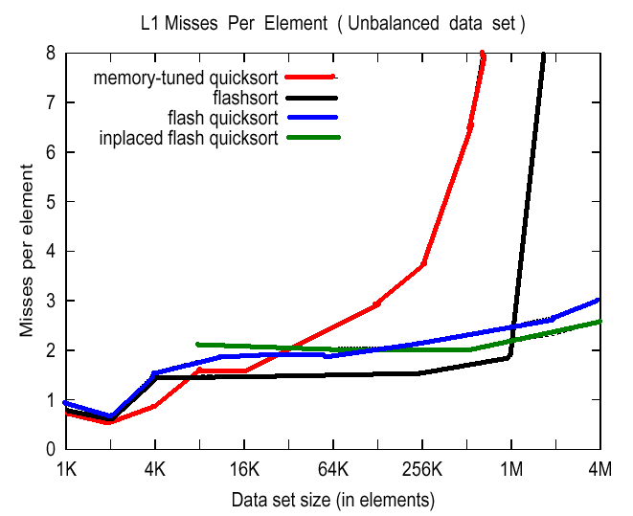

Slide 30
Conclusion
We developed cache-effective algorithms for both mergesort and quicksort.
The technique of padding, partitioning and buffering can also be used for other for optimizations directed at the cache.

Slide 31
Padding
The danger of conflict misses exists whenever a program regularly accesses to a large data set, particularly when the algorithm partitions the data sets in sizes that are power of 2.
Padding is effective for this kind of program to eliminate or reduce conflict misses.

Slide 32
Partitioning
When a program sequentially and repeatedly scans a large data set that can not be stored in the cache in its entirely, the program will suffer capacity misses.
Partitioning the data set based on the cache size to localize the memory used by a stage in execution is effective for this kind of program.

Slide 33
Buffering
The buffering technique is effective to reduce or eliminate conflict misses by using additional buffer to temporarily hold data elements for later reuse that would otherwise be swapped out of the cache.

Slide 34
The End

