Slide 1

Master Lab Course Web Applications: Exercise 4 – Final Presentation
Team 4
Markus Fensterer
Kamil Neczaj
Peter Retzer
Michael Schätzlein
25.02.2013

Slide 2
Idea – ARWars
Massive multiplayer browser game taking place in the real world
Based on Google Maps and Google Places API
Optimized for Desktop-PCs and Smartphones/Tablets
Features
Creation of an augmented reality overlay
Players have to meet at real life places to progress in the game

Slide 3

Rules
Two factions struggle for supremacy
Players assemble into teams
Players capture places available from Google Places
Captured places yield resources
Resources can be used to build units or are necessary to capture special places
Units aid in capturing or defending places

Slide 4

Business Model
Advertisments
Selling decorative objects
Selling organisational services
Competitors
Traditional browser games → Ogame, Droidwars
Persistent mobile multiplayer games → Mobile Mafia
Location-based networks → Foursquare, Google Latitude
Ingress by Niantic Labs (closed beta)

Slide 5








Technology Stack 1/3
Geolocation API
Guice
WebSocket
morphia

Slide 6
Technology Stack 2/3
mongoDB: High performance noSQL-database
morphia: Mapping Java objects to/from MongoDB
WebSocket: Bi-directional communication for the web
akka: Event-driven concurrency framework
Guice: Dependency injection framework
Google Maps/Places API: Map and location data

Slide 7
Technology Stack 3/3
jQueryUI: JavaScript user interface library
Pines Notify: JavaScript notifications for Bootstrap
Geolocation API: Retrieve position from the browser
Bootstrap: Powerful front-end framework
CoffeeScript: Language that compiles into JavaScript

Slide 8
Architecture
Services: Encapsulate business logic
DAOs: Abstract from the database
Views: User interface templates
Models: Represent entities
Controller: Connect business logic, data storage and representation
Actors: Carry out concurrent and asynchronous actions
View
Model
Controller
DAO
Service
Actor

Slide 9
Architecture example: Conquering
index: View for the main interface
ConquerController: Delegates calls from the UI to the services
NotificationService: Sends notifications to players
AuthenticationService: Retrieves the player currently logged in
ConqueringService: Manages conquering attempts, calculates result
PlayerDAO: Responsible for retrieving player-objects from the DB
index
ConquerController
Notification Service
Authentication Service
Conquering Service
Player DAO

Slide 10
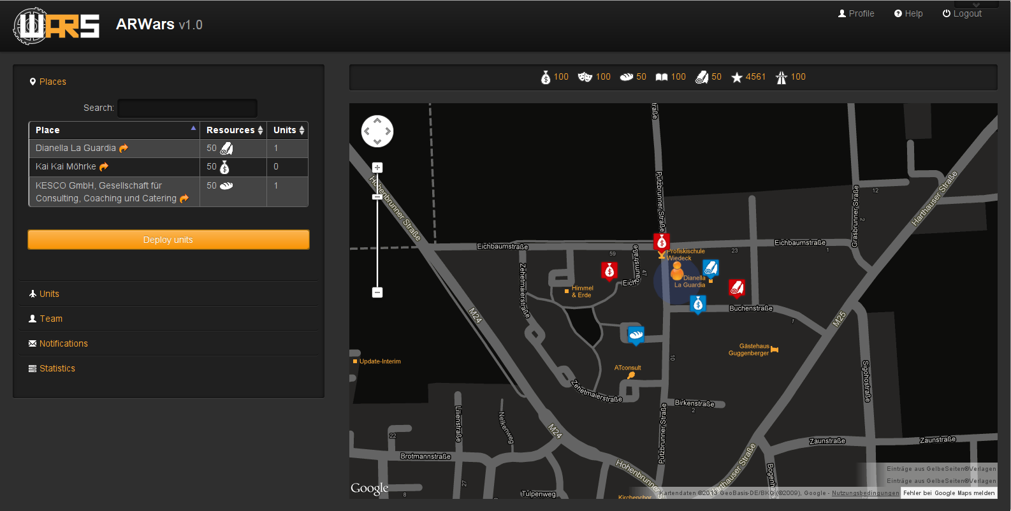
Screenshot Desktop

Slide 11
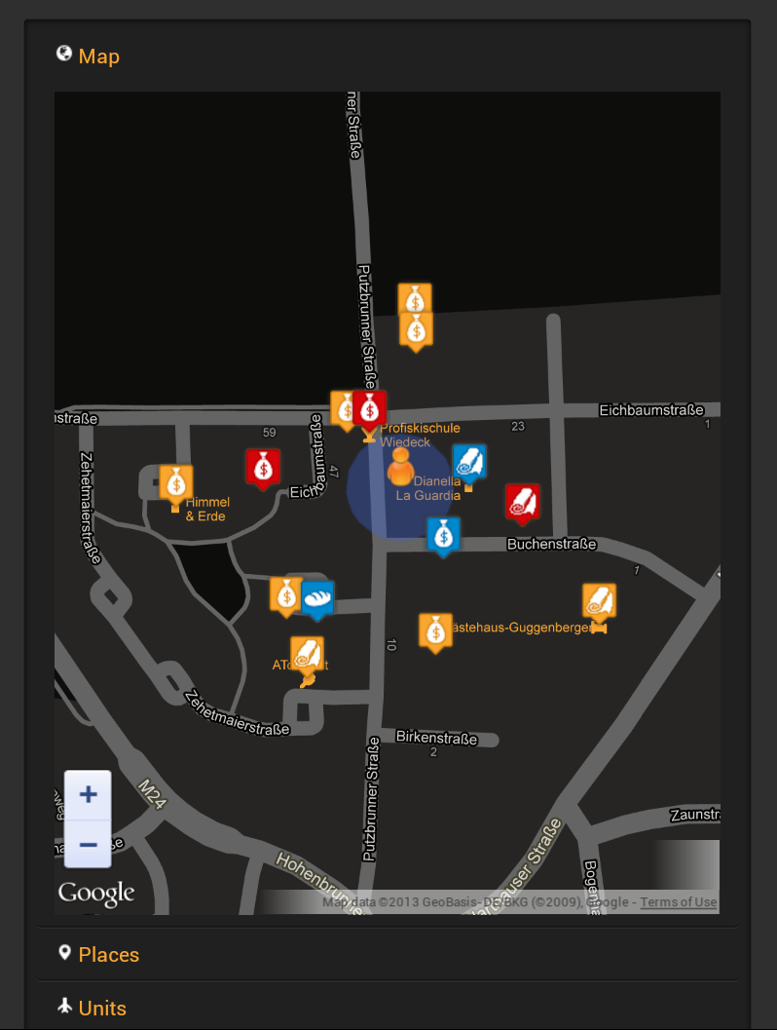
Screenshot Mobile

Slide 12
Demo

Slide 13

Conquering Places
Initiate conquering attempt
Let team members join
Check requirements
number of participants currently nearby the place (150m)
sufficient resources: evenly split across the participants
Inform the initiator
Conduct the battle: result is not known upfront
failure chance of a unit: btw. 5 and 10 percent
strength is uniformly distributed btw. minStrength and maxStrength
Inform participants of result

Slide 14
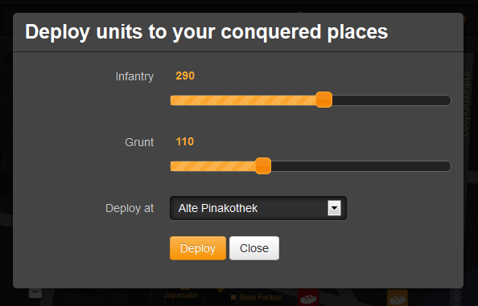
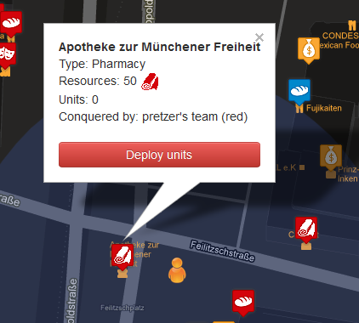
Deploying Units
Player can deploy units to his conquered places to defend them
Deploy menu can be invoked
from sidebar (where the conquered places of the player are listed) or
directly from the place popup window on the map

Slide 15
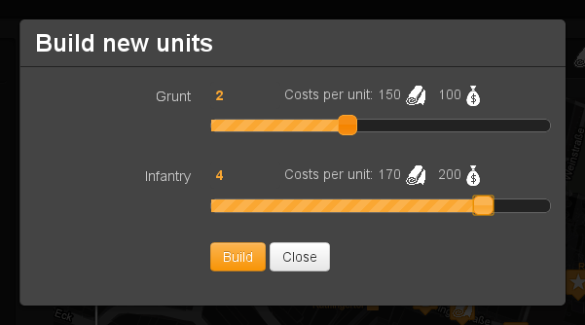
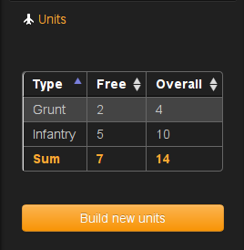
Building Units
Players can use their resources to build units
Total amount of units is limited by the food resource
Units live until they fail at a conquering attempt

Slide 16
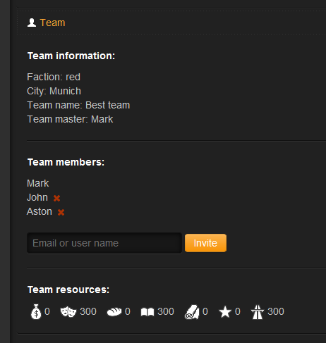
Team management
Team master
Permissions
Who becomes a team master
Actions
Inviting players to the team
Inviting stragers
Deleting players
Changing team name and avatar

Slide 17
Acceptance of an invitation – schema
Team master invites someone
A registred player already belonging to a team
A registred player
before first logging in
Not registered person by email
Invitation is sent to the player’s email address
Invitation is sent to the given email address
The person clicks on the confirmation link in the email to proceed
Redirection to the log-in page if not logged in
Redirection to the registration page
If faction and/or city differs the player is asked to pay for the change
If log in before clicking, the confirmation link the invitation can be accepted from first logging dialog
The player joins the new team

Slide 18
The end

