Slide 1


Master Lab Course Web Applications:
Exercise 4 – Final Presentation
Team 4
Markus Fensterer
Kamil Neczaj
Peter Retzer
Michael Schätzlein
25.02.2013

Slide 2


Idea – ARWars
Massive multiplayer browser game taking place
in the real world
Based on Google Maps and Google Places API
Optimized for Desktop-PCs and Smartphones/Tablets
Features
Creation of an augmented reality overlay
Players have to meet at real life places to progress in the game
25.02.2013
Master Lab Course Web Applications

Slide 3


Rules
Two factions struggle for supremacy
Players assemble into teams
Players capture places available
from Google Places
Captured places yield resources
Resources can be used to build units
or are necessary to capture special places
Units aid in capturing or defending places
19.11.2012
Master Lab Course Web Applications

Slide 4



Business Model
Advertisments
Selling decorative objects
Selling organisational services
Competitors
Traditional browser games → Ogame, Droidwars
Persistent mobile multiplayer games → Mobile Mafia
Location-based networks → Foursquare, Google Latitude
Ingress by Niantic Labs (closed beta)
19.11.2012
Master Lab Course Web Applications

Slide 5









Technology Stack 1/3
Geolocation
API
Guice
WebSocket
morphia
19.11.2012
Master Lab Course Web Applications

Slide 6
Technology Stack 2/3
mongoDB: High performance noSQL-database
morphia: Mapping Java objects to/from MongoDB
WebSocket: Bi-directional communication for the web
akka: Event-driven concurrency framework
Guice: Dependency injection framework
Google Maps/Places API: Map and location data
19.11.2012
Master Lab Course Web Applications

Slide 7
Technology Stack 3/3
jQueryUI: JavaScript user interface library
Pines Notify: JavaScript notifications for Bootstrap
Geolocation API: Retrieve position from the browser
Bootstrap: Powerful front-end framework
CoffeeScript: Language that compiles into JavaScript
19.11.2012
Master Lab Course Web Applications

Slide 8
Architecture
Services: Encapsulate business logic
DAOs: Abstract from the database
Views: User interface templates
Models: Represent entities
Controller: Connect business logic, data storage and representation
Actors: Carry out concurrent and asynchronous actions
View
Model
Controller
DAO
Service
Actor
19.11.2012
Master Lab Course Web Applications

Slide 9
Architecture example: Conquering
index: View for the main interface
ConquerController: Delegates calls from the UI to the services
NotificationService: Sends notifications to players
AuthenticationService: Retrieves the player currently logged in
ConqueringService: Manages conquering attempts, calculates result
PlayerDAO: Responsible for retrieving player-objects from the DB
index
ConquerController
Notification
Service
Authentication
Service
Conquering
Service
Player
DAO
19.11.2012
Master Lab Course Web Applications

Slide 10
Demo
25.02.2013
Master Lab Course Web Applications

Slide 11
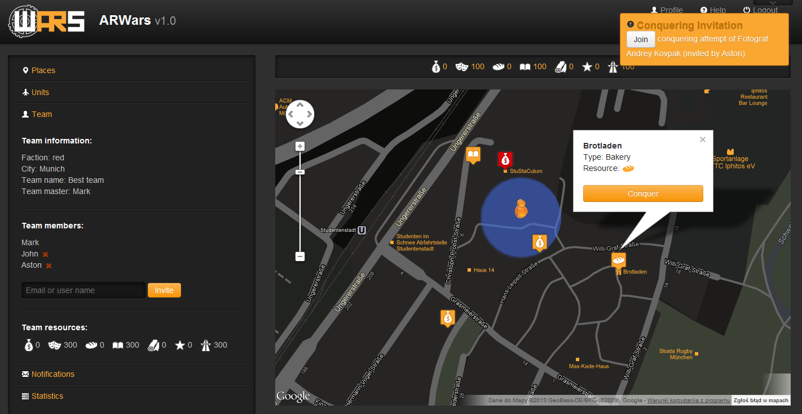

Main window
25.02.2013
Master Lab Course Web Applications

Slide 12

Conquering Places
Initiate conquering attempt
Let team members join
Check requirements
  number of participants currently nearby the place (150m)
  sufficient resources: evenly split across the participants
Inform the initiator
Conduct the battle: result is not known upfront
  failure chance of a unit: btw. 5 and 10 percent
  strength is uniformly distributed btw. minStrength and maxStrength
Inform participants of result
25.02.2013
Master Lab Course Web Applications

Slide 13

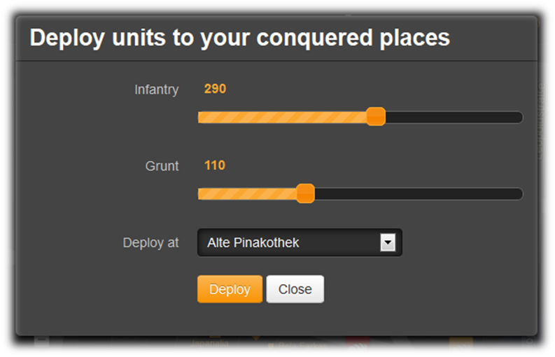
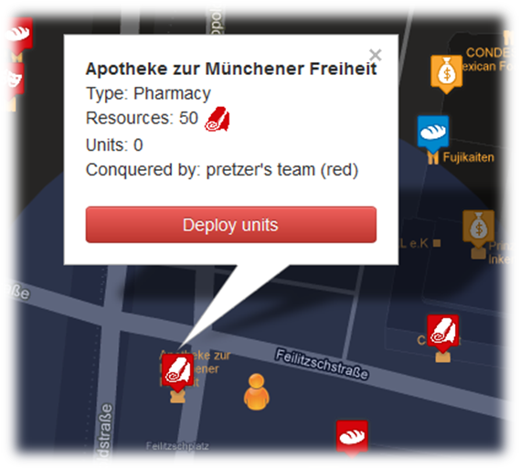
Deploying Units
Player can deploy units to his conquered places to defend them
Deploy menu can be invoked
  from sidebar (where the conquered places of the player are listed) or
  directly from the place popup window on the map
25.02.2013
Master Lab Course Web Applications

Slide 14
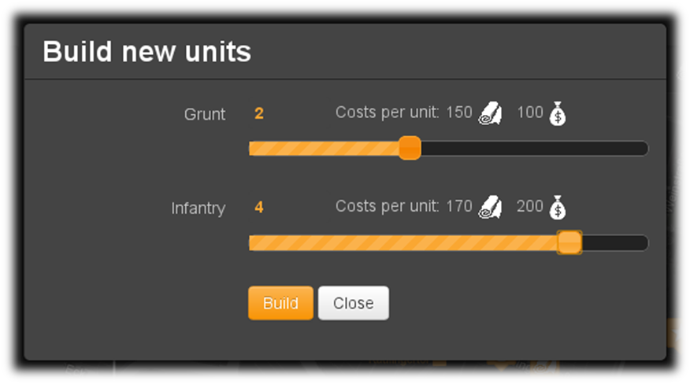
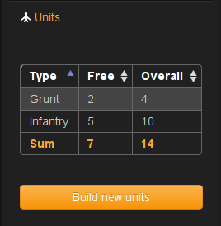
Building Units
Players can use their resources to build units
Total amount of units is limited by the food resource
Units live until they fail at a conquering attempt
25.02.2013
Master Lab Course Web Applications

Slide 15
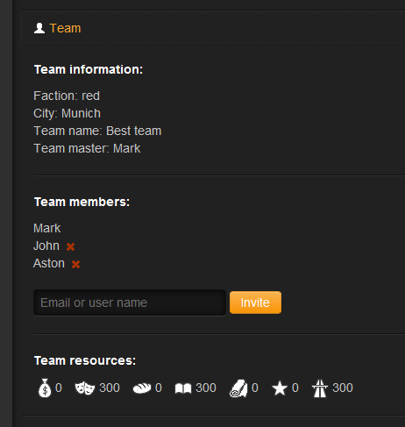


Team management
Team master
Permissions
Who becomes a team master
Actions
Inviting players to the team
Inviting stragers
Deleting players
Changing team name and avatar
25.02.2013
Master Lab Course Web Applications

Slide 16
Acceptance of an invitation – schema
Team master invites someone
A registred player already belonging to a team
A registred player
before first logging in
Not registered person by email
Invitation is sent to the player’s email address
Invitation is sent to the given email address
The person clicks on the confirmation link in the email to proceed
Redirection to the log-in page if not logged in
Redirection to the registration page
If faction and/or city differs the player is asked to pay for the change
If log in before clicking, the confirmation link the invitation can be accepted from first logging dialog
The player joins the new team
25.02.2013
Master Lab Course Web Applications

Slide 17
The end
25.02.2013
Master Lab Course Web Applications

