Slide 1



Master Lab Course Web Applications: Exercise 1 – Technologies
Team 4
Markus Fensterer
Kamil Neczaj
Peter Retzer
Michael Schätzlein
05.11.2012

Slide 2

Agenda
jQuery UI
mongoDB
Live demo
akka

Slide 3
akka
Toolkit for building highly concurrent applications
Allows easy distribution and decentralization
Event-driven development model
No worrying about threads and locks
Targeting JVM (Java and Scala)
Latest version: 2.0.3
License: Apache v2

Slide 4
akka
Actors
Akka uses actors to achieve concurrency
An actor is a lightweight concurrent entity
Perform asynchronous event-driven message processing
Supervision
Actors can spawn child actors → hierarchy
Failures are handled by the parent actor (supervisor)
Parents can restart or stop the child or escalate the failure up the hierarchy

Slide 5
jQuery UI
JavaScript library supporting the creation of web user interfaces
Depends on jQuery
Contains standard components like:
Interactions
Effects
drag and drop,
sorting, …
hide,
show,
toggle, …
Widgets
datepicker,
menu,
tabs, …
Latest version: 1.9.1
License: MIT, GPL v2

Slide 6
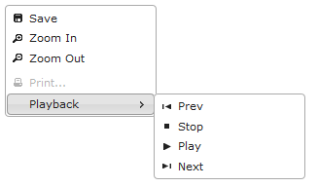
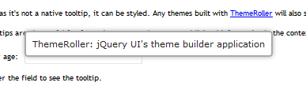
jQuery UI
Widgets can be themed
Definition of one common theme for all used widgets
Uses the “id” attribute of HTML elements
Examples (new in v1.9):
Menu Tooltip

Slide 7
mongoDB
Document-oriented database
Part of the NoSQL Database family
Stores data in documents with dynamic schemas
Documents are structured in the BSON format (similar to JSON)
Focus on high performance (no joins, indexing, etc.)
High availability through replication
Latest version: 2.2.1
License: GNU AGPL v3

Slide 8

mongoDB
Scalability is easily achieved by automatic sharding
Auto-partitioning of data across servers
Reads and writes are distributed over shards
Queries allow search by field, range queries, regular expression and can contain JavaScript code
Drivers exist for many programming languages (e.g. C, C++, Java, JS, C#, Perl, PHP, Python, Ruby, Scala,

Slide 9
Live demo
Sample web app that
integrates the three technologies
05.11.2012
9

Slide 10

QUESTIONS

Slide 11
References
http://akka.io/
http://doc.akka.io/docs/akka/2.0.3/
http://typesafe.com/technology/akka
http://api.jqueryui.com/
Dan Wellman (2011): jQuery UI 1.8: The User Interface Library for jQuery, Packt Publishing
http://blog.jqueryui.com/2012/10/jquery-ui-1-9-0/
http://jqueryui.com/themeroller/
http://www.mongodb.org/display/DOCS/Introduction
Seguin, Karl: The Little MongoDB Book, http://openmymind.net/mongodb.pdf
http://www.mongodb.org/display/DOCS/Querying

