Slide 1

Master Lab Course Web Applications: Exercise 3 – Data Model & Additional Use Cases
Team 4
Markus Fensterer
Kamil Neczaj
Peter Retzer
Michael Schätzlein
03.12.2012

Slide 2
Use Case – Build Units
Actor | Player
Precondition | The player has to be logged in and have sufficient resources.
Postcondition | The player gains the number of units built in exchange for the needed resources.
Scenario | The player builds units which help him conquering places and deploys them to conquered places in order to defend them. Within the units overview the player has access to all available units and the option to built new ones. To perform the build operation the player enters the desired quantity of units, and confirms his choice. Every unit has a certain cost, therefore the quantity is restricted by the available resources. As the result of the “Build Units” action the units are created and assigned to the player’s unit pool.

Slide 3
Use Case – Deploy Units
Actor | Player
Precondition | The player has to be logged in and have at least one place already conquered.
Postcondition | The place gains the number of units that where deployed.
Scenario | The player deploys units to conquered places to defend them. At the places overview the player has access to all the places his team already has conquered. To deploy units the player enters the desired quantity of units he wants to deploy and confirms his choice. The quantity is restricted by the available (undeployed) units. As the result of the “Deploy Units” action the units are assigned to the place.

Slide 4
Use Case – Manage team
Actor | Player
Precondition | The player has to be logged in.
Postcondition | An overview of all places conquered by his team is shown to the player.
Scenario | The player invokes the overview of all places conquered by his team. He is shown the status of the places belonging to the team including additional information about the places the team has taken over, and the ones which have been recently lost. There is an option to deploy units to the places.

Slide 5
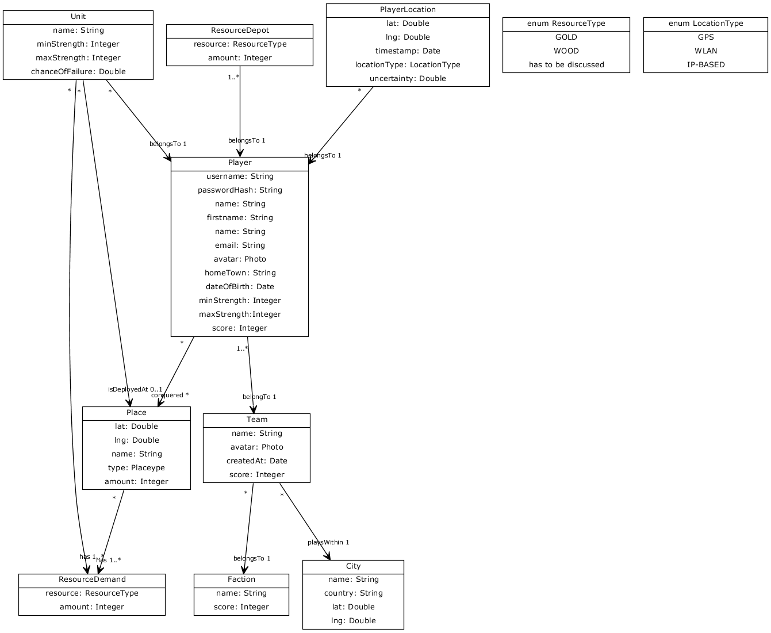
Data Model (1/2)

Slide 6
Data Model (2/2)

