Slide 1
Master Lab Course Web Applications: Exercise 2 – Project presentation
Team 4
Markus Fensterer
Kamil Neczaj
Peter Retzer
Michael Schätzlein
19.11.2012

Slide 2
Idea – Augmented Reality Wars
Massive multiplayer real-time strategy game
Bases on real map of real world around the player
Two versions: for smartfons and for computers/tablets
Features
Mixing real life with game
Players must really move in real world to move in the game

Slide 3
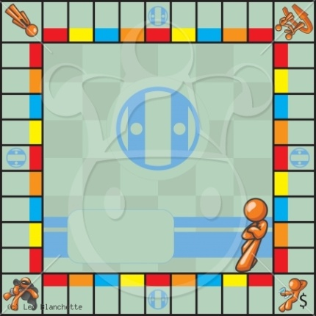
Rules
Two factions
Players build teams which belong to one of factions
Captured buildings generate resources
Players can use resources to make new virtual units, improve buildings and units

Slide 4
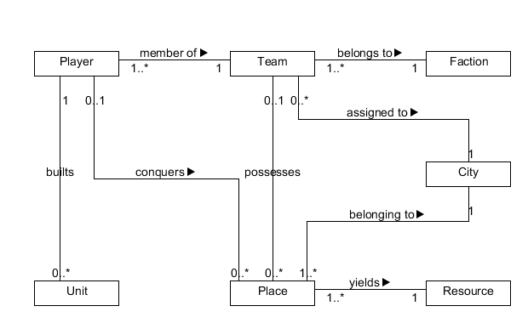
Data Model

Slide 5
Use cases
The player can initiate the following use cases:
conduct a conquering attempt
manage units
manage resources
The manager of a team can initiate these use cases:
send invitations to other users to join their team
Ban or delete a user from a team

Slide 6
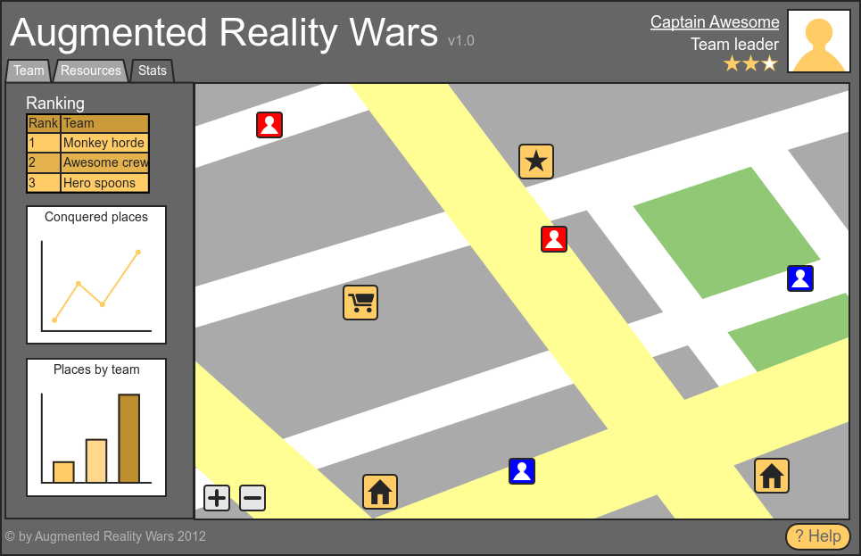
Mockup – computer version

Slide 7
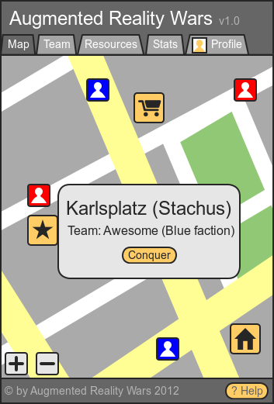
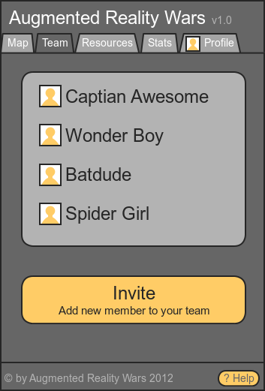
Mockup – smartphone version

Slide 8

Technologies
Server
Java,
Play! framework,
Akka,
WebSockets,
Neo4J,
MongoDB.
Client
HTML5 GeoLocation API,
jQuerry,
Twitter Bootstrap.

Slide 9

Possible Business Model
Sources of income:
Advertisments
Additional services for players: resources, moving player account to another fraction, changing name.
Competitors:
Other browser and standalone multiplayer games: OGame, Droid Wars, Kriegs Spiel
Location based social networks (foursquare, latitude)
Ingress – the direct competitor

