Slide 1
Master Lab Course Web Applications: Exercise 2 – Project presentation
Team 4
Markus Fensterer
Kamil Neczaj
Peter Retzer
Michael Schätzlein
19.11.2012

Slide 2
Idea – ARWars
Massive multiplayer browser game
Utilization of Google Maps to display the game world
Optimized for Desktop-PCs and Smartphones/Tablets
Features
Creation of an augmented reality overlay
Players have to meet at real life places to progress in the game

Slide 3
Rules
Two factions struggle for supremacy
Players assemble into teams
Players capture buildings available in Google Places
Captured buildings yield resources
Resources can be used to build troops or are necessary to capture special places
Troops aid in capturing or defending places
The number and type of places hold translate into a score

Slide 4
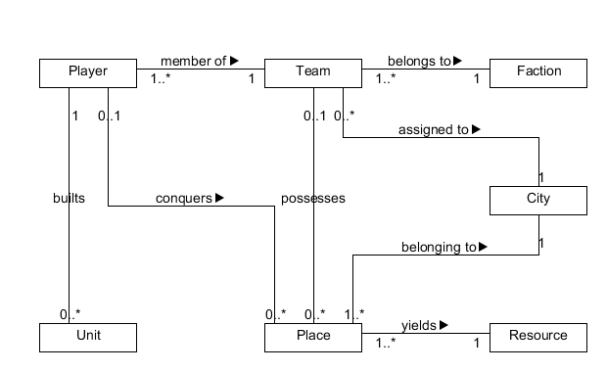
Data Model

Slide 5
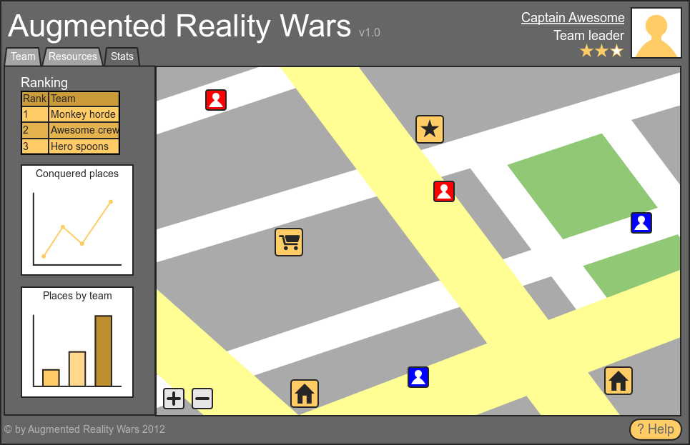
Use Case – Display stats & scores

Slide 6
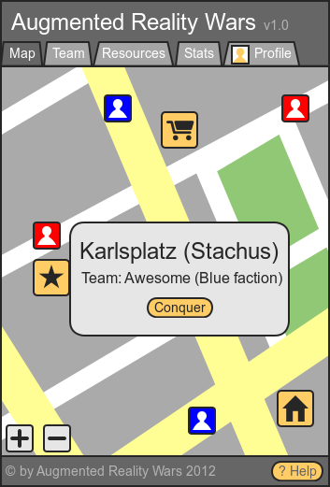
Use Case – Initiate conquering attempt

Slide 7
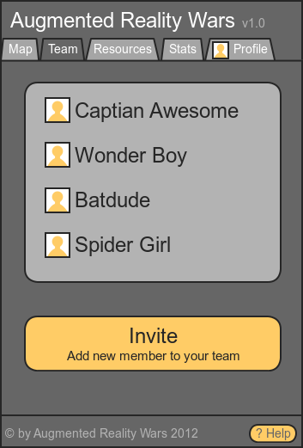
Use Case – Manage team

Slide 8

Technologies
Client
HTML5 GeoLocation API,
WebSockets,
jQuery,
Twitter Bootstrap.
Server
Java,
Play! framework,
Akka,
WebSockets,
Neo4J,
MongoDB.

Slide 9
Architecture
Server
controllers access services and render views
services operate on data objects
game logic (e.g. event generator)
Client
location
map interaction
client-side game logic
communication

Slide 10

Business Model
Advertisments
Selling decorative objects
Selling organisational services

Slide 11
Competitors
Traditional browser games (Ogame, Droidwars)
Persistent mobile multiplayer games (Mobile Mafia, Kriegs Spiel [sic!])
Location based social networks (Foursquare, Google Latitude)
Ingress by Niantic Labs (closed beta)

Slide 12
Unique selling proposition
Mixture of real-life exploration and traditional browser games
Players have to meet in person
Imposing of a virtual world over the known material world

