Slide 1
IoT Early Flood Detection and Avoidance System
PRESENTED BY:
Arun Ghimire (PAS073BEX408)
Nirajan Karki (PAS073BEX426)
Ramesh Shrestha (PAS073BEX432)
Sangita Pokhrel(PAS073BEX 435)

Slide 2
TABLE OF CONTENTS
INTRODUCTION
METHODOLOGY
BLOCK DIAGRAM
TIME EVALUATION
COST ESTIMATION
PROBLEMS
RISK ANALYSIS
EXPECTED OUTPUT

Slide 3
Introduction
It is an intelligent system which keeps close watch over various natural factors to predict a flood, so we can embrace ourselves for caution, to minimize the damage caused by the flood.
The design that detects the occurrence of the flood
The system will give an alert whenever there occurs
- rise in the water level in sea
- speed of the water in river
- when there is possibility of the heavy rain.

Slide 4
METHODOLOGY
The main electronics devices which are used in our project are:
Aurduino UNO : - Microcontroller board based on 8-bit ATmega328P microcontroller
Wifi Module: - Capable of offloading all wifi networking functions from another application processor
Water Level Sensor: - Used to detect the level of substances that can flow.

Slide 5
Water Flow Sensor: - Measures the speed of the water flow
Ultrasonic Sensor:
- Works on the principle of SONAR
- Measures distance by using ultrasonic waves
Temperature and Humidity Sensor: - Uses a capacitive Humidity sensor and a Thermistor to measure surrounding air

Slide 6
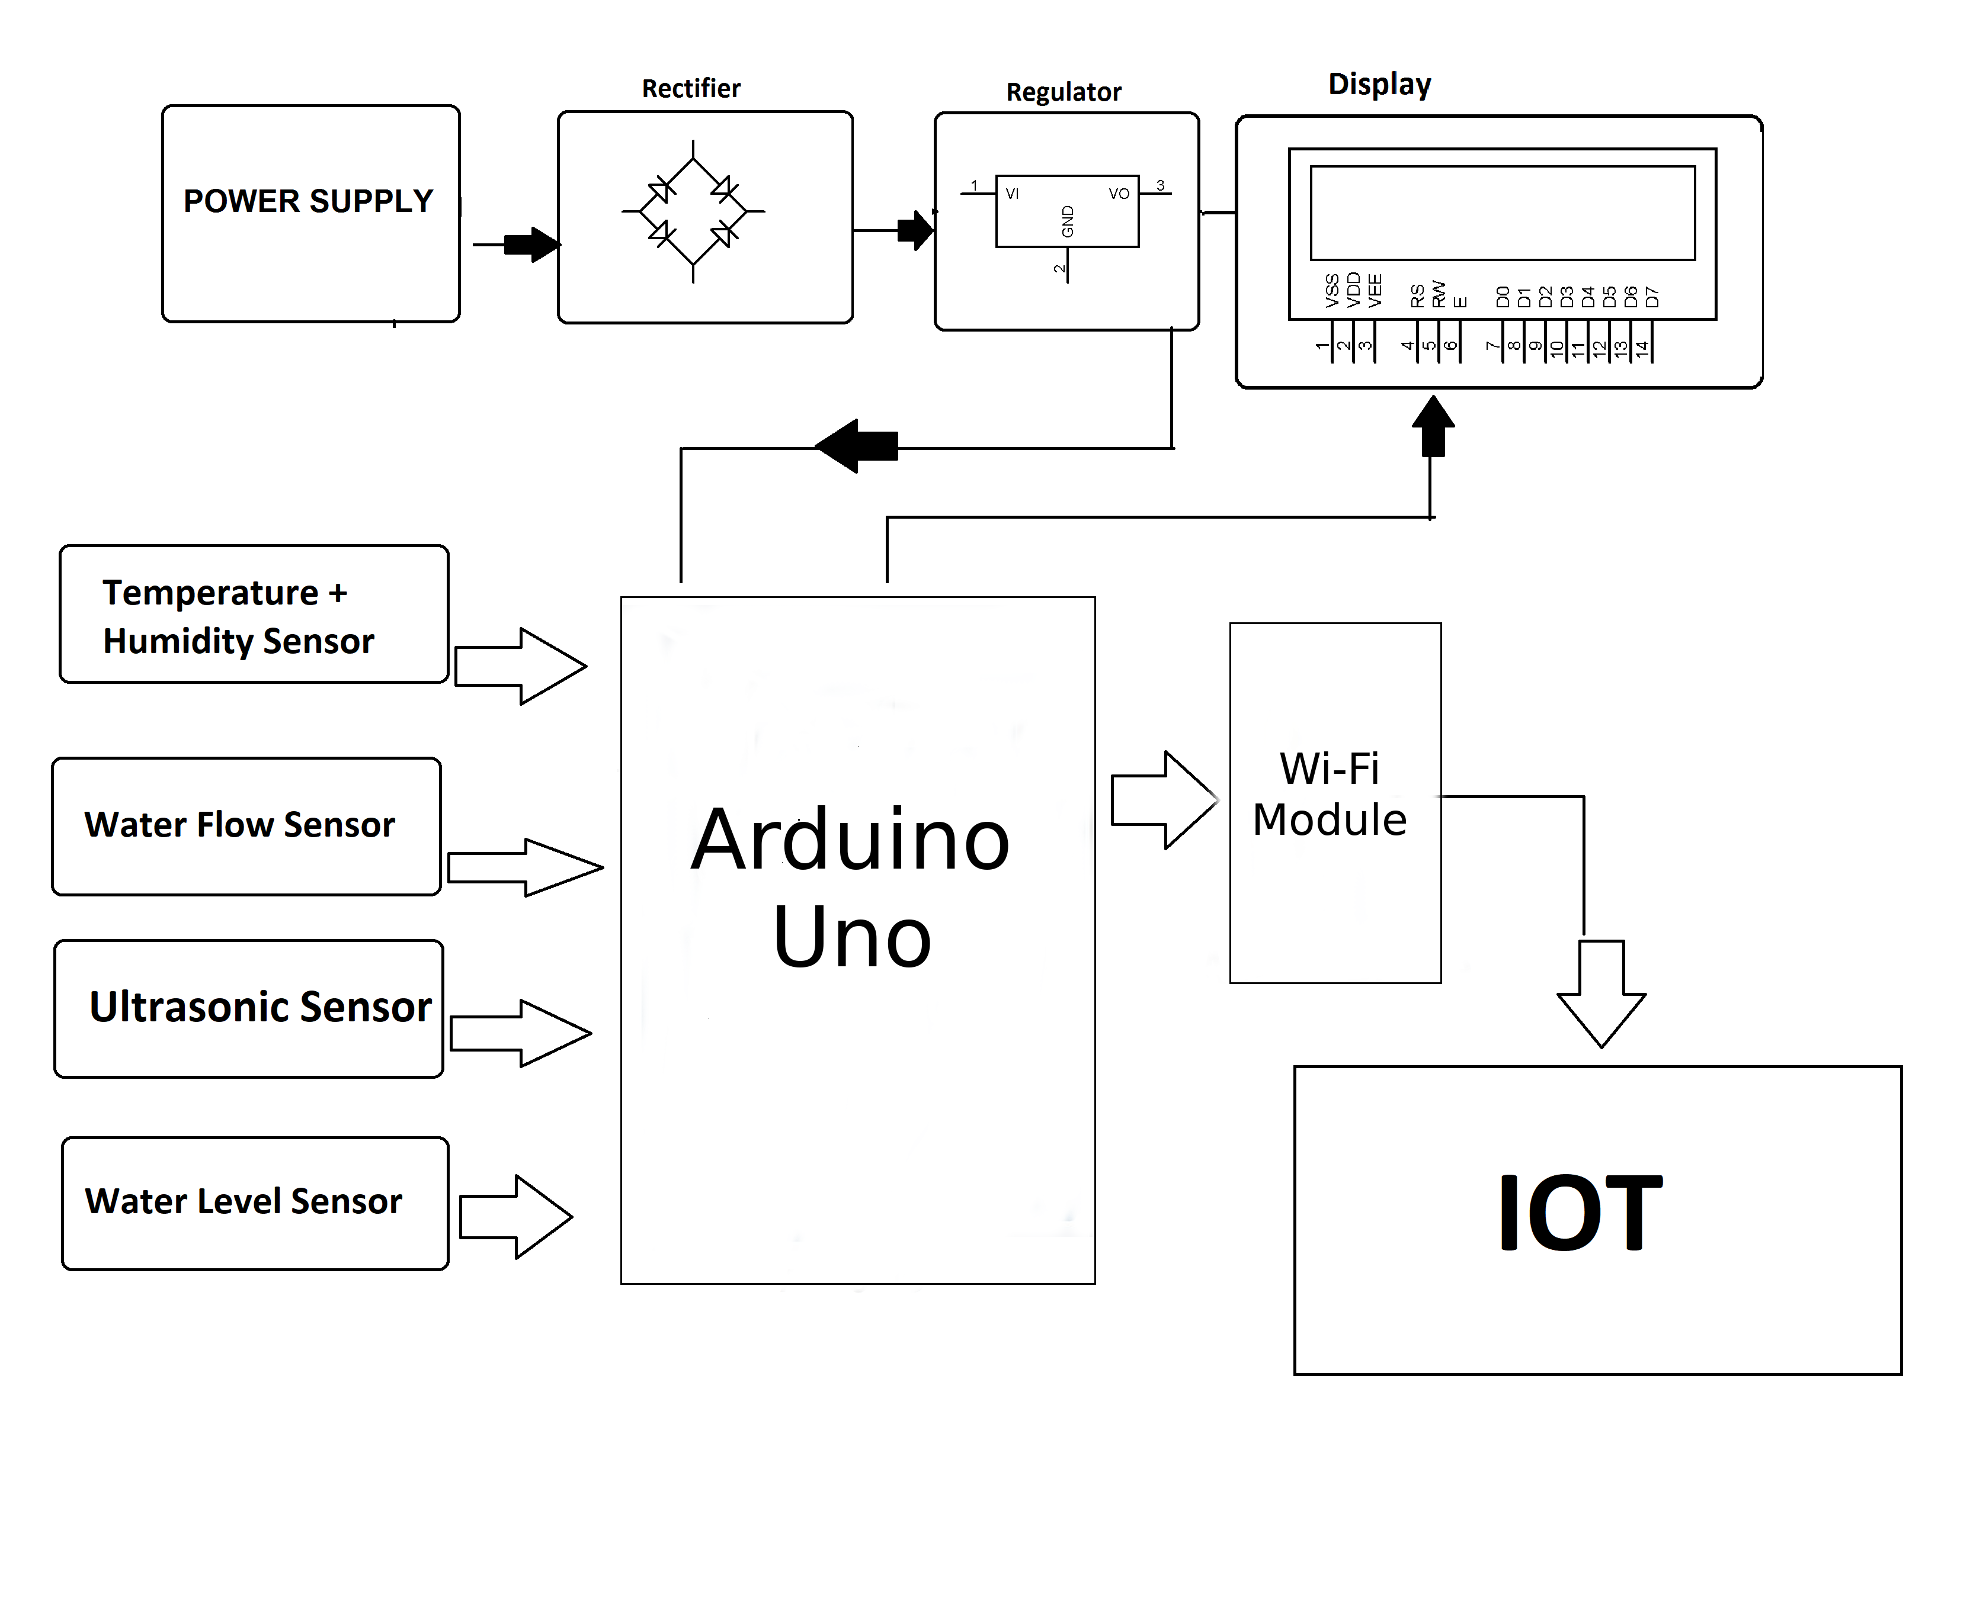
Fig: Block diagram of IoT Flood Detection Method

Slide 7
TIME EVALUATION
The task to be completed each week is listed in the following schedule and performed according to the time frame for each spans.
Week | Date (2076) | Proposed schedule
1 | 02/05 to 02/09 | Project proposal submission
2 | 02/11 to 02/19 | Components Purchasing
3 | 02/20 to 02/25 | Design the mechanical layout of the project.
4 | 02/26 to 02/32 | Sensor interfacing
5 | 03/01 to 03/07 | Final report preparation
6 | 03/08 to 03/14 | Final report submission

Slide 8
COST ESTIMATION
Components | Estimated Cost (Rs)
Arduino Uno | 1000
Wi-Fi Module | 550
Ultrasonic Sensor | 350
Water Level Sensor | 600
Temperature Humidity Sensor | 400
Water Flow Sensor | 800
LCD Display (16x2) | 250
PCB and Breadboards | 500
Miscellaneous | 1000
Total | 5450

Slide 9
PROBLEMS
No electronics devices are 100% precise.
Signal loss may occur due to heavy rainfall and cloudy condition.

Slide 10
RISK ANALYSIS
Unavailability of enough time for shifting to the safer place.
Geographical condition
Loss of life and property

Slide 11
EXPECTED OUTPUT
The design is expected to produce an alert message wherever there occurs any of the following.
The rise in the sea level beyond a certain limit.
Increase in the speed of water flow in rivers.
Change in weather is a way that gives warning of heavy rain.

Slide 12
THANK YOU !!!

