Slide 1
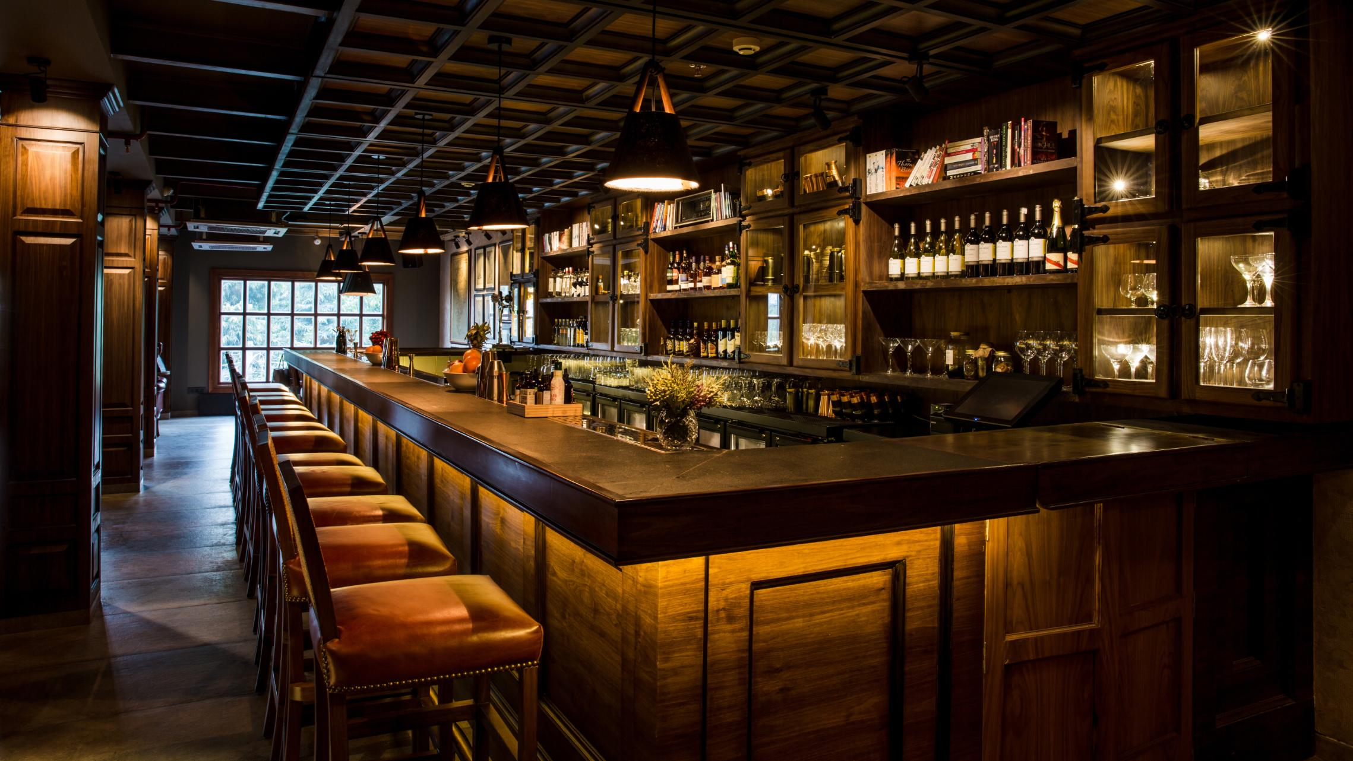
Bar Management System
Final Project: CS-5278
Kate Nelligan

Slide 2


Project Overview
Description: This project is meant to create an point of sale system for a bar.
Feature Highlights
1. A graphical user interface that allows the end-user to place orders for drinks
2. A database to store all orders
3. A printing utility to print stored orders and information about the order.
Architecture Highlights
1. Main method generates the GUI interface which includes an ordering system and display
2. Design patterns include a Factory method, Strategy patterns, and a Builder pattern
3. Inheritance is used to distinguish between different types of drink types.

Slide 3








Design Pattern and Object Oriented Focus
Inheritance
Polymorphism
Encapsulation
Information Hiding
Abstraction
Strategy Pattern
Builder Pattern
Factory Pattern

Slide 4




Program Architecture Diagram: Overall
GUI
Order Object
Order Database
Generates an
Connects to
Connects to
Creates
Inventory Database
Drink Object
Stores information
Order number
Bartender
Customer
Date
Drinks
Drink Quantities

Slide 5

Program Architecture Diagram: Drink Objects
Components of Drink Objects
Garnish
Abstract Drink Class
Glass
Price
Size
Name
Type
Derived Classes
Brand/Product name (beer)
Drink subtype (red or white wine)
Garnish (mixed drinks only)
Composite ingredients (mixed drinks only)
Ice
Drink Type
Glass

Slide 6
Program Architecture Diagram
Main
Inventory Database
Order Panel
Order Database
Order
Drink Factory
Drink and Quantity
Process Orders
<<abstract>> Drink
Drink Classes and Hierarchy
Non-alcoholic
Liquor
Beer
Wine
<<interface>> Mixed Drink Recipe
Builder Pattern Used To Make Mixed Drinks
<<interface>> Drink Builder
Draft/Bottle Beers
Red/White Wine
Strategy Patterns Used By Drinks
Mixed Drink
Mixologist
Mixed Drink Builder
<<interface>> Garnish
<< interface >> Ice
<< interface >> Glass

Slide 7
Program Architecture Diagram: Drink Classes
Abstract Class
Drink
Wine
Beer
Non-Alcoholic
Liquor
Made up of one or more liquors and one or more non-alcoholic drinks.
Red Wine
White Wine
Draft Beer
Bottle Beer
Mixed Drink
Large Draft
Small Draft

Slide 8


Challenges and Solutions
A recurring issue throughout the project was determining the appropriate scope.
Challenges
1. Determining the overall interface layout, and unique issues involved with Java Swing
2. Appropriately working in design patterns to encapsulate information
3. Scope creep: desire to include more features such as exporting data, an inventory system.
Solutions
1. Originally had login/authorization functionality, but I ran out of time, so I cut this out.
2. Time constraints prevented additional refactoring I planned (use of the Command pattern)
3. I had to scale back the functionality to ensure the core elements worked.

