Slide 1
Image Denoising as defense for adversarial Attacks
Notes:
Plan to present in class

Slide 2
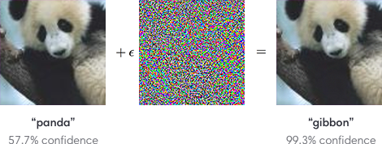
Adversarial image classification
[1] I.J. Goodfellow, J. Shlens and C. Szegedy, “Explaining and Harnessing Adversarial Examples,”
2015 International Conference on Learning Representations, 2015.

Slide 3
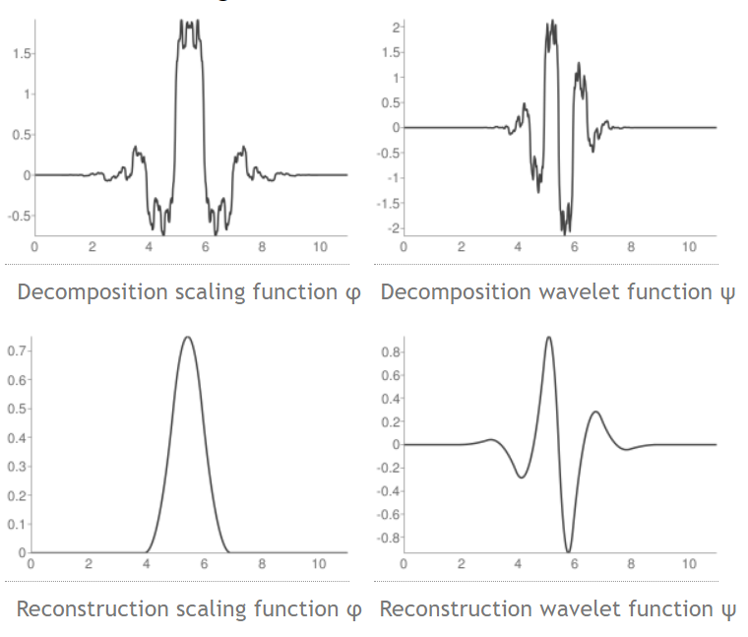
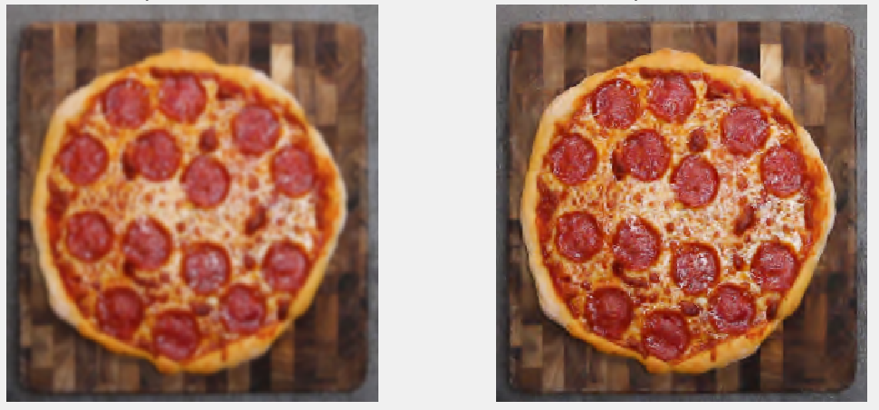
Gaussian vs. Wavelet denoising (same classification accuracy)
Gaussian Blur
Wavelet Denoising
Wavelet thresholding preserves image detail, unlike Gaussian blur
[2] Wavelet Browser: Birothogonal 3.5 Wavelet http://wavelets.pybytes.com/wavelet/bior3.5/

Slide 4
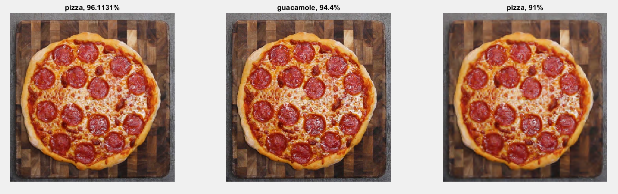

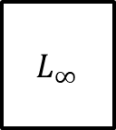
Adversarial defense against $L_{∞}$ attack
Original Image
Adversarial Image
Denoised Image
22 images tested
21 images correctly classified
NN
Iv3
Original Image (%)
Img
$$L_{∞}$$
Adversarial Image (%)
= 95.45% Accuracy
Wav
Denoised Image (%)
Notes:
L_inf means constrained optimization problem where the norm of pixel deviations over entire image are less than certain value
L_1 / L_2 attacks constrain the norm to be magnitude difference/ squared differences

Slide 5
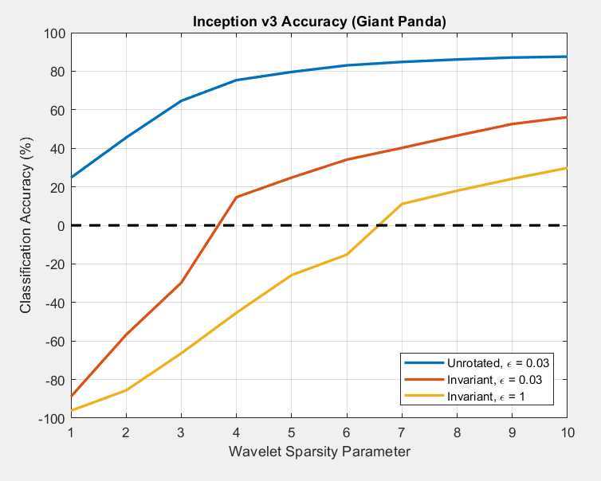
Limitations against robust attacks (rotation-invariant)
Giant Panda
Performance increases with higher thresholding parameter
Denoising less effective with higher perturbation levels
However, modern attacks prioritize minimal distortion
Guacamole

Slide 6
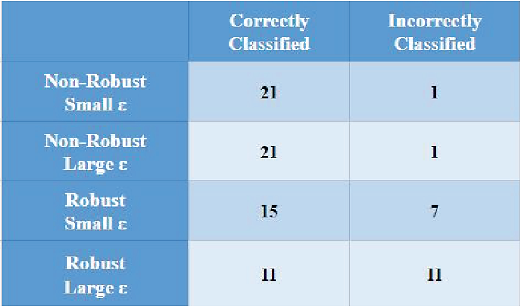
Advantages of current approach
Integration with existing neural networks/defenses
Minimal loss of image detail, compared to other transformation methods
Robust against targeted attacks with moderate levels of perturbation

