Slide 1
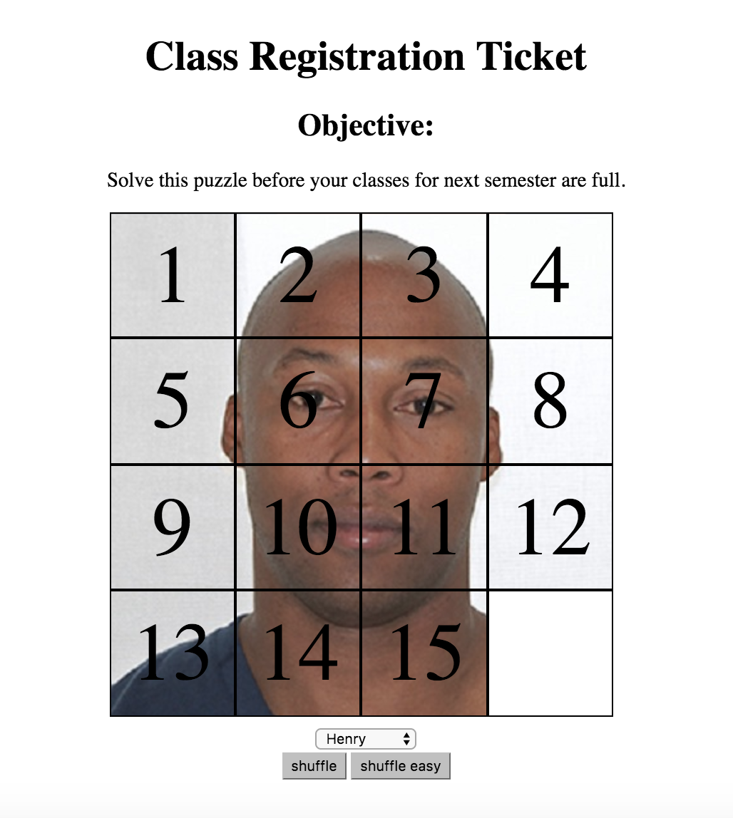
Fifteen Puzzle Game
Project members: Keon Hee Park, Kenny Nguyen & Shittul Mona
Team leader: Keon Hee Park
Description: The purpose of the game is to un-jumble all of the fifteen squares by moving couple squares. It is basically taking one square to the empty spot and move couple of the squares to different places.
Course: Web Programming (CSC 4370)
Instructor: Louis Henry
Date: November 7th, 2016

Slide 2
Project Members
Project Designer:
Keon Hee Park
Tester:
Shittul Mona
Programmer:
Kenny Nguyen (Lead)
Keon Hee Park

Slide 3
User
Statement of Problem: After the program shuffles the squares, it times the user how fast they can solve the game by putting those squares back to the right place.
General Requirements
Inputs: User clicks the shuffle button to misplace the squares.
Outputs: The system displays misplaced squares and requires user to put those squares back to the right places.

Slide 4
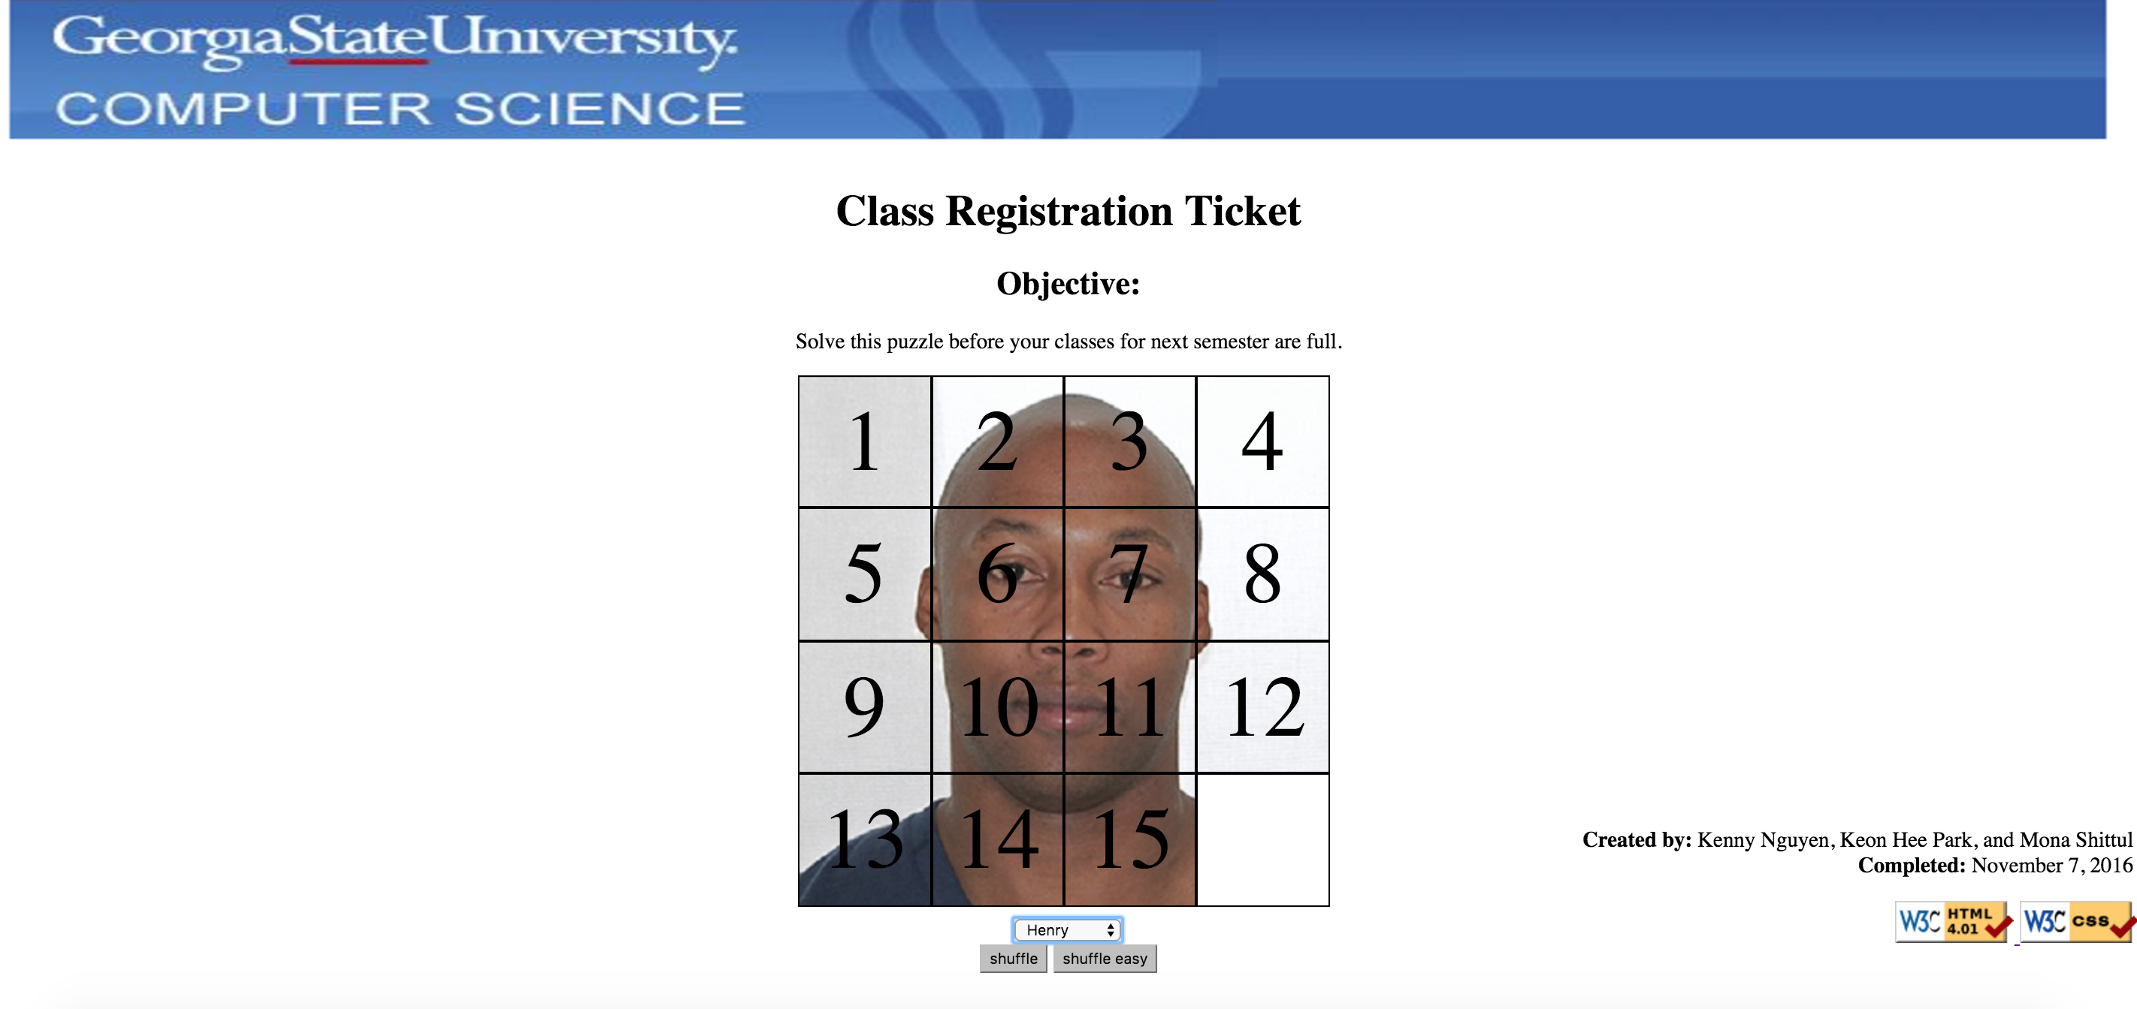
Design
Overview of Solution:
Simple and Easy-to-Use interface
Key Design Features:
HTML, CSS, JavaScript, and jQuery
User Interface:
Web

Slide 5
Development
Programming Languages:
HTML, CSS, JavaScript, and jQuery.
Music:
RuneScape Main Menu (2003).
Software Development Methodologies:
Extreme Programming (XP).
Development time: Tuesday to Saturday (November 1st to 5th).

Slide 6
Testing
Test Plan:
Check if different boards work
Check if the swaps work
Check if the shuffle works
Tracking and Reporting Bugs:
Refresh testing.

Slide 7
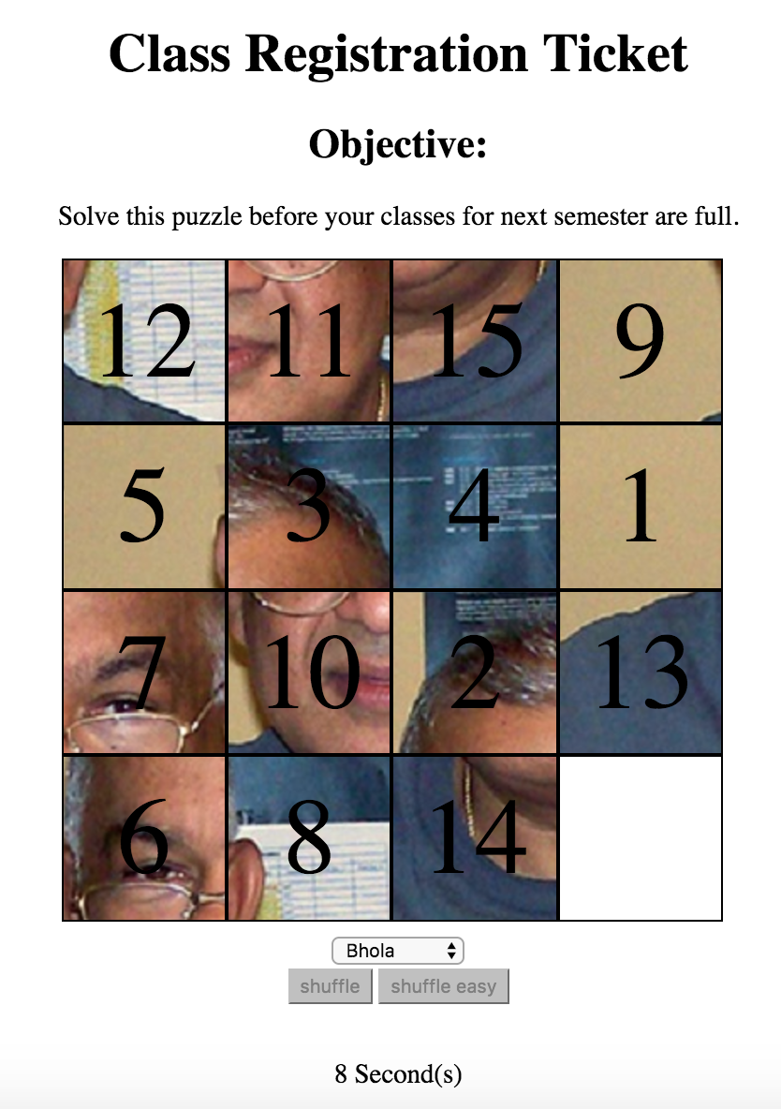
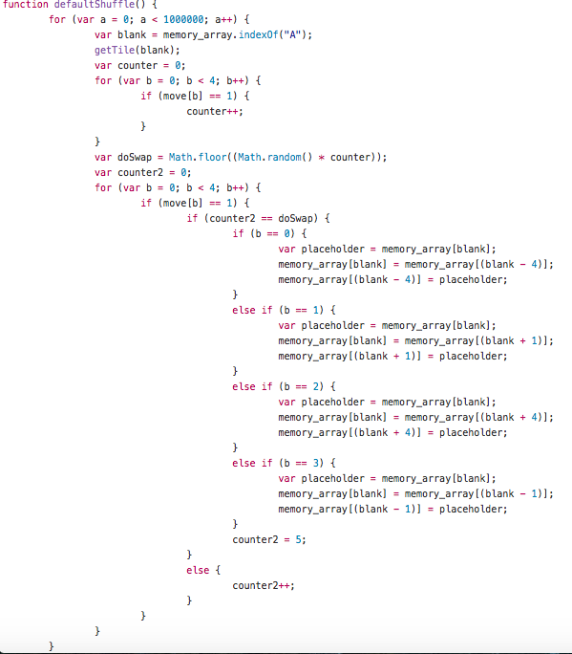
Code Display

Slide 8
Project Limitations and Future Possibilities
Interactivity:
Better choice of music.
Store records on a database to keep track of high scores.
Share your high score on social media.

Slide 9
Questions?
We have the answers!

